Slide 1
Inclusionary Housing
1. ALL JURISDICTIONS USE THIS SLIDE
(Update text in purple)
These slides are designed to help jurisdictions present about inclusionary housing. Please review the next two pages closely, because they explain how to use this deck.
See sample talking points at the Zoning for Affordability Resource Page.
Published May 2024.
MONTH YEAR

Slide 2
TIPS on Using this Slide Deck – Delete
2. GUIDE
This is a template slide deck that can be used to design new inclusionary programs or update existing programs. Some slides are tagged/intended for NEW (Inclusionary policies) or UPDATED (inclusionary policies) with a purple box.
Some slides may not be relevant. Less common or more detailed slides are available at the end of this presentation.
The Speaker notes are presented on a separate Word document and include draft talking points, directions on editing slides, and some additional notes and considerations. Add jurisdiction-specific info to talking points needed when underlined.
There are several slides with sample data shown in purple. You must update with local numbers.
  Right-click on charts and tables to edit in Excel.
  Potential data sources are noted in speaker notes for some slides.
Anything in Purple should be updated. Underlined notes need local info.

Slide 3
TIPS on Using this Slide Deck - delete (2)
3. GUIDE
Whenever possible replace photos with images of local projects in your community.
Apply your jurisdiction’s PowerPoint template to this deck or paste content from here into your template.
Some of the slides are aimed at a knowledgeable audience. You may need to add more details or background if the audience is not familiar with basic terms like Housing Elements or RHNA.

Slide 4
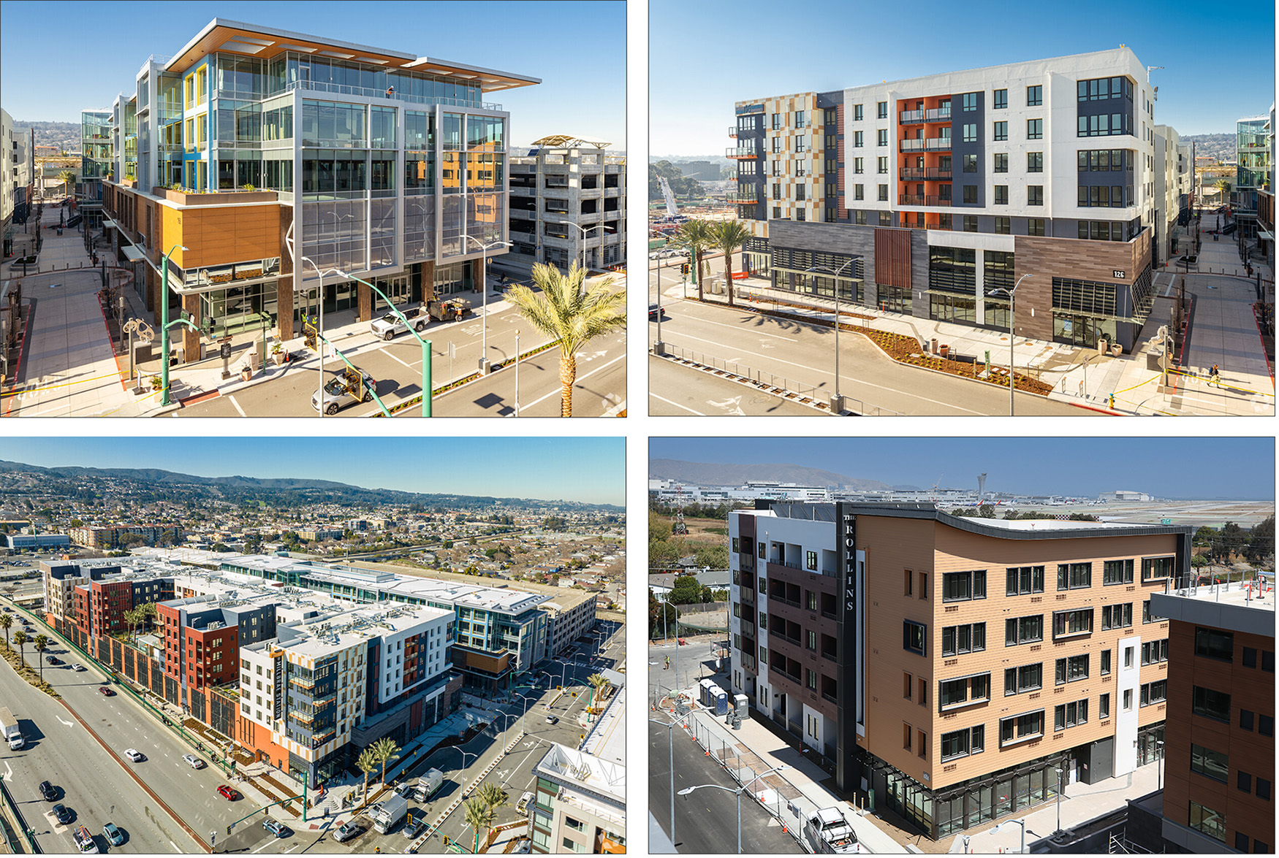
Agenda
4. ALL JURISDICTIONS USE THIS SLIDE
(Update text in purple)
What is inclusionary housing?
  Adopting a policy/updating our policy
  Understanding the need
  Understanding the economics
Key policy options
Next steps
Photo: Gateway at Millbrae Station, AECbytes.com, 2023

Slide 5
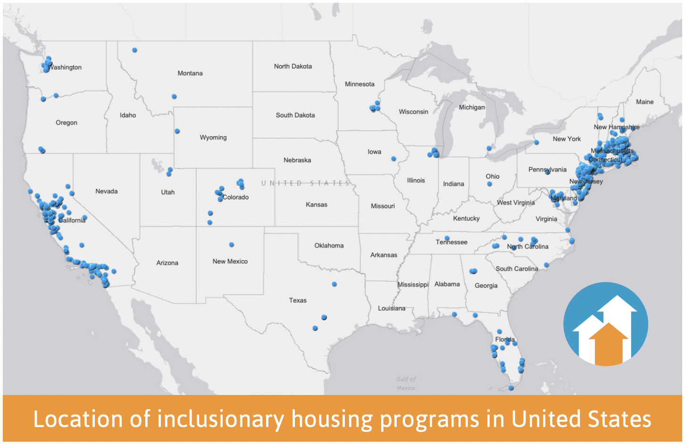
What is Inclusionary Housing?
5. ALL JURISDICTIONS USE THIS SLIDE
Inclusionary housing requires developers to sell or rent a portion of new residential units to lower-income households at an affordable rate.
Source: Grounded Solutions Network, InclusionaryHousing.org

Slide 6
ADOPTING/UPDATING A POLICY
6. ALL JURISDICTIONS USE THIS SLIDE
(Update text in purple)
Hold study session
Conduct community and stakeholder outreach
Develop the program
Test economic feasibility
Adopt an ordinance
Manage the program - Ongoing
Describe where your jurisdiction is in the process.

Slide 7
Why Inclusionary?
7. FOR JURISDICTIONS CREATING NEW POLICY
(Update text in purple)
Implementing Housing Element (Policy/program ##)
Compliance with MTC’s Transit Oriented Communities (TOC) Policy
Effective tool for affirmatively furthering fair housing
Effective tool for making progress towards RHNA
ADD key policy goal for the program, Housing Element language, or other summary point.

Slide 8
Why Update Our Policy?
8. FOR JURISDICTIONS UPDATING POLICY
(Update text in purple)
Implementing Housing Element (policy/program ##)
Compliance with MTC’s Transit Oriented Communities (TOC) Policy
Potential specific triggers for an update
  To track current economics – increase/decrease
  To take advantage of new opportunities associated with re-zoning or new plan
  To update program terms: applicability
ADD Key policy goal for the program, HE language or other summary point.

Slide 9




What does “Affordable Housing” mean?
9. FOR JURISDICTIONS CREATING NEW POLICY
(Update text in purple)
Example
Annual Income
Affordable Rent
Housekeeper
Bookkeeper
Teacher
Pharmacist
30 percent of AMI | 50 percent of AMI | 80 percent of AMI | 100 percent of AMI
$ 40,000 | $60,500 | $101,000 | $133,000
$1,000 | $1,700 | $2,700 | $3,300
Source: https://www.acgov.org/cda/hcd/documents/2023IncomeandRentLimits.pdf
- Incomes are for a family of 3 people (rounded), Rents for a 2 BR unit

Slide 10
Are we Meeting the Need?
10. ALL JURISDICTIONS USE THIS SLIDE

Slide 11
Inclusionary Program Results: 2020-202X
11. FOR JURISDICTIONS UPDATING POLICY
(Update text in purple)

Slide 12
Economics of Inclusionary Housing
12. ALL JURISDICTIONS USE THIS SLIDE
How do affordable housing requirements impact feasibility?

Slide 13
Feasibility Studies
13. ALL JURISDICTIONS USE THIS SLIDE
Compile data on multiple project types
Identify minimum profitability requirements
Compare profitability with and without affordability requirements (and incentives)
How do we determine what level of requirements are financially feasible?

Slide 14
Understanding the Economic Impact (2)
14. ALL JURISDICTIONS USE THIS SLIDE
How do affordable housing requirements effect profitability?
Total Costs | Incentives | Net Costs
$10 Million | Minus $4 Million | $6 Million ($10 minus $4)
Including affordable units reduces the amount a building could sell for. | Incentives like added density or reduced parking increase project value. | The net result is less costly than affordable requirements alone.

Slide 15
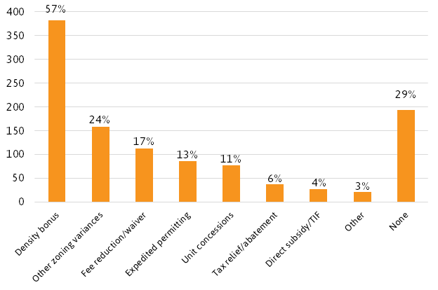
Incentives
15. ALL JURISDICTIONS USE THIS SLIDE
Most jurisdictions offer incentives that offset some or all of the cost of providing affordable units.
Source: Wang and Balachandran (2021)
Source: Wang and Balachandran (2021)

Slide 16



FAQ: Will developers just raise market rents to pay for affordable units?
16. ALL JURISDICTIONS USE THIS SLIDE
Rents/prices are set by the market
Developers set their rents at the current market price and can’t charge more than market regardless of their costs.
Affordability requirements push land prices down
If market rents or prices aren’t high enough to cover costs (including affordable housing requirements) developers can’t build.
But because these requirements apply to every potential developer, landowners will often accept a lower price in order to sell.
But that can lead to higher prices over time
If requirements are too high, that can push land prices down to the point where some sellers may choose not to sell. Owners may hold on to developable land or sell for non-residential uses. If less land sells, fewer homes will be built leading to higher prices.

Slide 17




FAQ: Will affordable housing requirements make housing too expensive to build?
17. ALL JURISDICTIONS USE THIS SLIDE
There is a real risk of setting requirements too high
If requirements are too high, they can become a barrier to building.
Research shows little or no impact on production
For example, a New York University study comparing Bay Area jurisdictions with IZ to those without found no difference in the rate of housing production.*
Most programs conduct a feasibility analysis
These studies ensure that affordable housing requirements are small enough that building remains feasible.
And offer incentives
Also, incentives such as density bonuses and streamlined permitting lower costs and offset some of the cost of compliance.
* Furman Center for Real Estate at NYU, The Effects of Inclusionary Zoning on Local Housing Markets: Lessons from the San Francisco, Washington DC and Suburban Boston Areas, 2008
* Furman Center for Real Estate at NYU, The Effects of Inclusionary Zoning on Local Housing Markets: Lessons from the San Francisco, Washington DC and Suburban Boston Areas, 2008

Slide 18
Compliance Options
18. ALL JURISDICTIONS USE THIS SLIDE
Designing an inclusionary housing program

Slide 19
Compliance Options (2)
19. ALL JURISDICTIONS USE THIS SLIDE
Building the units onsite, integrated with the housing development
Fee in-lieu
Off-site development /nonprofit partnerships
Land dedication
Preservation of existing buildings

Slide 20
On-site Affordability Requirements
20. ALL JURISDICTIONS USE THIS SLIDE
What percent of units do most programs require developers to provide on site as affordable housing?

Slide 21
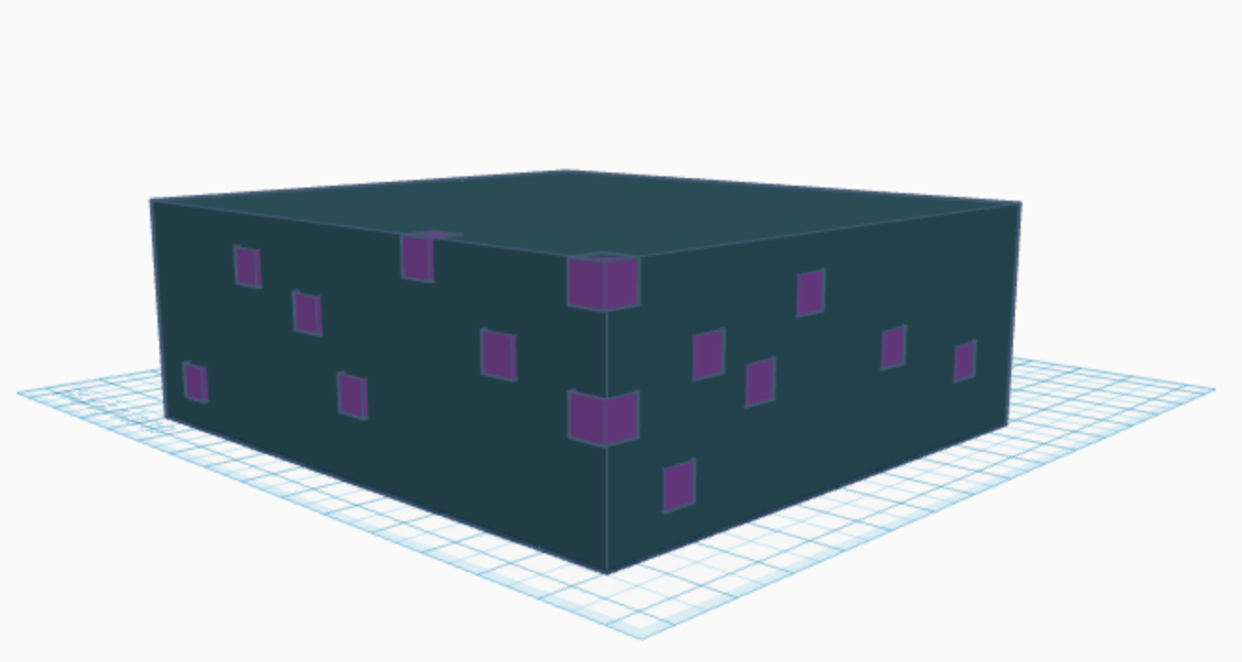

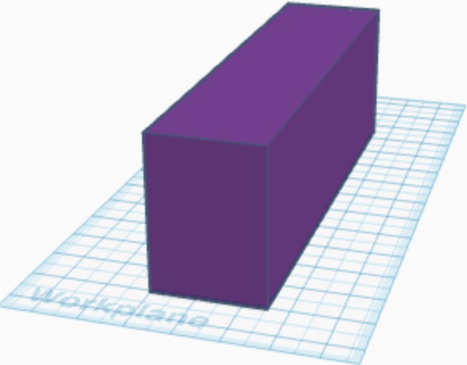
In-Lieu Fees
21. ALL JURISDICTIONS USE THIS SLIDE
Onsite BMR Units
Fee to fund off-site 100 percent affordable buildings
Housing Trust Fund
Project Site
Project Site
$27.8 Million
OR
Market - 560 units
Market - 700 units
Somewhere else in town
Affordable - 140 units (20%)
Affordable - 140 units

Slide 22
In-Lieu Fees (2)
22. ALL JURISDICTIONS USE THIS SLIDE
 | Advantages | Challenges
Program Design | Achieves legally desirable flexibility Can simplify affordability monitoring | Jurisdictions often set fees too low
Keys to Success | Potential leverage of outside funds Leverage expertise of nonprofits | Requires outside subsidies Requires strong nonprofit partners
Housing Outcomes | More Units More flexibility in housing outcomes Can target deeper affordability Can simplify market rate financing | Can be difficult to build units proximate to market rate if land is sparse or expensive Affordable units are built after market rate units

Slide 23
Off-site Program Considerations
23. ALL JURISDICTIONS USE THIS SLIDE
(Update text in purple)
Include staff recommendations or jurisdiction-specific policy considerations. Do you have a recent deal/project?
Off-site affordable housing
Land dedication
Preserving affordability in existing housing units

Slide 24
FAQ: How do you achieve economic integration with various compliance options?
24. ALL JURISDICTIONS USE THIS SLIDE
Mixed-income neighborhoods matter
Research shows that access to mixed-income neighborhoods makes a big difference - particularly for low-income kids.
Therefore: The fee option makes sense when we have access to sites for affordable buildings
If a jurisdiction can build 100% affordable projects in all kinds of neighborhoods, a fee option can help more families benefit.
When affordable buildings are concentrated in a few neighborhoods, onsite units may be necessary to overcome segregation
Mixed-income buildings may not
There does not seem to be any additional benefit from mixed-income buildings.*
Residents prefer affordable buildings
In surveys, affordable housing residents have consistently shown a slight preference for 100% affordable buildings over BMR units in luxury buildings.**
* Urban Institute, “Effects from Living in Mixed-Income Communities for Low-Income Families: A Review of the Literature.” 2011.
** National Initiative on Mixed Income Communities “Resident Experiences of Exclusion and Bias in Inclusionary Housing in Cambridge, MA” 2022.
* Urban Institute, “Effects from Living in Mixed-Income Communities for Low-Income Families: A Review of the Literature.” 2011.
** National Initiative on Mixed Income Communities “Resident Experiences of Exclusion and Bias in Inclusionary Housing in Cambridge, MA” 2022.

Slide 25



FAQ: Can you achieve good housing outcomes with all compliance options?
25. ALL JURISDICTIONS USE THIS SLIDE
We can build more with fees
Generally, the fees are set high enough that a jurisdiction can produce at least 1 off-site unit for each unit not provided on-site.
Thanks to leverage
100% affordable projects can add state and federal resources to local in lieu fee funds to build more units at deeper affordability levels.
The more local funds, the more state and federal investment we can secure.
That's why 75% of California Inclusionary Housing Programs allow In-lieu fees.*
Market Rate Building paying in lieu fee
100% Affordable Housing Development
Federal and State Housing Programs
* Source: Wang, R., and S. Balachandran. "Inclusionary housing in the United States” Lincoln Institute of Land Policy (2019).
* Source: Wang, R., and S. Balachandran. "Inclusionary housing in the United States” Lincoln Institute of Land Policy (2019).

Slide 26
Program Design
26. ALL JURISDICTIONS USE THIS SLIDE
Getting into the details

Slide 27
Program Applicability and Exemptions
27. FOR JURISDICTIONS UPDATING POLICY
(Update text in purple)
Project size
  Some jurisdictions include all residential projects.
  Many jurisdictions include projects with 11 or more units.
  Some jurisdictions limit onsite options to larger projects.
Tenure (Owner/Renter)
  Most jurisdictions include rental and ownership units.
  Rental units and homeownership units generally target different household incomes.
Local Context
Current Applicability:
Proposal or Proposed Changes:

Slide 28
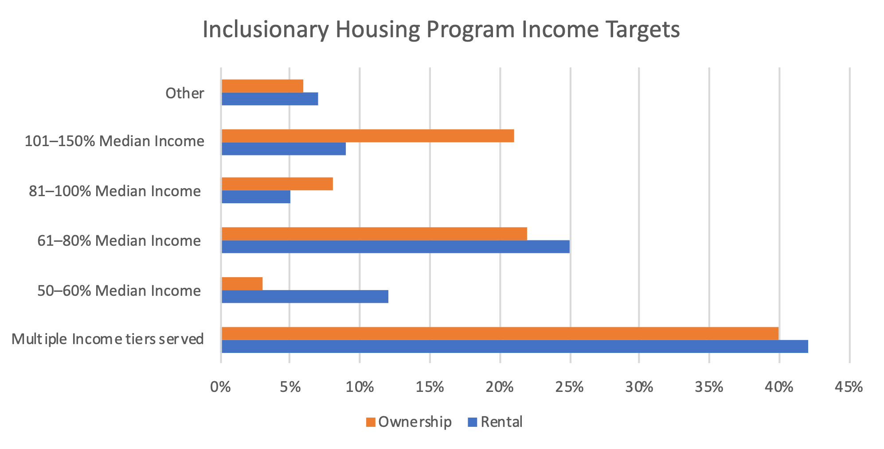
Income Targeting
28. ALL JURISDICTIONS USE THIS SLIDE
What income groups are most commonly served by onsite inclusionary units?

Slide 29
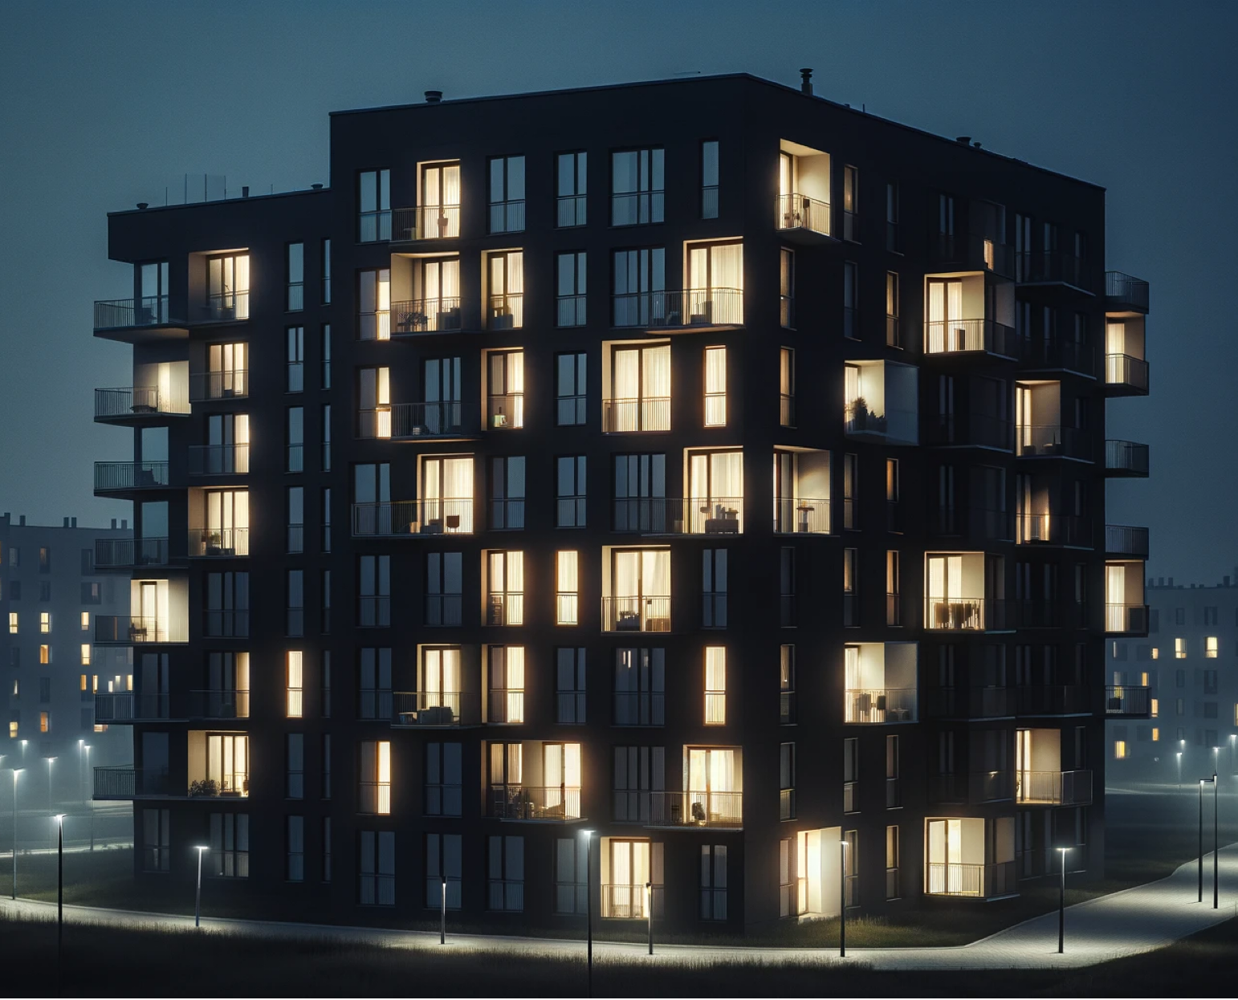
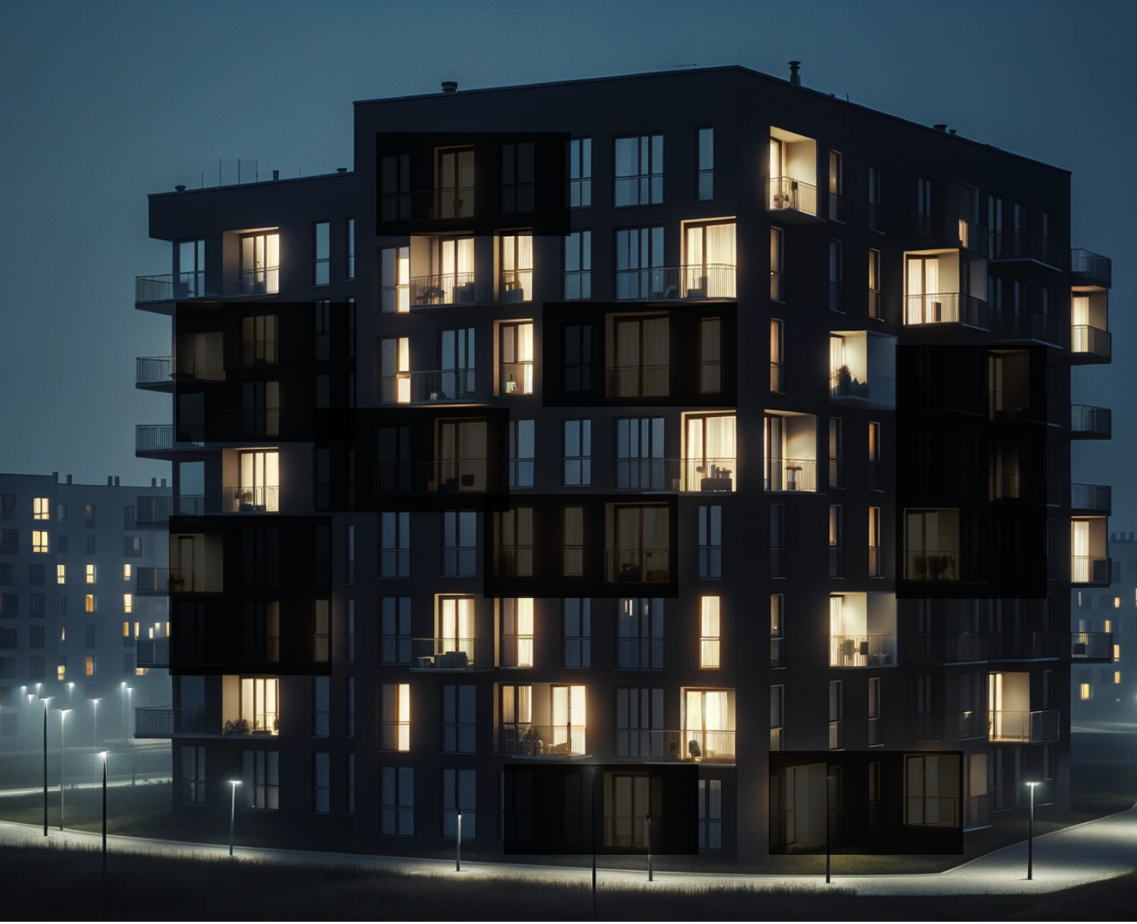
FAQ: Can an inclusionary program serve very low-income households?
29. ALL JURISDICTIONS USE THIS SLIDE
Higher percentage of low-income units
Lower percentage of very low-income units
- OR -

Slide 30
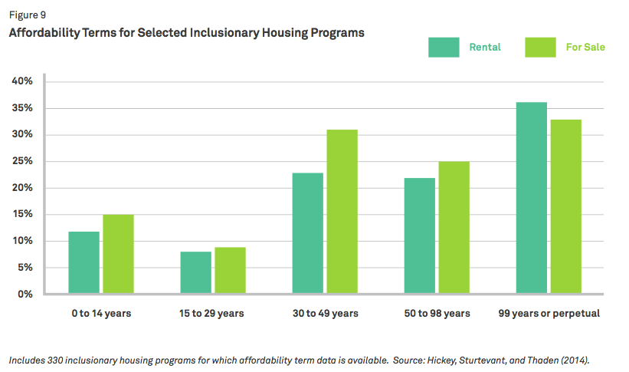
Preserving Affordability
30. ALL JURISDICTIONS USE THIS SLIDE
How long do inclusionary programs require units to remain affordable?

Slide 31
Other Common Topics
31. ALL JURISDICTIONS USE THIS SLIDE
Design/amenities for affordable units
Clustering of affordable units
Zones/target area
Not all programs address these issues.

Slide 32
Monitoring and Stewardship
32. ALL JURISDICTIONS USE THIS SLIDE
Setting affordable rents
Tenant selection process and prioritization
Income certifications
Property management
  Rental
  Homeownership

Slide 33
Summary
33. ALL JURISDICTIONS USE THIS SLIDE
(Update text in purple)
TODAY
NEXT STEPS

Slide 34
Additional Slides
34. ALL JURISDICTIONS USE THIS SLIDE IF NEEDED
(Update text in purple)
These are not broadly applicable but may be relevant for some discussions on inclusionary housing

Slide 35
Fractional Units
35. FOR JURISDICTIONS CREATING NEW POLICY
(Update text in purple)
The Basics
Inclusionary requirements often result in a fractional requirement
Options
Convert fractional amount to an in-lieu fee
Round requirement up to the nearest whole unit at .5, .7, or .75 units
Potential Approach:
Collect fees on fractional units or round up to the nearest full unit, at the developer’s discretion.

Slide 36
Compliance with MTC’s TOC Policy
36. ALL JURISDICTIONS USE THIS SLIDE
(Update text in purple)
The Basics
TOC compliance requires jurisdictions to have at least 6 of the 28 affordable housing policy options.
Affordable policies must meet the minimum requirements detailed in the TOC policy.
TOC Minimum Requirements: Inclusionary
  15 percent inclusionary for rental and ownership units, unless demonstrated to be infeasible.
  Applicable to projects with 11 or more units.
  Targeting a maximum 80 percent AMI for rental and 120 percent AMI for Ownership.
  Minimum 55-year deed restriction.
Juris name is a TOC Community per MTC, based on transit amenities.
Compliance with MTC’s TOC policy would increase competitiveness for OBAG funds in 2026.

Slide 37
Program Management
37. ALL JURISDICTIONS USE THIS SLIDE
Schedule for future updates
Program management
  Staff
  Monitoring fees
  Outsourcing

Slide 38
Interface: State Density Bonus Law
38. ALL JURISDICTIONS USE THIS SLIDE
Matching inclusionary income levels to incomes identified in Density Bonus income tiers.
Assume projects providing onsite inclusionary units will benefit from increased density and other development incentives.
Consider offering increased incentives for increased affordability.
State Density Bonus Law (SDBL) offers increased density, waivers and concessions to projects that provide five percent or more affordable housing on site. Inclusionary units do trigger State Density Bonus Rights

Slide 39

FAQ: Do resale restrictions mean homeowners don’t build wealth?
39. ALL JURISDICTIONS USE THIS SLIDE
The Urban Institute studied economic outcomes for buyers in seven homeownership programs with long-term affordability restrictions and found that sellers were able to experience significant equity accumulation even when the resale prices were restricted to preserve affordability.

Slide 40
Can we meet our affordable housing needs without inclusionary?
40. FOR JURISDICTIONS CREATING NEW POLICY
(Update text in purple)
Add your local data here

