Slide 1
Understanding New Laws About Residential Development in Commercial Zones
AB 2011 (2022) and SB 6 (2022)
Content Is Outdated. This resource has not been updated with laws passed after June 2023. Please check the 2024 New Housing Laws Webinar and Summary for more information.

Slide 2
Using the Template PPT
Main presentation includes high-level overview of AB 2011 and SB6
Appendix includes more detail to include if needed
Update text and add information or local details where indicated to insert or replace
DISCLAIMER: This presentation is intended solely as a technical overview of the provisions of AB 2011 (2022). It is not intended to serve as legal advice regarding any jurisdiction's specific policies or any proposed housing development project. Local staff should consult with their city attorney or county counsel when determining the applicability of these provisions to any proposed housing development project in their jurisdiction. Because the laws are so new, the legislative intent of major provisions is still being discussed and this memo may change significantly.

Slide 3
AB 2011 and SB 6
What do the laws say?
Where do they apply?
What can be built?
What can cities regulate?
What are the rules that apply for developers?
What can you do to prepare?
Appendix

Slide 4
What do the laws say?

Slide 5
What do the laws say?
The laws allow developments that qualify to partially bypass local zoning rules and use state standards to build housing in zones that allow office, retail or parking
Goes into effect July 1, 2023
Labor standards are required

Slide 6
Where do the laws apply?

Slide 7
Where do the laws apply?
Generally, in zones where office, retail or parking are principally permitted uses*
*AB 2011 “principally permitted use” means a use that may occupy more than one-third of the square footage of the site without conditional use permit (CUP)
SB 6 does not define “principally permitted use”

Slide 8
Map of Applicable Zones
Insert a map if you have it. Be sure to add alternative text.

Slide 9
What sites are eligible?
AB 2011 Mixed Income
Zoned commercial
On a wide street
Smaller than 20 acres
Additional rules (see appendix)
AB 2011 Affordable
Zoned commercial
Additional rules (see appendix)
SB 6
Zoned commercial
Additional rules (see appendix)
Notes:
The law uses the language commercial corridor, but its definition is a big street

Slide 10
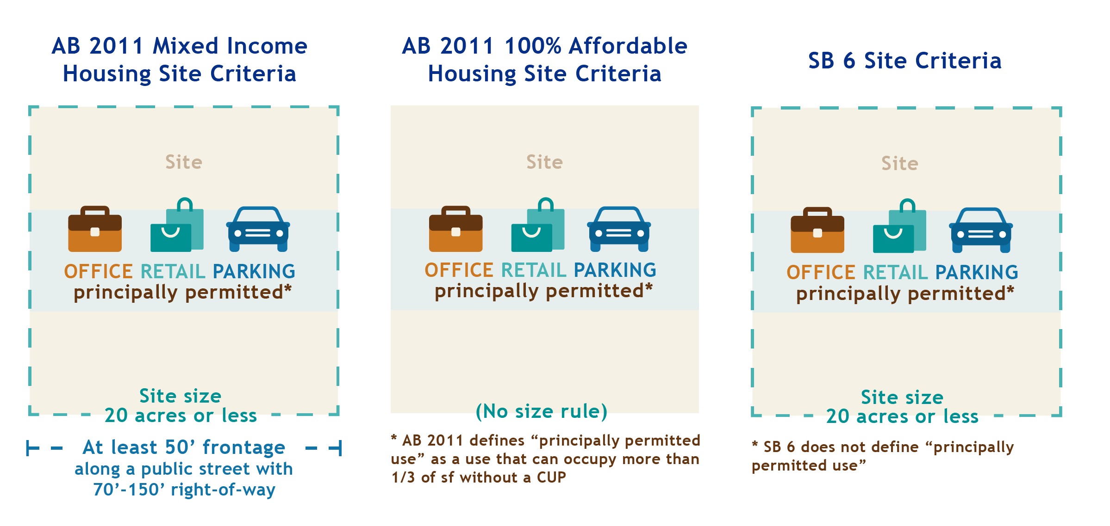
What are the site criteria?
Many other requirements apply

Slide 11
What can be built?

Slide 12
What can be built?
Affordable multi-family housing
Mixed income multi-family house
Mixed use with multi-family housing

Slide 13
What can be built? (comparison)
AB 2011 Mixed Income
Density, height and setbacks based on lot size, street width, adjacent uses, access to transit, population
No maximum density
At least 2/3 residential
AB 2011 Affordable
Project density must be at or above 20/30 DUA (insert default density for your jx)
No maximum density
At least 2/3 residential
SB 6
Project density must be at or above 20/30 DUA (insert default density for your jx)
No maximum density
At least 50% residential

Slide 14
Other Project Considerations
Eligible for density bonus, incentives, concessions, waivers or parking ratios
Must comply with SB 330 (Gov. Code § 663300(d)) replacement housing requirements even if not in affected city/county

Slide 15
What can cities regulate?

Slide 16
What can cities regulate?
Implementing ordinances
Parcels to exempt (must make findings and reallocate density)
Monitoring labor requirements
Enforcing relocation assistance

Slide 17
Affordability
AB 2011 projects have specified affordability requirements (see appendix)
SB 6 projects only need to provide affordability as required by local standards (or by SB 35, if applicable)
City may impose higher affordability standards

Slide 18
What can you do to prepare?

Slide 19
Implementing Ordinance(s)
Both bills allow but do not require jurisdictions to adopt implementing ordinances
Could adopt:
  Separate ordinances for each law, or
  One ordinance that covers options for residential development in “zones where commercial, retail, or parking are principally permitted uses”

Slide 20
Exempting Parcels
Consider what parcels to exempt
Complete environmental review and adopt pending Neighborhood Area Plans before Jan 1, 2024 (NOP must have been issued before Jan 1, 2022)

Slide 21
Relocation Requirements
Determine how to enforce relocation assistance requirements for qualified commercial tenants and displaced residents

Slide 22
Labor Requirements
Decide if and how to monitor labor requirements including reviewing reports from developers

Slide 23
APPENDIX

Slide 24
ABAG AB 2011 & SB 6 Resources
Understanding AB 2011 SB 6
AB 2011 SB 6 Summary of Key Details
Webinar: Overview of AB 2011 SB 6
AB 2011 Staff Workplan
AB 2011 How-to Review Development Proposals
AB 2011 Affordable Project Application Checklist
AB 2011 Mixed Income Project Application Checklist
Guide to California State Replacement Housing Requirements

Slide 25
What do the laws say? (additional details)

Slide 26
What else do the laws say?
Generally, with many exceptions
  A developer is allowed to build a housing project on a site that is zoned for office/retail/parking and meets other rules
Three sets of standards and rules and requirements
  AB 2011 Mixed Income
  AB 2011 Affordable
  SB 6
Goes into effect July 1, 2023
Labor standards are required

Slide 27
What are the differences between the laws?
SB 6 is much less prescriptive than AB 2011
SB 6 has stricter labor standards than AB 2011
SB 6 has no specified approval process (unless invoking SB 35)
  No prescribed review timelines
  No ministerial process
  CEQA applies
Developers will likely use SB 6 if the project doesn’t qualify for AB 2011
See Appendix for more detailed information

Slide 28
What can be built? (additional details)

Slide 29
SB 6 Projects
The project’s proposed density must be at or above 20/30 DUA (insert default density for your jx)
City cannot apply a maximum density
Must comply with other development standards from existing zoning for the site or closest parcel that allows 20/30 DUA (insert default density) whichever is higher density
Must comply with all other objective standards for the site
Must be at least 50% residential
Notes:
Closest parcel notes

Slide 30
Applying Standards: SB 6 Project
32 Moon Ct
Proposed density 40 DUA
Site zoning allows 20 DUA
Objective Standards
Closest parcel that allows 40 DUA is 123 Main St
Apply zoning, parking, design and ordinances from 123 Main St
Comply with all other standards from 17 Sacramento
If no zone in city allows 40 DUA, apply standards from zone with the highest residential density

Slide 31
AB 2011 100% Affordable Projects
The project’s proposed density must be at or above 20/30 DUA (insert default density for your jx)
City cannot apply a maximum density
Must be at least 2/3 residential
Must comply with other development standards from existing zoning for the site or closest parcel that allows 20/30 DUA (insert default density) whichever is higher density

Slide 32
Applying Standards: 100% Affordable Project
52 Moon Ct
Proposed density 40 DUA
Site zoning allows 20 DUA
Objective Standards
Closest parcel that allows 40 DUA is 123 Main St
Apply zoning, parking, design and ordinances from 123 Main St
Other Objective Standards:
Applied from closest zone that allows project density or higher

Slide 33
AB 2011 Mixed Income Projects
The density, height and setbacks are prescribed based on multiple factors (lot size, street width, adjacent uses, access to transit, population)
  City cannot apply a maximum density
  Proposed density must meet or exceed
    30-80 DUA (If your default density is 30 DUA, metropolitan)
    20-70 DUA (If your default density is 20 DUA, non-metropolitan)
  Height limit is 35-65 feet (or currently permitted height if greater)
  No parking minimums other than for bicycle, EV or spaces available to persons with disabilities
  Setbacks are complicated
Must be at least 2/3 residential

Slide 34
Applying Standards: AB 2011 Mixed Income Project
17 Moon Ct:
Proposed density 50 DUA
Current zoning (commercial) allows 20 DUA, 40 feet
75-foot-wide street
Law Defines Density, Height, Parking & Setbacks:
Density: Proposal must have a minimum of 30/40 DUA (insert for jx)
Height Limit: 40 feet (current zoning allows 40 feet)
Other Zoning/Objective Standards:
Closest parcel that allows 50 DUA is 123 Main St
Apply other standards from 123 Main St
If no zone allows 50 DUA, apply standards from zone with the highest residential density
See Appendix for Standards

Slide 35
What are the rules that apply for developers?

Slide 36
What are the rules that apply for developers?
Developers must:
Meet all site and project criteria (see appendix)
Conduct environmental assessment
Provide defined levels of affordability
Adhere to legally prescribed or existing objective standards
Provide notice and relocation assistance for qualified tenants
Pay prevailing wage

Slide 37
What can you do to prepare? (additional details)

Slide 38
What can you do to prepare?
Pass implementing ordinance(s)
Make findings and reallocate units to exempt parcels
Create development project applications and review processes that meet legally required timelines
Define “project site”
Clarify how “closest parcel” will be determined
Prepare maps of eligible parcels:
  Where additional density and height may apply
  By project type that is allowed

Slide 39
AB 2011 Recommended Actions
Consider adopting an implementing ordinance
Decide if parcels will be exempted, make written findings and designate “substitute” parcels
Create a development project application and review process that fits within the ministerial review timelines
Make a plan for tracking projects in Annual Progress Report
Complete environmental review and adopt pending Neighborhood Area Plans before Jan 1, 2024 (NOP must have been issued before Jan 1, 2022)

Slide 40
SB 6 Recommended Actions
Consider adopting an implementing ordinance
Decide if parcels will be exempted, how density will be reallocated and make written findings
Create development project application
Develop review process for projects that may invoke SB 35

Slide 41
What do you do when you get an application? (additional details)

Slide 42
What do you do when you get an application?
Process and review application within specified timelines

Slide 43
Application Process
AB 2011
Review and inform developer of inconsistencies with site and project criteria within 60 or 90 days
Process and review for objective standards within 90 or 180 days
Exempt from CEQA
SB 6
If project invokes SB 35, adhere to that process

Slide 44
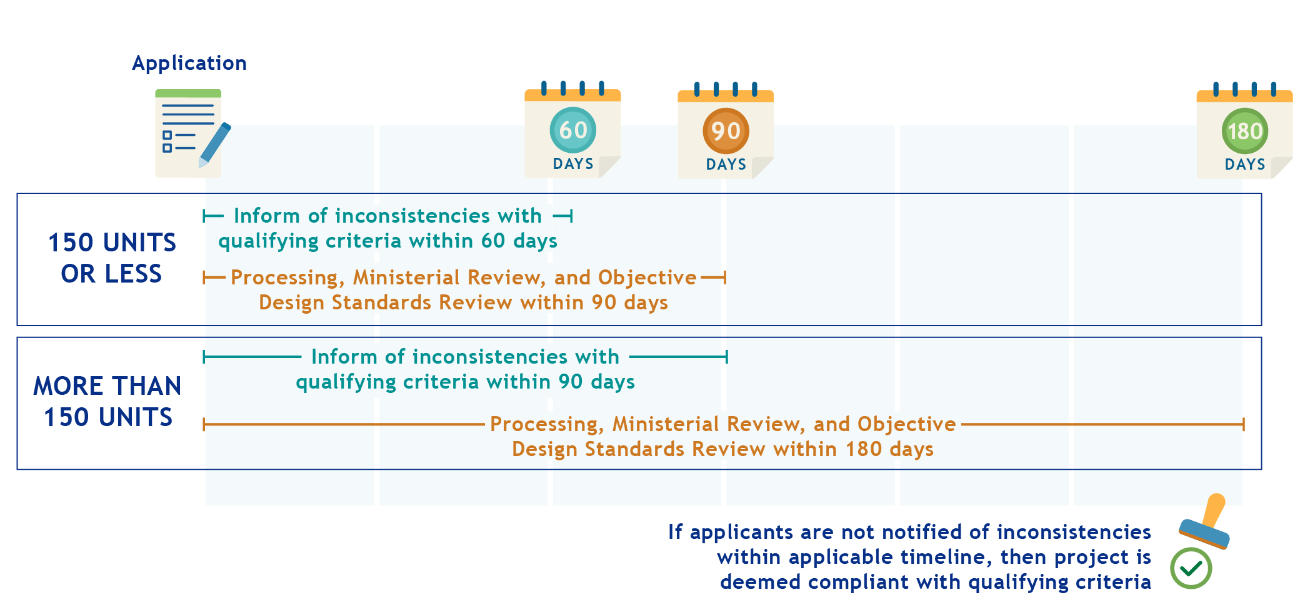
AB 2011 Ministerial Review Process

Slide 45
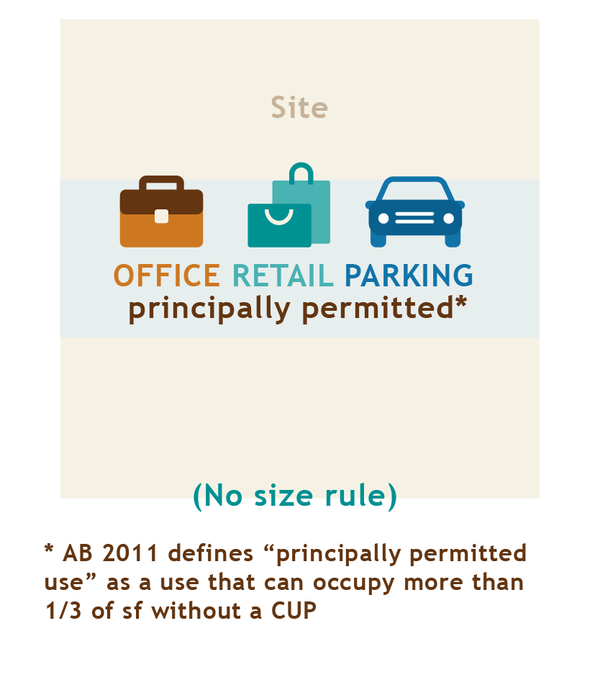
Site Criteria: AB 2011 Affordable Projects
Site:
  In an “urban area” adjoining urban uses
  Satisfies SB 35 environmental criteria (Gov. Code Sec. 65913.4(a)(6)(B)-(K))
  Complete Phase I environmental assessment and any necessary mitigation
  If in a neighborhood area plan must permit multi-family housing (subject to adoption deadlines)
See Summary of Key Details for full list of criteria

Slide 46
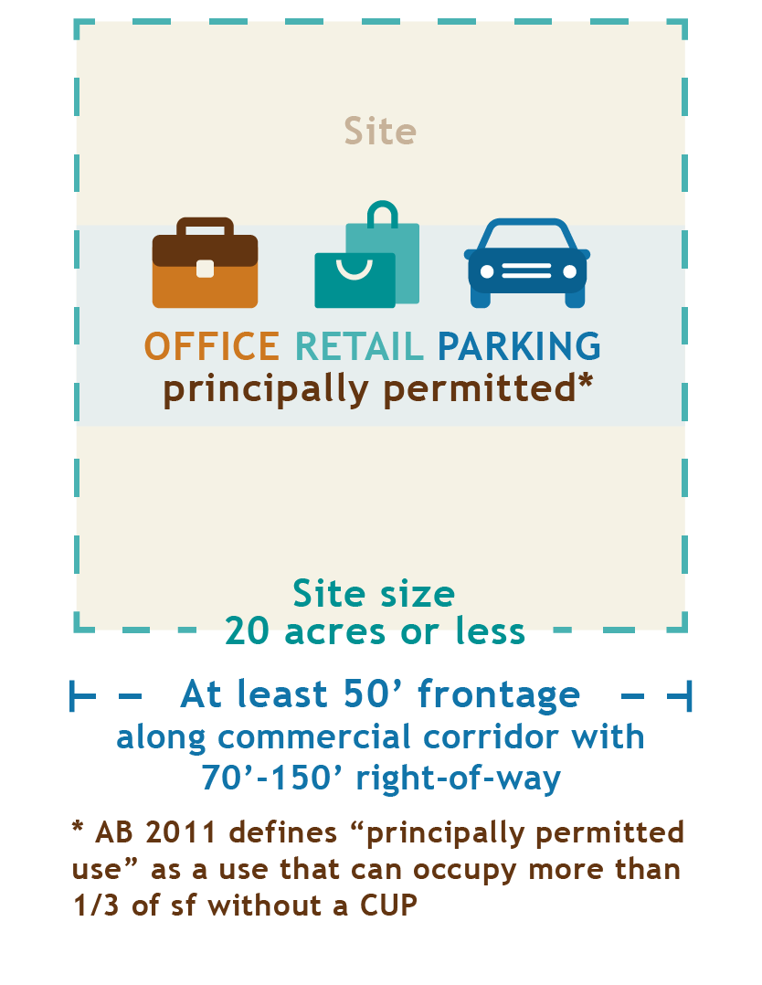
Site Criteria: AB 2011 Mixed Income Projects
Meets 100% Affordable criteria, and
  20 acres or smaller
  No residential use within last 10 years
  No demolition of a historic structure
  Not zoned for single-family
See Summary of Key Details for full list of criteria

Slide 47
Affordability: AB 2011 Mixed Income Projects
Rental Projects
  8% very low-income and 5% extremely low-income or 15% low-income
  55-year deed restriction
  “Affordable rent” per Health & Safety Code Sec. 50053
Owner-Occupied Projects
  30% moderate or 15% low-income
  45-year deed restriction
  “Affordable housing cost” per Health & Safety Code Sec. 50052.5
Local inclusionary rules can set higher levels of affordability
(Replace the above with local affordability requirements if higher)

Slide 48
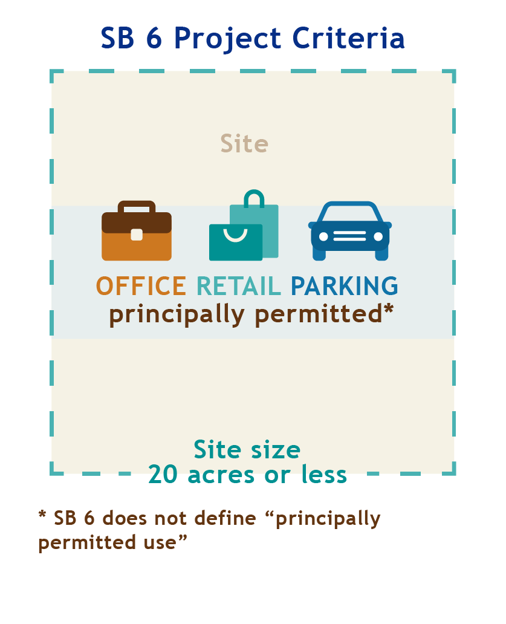
Site Criteria: SB 6 Projects
Zoning - Office, retail or parking principally permitted use
Size - 20 acres or less
Not rural - Within an urbanized area/urban cluster (urban areas)
Not industrial - Not on or adjoined to site with more than one-third industrial uses

Slide 49
Requirements: SB 6 Projects
Affordable housing is NOT required, except to:
  Satisfy local inclusionary requirement
  Qualify for SB 35
Prevailing wage and “skilled and trained workforce”
  Unless specific bidding process utilized
Provide relocation assistance to qualified commercial tenants
100% residential OR mixed-use project with at least 50% of square feet residential
  Consistent with Plan Bay Area 2050
Check Summary of Key Details for more information

Slide 50
Exempting Parcels from AB 2011
May exempt parcels prior to receiving development application IF findings with substantial evidence of:
  (1) Agency has identified one or more parcels that meet certain specified AB 2011 criteria;
  (2) If those parcels would not be otherwise eligible for development under AB 2011, agency has permitted parcel to be developed at residential densities above applicable AB 2011 densities (and if mixed income housing project, above applicable AB 2011 heights); AND
  (3) Development of the parcel(s) will result in:
    (i) no net loss of the total potential residential density in jurisdiction,
    (ii) no let loss of the potential residential density of housing affordable to lower income households, and
    (iii) affirmative furthering of fair housing.

Slide 51
Exempting Parcels from SB 6
May exempt parcels IF findings with substantial evidence of:
  (1) Concurrently relocated lost density to other parcels OR
  (2) Accommodation of lost density on parcels by allowing greater residential density than required by SB 6
Replacement parcels must:
  (1) Be suitable for residential development AND
  (2) Allow by-right development

Slide 52
AB 2011 vs. SB 6
- | AB 2011 | SB 6
Location | + Permits residential development in commercial zone | + Permits residential development in commercial zone
Project Type | - Multifamily residential projects only | + May be a mixed-use project so long as 50% residential
Affordable Housing | - Must provide some affordable housing | + No requirement to provide affordable housing*
CEQA | + Exempt from CEQA | - Not exempt from CEQA*
Labor Requirements | + Prevailing wage required | - Prevailing wage and “skilled and trained workforce” required
Approval Process | + Streamlined, ministerial process | - No streamlined, ministerial process*
*Unless applicant is eligible for and invokes SB 35

Slide 53
AB 2011 vs. SB 35
- | AB 2011 | SB 35
Location | + Permits residential development in commercial zone | - Must be zoned or planned for residential or mixed-use development
Project Type | - Multifamily residential projects only | + May be a mixed-use project so long as 2/3 residential
Affordable Housing | - Must provide some affordable housing | - Must provide at least 10, 20 or 50% affordable housing
CEQA | + Exempt from CEQA | + Exempt from CEQA
Labor Requirements | - Prevailing wage required | - Prevailing wage required
Approval Process | + Streamlined, ministerial process | + Streamlined, ministerial process
Other | + No required tribal consultation | - Required tribal consultation process

Slide 54
SB 6 Expansion of SB 35
- | SB 35 | SB 6
Location | Urbanized infill site Residential or mixed-use zone Must comply with Gov. Code Sec. 65914.3(a)(6)(A)-(K) | Site where office, retail or parking are principally permitted use
Project Type | 100% residential; or Mixed-used projects with at least 2/3rd residential | 100% residential; or Mixed-use project with at least 50% residential
Labor Requirements | Prevailing wage required | Prevailing wage and “skilled and trained workforce” required
Affordable Housing | Must provide at least 10, 20 or 50% affordable housing | Must provide at least 10, 20 or 50% affordable housing
Approval Process | Same as AB 2011 except tribal consultation required | Same as AB 2011 except tribal consultation required

Slide 55
Development Standards: AB 2011 Mixed Income
Uses height and density standards from the law
Incorporates objective zoning, subdivision and design review standards for either:
  Closest zone allowing required multi-family residential density OR
  Zone allowing greatest multi-family residential density in the jurisdiction (if required density does not exist)
Cannot require parking except bicycle, electric vehicle and disabled spots
Check Summary of Key Details for more information

Slide 56
Development Standards: AB 2011 Mixed Income cont’d
Defines standards for density, height and setbacks
Cannot require parking except bicycle, electric vehicle and disabled spots
Incorporates objective zoning, subdivision and design review standards for either:
  Closest zone allowing required multi-family residential density OR
  If required density does not exist, zone allowing greatest multi-family residential density in the jurisdiction
Check Summary of Key Details for more information

Slide 57
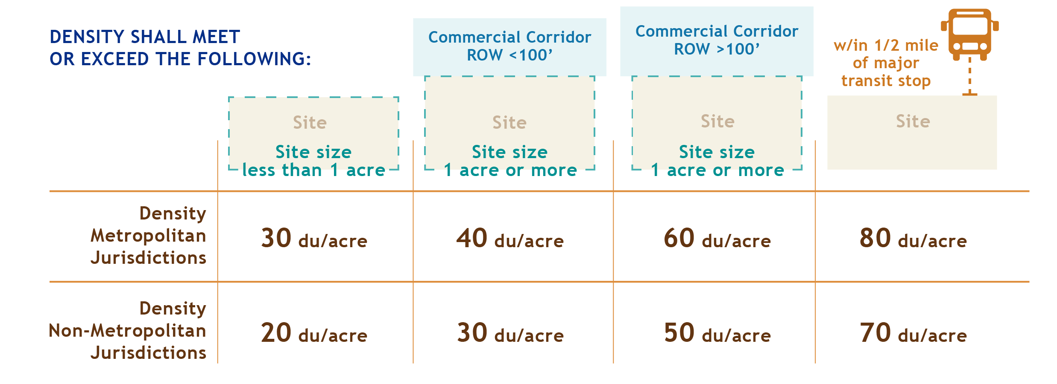
Density: AB 2011 Mixed Income

Slide 58
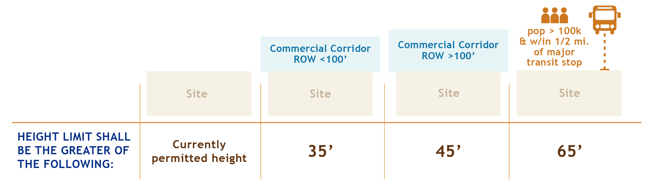
Height Limit: Mixed Income

