Slide 1

AB 1332 Pre-Approved ADU Plans
This PowerPoint, produced by ABAG’s Regional Housing Technical Assistance Program, is a template that staff can use when updating City Council/Planning Commission about AB 1332. Delete this box and tailor the information before using.
Informational Presentation

Slide 2

AB 1332: Not city-owned plans
Jurisdiction: “Let’s hire an architect to make some plans that we can give out for free.”

Slide 3

AB 1332: Allows anyone to submit plans for preapproval
Plan owner*: “I’ve got some really cool plans that I want you to take a look at now, so I can reuse them with other clients.
I get that you will have to look at things like site specific objective standards when I reuse them.”
*Plan owner may be an architect, designer, contractor, etc. Jurisdictions cannot limit who submits plans for pre-approval

Slide 4
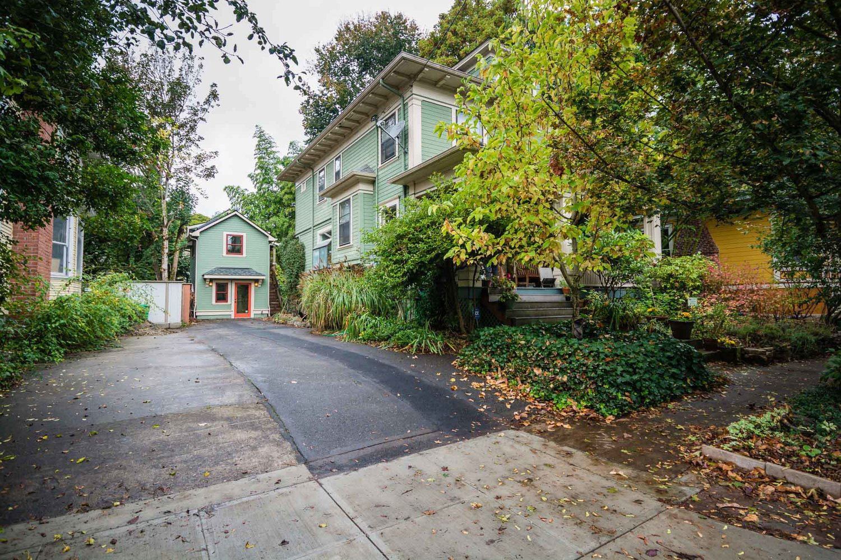
Pre-approved Plans
Applicant owns the plans (plan owner)
[City/County] posts general plan information online
[City/County] can charge a processing fee on top of review/permit fees
Property owner contacts the plan owner to purchase or use the plans

Slide 5
Prep Work
Develop internal review processes and create applications/instructions for applicants:
  Pre-approved plan applications/instructions for plan owners (designers, etc.)
  Site-specific applications for homeowners/property owners
Develop process for internal review of site-specific applications using pre-approved plans
Identify fees for pre-approval and site-specific applications

Slide 6
Review Process
Part 1: Pre-Approval
(site-agnostic)
  Review within 60 days
  Include any standards not related to the site (most building code)
Part 2 – Using the Plans (site-specific)
  For detached ADUs, review within 30 days; otherwise, review within 60 days
  Include any standards that depend on the site (e.g. Title 24, site map, historic review, utilities hook ups, FEMA zone)

Slide 7
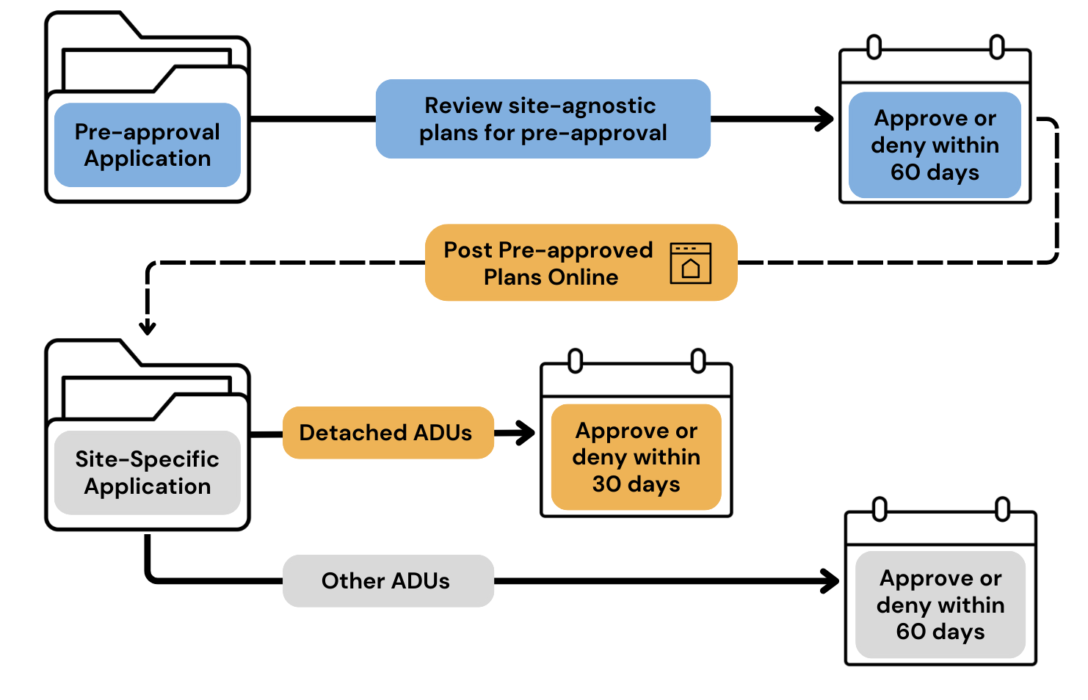
Review Timelines

Slide 8
Benefits
Aims to make it faster and easier to get ADU permits
Using off-the-shelf designs can be less expensive
Can make it easier for people to build ADUs

Slide 9
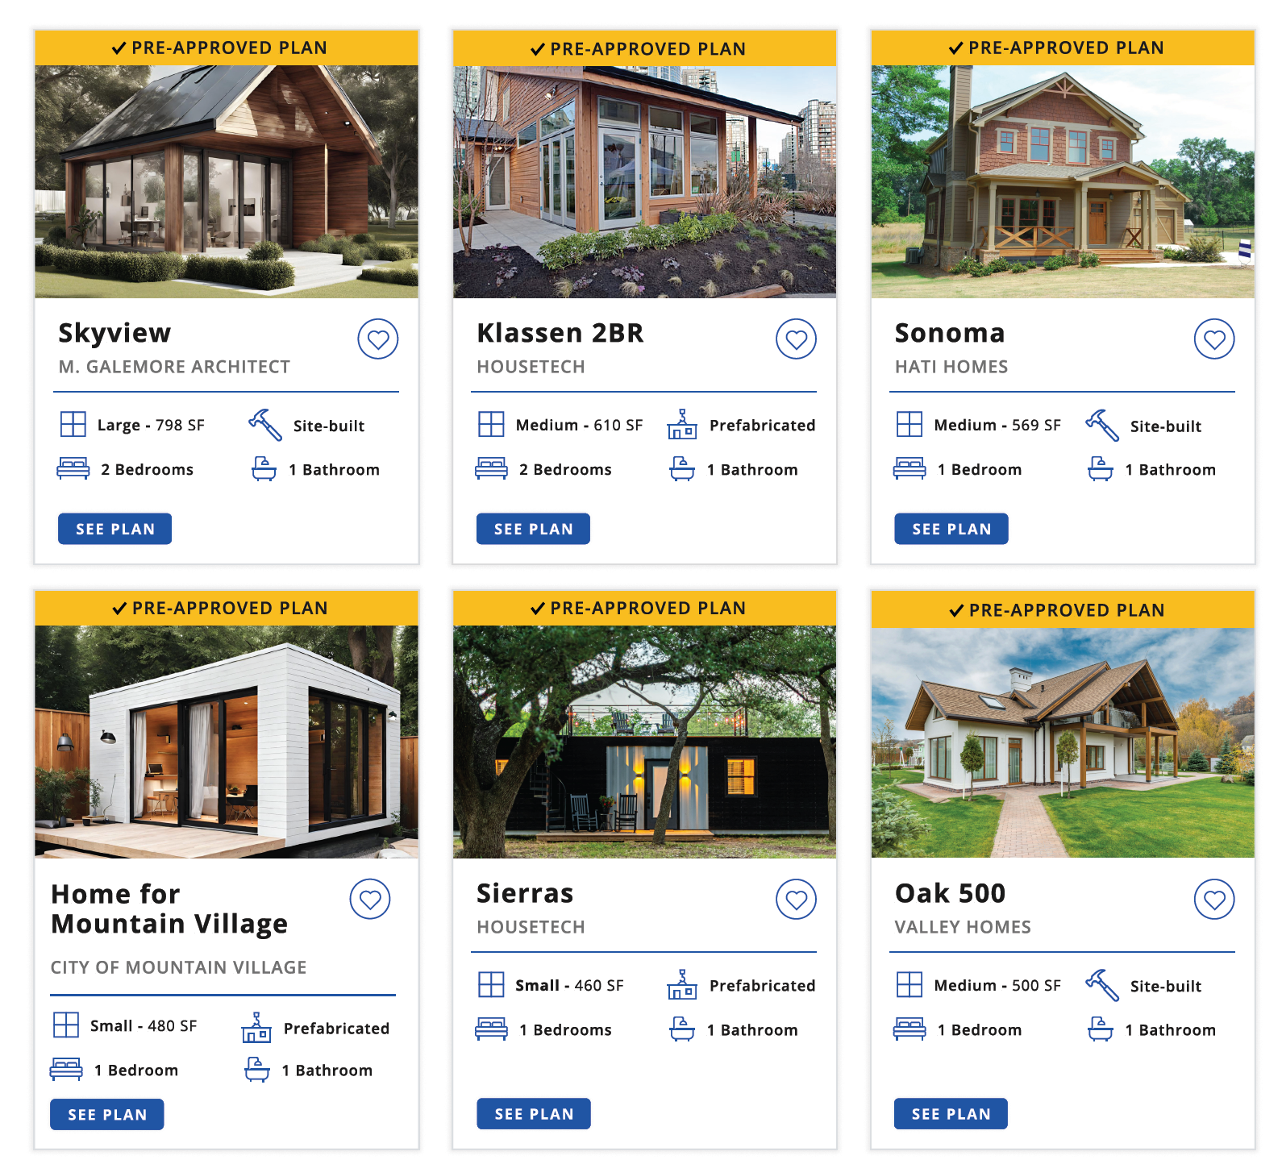
Going above and beyond
  Offer plans from other cities
  Select and pre-approve plans that have been approved in other places or are in the public domain (must ask plan owners if they want to be part of the program)
  Offer plans that went through conventional review
  Select and pre-approve plans the city has already approved for a site-specific ADU (must ask new applicants if they want to be part of the program)
  Develop a more user-friendly website
  If possible, develop a high-quality website where homeowners can view or filter plans
Photo: ADU Plans Gallery

Slide 10
Extra Slides

Slide 11




Part 1 - Pre-approval (site-agnostic) phase
Time
Frame
Approve or deny plan within 60 days
Website
Post plan information/ designer contact details online
Postings are not endorsements
Remove plans within 30 days if requested by designer
Cost
Charge same permitting fees as for other ADUs
May include processing fee to administer the pre-approved plans program if typical
Standards
Complete building code and objective standards review. Must meet state ADU law
No site-specific review (T24, zoning, historic resources, coastal zone, utilities, etc.)
Pre-approval expires at the end of the building code cycle

Slide 12
Part 2 – Reusing plans (site-specific) phase
Cost
Can charge fees
Time Frame
If the plans are for a detached ADU, approve or deny within 30 days. Otherwise approve or deny within 60 days
Standards
  Ensure plan is identical to original plan
  Apply site specific rules (e.g. Title 24, site map, historic review, utilities hook ups, FEMA zone)
  Outside agency review

Slide 13
Regional Housing Technical Assistance
AB 1332 Info Sessions & Resources
Watch the recorded information sessions to learn more about compliance and implementation and use the guidance and resources provided at the link below.
https://abag.ca.gov/technical-assistance/ab-1332-pre-approved-adu-plans-information-sessions

