Slide 1
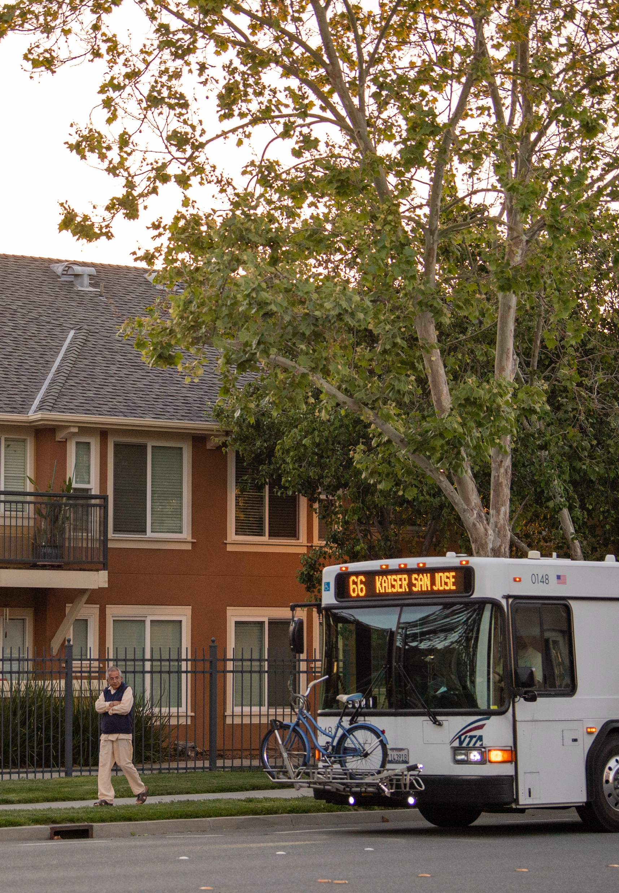

MTC’s Transit Oriented Communities Policy
[NOTE TO JURISDICTIONS: Update bracketed highlighted content throughout presentation]
[Change image as desired]
Overview of Requirements and Pathway to Compliance
[Meeting Date]

Slide 2
Agenda/Goal Today
Agenda
  Overview of the MTC TOC Policy
  [Jurisdiction name] and TOC Policy consistency
Actions
  Receive direction on how to advance compliance with MTC’s TOC Policy
  Receive direction on recommended policy updates
Notes:
SPEAKER NOTES
In 2022, MTC adopted the TOC policy to implement Plan Bay Area. The TOC policy establishes minimum requirements for jurisdictions related to density in station areas, affordable housing policies, parking management, and station access planning.
Today we will provide an overview of the TOC Policy, OBAG funds, and potential impact of TOC Policy compliance on future funding.
We seek direction on how to advance city’s compliance with the TOC Policy.

Slide 3

TOC Overview
Transit Oriented Communities (TOC) Policy
  Adopted in 2022, TOC is a program that advances implementation of Plan Bay Area and identifies criteria in various categories (e.g., parking standards or minimum zoning)
  Goal: protect regional transportation investments by encouraging appropriate densities, parking controls, affordable housing and station access
  Compliance is voluntary
Why be Consistent with TOC?
  Prioritization for One Bay Area Grant (OBAG) funds, beginning with OBAG 4 in 2026
  Support sustainable planning goals identified in Plan Bay Area 2050
Notes:
SPEAKER NOTES
MTC’s TOC Policy requires that jurisdictions with ferry, rail, and bus rapid transit stops take certain steps towards promoting inclusive, accessible, mixed-use neighborhoods around these transit hubs
MTC is the Metropolitan Planning Organization and the transportation planning, financing and coordinating agency for the 9-county Bay Area.​
As the 4th cycle of the One Bay Area Grant (OBAG) program is developed in 2025, MTC will develop criteria for how TOC Policy compliance will impact competitiveness for OBAG 4 funding.
The OBAG program is MTC’s framework for programming federal highway formula funds.
TOC Policy compliance also helps further the region’s long-range plan for creating a Bay Area that’s more affordable, connected, diverse, healthy and vibrant.

Slide 4
One Bay Area Grant (OBAG)
MTC program to distribute region’s share of federal transportation funding
Past three funding cycles
  MTC has distributed over $941 million
  [City] has received just under [$XXXX] million
Next funding cycle
  Scheduled for 2026
  TOC Policy compliance will be a meaningful factor
“Future One Bay Area Grant (OBAG) funding cycles will consider funding revisions that prioritize investments in transit stations areas that are subject to and compliant with the TOC Policy.”
Notes:
SPEAKER NOTES
One Bay Area Grants, or OBAG funds, are an important source of regional dollars to implement transportation improvements and planning. In the past three rounds, OBAG funded $941 million across the region. The next round of OBAG funds, OBAG 4, is planned for 2026. Consistency with the TOC policy will be a scoring consideration for OBAG 4.

Slide 5

Past OBAG Projects
Projects Awarded OBAG Funds
  [Project Name, Year, $XXXXX]
  [Project Name, Year, $XXXXX]
  [Project Name, Year, $XXXXX]
  [Project Name, Year, $XXXXX]
  [Project Name, Year, $XXXXX]
Total [$X,X00,000]
[Change image as desired]
[Change image as desired]
[NOTE TO JURISDICTIONS: [Update bracketed highlighted content. Add list of prior OBAG funded projects and total amount of awards. Add photos of projects.]
Notes:
SPEAKER NOTES
Jurisdiction Name has been successful in securing total dollar amount of OBAG funds for important transportation improvements and planning grants. These regional dollars have enabled Jurisdiction Name to build describe projects

Slide 6
Potential Future OBAG Projects
Projects that could be Awarded OBAG Funds
  [Project Name, Year, $XXXXX]
  [Project Name, Year, $XXXXX]
  [Project Name, Year, $XXXXX]
  [Project Name, Year, $XXXXX]
  [Project Name, Year, $XXXXX]
Total [$X,X00,000]
[Change image as desired]
[Change image as desired]
[NOTE TO JURISDICTIONS: Update bracketed highlighted content. Add list of potential future OBAG funded projects and total amount of awards. Add photos of projects.]
Notes:
SPEAKER NOTES:
Staff have identified several projects that would be good candidates for OBAG funding in the next round, anticipated in 2026.
Describe potential projects
Jurisdiction Name would be more competitive for OBAG funds if we were consistent with the TOC policy. MTC has made it clear that consistency with the TOC policy will be a factor for prioritization of OBAG funds

Slide 7
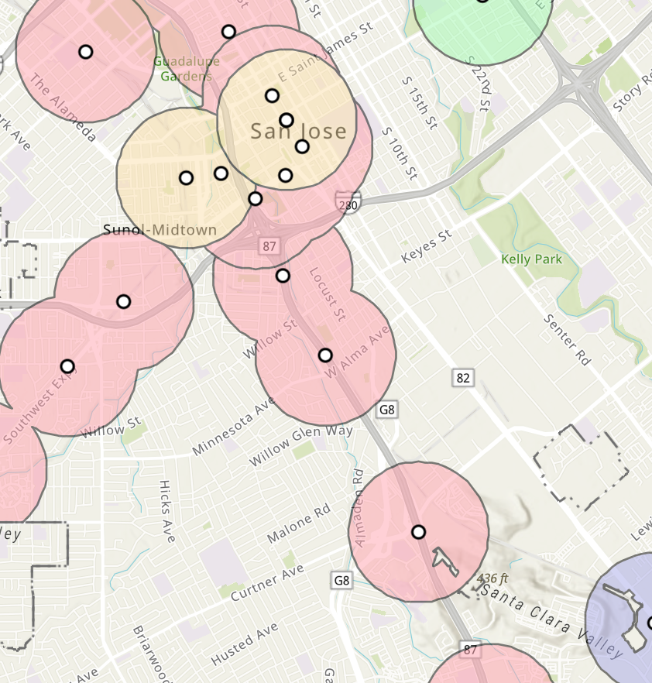
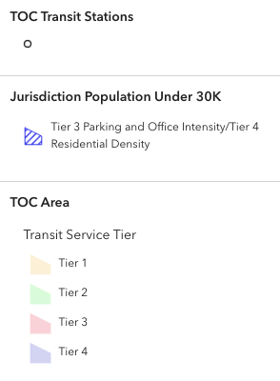
TOC Station Area
The TOC policy applies to areas within 1/2-mile of existing and planned rail stations, bus rapid transit stops, and ferry terminals.​
[NOTE TO JURISDICTIONS: Create image of your jurisdiction’s TOC(s) by screenshotting this map:
https://experience.arcgis.com/experience/01311260043f4bd689907c9df577bfff]
Notes:
SPEAKER NOTES
There are (ENTER NUMBER) TOC areas in the JURISDICTION NAME. Over 60 jurisdictions in the Bay Area have at least one TOC area. Each TOC is assigned a tier based on the station’s level of transit service. A Tier 1 station has higher levels of transit service, while a Tier 4 station has less robust service. Some of the TOC Policy’s requirements -- including those for residential and commercial office density and maximum parking -- vary based on the TOC area’s transit tier. Higher levels of transit service are correlated with higher expected densities. The TOC Policy also identifies parking controls for station areas, where jurisdictions limit parking allowed in new residential and commercial developments to a ratio correlated with the TOC’s transit tier.
NAME OF JURISDICTION has xx station areas –
Station Name and Tier level
Station Name and Tier level
Station Name and Tier level
Station Name and Tier level
Most of MTC’s TOC policy requirements are limited to the TOC area – especially zoning and parking. Most of the policies and planning we will discuss today will be specific to the TOC. However we currently apply some affordable housing policies citywide.

Slide 8
TOC Compliance Requirements
Density
  Required minimum and maximum densities for new housing and office development.
Affordable Housing/Commercial Stabilization Policies
  Jurisdiction chooses policies from a menu of policy options: 2 Production,
  2 Preservation, 2 Protection, & 1 Commercial Stabilization.​
Parking Management
  Parking maximums for residential and commercial development.
  Requirements for bicycle, shared, unbundled parking, and TDM or curb management.​
Transit Station Access and Circulation
  Comply with Complete Streets Policy, prioritize active transportation.​
  Complete an access gap analysis and identify opportunities for Mobility Hubs.
Notes:
SPEAKER NOTES
The TOC policy has four key areas – Density, Affordable Housing, Parking Management, and Transit Station Access and Circulation.
For each of these areas the policy sets minimum requirements

Slide 9
Density
[NOTE TO JURISDICTIONS: [Update the status for each policy to rate your jurisdiction’s current level of compliance with the TOC requirements for each category. Choose yes or no for areas where the grant will fund work.]
A jurisdiction must meet the following four density standards, which vary based on a TOC’s transit tier:
Policy | Status | Grant Funding
Residential Density Minimum | ✓ Consistent * Needs amendment ! Needs new policy N/A | Yes No
Residential Density Maximum
Commercial Office Density Minimum
Commercial Office Density Maximum
Notes:
SPEAKER NOTES
The TOC establishes specific targets for average density minimums and maximums across the TOC area. The density requirements apply only to the ½ mile radius around the station.
Generally, Jurisdiction name’s zoning controls [are/are not] consistent with the TOC policy.
Jurisdiction name [does/does not] have minimum residential densities. To be consistent with the TOC policy, staff recommend adopting residential density minimums.

Slide 10
2. Production Housing Policies
[NOTE TO JURISDICTIONS: [Update the status for each policy to rate your jurisdiction’s current level of compliance with the TOC requirements for each category. Choose yes or no for areas where the grant will fund work.]
A jurisdiction must adopt at least two of the following policies:
Policy | Status | Grant Funding
Inclusionary Zoning | ✓ Consistent * Needs amendment ! Needs new policy N/A | Yes No
Affordable Housing Funding
Affordable Housing Overlay Zones
Public Land for Affordable Housing
Ministerial Approval
Public/Community Land Trusts
Development Certainty and Streamlined Entitlement Process
Notes:
SPEAKER NOTES
Jurisdictions should select at least two policies from each of the three Ps: Production, Preservation and Protection.
The table identifies the policies staff found to be already consistent, followed by policies recommend for amendment or adoption.
The other policies listed are options in the TOC policy, however staff are not recommending adoption of these policies.
XXX policy is already consistent with the TOC Policy
XXX policy will require some amendments to be consistent
XXX policy could be developed, with support from the MTC grant, to be consistent with the TOC policy.

Slide 11
2. Preservation Housing Policies
[NOTE TO JURISDICTIONS: [Update the status for each policy to rate your jurisdiction’s current level of compliance with the TOC requirements for each category. Choose yes or no for areas where the grant will fund work.]
A jurisdiction must adopt at least two of the following policies:
Policy | Status | Grant Funding
Funding to Preserve Unsubsidized Affordable Housing | ✓ Consistent * Needs amendment ! Needs new policy N/A | Yes No
Tenant/Community Opportunity to Purchase
Single-Room Occupancy (SRO) Preservation
Condominium Conversion Restrictions
Public/Community Land Trusts
Funding to Support Preservation Capacity
Mobile Home Preservation
Preventing Displacement from Substandard Conditions and Associated Code Enforcement Activities
Notes:
SPEAKER NOTES
Jurisdictions should select at least two policies from each of the three Ps: Production, Preservation and Protection.
The table identifies the policies staff found to be already consistent, followed by policies recommend for amendment or adoption.
The other policies listed are options in the TOC policy, however staff are not recommending adoption of these policies.
XXX policy is already consistent with the TOC Policy
XXX policy will require some amendments to be consistent
XXX policy could be developed, with support from the MTC grant, to be consistent with the TOC policy.

Slide 12
2. Protection Housing Policies
[NOTE TO JURISDICTIONS: [Update the status for each policy to rate your jurisdiction’s current level of compliance with the TOC requirements for each category. Choose yes or no for areas where the grant will fund work.]
A jurisdiction must adopt at least two of the following policies:
Policy | Status | Grant Funding
“Just Cause” Eviction | ✓ Consistent * Needs amendment ! Needs new policy N/A | Yes No
No Net Loss and Right to Return to Demolished Homes
Legal Assistance for Tenants
Foreclosure Assistance
Rental Assistance Program
Rent Stabilization
Preventing Displacement from Substandard Conditions and Associated Code Enforcement Activities
Tenant Relocation Assistance
Mobile Home Rent Stabilization
Fair Housing Enforcement
Tenant Anti-Harassment Protections
Notes:
SPEAKER NOTES
Jurisdictions should select at least two policies from each of the three Ps: Production, Preservation and Protection.
The table identifies the policies staff found to be already consistent, followed by policies recommend for amendment or adoption.
The other policies listed are options in the TOC policy, however staff are not recommending adoption of these policies.
XXX policy is already consistent with the TOC Policy
XXX policy will require some amendments to be consistent
XXX policy could be developed, with support from the MTC grant, to be consistent with the TOC policy.

Slide 13
2. Commercial Stabilization Policies
[NOTE TO JURISDICTIONS: the commercial stabilization policies are not eligible for funding from the TOC Planning and Implementation Grant program. Information about these policies is included here in case you want to update your Council/Board about the jurisdiction’s status on all TOC requirements.
Update the status for each policy to rate your jurisdiction’s current level of compliance with the TOC requirements for each category. ]
A jurisdiction must adopt at least one of the following policies:
Policy | Status
Small Business and Non-Profit Overlay Zone | ✓ Consistent * Needs amendment ! Needs new policy N/A
Small Business and Non-Profit Preference Policy
Small Business and Non-Profit Financial Assistance Program
Small Business Advocate Office
Notes:
SPEAKER NOTES
Jurisdictions should select at least one commercial stabilization policy.
Jurisdiction Name (has a XXX in place or proposes to pursue XXX)

Slide 14
3. Parking
[NOTE TO JURISDICTIONS: [Update the status for each policy to rate your jurisdiction’s current level of compliance with the TOC requirements for each category. Choose yes or no for areas where the grant will fund work.]
A jurisdiction must comply with all of the following policies:
Policy | Status | Grant Funding
Residential Parking Minimums | ✓ Consistent * Needs amendment ! Needs new policy N/A | Yes No
Residential Parking Maximums
Commercial Parking Minimums
Commercial Parking Maximums
Allow Unbundled Parking (Separate the Cost of a Parking Space from Rent/Sales Price)
Allow Shared Parking Between Different Land Uses
Residential Bicycle Parking: 1 Secure Space per Unit
Office Bicycle Parking: 1 Secure Space per 5,000 Occupied sq. ft.
Notes:
SPEAKER NOTES
The TOC policy asks for consistency with all eight of these parking management strategies.
XXX & XXX policy is already consistent with the TOC policy
XXX & XXX policy will require some amendments to be consistent
XXX & XXX policy could be developed, with support from the MTC grant, to be consistent with the TOC policy.

Slide 15
3. Parking (Continued)
[NOTE TO JURISDICTIONS: [Update the status for each policy to rate your jurisdiction’s current level of compliance with the TOC requirements for each category. Choose yes or no for areas where the grant will fund work.]
A jurisdiction must pick one of the following policies:
Policy | Status | Grant Funding
TDM Policy for New Development | ✓ Consistent * Needs amendment ! Needs new policy N/A | Yes No
Curb Strategy/Management
Parking Benefit District (PBD)
Demand-Responsive Pricing or Priced Parking
Notes:
SPEAKER NOTES
Also, jurisdictions must demonstrate consistency with one of these requirements.
Jurisdiction Name (has a XXX in place, proposes to pursue XXX with the support of a grant from MTC, or ???)

Slide 16
4. Transit Access and Circulation
[NOTE TO JURISDICTIONS: [Update the status for each policy to rate your jurisdiction’s current level of compliance with the TOC requirements for each category. Choose yes or no for areas where the grant will fund work.]
A jurisdiction must comply with all of the following policies:
Policy | Status | Grant Funding
Adopt a jurisdiction-wide Complete Streets Policy | ✓ Consistent * Needs amendment ! Needs new policy N/A | Yes No
Prioritize implementation of active transportation projects in TOC area(s)
Complete an access gap analysis and capital improvement program for station access
Identify Mobility Hub planning and implementation opportunities in TOC area(s)
Notes:
SPEAKER NOTES
The TOC policy asks for consistency with all four of these station access and circulation requirements.
XXX & XXX policy is already consistent with the TOC
XXX & XXX policy will require some amendments to be consistent
Xxx & XXX policy could be developed, with support from the MTC grant, to be consistent with the TOC policy.

Slide 17
Timeline
2025 | Partner coordination and engagement Draft OBAG 4 policy development
2026 | Final OBAG 4 policy adoption OBAG call for projects (County Program) TOC Policy compliance documentation deadline
2027 | OBAG 4 project selection (county program)
Notes:
SPEAKER NOTES

Slide 18
Discussion and Recommended Action
Discussion:
  TOC Policy compliance enables us to remain competitive for OBAG funds and other regional resources
  Policy updates are needed to achieve compliance prior to 2026 deadline
Recommended Action Today:
  Direct staff to advance work needed for TOC Policy compliance
Notes:
SPEAKER NOTES

Slide 19
Optional Slides
Notes:
SPEAKER NOTES

