Slide 1

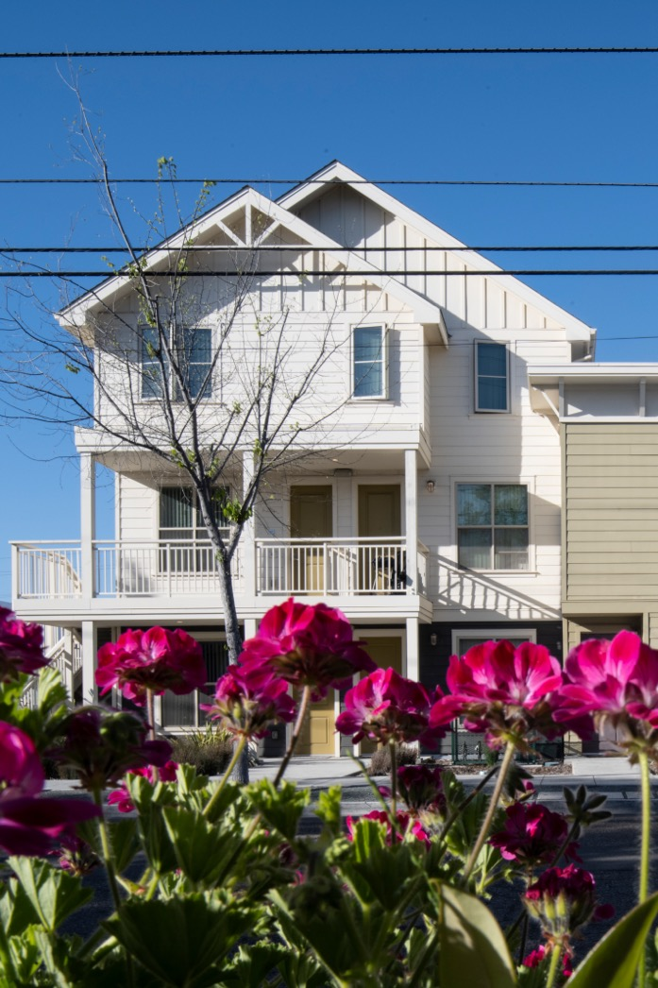
Making
Density
Work
Tools for Creating Great Neighborhoods
Notes:
This deck builds upon the themes of Presentation #1, providing a deeper dive into how zoning, density and design are tools for creating more housing choice and more inclusive neighborhoods. The slide deck also provides examples of a variety of housing types that can fit into different neighborhood contexts, within different ranges of density. Each explanation of a housing type is complemented by real Bay Area examples, and template slides that can be customized for your community.

Slide 2

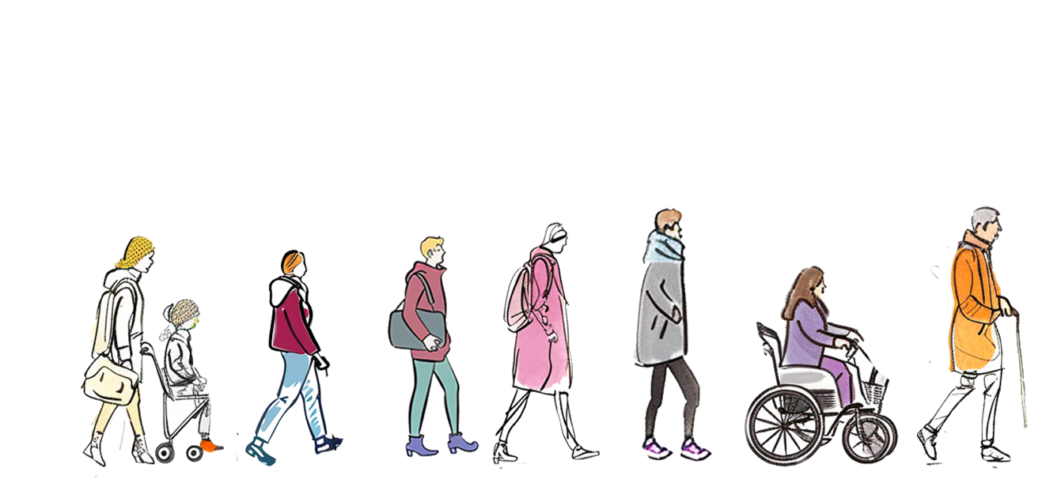
Why does housing choice matter?
Diverse housing options help meet our housing needs in all stages of life.
With more housing choices, we don’t have to leave our community as our housing needs change.
How many different types of houses have you lived in?
Notes:
The presentation starts off with a brief question for audience consideration and input, connecting personally to the different types of housing they have likely lived in over the course of their lives: from birth through today. The point is to underscore that housing needs change over time.

Slide 3
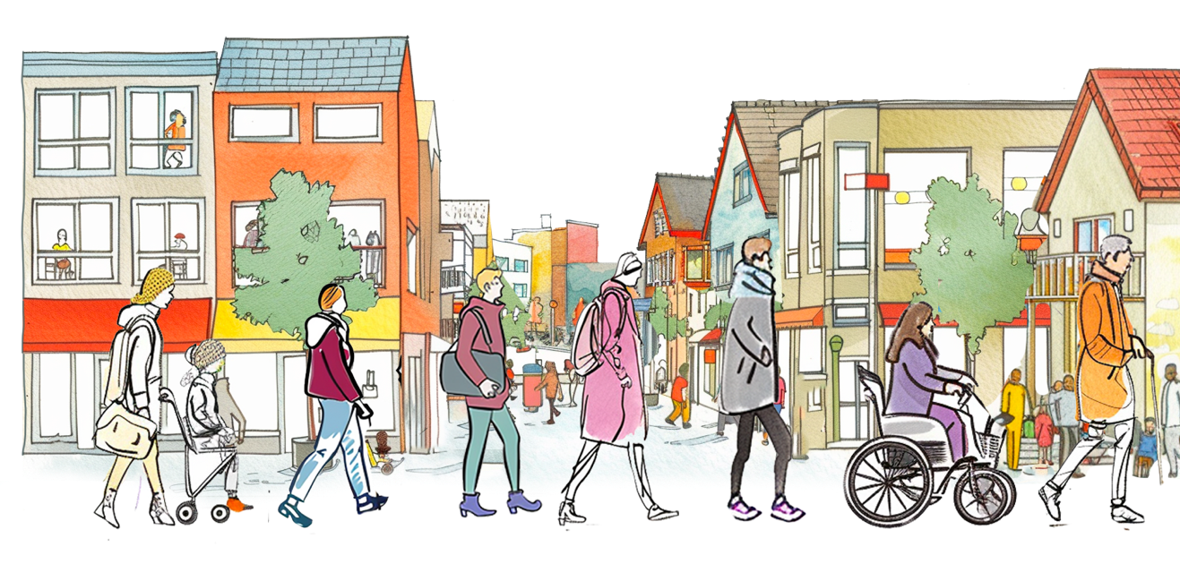
A great neighborhood provides housing options
By creating neighborhoods with more housing options
we help our friends, neighbors and future generations remain in our community as their needs change
while welcoming new neighbors!
Notes:
Different housing options help to meet the needs of different households, as well as the changing needs of individual households. By providing a diversity of homes (different sizes, costs, locations and configurations...) we help create a diverse, stable and welcoming community where people can find the housing they need.

Slide 4
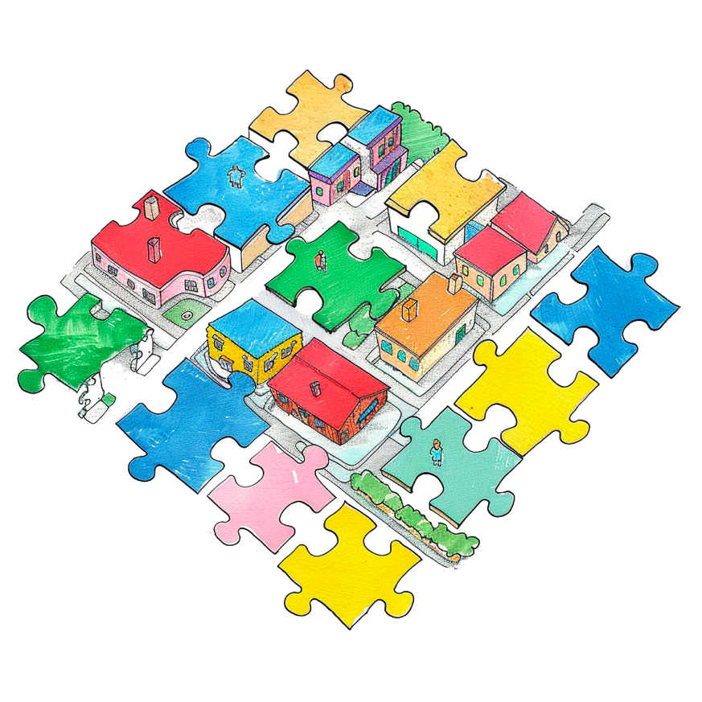
Tools for creating housing choices in our neighborhoods
Tools that shape buildings
Tools that support affordability
Design standards and architectural guidelines
Development standards like height limits
Zoning for more density, smaller unit sizes
Requirements or incentives for affordability
Streamlined review for affordable housing
Tools that define what, where and how much
Zoning for use and density
Development standards like requirements for parking and setbacks
Notes:
This slide introduces tools that communities use to create different housing choices. It defines three broad categories: tools that shape buildings, tools that support affordability and tools that guide where and what we build. All of these tools work together to create great neighborhoods with diverse housing options.

Slide 5
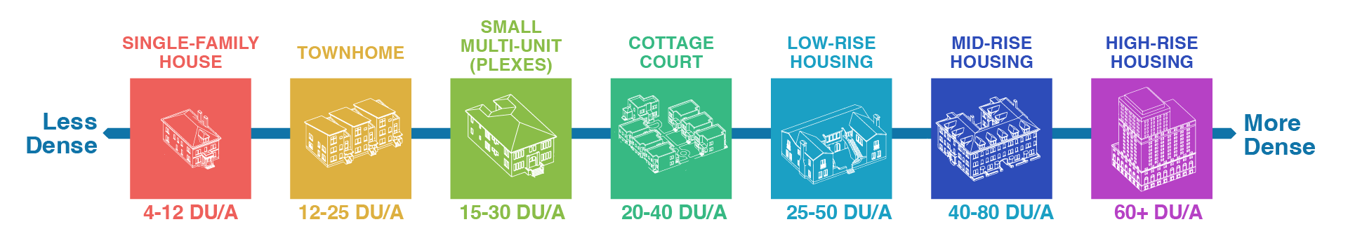
Tools that define what, where and how much:
Zoning and Development Standards
Different densities support different types of housing. A wider range of densities creates more diverse housing options.
Larger families
Older adults, smaller families, local workers
Young adults, friends sharing homes
Notes:
This slide provides a high-level overview of a large and complex set of tools that communities use to determine what kinds of housing can be built, where it can be built, and the amount of it that can be built. It highlights the connection between different density ranges, different housing types, and the different kinds of households that are generally served. You can use this in addition to the housing type slides later in the slide deck to look more specifically at the density ranges and housing types that are the focus of your rezoning effort.

Slide 6
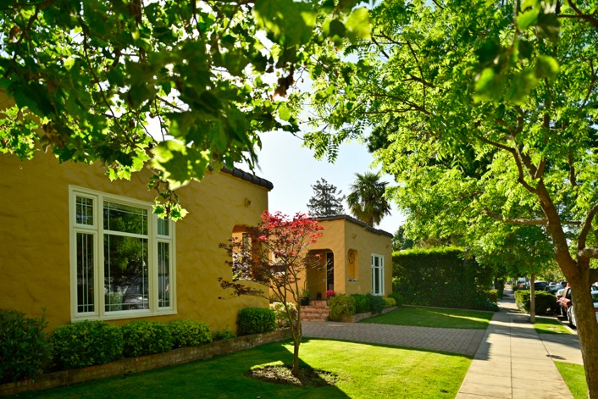
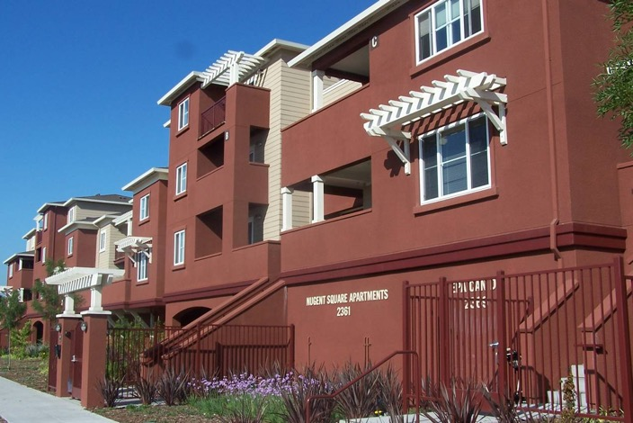
Tools that shape buildings:
Parking, setback, and landscape standards
Parking, setback and landscape standards should be appropriate for the location and type of housing
compared
to
This relatively dense senior housing is set back far from the sidewalk
This four-story housing has a smaller setback and is closer to the sidewalk
Notes:
Zoning and other development standards also help to shape new buildings and how they relate to the street and their surroundings. These tools include things such as setbacks, parking requirements and landscaping standards. The shape of a building and the design of street-facing areas can have a bigger impact on the neighborhood than the actual number of units in the building. These tools can and should consider the cost impact of different requirements. Sometimes development standards can make the type of housing we want to see impossible to build. We need to have a clear vision of the housing we want to see, and then structure our tools appropriately.

Slide 7




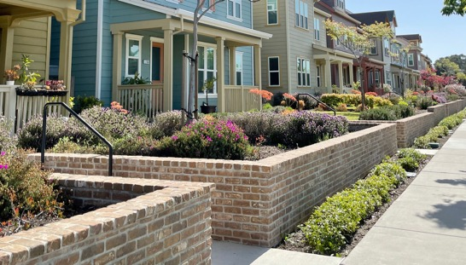
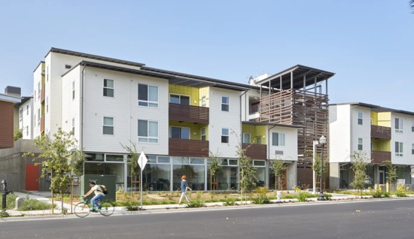
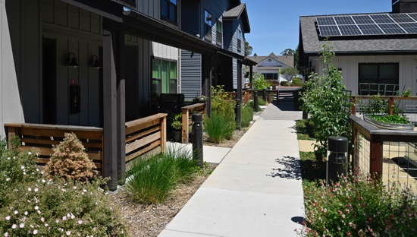
Tools that shape buildings:
Design standards or guidelines
Design tools shape:
the building’s form and materials
where it is located on the property
how it connects to the street and surroundings
Design guidelines help buildings fit their context and improve the street, even if the building contains multiple homes.
Setbacks and street connectivity
Façade, massing, and step backs
Site design and green space
Photo by Bruce Damonte, Courtesy MidPen Housing
Notes:
Design guidelines also help shape buildings and how they fit in their context. This includes green spaces, building architecture and materials, and the public and semi-public spaces around a building, as examples. Under California state law, some developments can only be reviewed using objective standards (i.e., standards that are not open to interpretation). Design tools should also consider the cost impact of different standards to avoid adding to the high price of new homes.

Slide 8



Tools that support affordability:
Density, inclusionary zoning and streamlined review
Zoning and other policies can encourage more affordable housing by:
Allowing smaller homes and more diverse home types
Allowing more density or larger building sizes in return for affordability
Providing a faster and easier review process for new affordable homes
Zoning can also require that new developments include affordable homes or contribute funding to support affordable homes on other sites.
Notes:
Communities also have a number of tools that can be used to support greater affordability—by allowing more homes on a single property (smaller homes are generally more affordable), incentivizing or requiring housing that is affordable to households at different income levels (e.g., inclusionary zoning) and/or providing streamlined review for affordable housing (which is sometimes now required under state law). All of these help to reduce the per-unit cost of housing and facilitate more affordable housing outcomes.

Slide 9

Making Density Work
Catalogue of Housing Types
Notes:
The Catalogue of Housing Types provides slide sets for each of the following housing types:
Townhomes
Small Multi-Unit Buildings (Duplexes, Triplexes, JADUs etc.)
Mixed Use Buildings
Cottage Courts
Low-Rise Housing
Mid-Rise Housing
For each type, several slides are provided:
Overview slide that defines this housing type
Several examples of this housing type from Bay Area communities
A template slide for showing one or more examples from your community.
As always, edit the slides to make them as relevant to your context and project as possible. Also, consult the User Guide for more information on where and how you can find additional images that might be useful in your presentation.

Slide 10

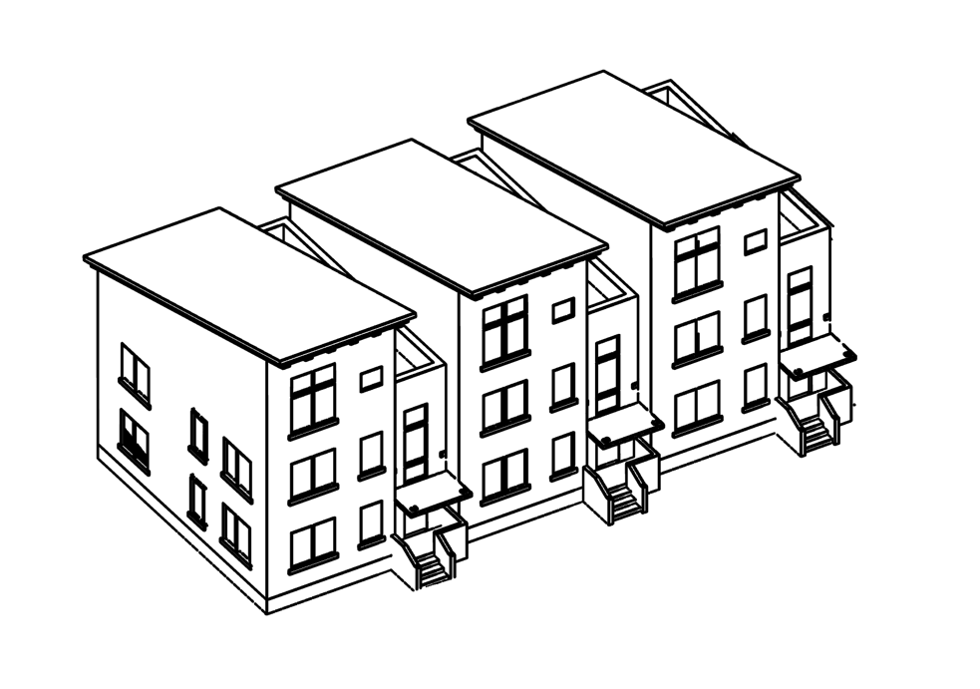
Home Type:
Townhome
CHARACTERISTICS
(Usually) a multi-floor single-family home.
Shares one or two walls with adjacent homes.
Amenities often include:
  Private entrance
  Private outdoor space
  Parking
  Sometimes outdoor space and parking is shared
Can be found in a variety of neighborhood types.
Generally smaller in size and more affordable than a larger, detached single-family home.
What housing needs do townhomes serve?
Are there townhomes in our community today? Where are they?
12-25 homes per acre (DU/A)
Are there places in our community where new townhomes could work?

Slide 11


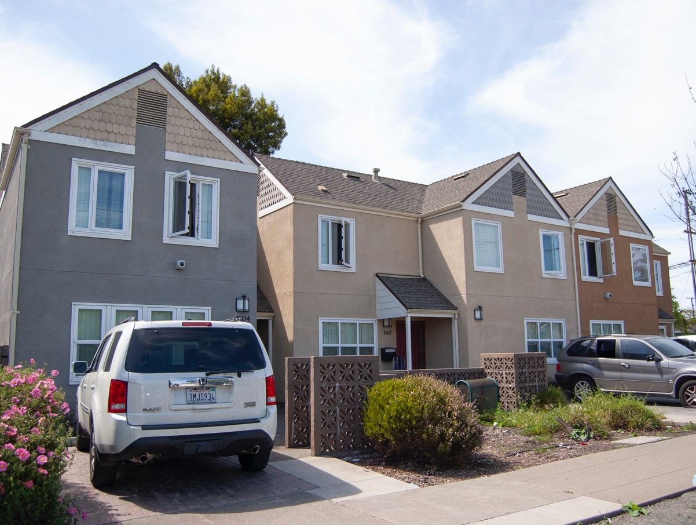



Townhome Example#1
  870 Jones St
  Alameda County
  Affordable housing
  Built 1989
  18 homes per acre

Slide 12
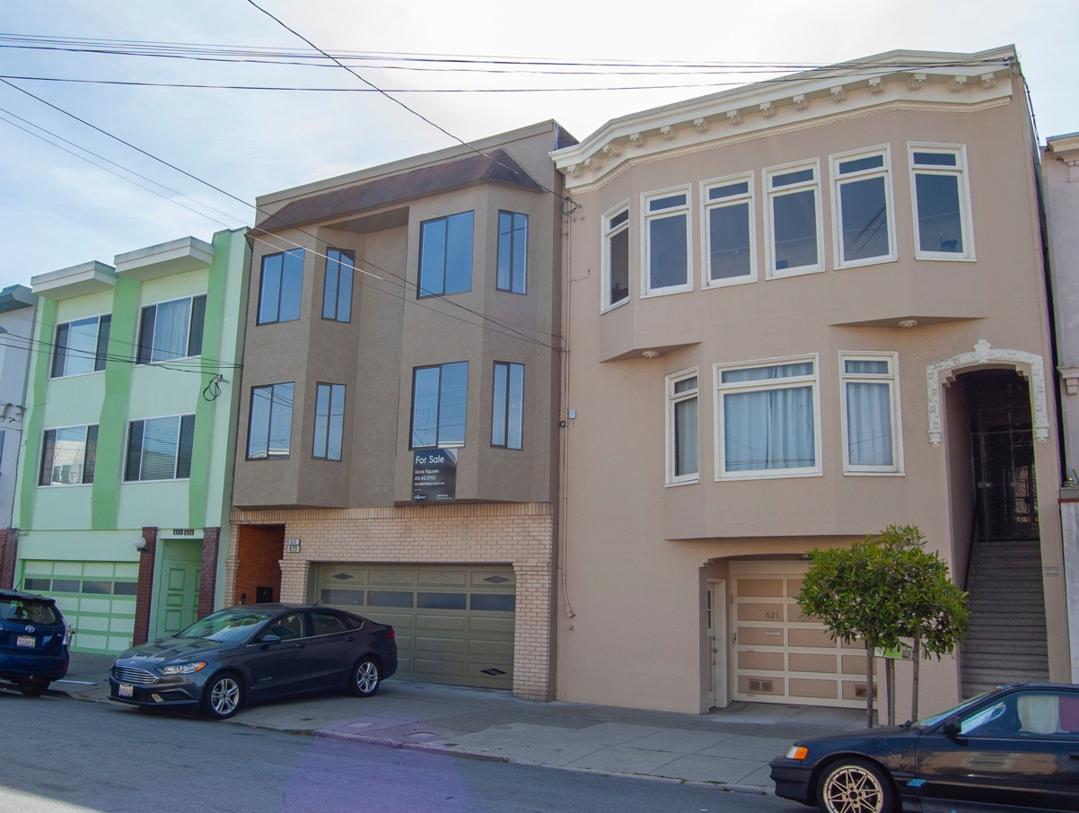
Townhome Example #2
  623 17 St
  San Francisco
  Market-rate housing
  Built 1986
  50 homes per acre

Slide 13

Townhome example from our community
  Address
  Location
  Housing type
  Year built
  ## homes per acre

Slide 14
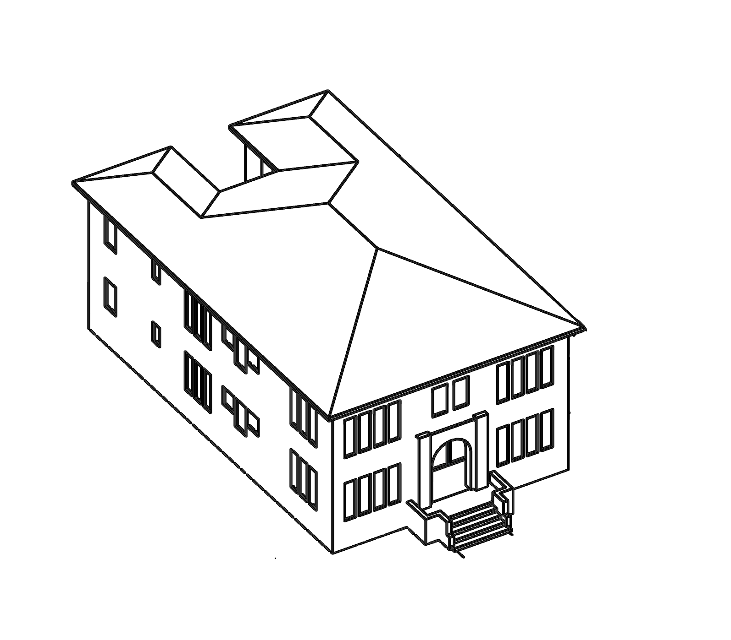
Home Type:
Small Multi-Unit Buildings
CHARACTERISTICS
A smaller building split into multiple units.
Duplexes and triplexes are common, but can be up to eight units.
Smaller units which tend to be more affordable.
Used to be a common housing type in older, walkable neighborhoods.
Sometimes converted from larger single-family homes.
What housing needs do small multi-unit buildings serve?
Are there small multi-unit buildings in our community today? Where are they?
15-30 homes per acre (DU/A)
Are there places in our community where new small multi-unit buildings could work?

Slide 15
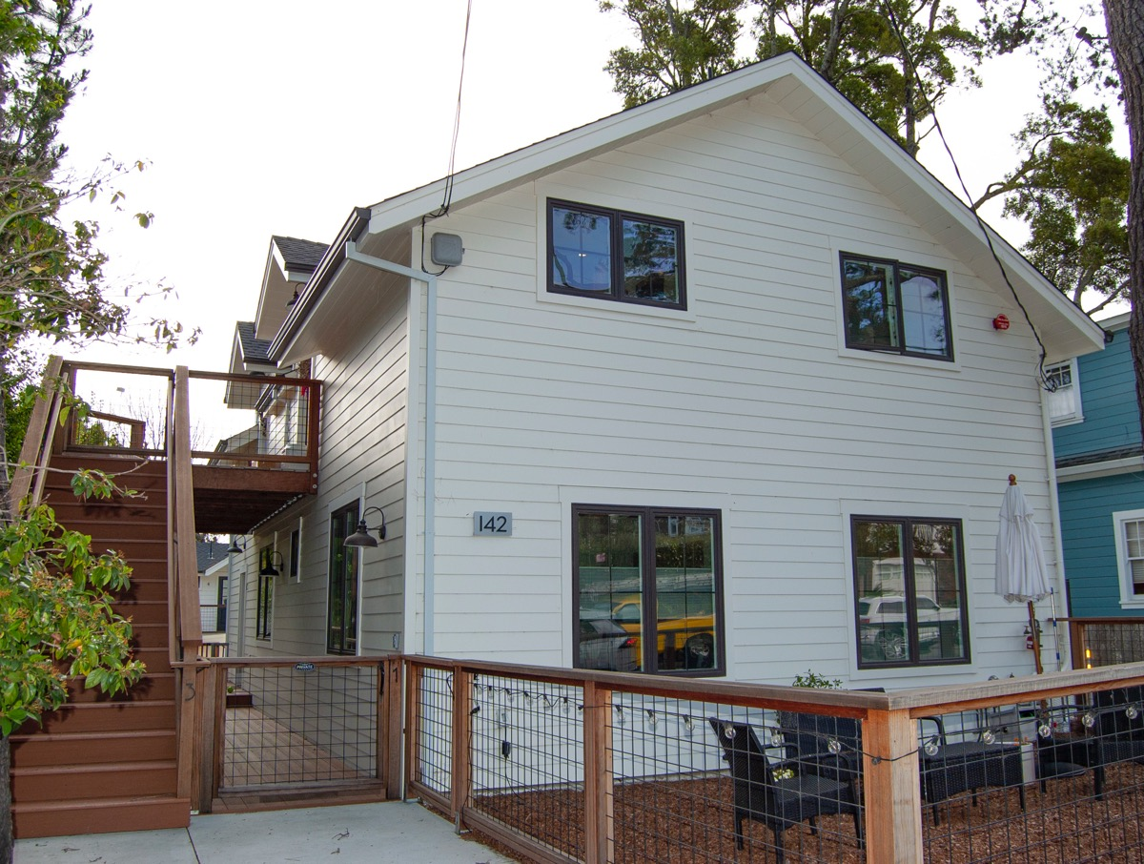
Duplex Example
  142 Willow Ave
  Marin County
  Market-rate housing
  Built 1965
  29 homes per acre

Slide 16
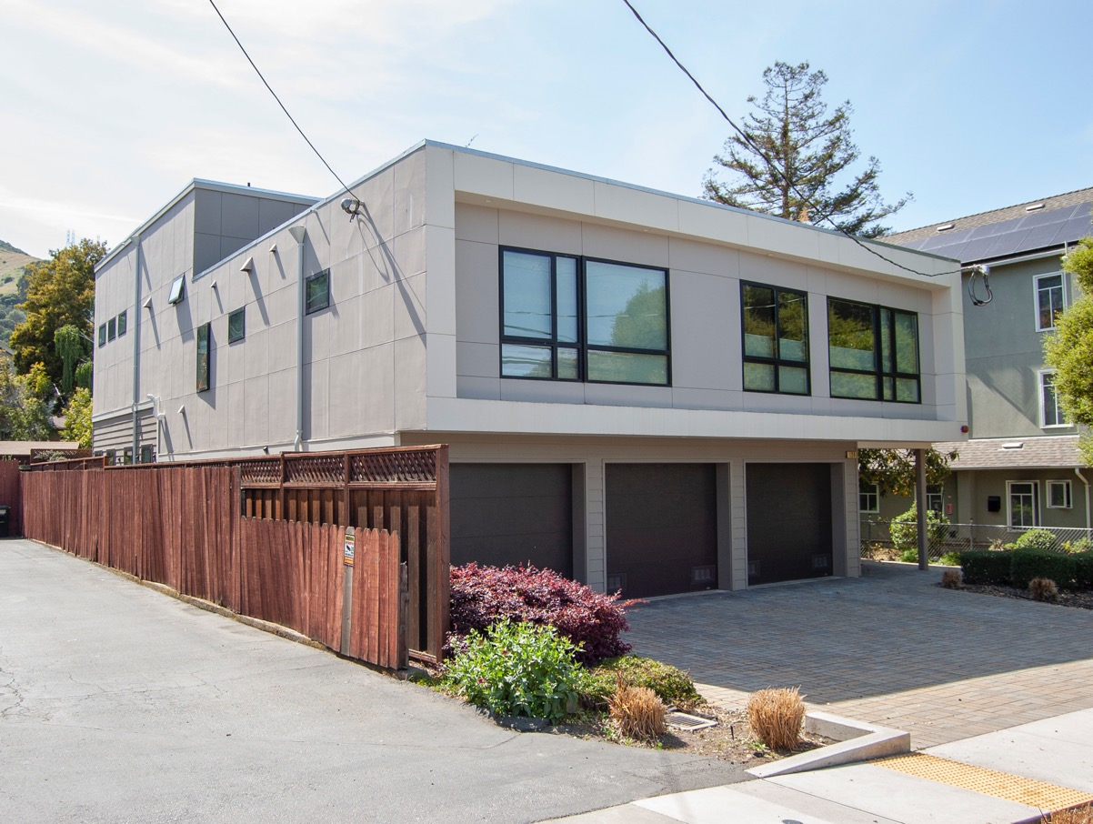
Triplex Example
  124 San Bruno Ave
  San Mateo County
  Market-rate housing
  Built 2019
  23 homes per acre

Slide 17
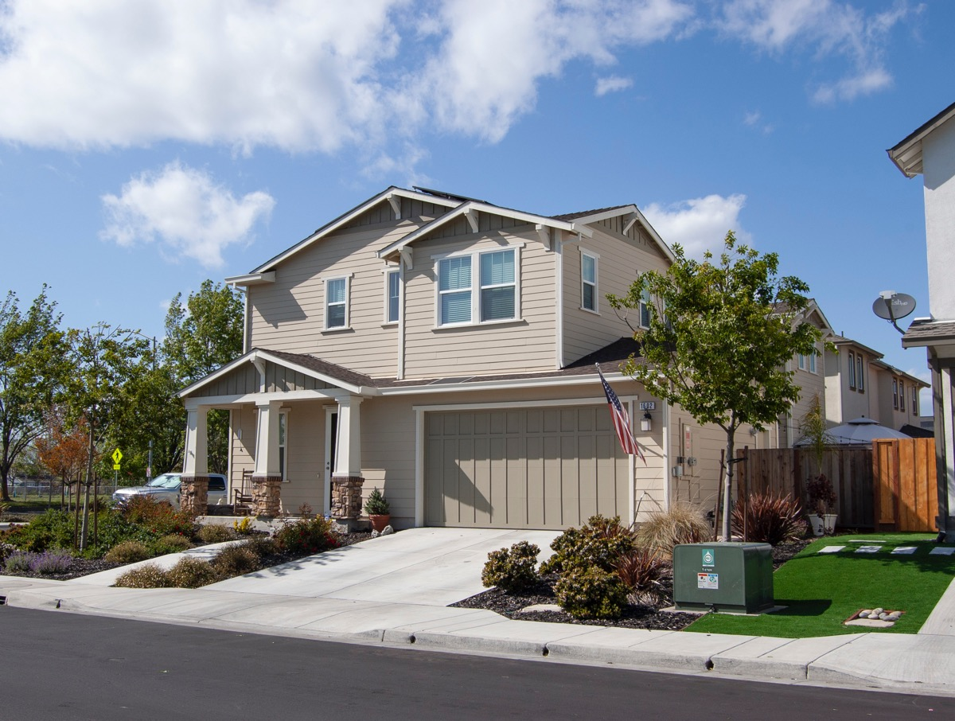
Conversion / JADU Example
  1602 Winterberry Ln
  Sonoma County
  Affordable housing
  25 homes per acre

Slide 18
Example from our community
  Address
  Location
  Housing type
  Year built
  ## homes per acre

Slide 19
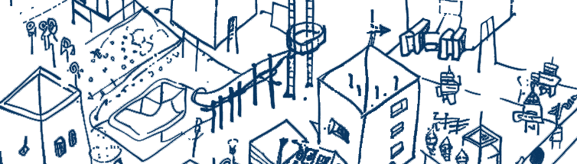
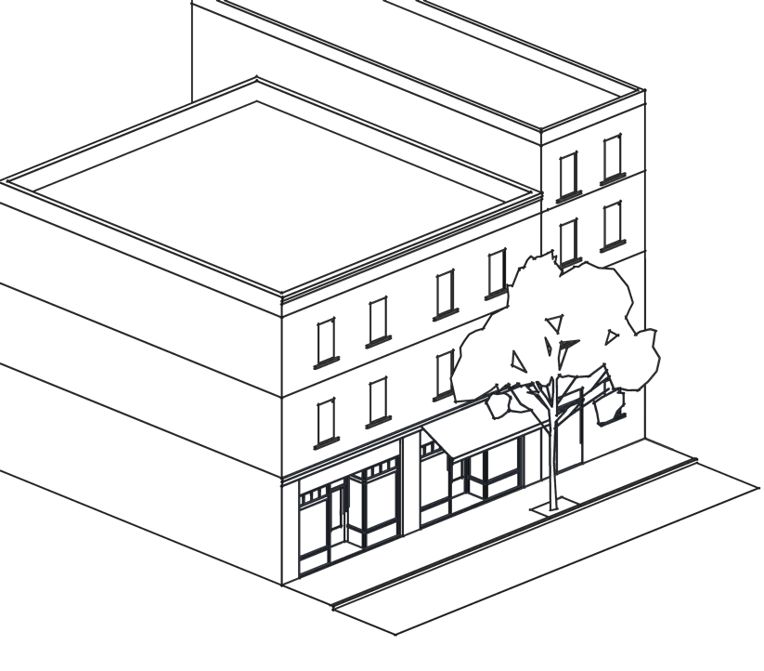
Home Type:
Mixed-Use Buildings
CHARACTERISTICS
Buildings that include housing alongside other uses like offices, shops or restaurants.
Often smaller apartments, but can be larger homes for rent or sale.
Parking can be shared between the homes and businesses, but they are often located in areas that are walkable and served by transit.
Often found in older “main street” neighborhoods, but increasingly included in new developments on commercial streets
What housing needs do mixed-use buildings serve?
Are there mixed-use buildings in our community today? Where are they?
Are there places in our community where mixed-use buildings could work?
Density varies

Slide 20
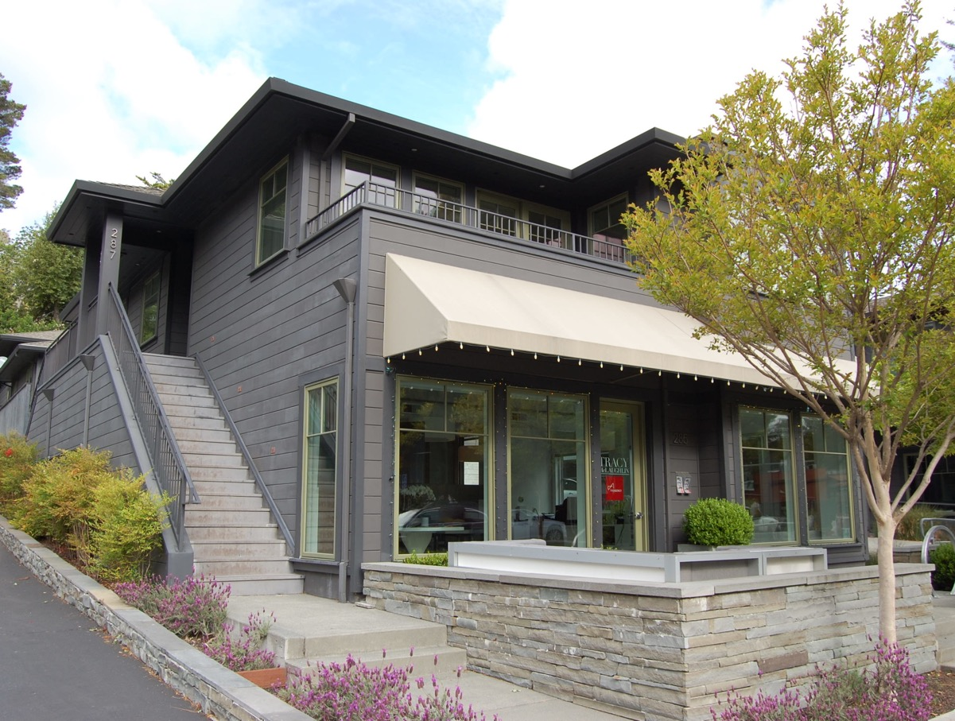
Mixed-Use Example
  285 Magnolia
  Marin County
  Market-rate housing
  11 homes per acre

Slide 21
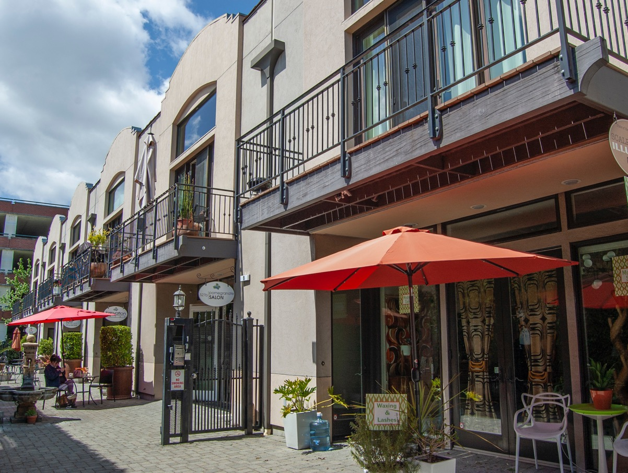
Mixed-Use Example
  527 Mendocino
  Sonoma County
  Market-rate housing
  Built 2005
  4 homes per acre

Slide 22
Mixed-use example from our community
  Address
  Location
  Housing type
  Year built
  ## homes per acre

Slide 23
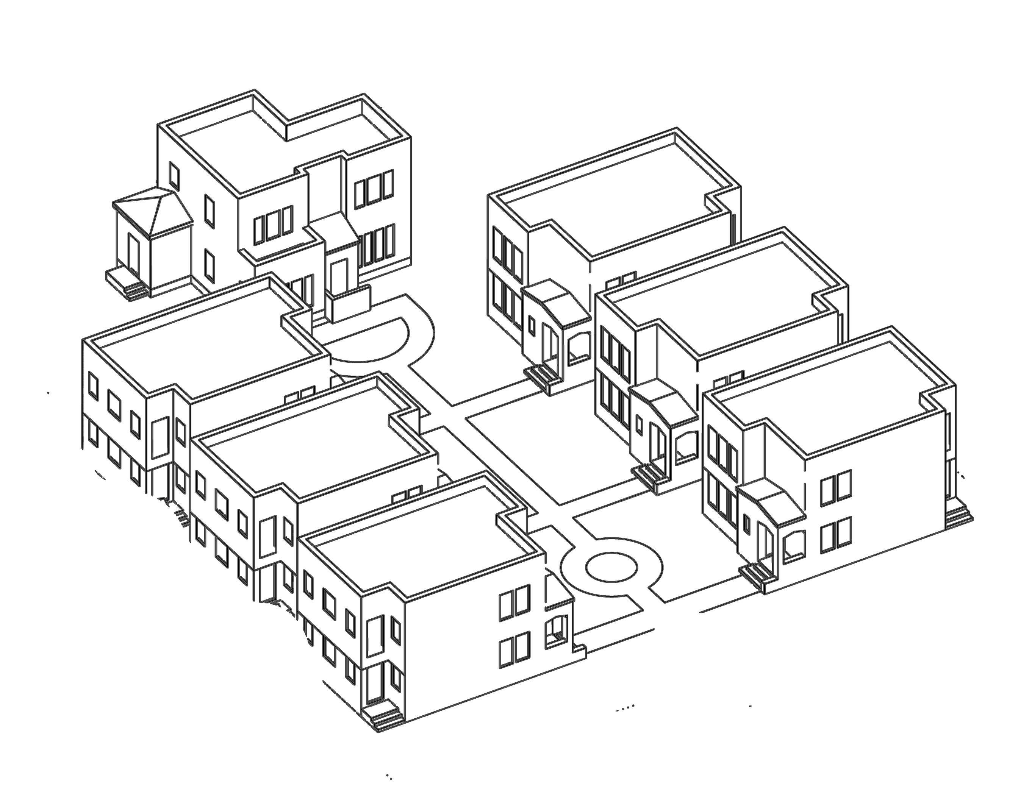
Home Type:
Cottage Courts
CHARACTERISTICS
A cluster of smaller homes around a shared courtyard or small park.
Usually one- or two- story buildings.
Were more common in the first half of the 1900s, but there are more recent examples in some communities.
Sometimes built with other amenities for families to share in addition to green space.
What housing needs do cottage courts serve?
Are there cottage courts in our community today? Where are they?
20-40 homes per acre (DU/A)
Are there places in our community where cottage courts could work?

Slide 24
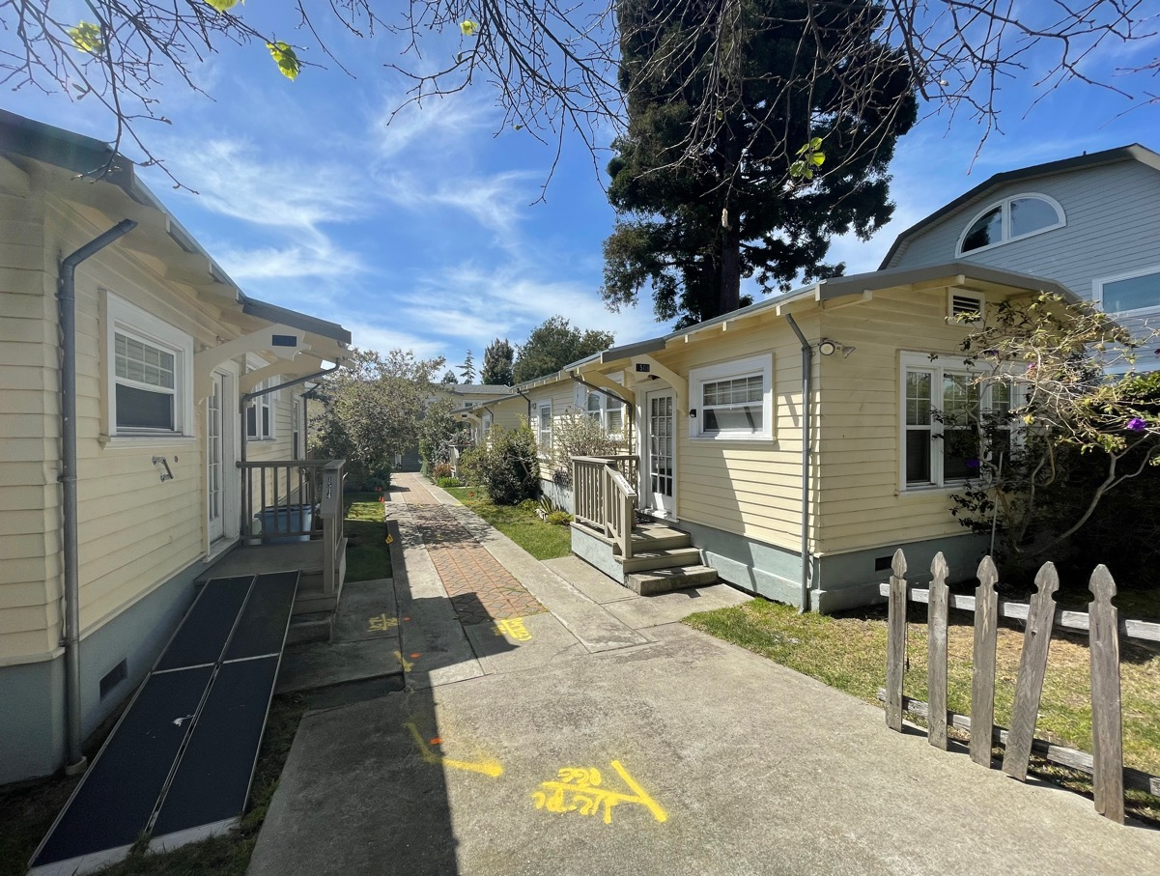
Cottage Court Example
  1508 10th St
  Alameda County
  Market-rate senior
  Built 1926
  30 homes per acre

Slide 25
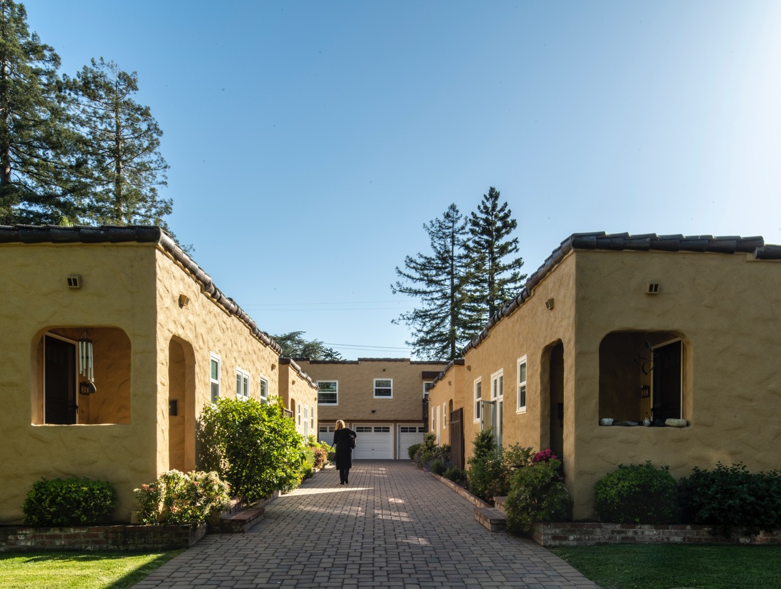
Cottage Court Example
  150 Birch St
  San Mateo County
  Built 1922
  28 homes per acre

Slide 26
Cottage court example from our community
  Address
  Location
  Housing type
  Year built
  ## homes per acre

Slide 27
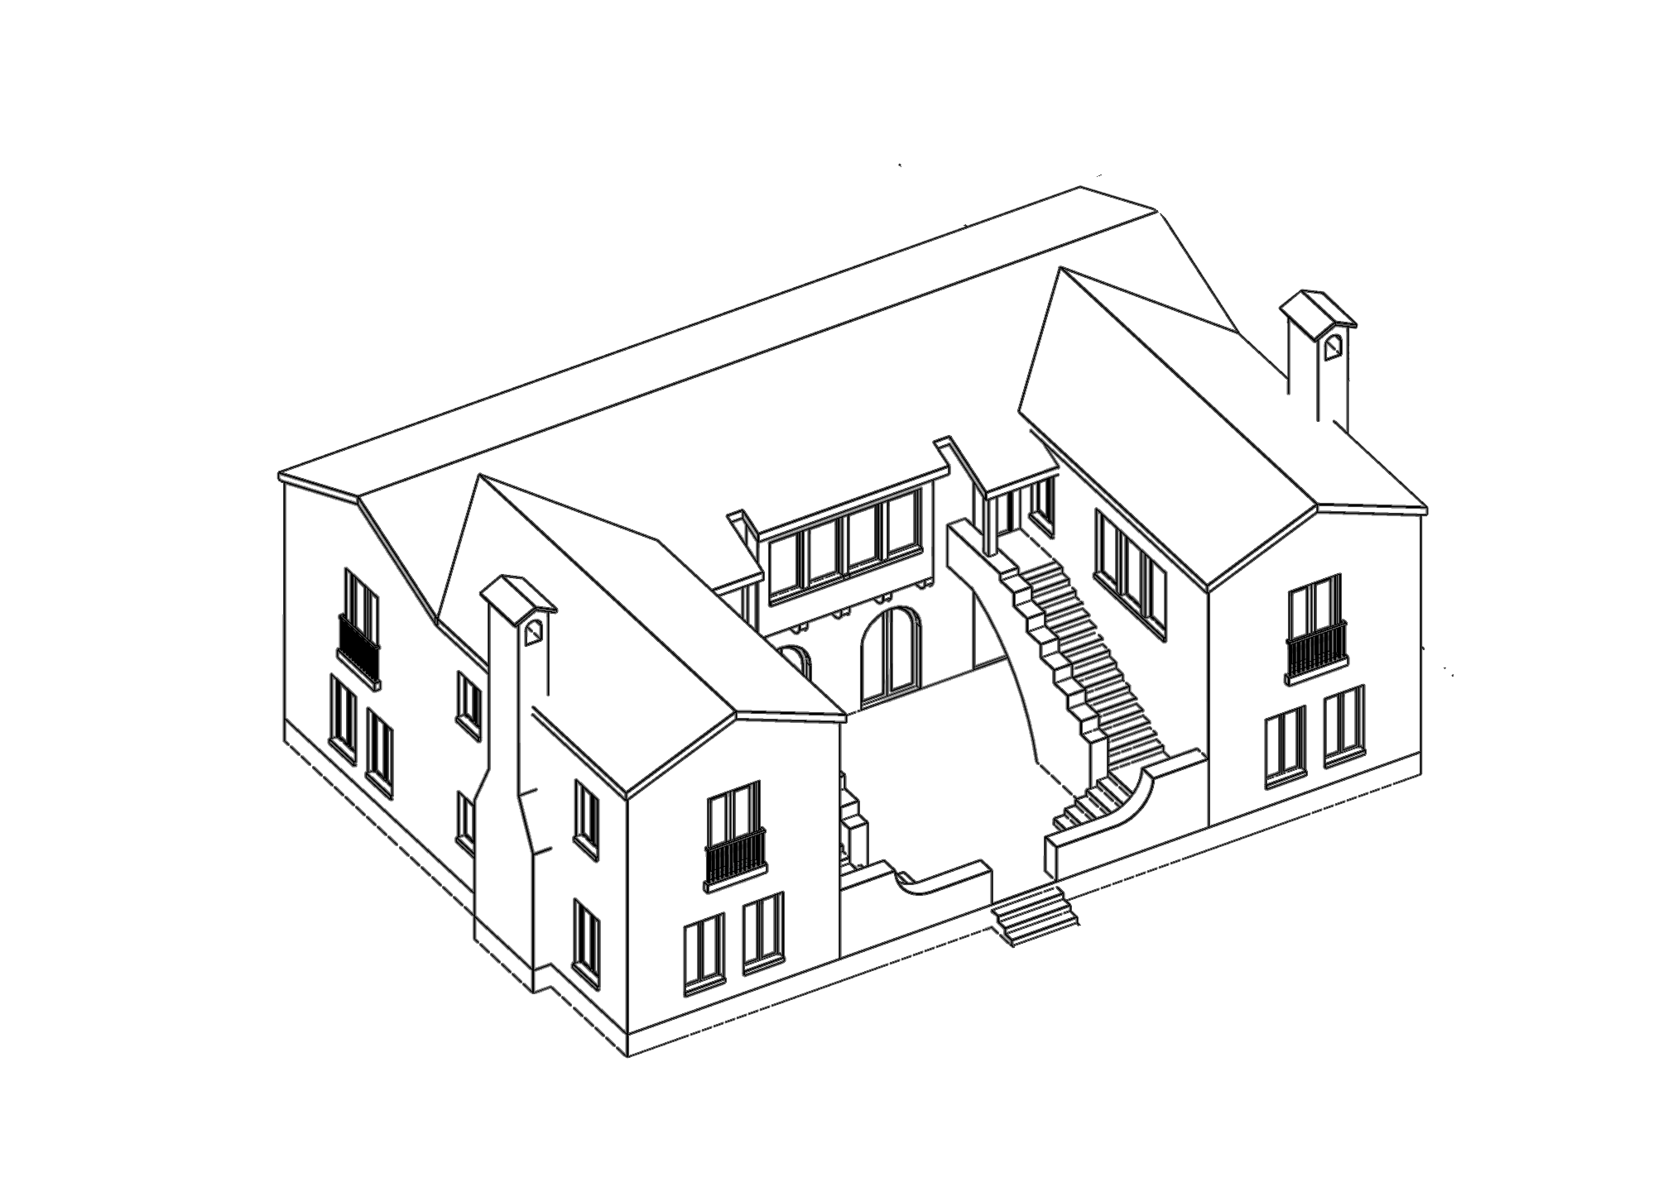
Home Type:
Low-Rise Housing
CHARACTERISTICS
Two- to four-story multi-unit buildings.
Number of bedrooms per unit can vary, from studios to three or even four bedrooms.
Often located in walkable locations near neighborhood shopping districts and close to transit with limited parking.
What housing needs does low-rise housing serve?
Is there low-rise housing in our community today? Where is it?
25-50 homes per acre (DU/A)
Are there places in our community where low-rise housing could work?

Slide 28
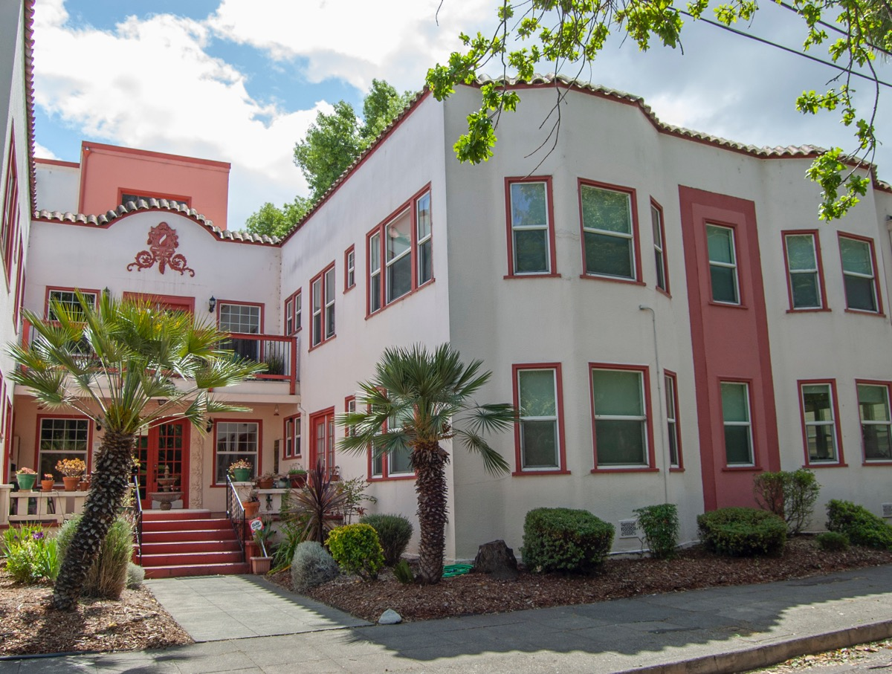
Low-Rise Housing Example
  500 8th St
  Sonoma County
  Market-rate housing
  Built 1933
  35 homes per acre

Slide 29
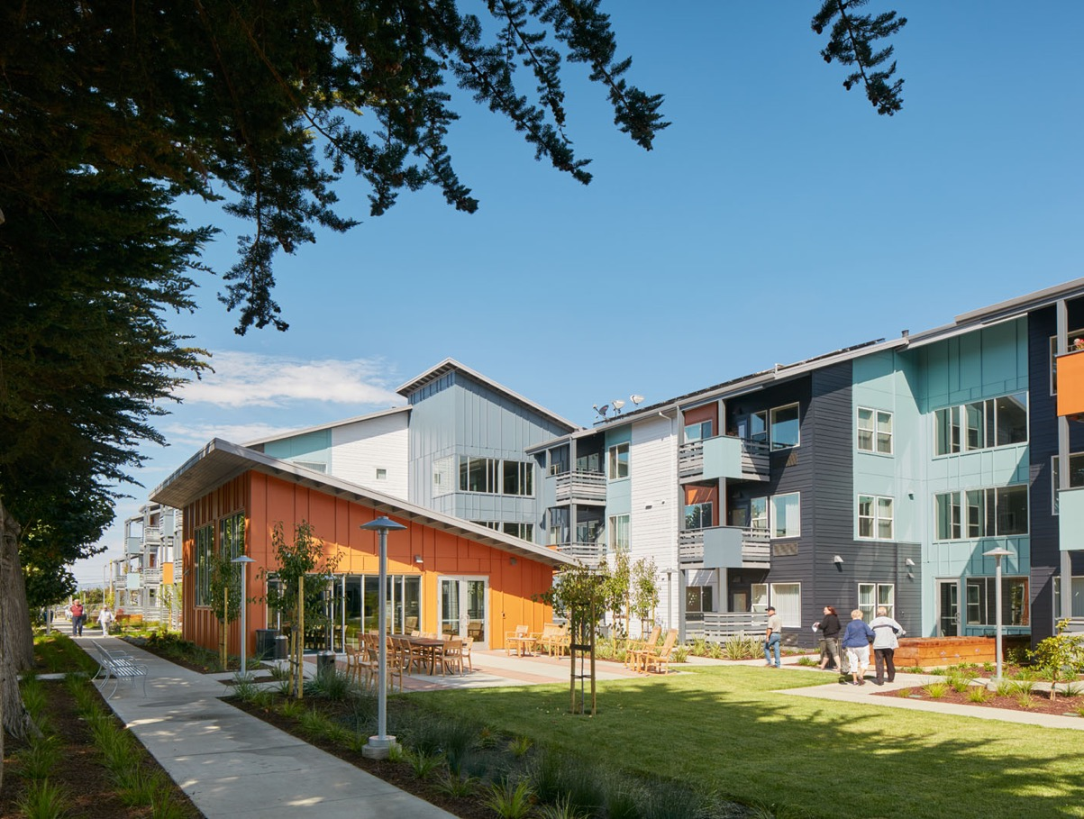
Low-Rise Housing Example
  801 Arnold Way
  San Mateo County
  Built 2015
  Affordable senior housing
  27 homes per acre
Photo by Bruce Damonte, Courtesy MidPen Housing

Slide 30
Low-rise housing example from our community
  Address
  Location
  Housing type
  Year built
  ## homes per acre

Slide 31
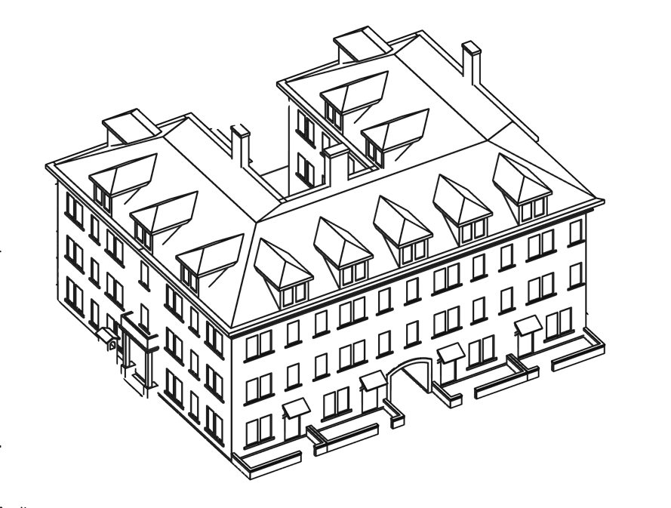
Home Type:
Mid-Rise Housing
CHARACTERISTICS
Four- to eight-story buildings.
Variety of unit sizes, either for-rent or for-sale (apartments or condos).
Often include amenities like covered or structured parking, shared green space and ground-level businesses.
Typically located in walkable, transit-oriented areas where larger buildings are more common, and in transition zones between commercial areas and lower-intensity residential areas.
What housing needs does mid-rise housing serve?
Is there mid-rise housing in our community today? Where is it?
40-80 homes per acre (DU/A)
Are there places in our community where mid-rise housing could work?

Slide 32
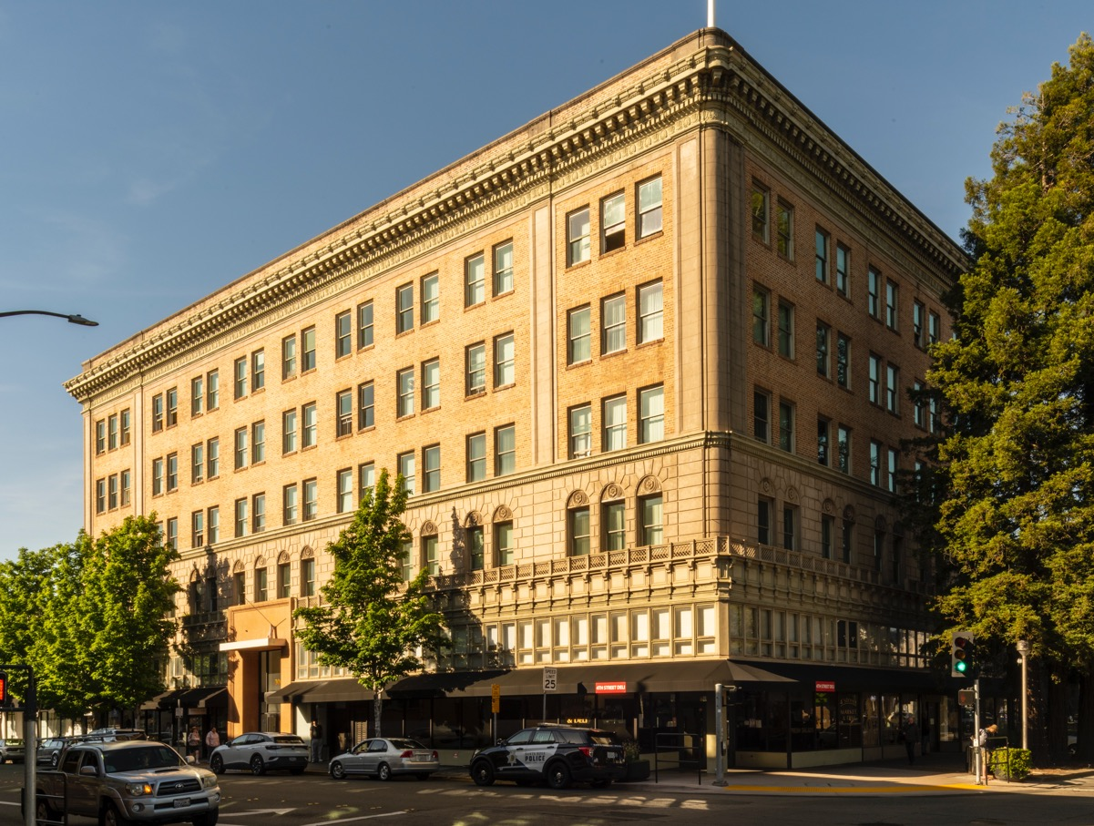
Mid-Rise Housing Example
  306 Mendocino Ave
  Sonoma County
  Affordable senior housing
  Mixed use
  Built 1921
  241 homes per acre

Slide 33
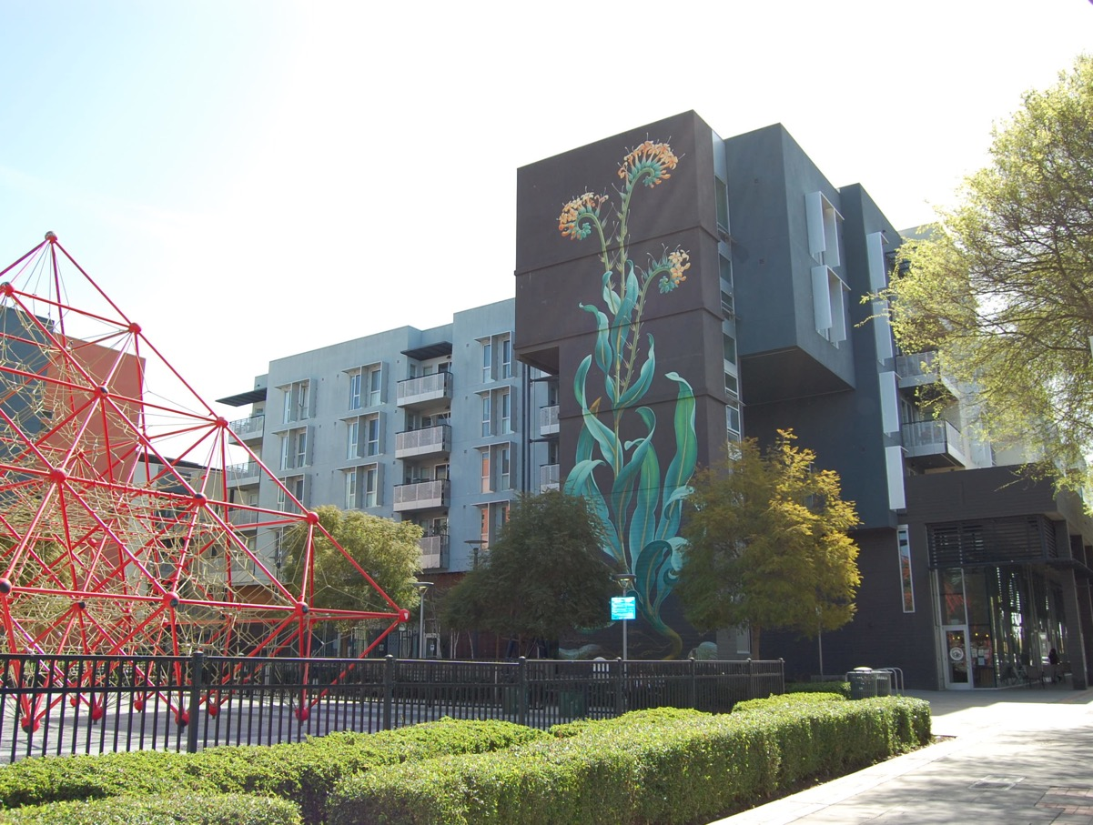
Mid-Rise Housing Example
  Union Flats
  Alameda County
  Affordable housing for families
  Transit-oriented
  Built 2022
  72 homes per acre

Slide 34
Mid-rise apartment example from our community
  Address
  Location
  Housing type
  Year built
  ## homes per acre

Slide 35
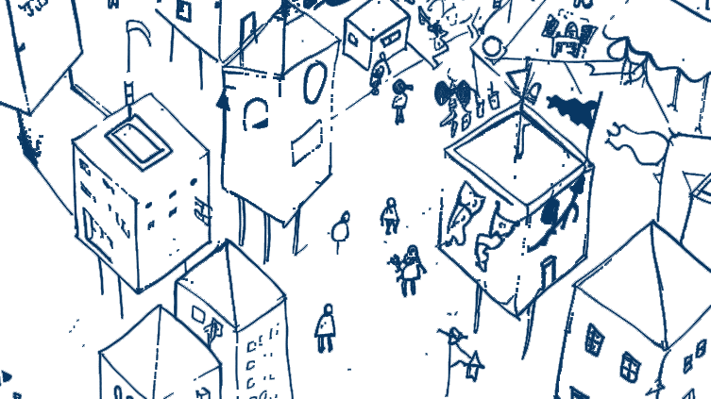
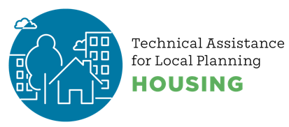


Thanks for joining the conversation!
created by
Notes:
Use this as a closing slide. Feel free to delete the credit logos, and/or add your own.

Slide 36
Postscript
This resource was created to support local government staff in having constructive conversations about housing with their communities.
Related materials, including speaker notes and hi-resolution images, can be found at https://abag.ca.gov/technical-assistance/housing-density-design-resources
All images in this presentation may be re-used. Certain images have a corresponding citation – if re-publishing that image in other contexts, duplicating that citation is required.
Notes:
This slide provides information about the slide deck, other resources, and permissions for using the images in the deck. Delete this slide from your public-facing presentation.
For information about this material, please reach out to:
Clair A. McDevitt
Associate PIO, REAP Programs
cmcdevitt@bayareametro.gov

