Slide 1

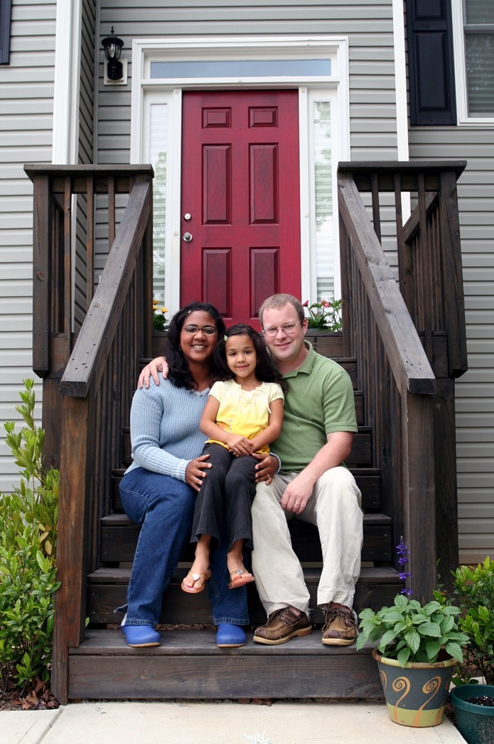
Making
Housing
Happen
Notes:
This slide deck is designed as an introductory presentation to establish a shared understanding of major concepts and to align the discussion of density and zoning with core community values. Language used in this deck should be updated to align with community context and speak directly to community priorities.

Slide 2

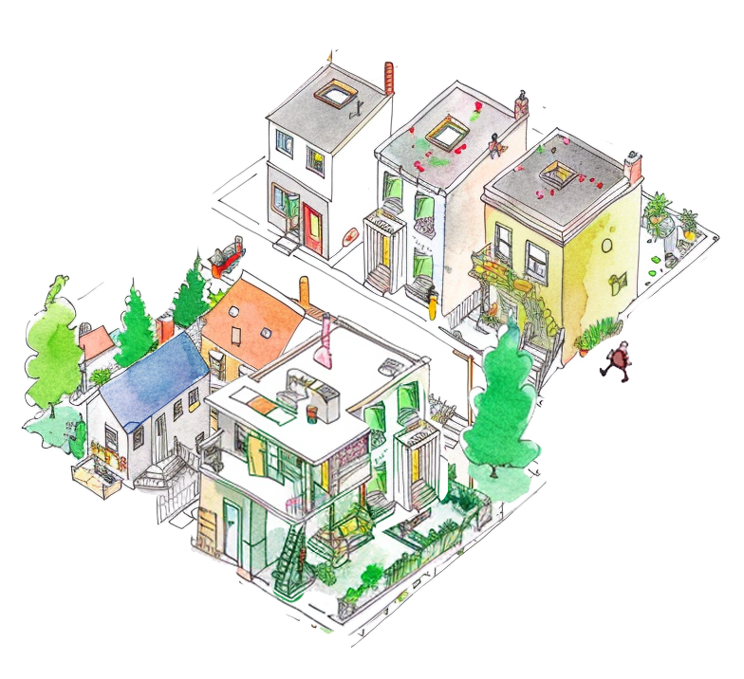





Why Housing Matters
It is where we live, raise our families and grow old.
It supports our workforce and builds our community’s economic health.
It is one of the biggest investments of our lives (for owners and renters).
Depending on where it’s located, it can help reduce trips and traffic congestion.
It is critical to our health and well being.
Notes:
This slide lists some core reasons why having enough housing and diverse housing choices is important. Edit so that the points made resonate with your community members. The illustration shows a diversity of housing types in a “sketch” but you can replace with a photo of a family or local housing, or opt to not have an image.

Slide 3
Why Does Housing Matter to You?
Notes:
Use this slide to prompt conversation about shared community goals and values. The blank boxes on the slide can be used to take notes on the conversation. Depending on your set up, you can do that directly in the slide, in a separate document, or on flipcharts in the room where you’re meeting. To the extent possible, take notes in a way that participants can see you capturing their ideas.

Slide 4

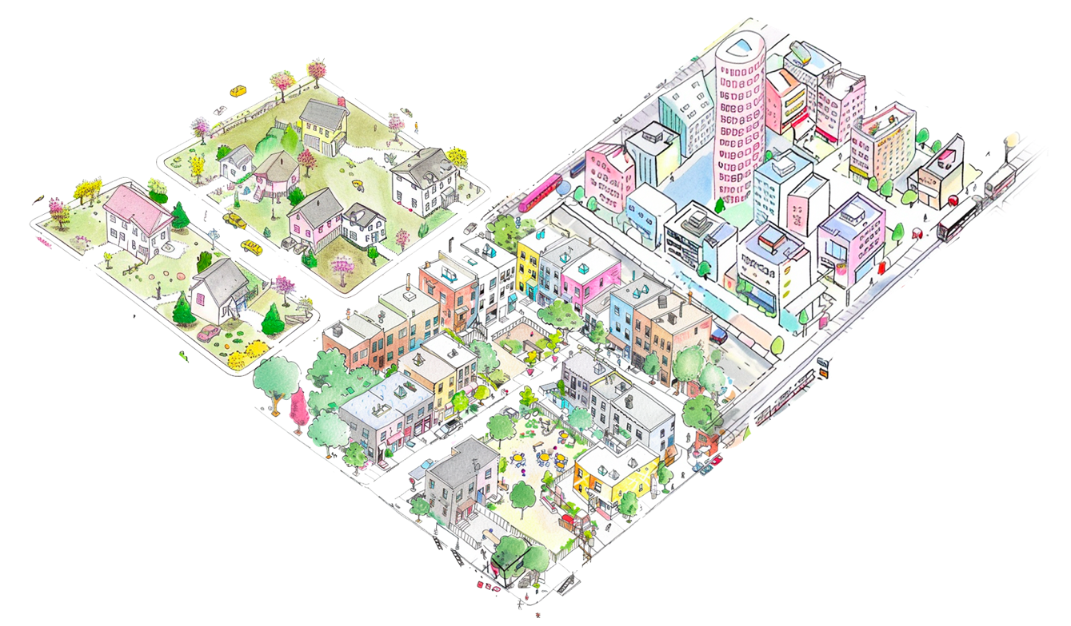
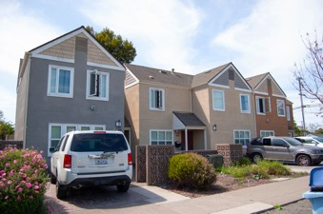
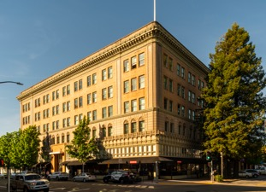
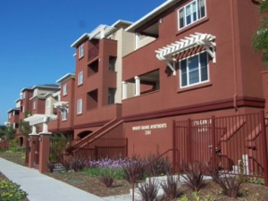
Zoning implements our community’s vision and goals
Zoning is…
The tool we use to define what density can be built in each part of the community, the rules about how large the buildings can be and how they should be designed.
By allowing different densities and more density, zoning can support diverse housing outcomes that meet a wider range of housing needs.
Notes:
This slide briefly explains what zoning is, how it defines the level of density in each area of the community and other rules about how big buildings can be and the uses that are allowed. It is designed for a very general audience. You can change the general images for ones that are specifically from your community or keep them as generic examples.

Slide 5
Density is one part of how we plan our community
Density defines…
The amount of housing and number of people that can live in a particular area.
Different levels of density support different types of housing.
Lower Density Neighborhoods
Single family homes
Duplexes & townhouses
ADUs
Limited transit
Higher Density Neighborhoods
Larger apartment & condo buildings
Mixed-use buildings
Larger retail & offices
Rapid transit
Mixed Density Neighborhoods
Small apartment & condo buildings
Triplexes and townhouses
Smaller retail & offices
Walking, rolling & transit
Notes:
This slide introduces the ways in which “density” is measured, and the connection between density, housing types, other uses and mobility. Think of example areas of your community that you can reference as examples.

Slide 6
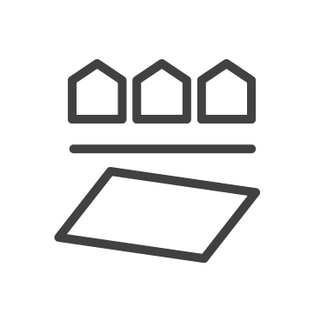

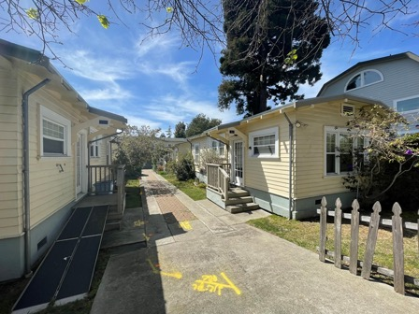
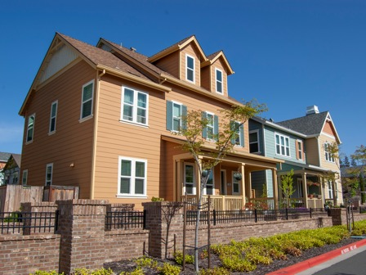

Density can be measured in different ways
Measures of density can include…
Usually "higher density" means more housing, more people and bigger buildings. But sometimes density can surprise you!
Housing units per acre
People per
square mile
Size of buildings on their lots
Cottage courts
6 small units on 0.2 acres = 30 homes per acre (DU/A)
Single-family homes
144 large units on 16 acres = 9 homes per acre (DU/A)
Notes:
This slide shows some different ways that density can be measured. Housing units per acre is the standard measurement, but people per square mile is an opportunity to discuss overcrowding, and units per building is an opportunity to talk about building design and construction costs. The side-by-side example is an opportunity to show that higher density buildings are not necessarily larger.

Slide 7
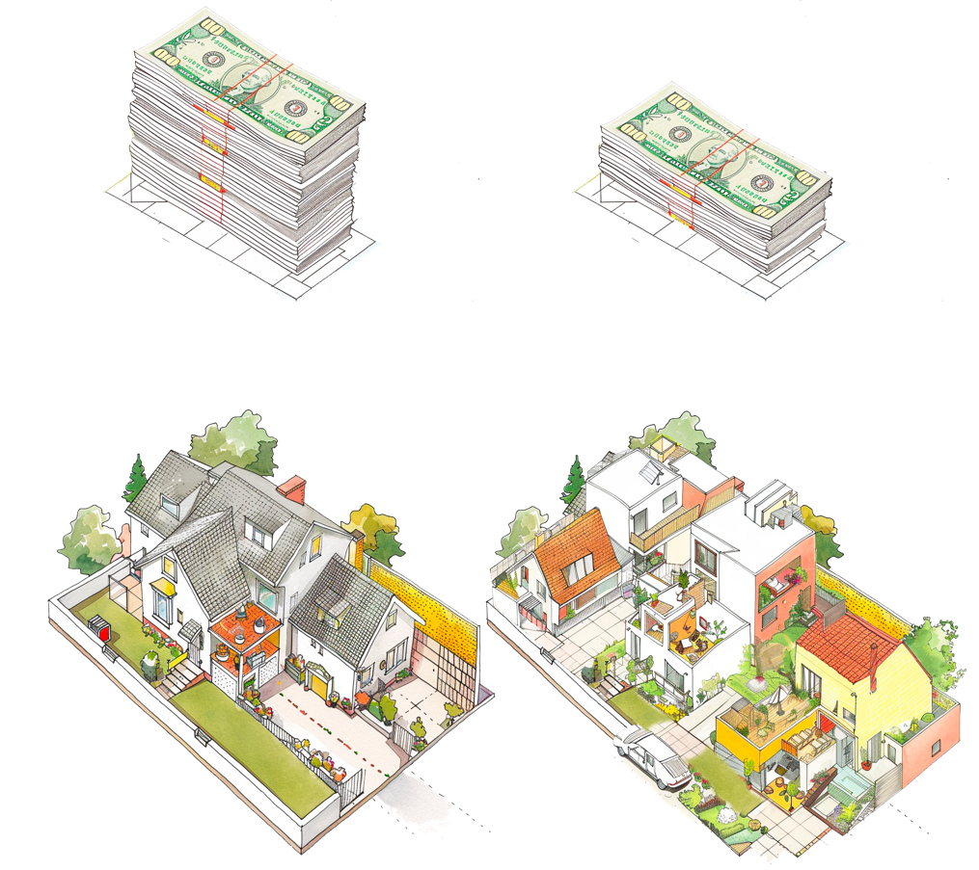
Density can also support more housing affordability
Land and construction costs are expensive
Increasing density allows the cost to be shared across multiple homes
1 home =
higher cost per square foot
4 homes =
lower cost per square foot
Creating more affordable housing!
Notes:
This slide provides a high-level overview of how density can help support affordability by allowing land and construction costs to be shared over more units. In your comments, you can acknowledge that high density developments can be expensive, too. But even in expensive buildings, the smaller units are more affordable than the larger ones, because cost-per-square-foot matters.

Slide 8

How does zoning affect housing affordability in our community?
[Example Neighborhood Name]
Density allowed by zoning: XX DU/A
Average home price: $XXX,000
[Example Neighborhood Name]
Density allowed by zoning: XX DU/A
Average home price: $XXX,000
Notes:
Use this slide to cite local examples of different density levels and the relationship to affordability. Local examples help your audience ground the conversation in tangible experiences of neighborhood character and cost. Choose two neighborhoods that best illustrate your intended message and add details to the placeholder boxes. This can be two neighborhoods with drastically different densities, or two neighborhoods where higher density is working well.

Slide 9
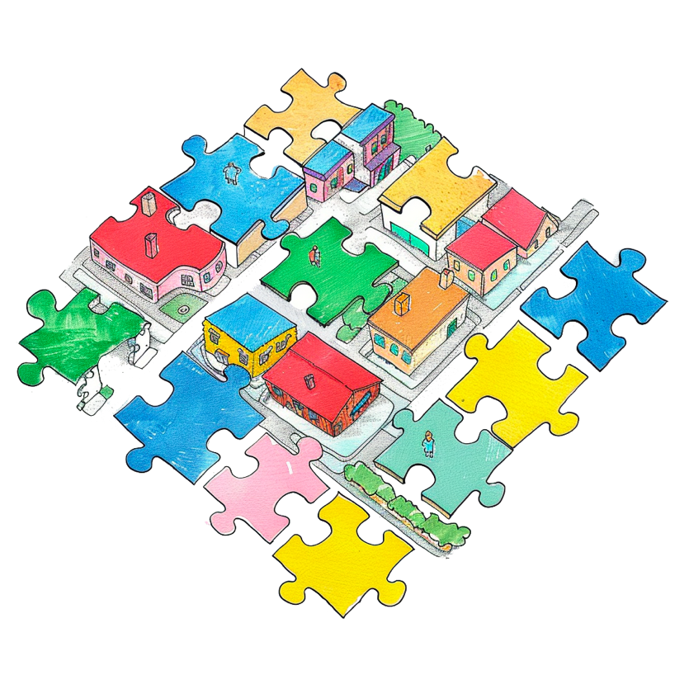

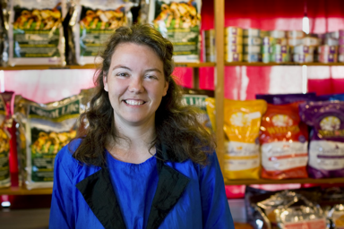
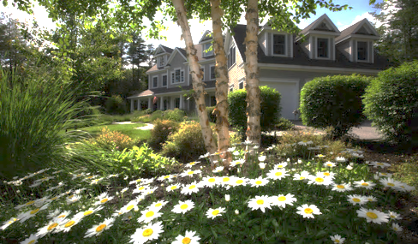
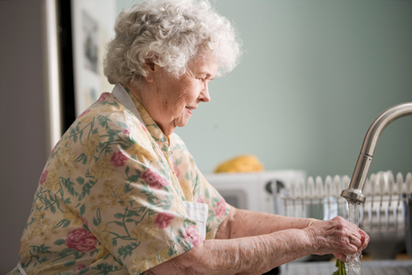
Rezoning to higher densities gives us more options for:
Housing our families, neighbors and workforce
Supporting our local workers and businesses
Creating more homes close to green space, jobs and other amenities
Improving affordability and reducing the cost of living
Notes:
This slide connects back to the important theme of supporting local families, seniors and workers who need housing as well as supporting other important community priorities. Edit as needed to connect back to points you made in Slide 2 and bring up points that people made in response to Slide 3.

Slide 10
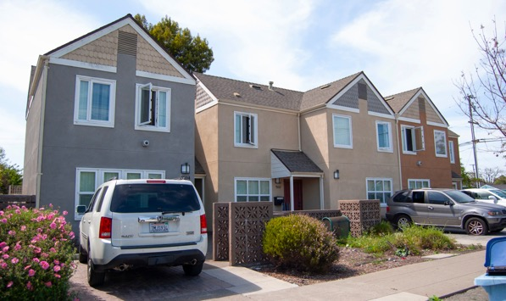
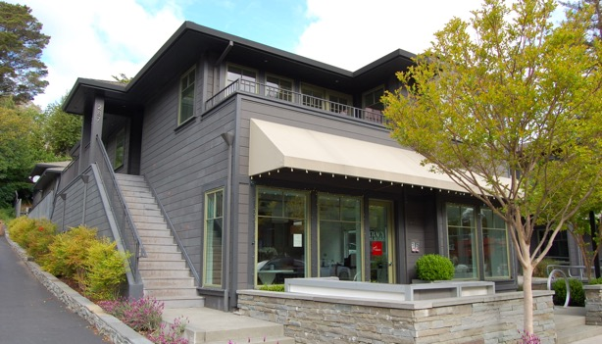
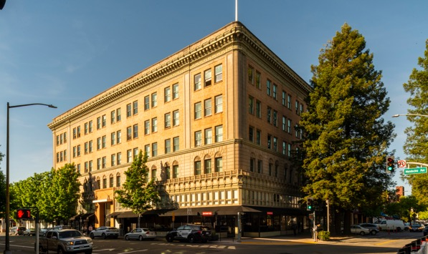








New homes can take many forms
Affordable townhomes
  870 Jones St.
  Alameda County
  Affordable housing
  18 units per acre
Mixed use with homes
above shops
  285 Magnolia Ave.
  Marin County
  Market rate
  11 units per acre
Larger buildings with many smaller homes
  306 Mendocino Ave.
  Santa Rosa
  Senior + affordable
  ~200 units per acre
Different kinds of housing serve different kinds of households.
Who in our community needs housing?
Notes:
This slide can be used to make the point that zoning at different densities can expand the range of housing choices to meet the full range of housing needs. A prompt question is provided to invite audience input. You can use these examples from communities around the Bay Area or replace them with ones specific to your community. Slide 10 can also be used to present local examples, and the Activity 2 slide deck (Housing Choices for a Better Future) can be used for a more in-depth group conversation about housing choices.

Slide 11


An example from our community
[Housing type] in [Neighborhood]
  [Density] homes per acre (DU/A)
  [Market rate/Affordable/Senior]
  [Year built]
Benefit/amenity 1
Benefit/amenity 2
Benefit/amenity 3
Notes:
This slide template can be used to present local examples of the different forms that higher density buildings can take. Pick projects or buildings that are generally well-liked and contribute to community goals like housing diversity or walkability. Examples can be recent or ones that have been around for decades—whatever will best help you make the point that denser housing can fit into the community context and create desirable housing choices.

Slide 12

Common concerns about density
Notes:
This last section is provided to help respond to common concerns people raise about adding more density in your community. You can delete them, modify them, or add to them to address concerns you have been hearing from community members.

Slide 13
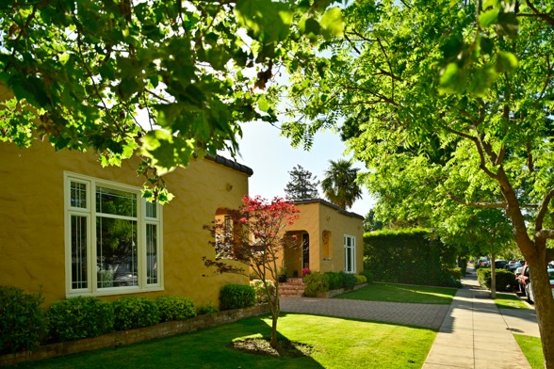
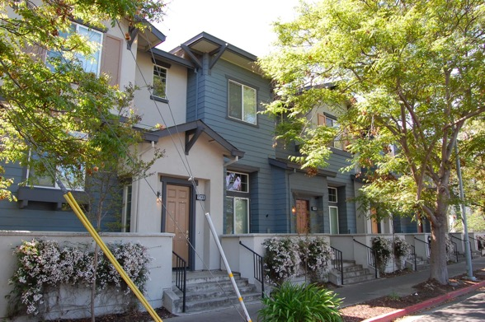
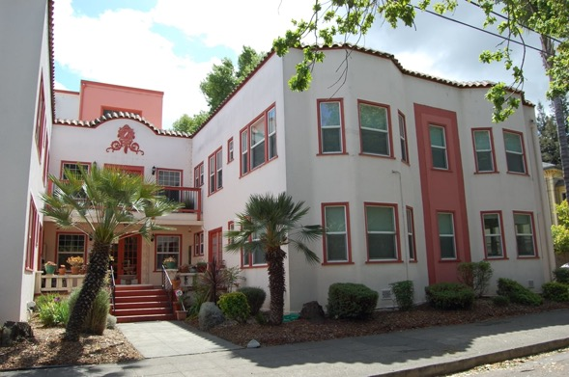
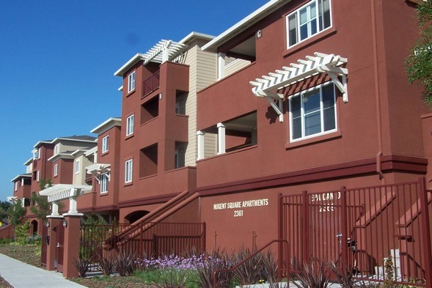
Will higher density buildings fit in our community?
Multi-unit homes can take many forms and be designed to fit in their context, whether low density, medium density or high density.
Density does not determine building style -
Design does.
Cottage Courts
Modern Rowhomes
Small Multi-Family
Larger Multi-Family
Notes:
This slide helps make the point that density alone does not dictate building form. A collection of small cottages can have an effective density that is quite high even though they look small, while a single family home can be low density, but quite large. Yes – higher densities will generally be coupled with greater building height and bulk. But our design and development standards are an important part of making sure buildings fit in. Shift to local images if helpful or use these examples from other Bay Area communities.

Slide 14
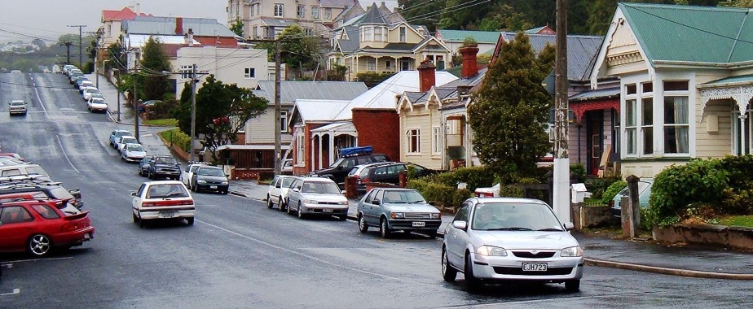
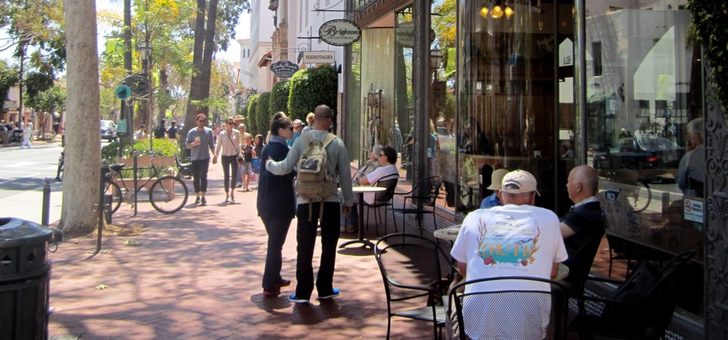
Won’t density impact parking & traffic?
Lower density housing…
Requires more and longer car trips to work, school and the store.
Makes owning a car a necessity (many single-family homes have two or more cars).
Higher density housing…
Puts people closer to jobs, school,
shopping and other destinations.
Allows some trips to be walking or rolling, bike rides or by transit.
Owning a car is optional (many higher density homes have only one car).
”City Streets” by Mr. Thinktank CC BY 2.0 DEED
”Friendly Neighborhood in CA” by La Citta Vita CC BY-SA 2.0 DEED
Notes:
It is true that adding more housing will add more people and, very likely, more cars. But it’s also true that higher density housing creates less traffic per capita than lower density housing. An important part of the density-and-traffic conversation is where homes are located and whether the people who live in those places are able to drive less, or even not at all. Most likely your community is currently impacted by people having to drive long distances, including people who work in your community but live elsewhere and commute because they can’t find a nearby place to live.

Slide 15
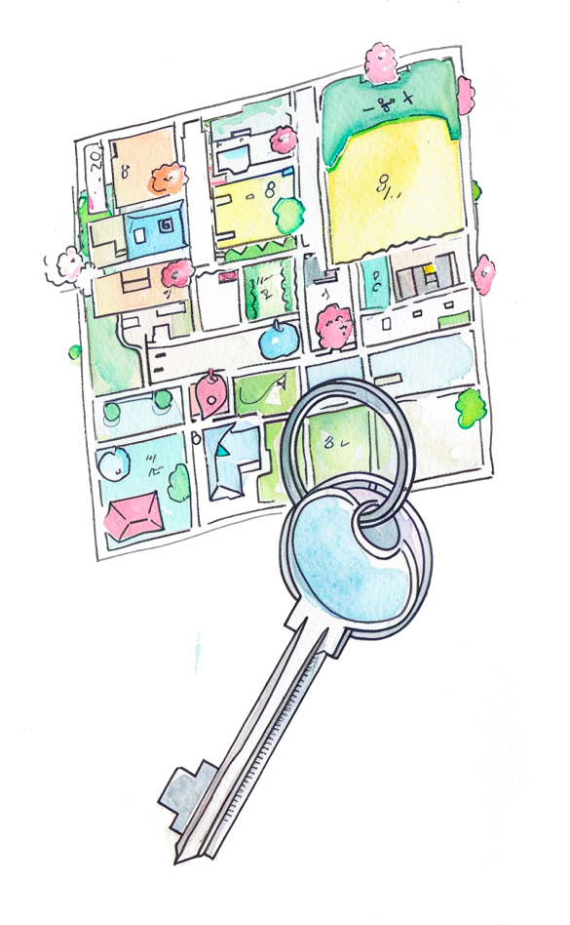
Will higher density buildings impact prices?
A reason homes are expensive because we don’t have enough to meet our needs.
New homes are expensive to build. New home prices and rents often reflect that.
There is a lot of competition for too few homes, so even older homes can be rented or sold for more.
Local programs and services can help support vulnerable residents as new homes are built.
Building more diverse housing types can help reduce prices and rents over time.
Older homes can be “freed up” as people move into new units.
Empty nesters can move out of larger homes into smaller homes close by.
Over time, supply is in better synch with demand.
Notes:
This slide helps make the point that the primary driver of high housing prices is inadequate supply to meet demand. While it is true that many recently-built homes are expensive, that is largely because building new homes is also expensive. The slide provides a number of points related to drivers of housing costs and the importance of creating more housing. Edit the list of key points to make it as specific to your community as possible.

Slide 16
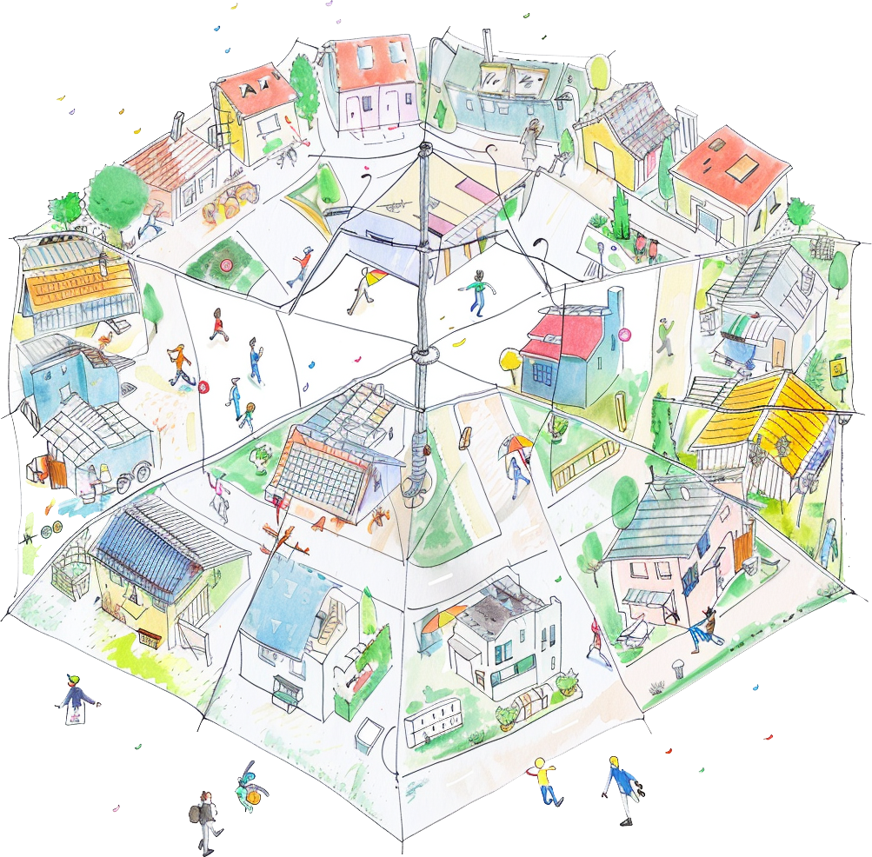
What will density mean for our sense of community?
Community is…
Preventing displacement – keeping our neighbors housed
Welcoming new neighbors
Supporting local workers
Increasing opportunities for local businesses
Adding more housing choices can help build a more inclusive, vibrant and sustainable community
Notes:
There are understandable concerns about the loss of community character or even the loss of sense of community due to growth and development. This slide underscores a primary theme of this deck, connecting the need for more housing to the understanding of what community is: the people. While we could keep all of our buildings exactly the same as they are today, that wouldn’t maintain the community. By creating more housing to provide more housing choices and support affordability we can actually strengthen and sustain community.

Slide 17
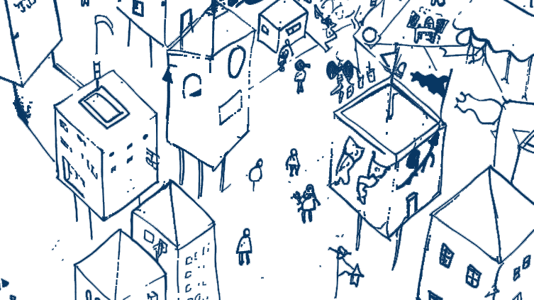
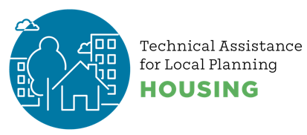


Thanks for joining the conversation!
created by
Notes:
Use this as a closing slide. Feel free to delete the credit logos, and/or add your own.

Slide 18
Postscript
This resource was created to support local government staff in having constructive conversations about housing with their communities.
Related materials, including speaker notes and hi-resolution images, can be found at https://abag.ca.gov/technical-assistance/housing-density-design-resources
All images in this presentation may be re-used. Certain images have a corresponding citation – if re-publishing that image in other contexts, duplicating that citation is required.
Notes:
This slide provides information about the slide deck, other resources, and permissions for using the images in the deck. Delete this slide for public-facing presentation.
For information about this material, please reach out to:
Clair A. McDevitt
Associate PIO, REAP Programs
cmcdevitt@bayareametro.gov

