Slide 1

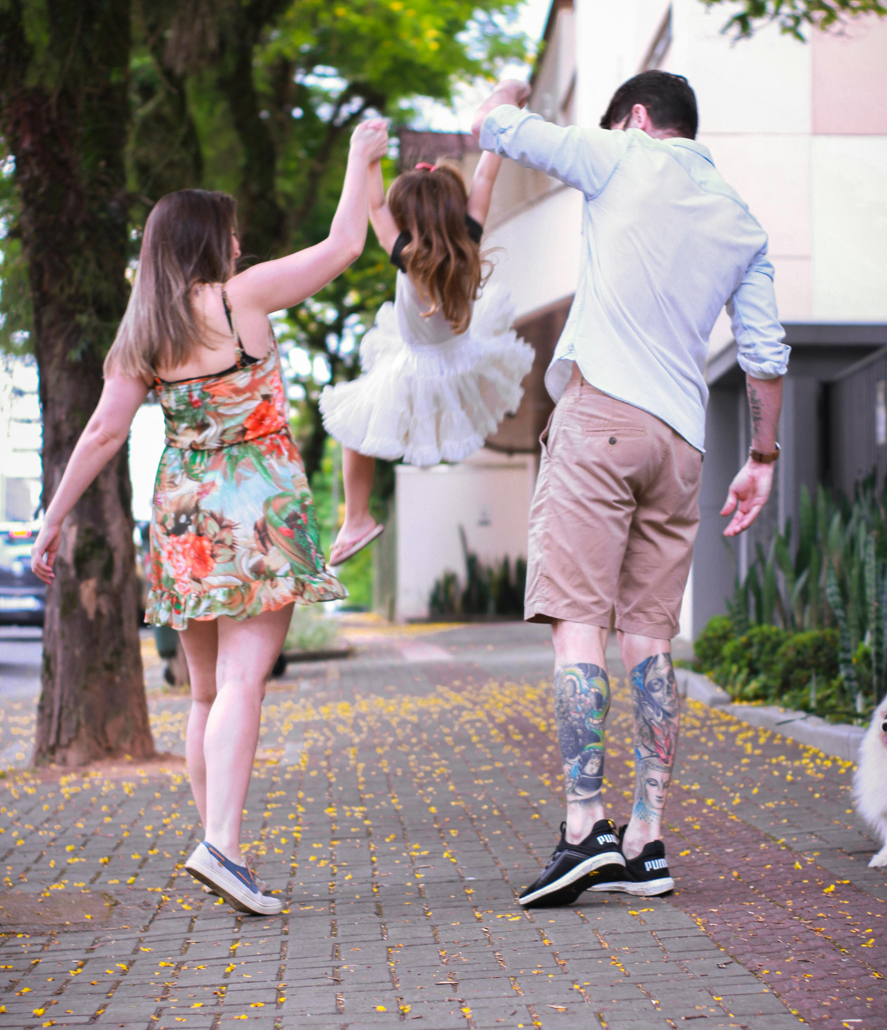
Housing Choices for a Better Future
Envisioning the Future We Want
Notes:
This slide deck provides the structure for engaging community members in a conversation about how housing can help to create the future we want. It strives to help people understand that change is inevitable, but that we have the opportunity to shape the change that we want. It underscores that conversations about development, growth and zoning are conversations about people: the friends, family and neighbors we want to be a part of our community into the future.

Slide 2





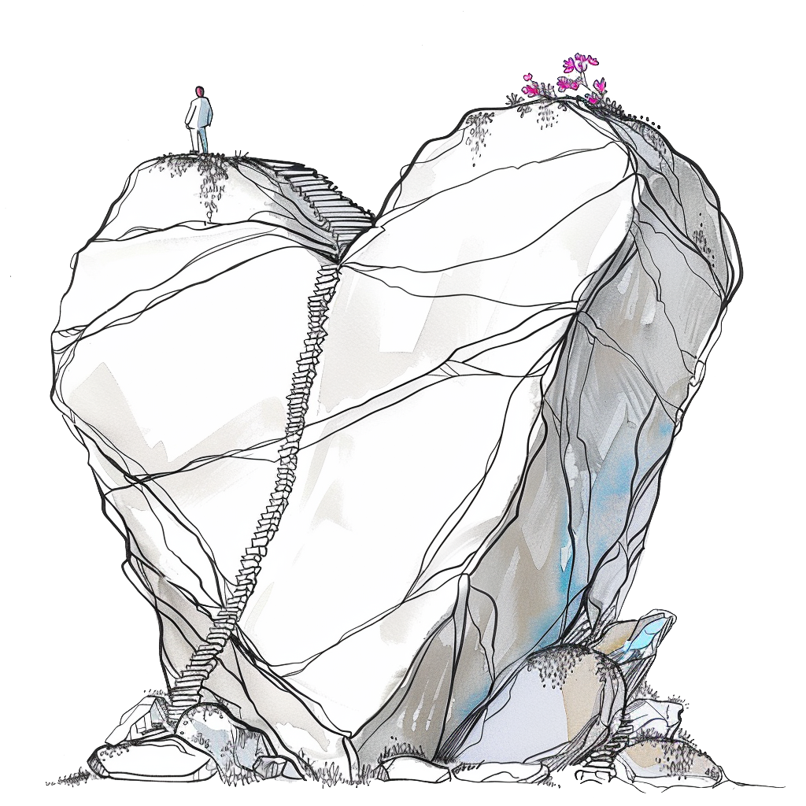
What do you love about your community today?
Our community is a great place to…
live
work
study
play
what else?
What do you love most about our community?
What do we want to make sure remains stable as we plan for the future?
Notes:
Planning doesn’t take place in a vacuum. It’s important to start the conversation with identifying the things we most like about the community today. While people might identify specific buildings, places or overall community character, it is also likely that they will identify things like diversity, being a great place for families, their neighbors, access to green space and other benefits.

Slide 3
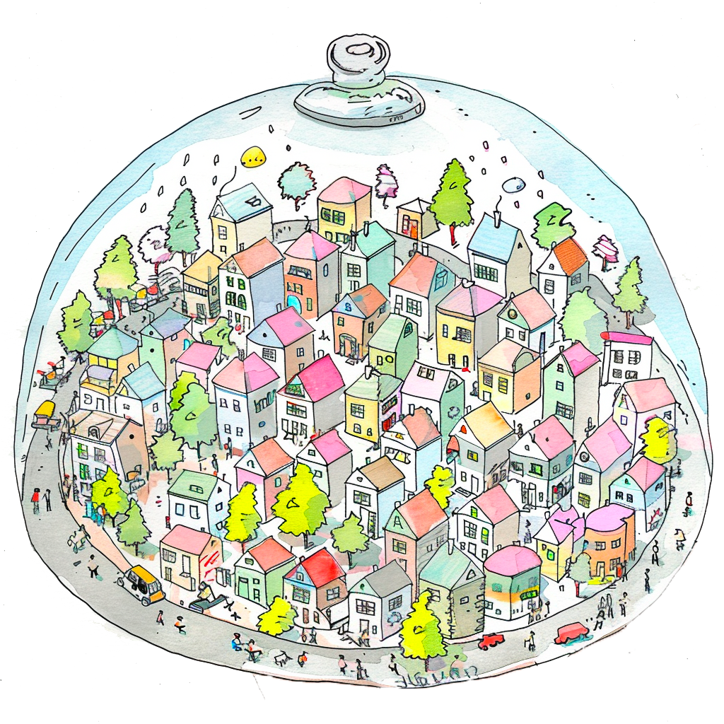
Change is hard, but also inevitable
We can’t stop change from happening.
Even if we never built another building or changed a single thing about our physical environment, our community would change.
If we don’t provide enough housing…
Our community will be become increasingly unaffordable.
People we care about may have to leave because they can’t find housing that meets their needs.
Our workforce will have to drive further to get to their jobs.
We might lose some of the things we love about our community today.
Notes:
It’s easy to think that stopping physical change in a community will somehow stop all change. But we know that’s not the case. If no new housing is created, the most likely outcome will be that home prices and rents will go up, and some of the very things identified as needing to remain stable will be eroded or lost. In fact, some of the impacts of not creating enough housing can seem counter-intuitive, with environmental impacts being greater from not allowing more housing closer to jobs and services, as people have to commute longer distances and outlying green spaces get turned into needed housing.

Slide 4




We can plan for the future we want by…
Including all members of our community in the conversation – including those who work here.
Remember that this is a conversation about people – neighbors, friends, children, teachers and others – not just buildings.
Talking openly and honestly about it.
Thinking about what future generations will need.
Notes:
Edit this slide to make points that will resonate most with your community. Underscore that housing conversations are not just about the people who live here today, but about planning for the people who will live here 50 years from now. Encourage people to speak openly and honestly, but also to be respectful of different points of view. Being a community is about working together, listening and finding common ground.

Slide 5


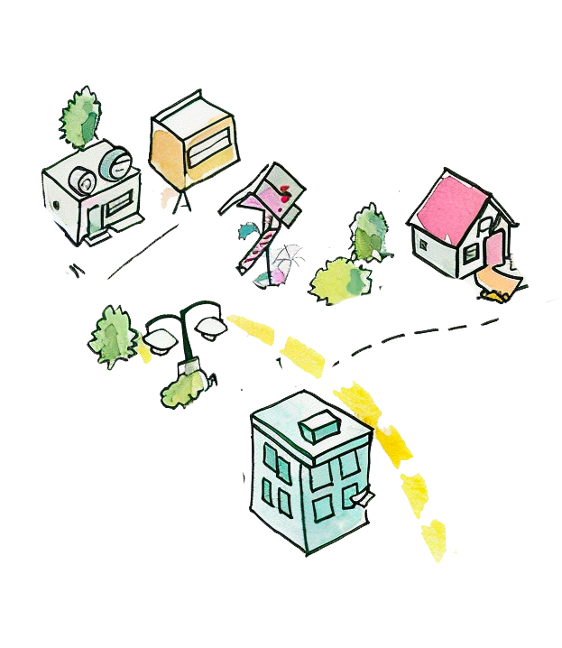
Envisioning the future we want
It’s the year 2050 – and you’re here, happy, and in great health!
You’re hosting friends from out of state. They want to see the great community you have shaped – where everything you wanted was achieved.
So you take them on a walk / roll / drive / bike ride to show them everything you’ve achieved as a community.
Notes:
Now comes the fun part: imagining the future we want.
Use the prompt from the slide or edit it to something you think will work best for your purposes. The idea is to encourage people to let go of thinking about all the obstacles and all the things they don’t want to see. What would things look like if we were successful in creating the future they desire?

Slide 6
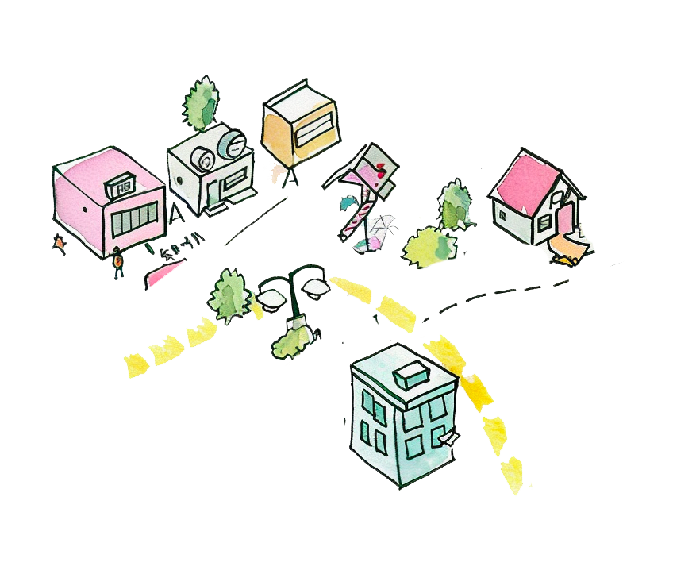
Describe the future you envision!
Where do you take your friends?
What do you see along the way?
Who do you see?
What kinds of housing do you pass?
What was built recently that you’re proud of?
When asked “how did this come to be” – what do you say?
Notes:
Be sure to challenge the group to think broadly and deeply about their vision. It should not just be about the buildings they see, but about the people who are there, the activities and amenities available, and even the process of making their vision a reality. You can facilitate this part of the conversation in any number of ways. Here are some fun ideas:
Give everyone a piece of paper and colored markers and ask them to take 5 to 10 minutes to draw their vision first, and then go around the room and share each person’s drawing.
Break into small groups and have kits of loose parts (pipe cleaners, egg cartons, string, plastic dinos…) that people can use to build a model of their ideal future. Have someone at each group record key ideas that come out of their conversation in addition to hearing the group describe their model.
Ask people to close their eyes and think about their vision. Then “popcorn” around the room to capture a single word or short phrase that best captures what was in their head.

Slide 7
How did housing shape our future?
Who lives in your ideal future neighborhood?
How far do people have to travel to get to daily destinations (work, school, groceries, etc.)?
What housing choices are there (type, size, cost, location.)?
How does your vision compare with what we have today? What’s missing?
Notes:
While the vision exercise was purposefully broad, this slide prompts deeper thinking focused on housing. Who lives here? What housing choices are available, and where? How does the vision compare to today? What’s missing? What’s the same? If people say that everything is the same (the buildings, the people, etc.), find a nice way to remind them that change is inevitable….

Slide 8
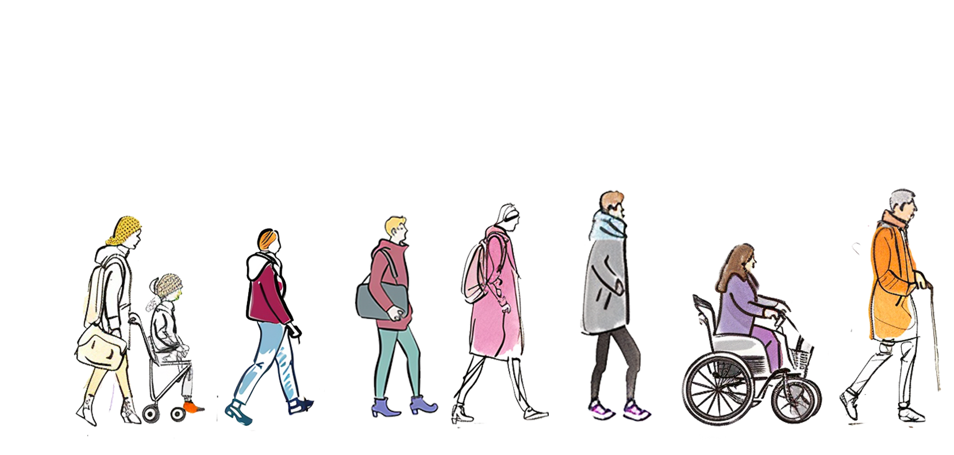
Who was involved in making our vision a reality?
Notes:
These slides can be edited to focus in on questions you think are most important to consider in your community conversation. The three slides provided are focused on getting specific about who needs to be involved, how to overcome anticipated obstacles, and the sometimes intangible factors that can contribute to success. The point is to position your participants as problem-solvers who can start to see themselves as allies in working together to achieve the vision they just described.

Slide 9
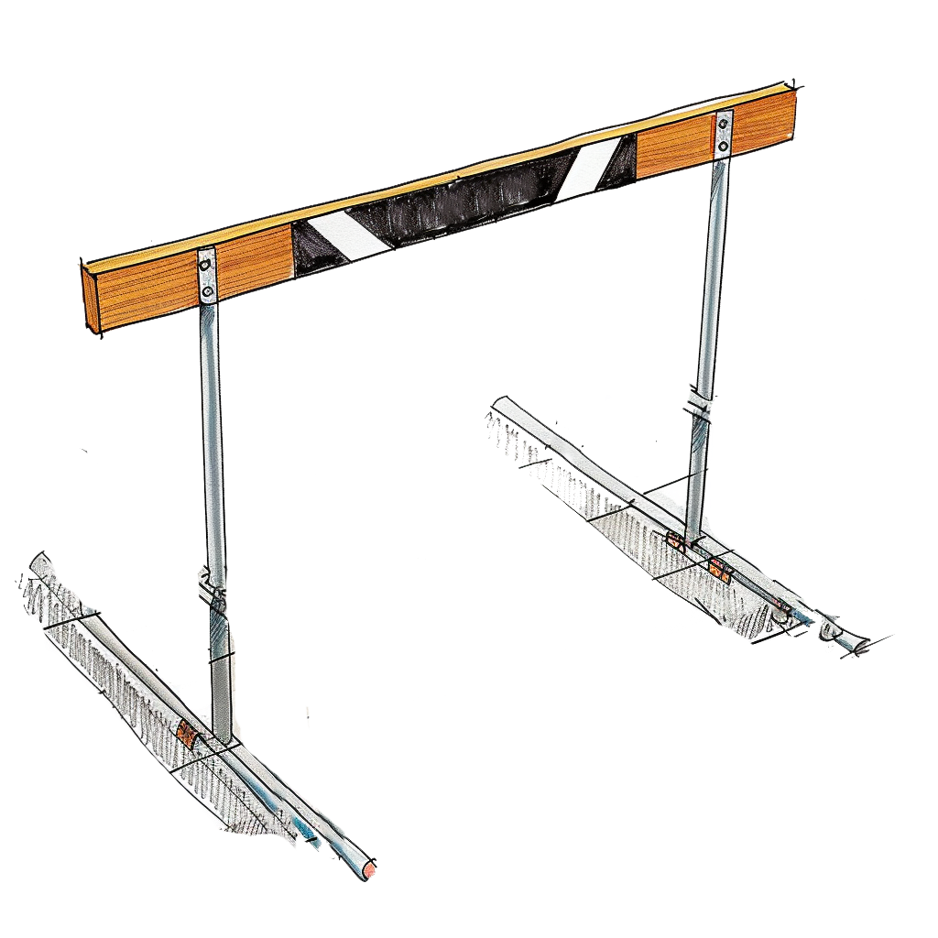
What obstacles did we face? How did we overcome them?
Notes:
These slides can be edited to focus in on questions you think are most important to consider in your community conversation. The three slides provided are focused on getting specific about who needs to be involved, how to overcome anticipated obstacles, and the sometimes intangible factors that can contribute to success. The point is to position your participants as problem-solvers who can start to see themselves as allies in working together to achieve the vision they just described.

Slide 10
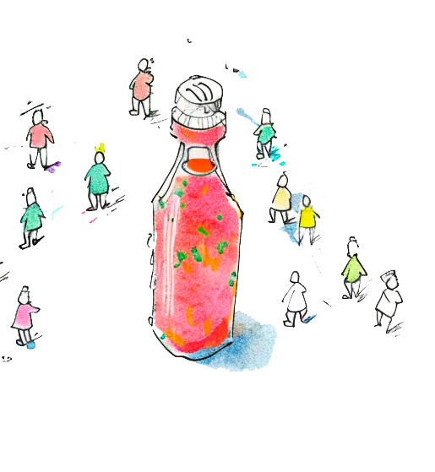
What’s the “secret sauce” that got us there?
Notes:
These slides can be edited to focus in on questions you think are most important to consider in your community conversation. The three slides provided are focused on getting specific about who needs to be involved, how to overcome anticipated obstacles, and the sometimes intangible factors that can contribute to success. The point is to position your participants as problem-solvers who can start to see themselves as allies in working together to achieve the vision they just described.

Slide 11
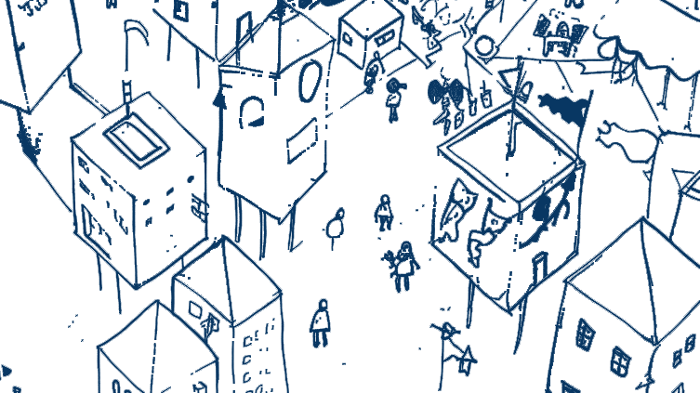



Thanks for joining the conversation!
created by
Notes:
Use this as a closing slide. Feel free to delete the credit logos, and/or add your own.

Slide 12
Postscript
This resource was created to support local government staff in having constructive conversations about housing with their communities.
Related materials, including speaker notes and hi-resolution images, can be found at https://abag.ca.gov/technical-assistance/housing-density-design-resources
All images in this presentation may be re-used. Certain images have a corresponding citation – if re-publishing that image in other contexts, duplicating that citation is required.
Notes:
This slide provides information about the slide deck, other resources, and permissions for using the images in the deck. Delete this slide from your public-facing presentation.
For information about this material, please reach out to:
Clair A. McDevitt
Associate PIO, REAP Programs
cmcdevitt@bayareametro.gov

