Slide 1
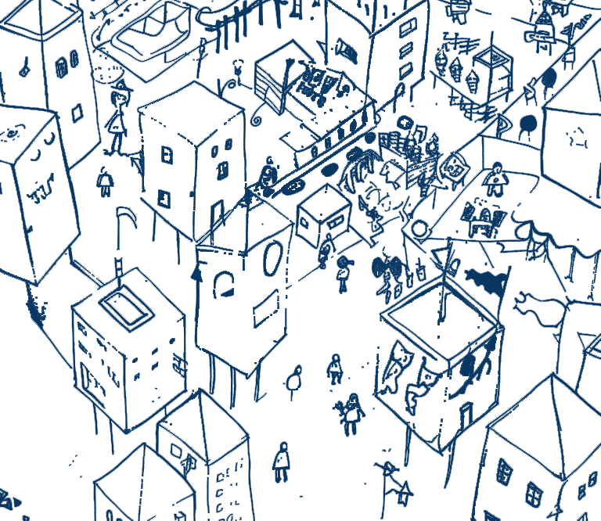
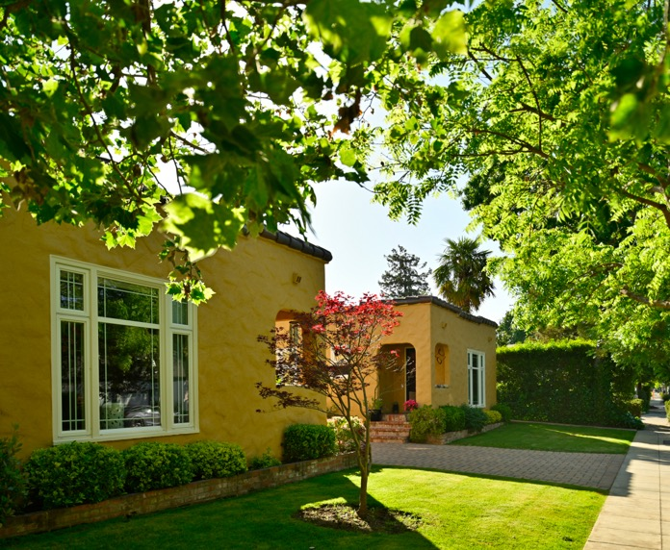
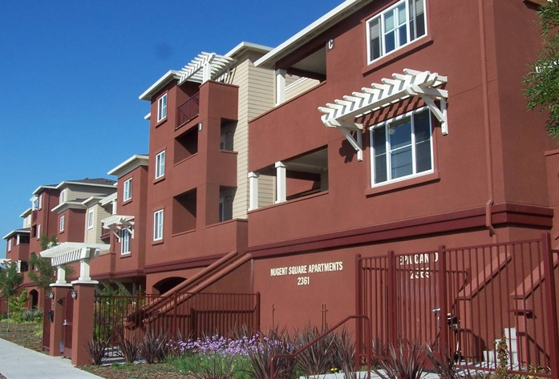
Guess the
Density!
Notes:
This deck is structured to support an interactive conversation about how the perceived and actual density of a development do not always align. It is intended so spark a more nuanced conversation that leads with “what is the type of housing we want” rather than an immediate negative response to “higher density.”

Slide 2
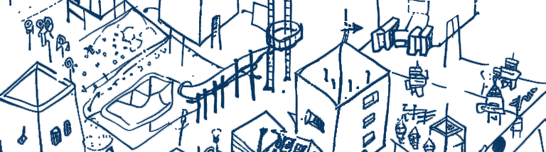

Context
What is allowed now
Where we are proposing changes
Notes:
Use this template slide to ground the activity in your local context. Explain the reason for having this conversation and, if applicable, the types of changes being considered or proposed. You may want to give examples of what kinds of buildings are currently allowed and what kinds of buildings might result if the changes are made.
Be sure to use language that gives participants a vocabulary they can understand and use. See the User Guide for examples.

Slide 3
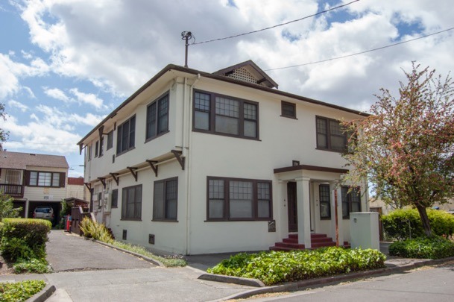
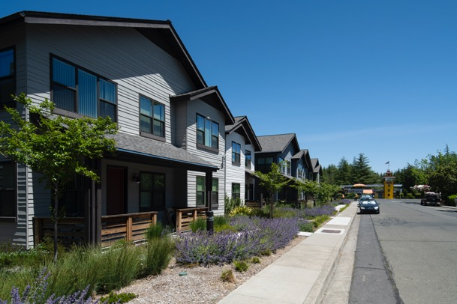
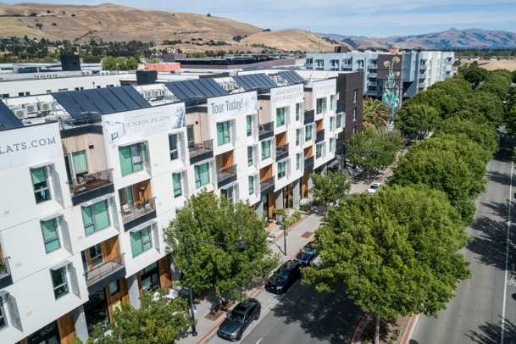
Guess the Density! #1
Cherry Street
Alta Madrone
The Union Flats
Match the number of homes per acre (DU/A) to the image you think it corresponds to.
122
DU/A
72
DU/A
23
DU/A
Notes:
This slide and the slides that follow are structured as an interactive exercise in which participant are asked to match the density number (dwelling units per acre) to the images shown. The intent is to help demonstrate how “density” can sometimes be a misleading metric for describing the size of a building and how it might fit even in a predominantly “low density” neighborhood.
There are three Guess the Density sections (numbered on the slides), with each section including an intro slide (the “game” slide); an answer slide; a key takeaways slide; and then a detailed slide with information about each of the buildings that was displayed. Consider deleting or rearranging sections to help guide the conversation based on your context. If the examples in a section are all irrelevant for your community, delete that section and replace it with examples from your community.

Slide 4
Guess the Density! #1 Answers
Cherry Street
Alta Madrone
The Union Flats
122 DU/A
23 DU/A
72 DU/A
Notes:
This slide displays the correct answers to the preceding “Guess the Density” slide. Ask for a show of hands on how many people got 1, 2 or 3 of the answers correct. Ask them to talk about they they chose what they did.

Slide 5
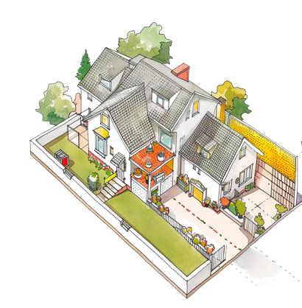
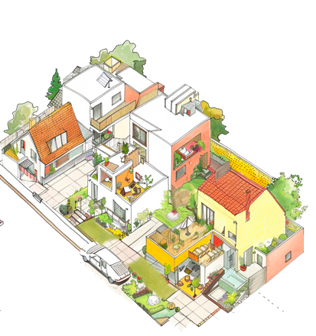
Doesn’t a higher number mean a bigger building?
Not always!
Density measures homes per acre, not the size of the building.
Density doesn’t determine the character of the building – design does.
How we experience density depends on many things: the size of the building, the size of the lot and how it relates to the street.
A large single-family home on a small lot might look (and actually be) just as big as multiple smaller homes on the same lot.
Let’s look at these three examples…
Notes:
This slide provides some key points you might want to share to help explain why the numbers might not have lined up as people expected. Edit them to make other points you think are important for your community conversation (or to remove points you don’t think are helpful).

Slide 6

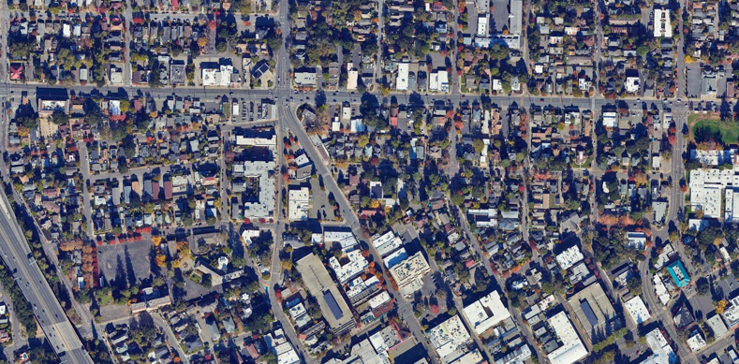
Cherry Street
122
Homes per Acre (DU/A)
6 homes on a 0.05-acre lot
Market-rate
Built in 1920
In a mixed-density neighborhood close to downtown
Maps Data: Google © 2023
Notes:
This slide provides basic information about the “highest density” example in this set of housing developments. This example is from Santa Rosa in Sonoma County.

Slide 7
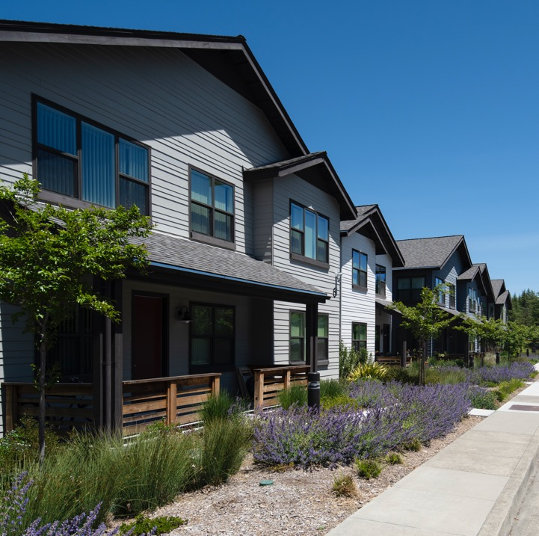
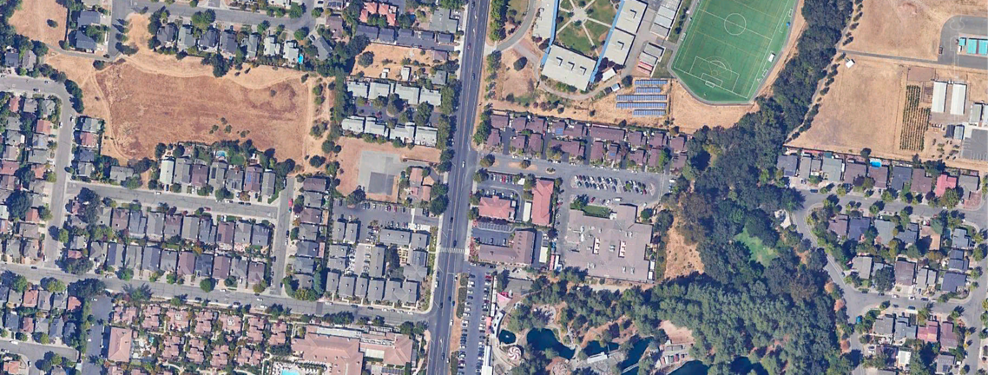
Alta Madrone
23
Homes per Acre (DU/A)
48 homes on a 2.1-acre lot
100% affordable housing
Includes community garden, playground and other amenities
In a single-family neighborhood near schools and green space
Maps Data: Google © 2023
Notes:
This slide provides information about the “lowest density” example in this set of housing developments. This example is from the City of Sonoma in Sonoma County.

Slide 8
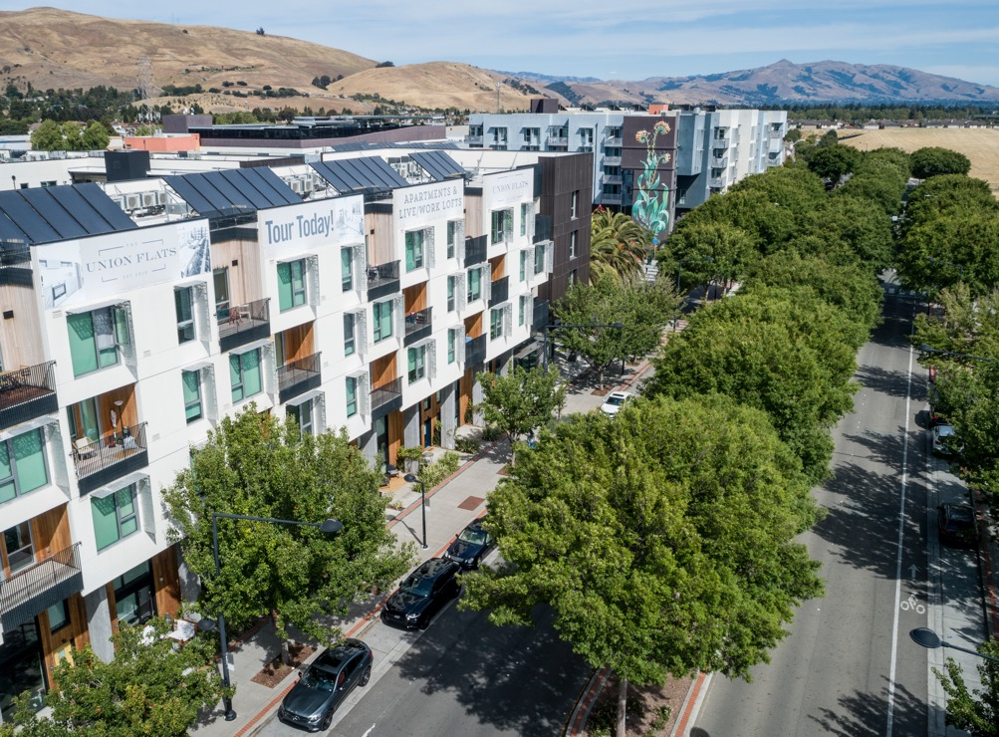
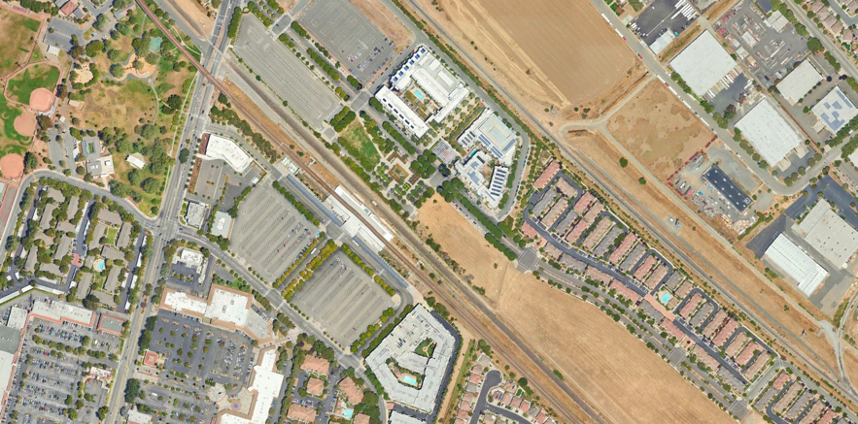
Union Flats
72
Homes per Acre (DU/A)
155 homes on a 2.14-acre lot
Affordable housing
Residential gardens and shared open space
Transit-adjacent, and near grocery stores and pharmacies
Maps Data: Google © 2023
Notes:
This slide provides information about the middle density example in this set of housing developments. This example is from Union City in Alameda County.

Slide 9
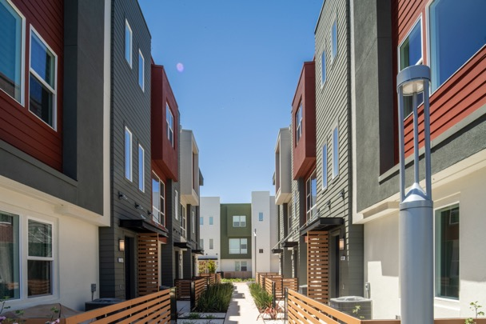
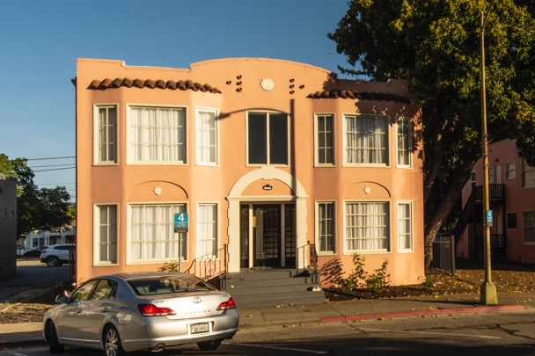
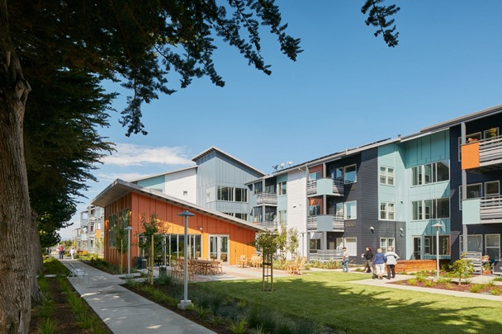
Guess the Density! #2
Photo by Bruce Damonte, Courtesy MidPen Housing
Laguna Vista
Pink Palaces
Half Moon Village
Match the number of homes per acre (DU/A) to the image you think it corresponds to.
35
DU/A
19
DU/A
26
DU/A
Notes:
It’s time for round two!
This slide introduces a new set of three example developments and asks participants to match the density (expressed as dwelling units per acre) to each example. Note that the density range for these examples is much narrower than in the first set of three.

Slide 10
Guess the Density! #2 Answers
Photo by Bruce Damonte, Courtesy MidPen Housing
Laguna Vista
Pink Palaces
Half Moon Village
19 DU/A
35 DU/A
26 DU/A
Notes:
This slide tells the meeting participants which answer applies to each of the images. Ask the room for a show of hands on how many people got each one correct. Ask them to express how they arrived at each of their answers.

Slide 11
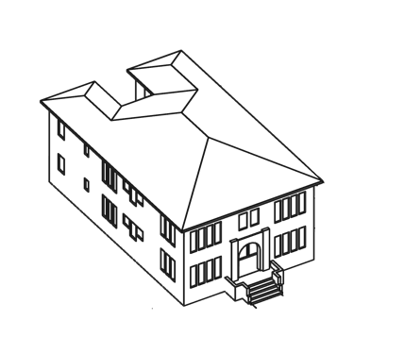
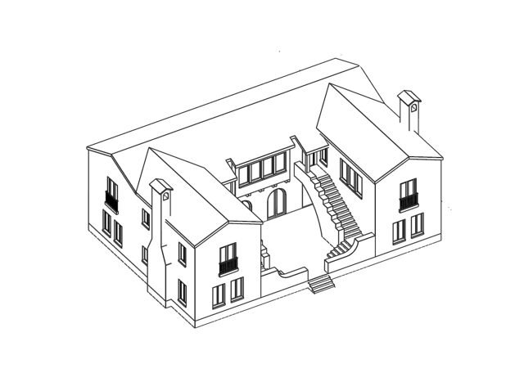
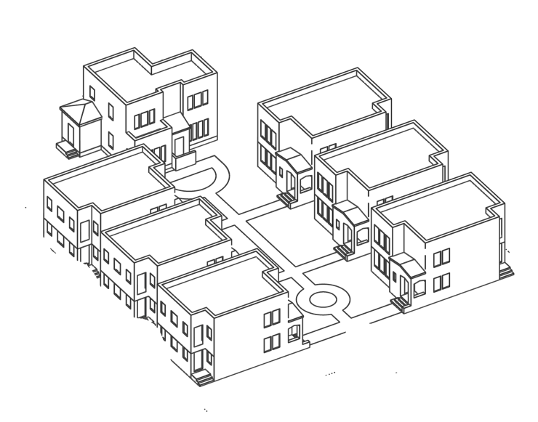
Many older residential buildings that we love couldn’t be built today!
It’s not uncommon for older buildings in existing neighborhoods to be higher density, because we used to generally build smaller units and had more flexible regulations than we do today.
Many of the duplexes, triplexes, and smaller apartment buildings that we walk past every day could not be built under the density limits we currently have in place.
Notes:
In addition to discussing the points participants raise, use this slide to make your own key points. The bullets provided point out that the older buildings that exist in many communities are appreciated for their character and “fit,” and yet many times could not be built under the zoning in place today.
The slides in Presentation 2: Making Density Work can help explain the other ways in which buildings are regulated to help them fit, even when they contain multiple homes.

Slide 12
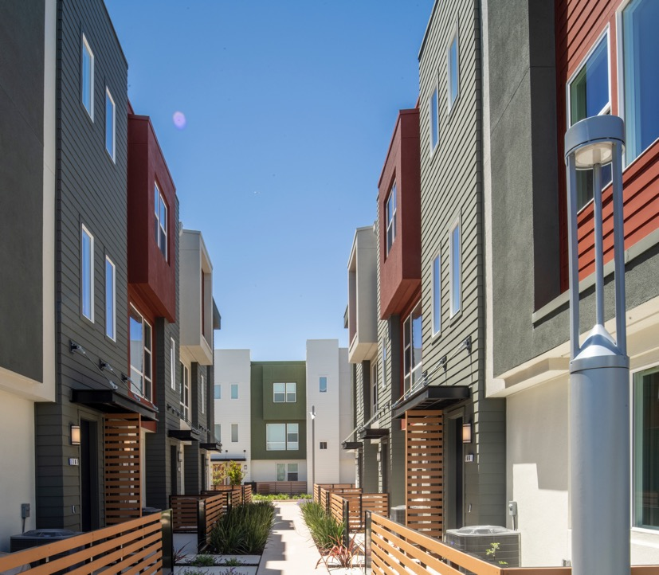
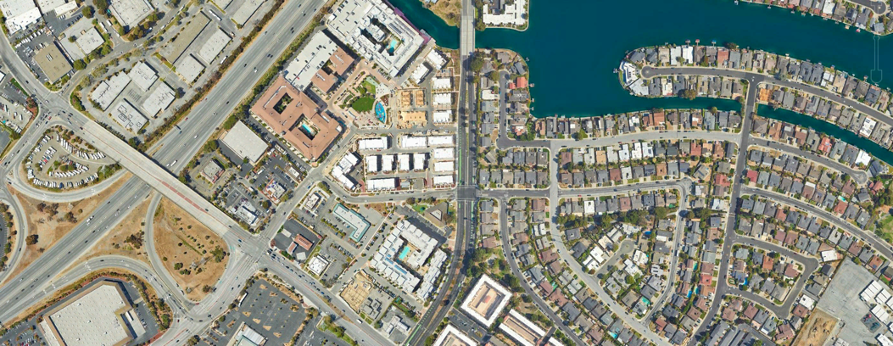
Laguna Vista
19
Homes per Acre (DU/A)
92 homes on a 4.79 lot
Mixed affordable and market-rate
214 parking spaces
Highway-adjacent, close to some retail
Maps Data: Google © 2023
Notes:
This slide provides basic information about the “lowest density” example in this set of housing developments. This example is from Foster City in San Mateo County.

Slide 13
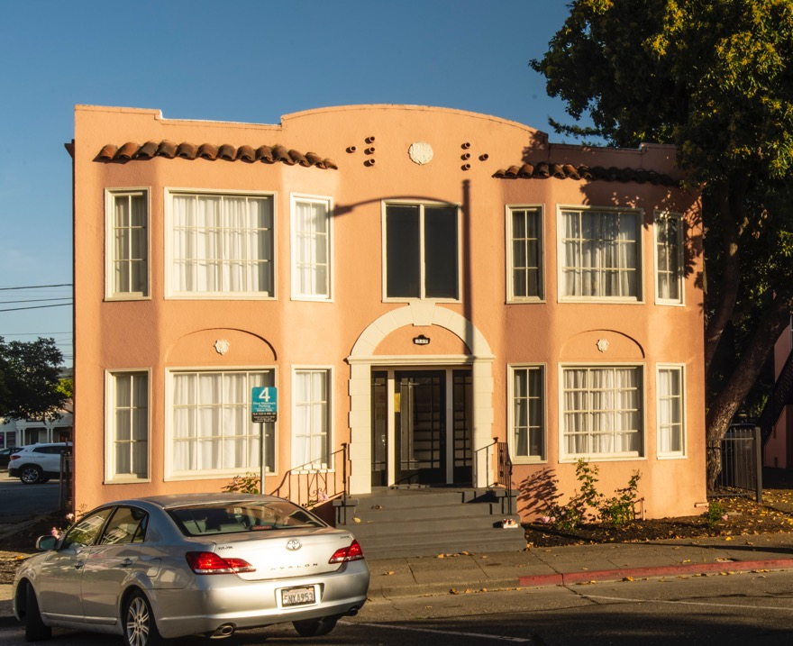
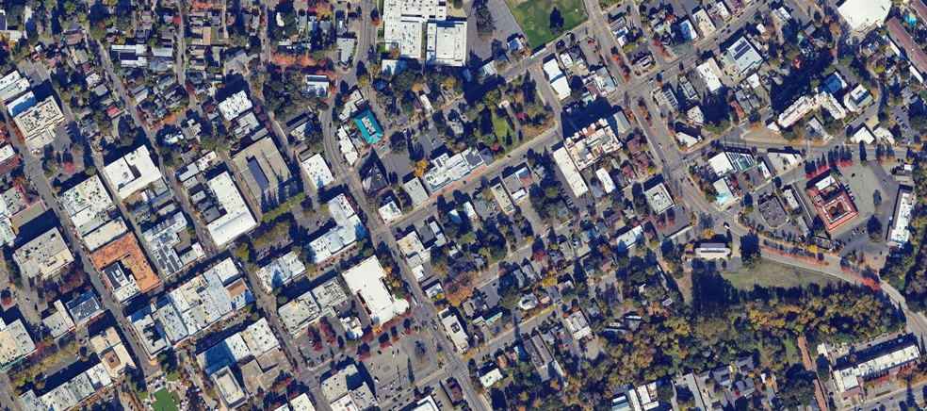
Pink Palaces
35
Homes per Acre (DU/A)
12 homes on an 0.35-acre lot
Market-rate housing
In a mixed-density neighborhood close to downtown, transit, schools and green space
Maps Data: Google © 2023
Notes:
This slide provides basic information about the “highest density” example in this set of housing developments. This example is from Santa Rosa in Sonoma County.

Slide 14
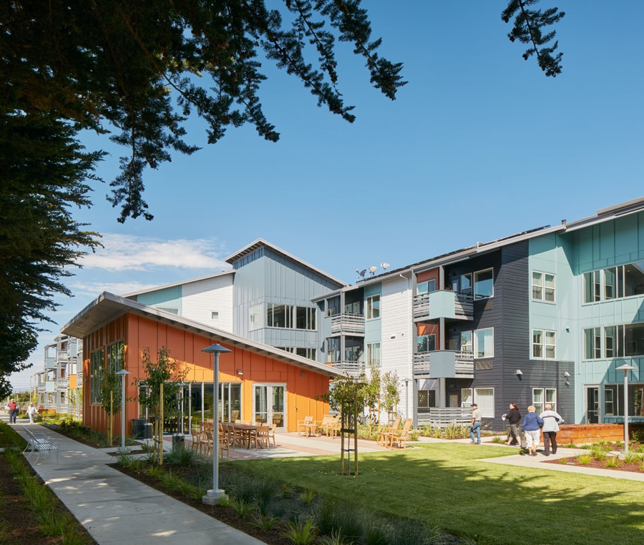
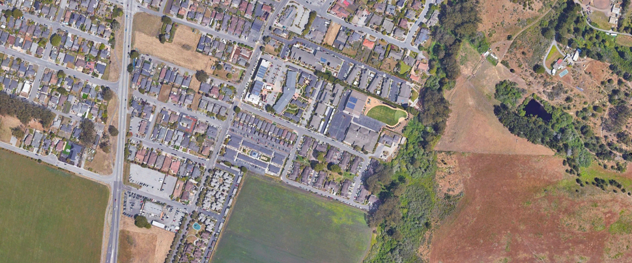
Half Moon Village
26
Homes per Acre (DU/A)
160 homes on 6 acres
Affordable senior housing
Includes community rooms, public computers, health & wellness programming, social programming and community gardens
Photo by Bruce Damonte, Courtesy MidPen Housing
Maps Data: Google © 2023
Notes:
This slide provides information about the middle density example in this set of housing developments. This example is from Half Moon Bay in San Mateo County.

Slide 15
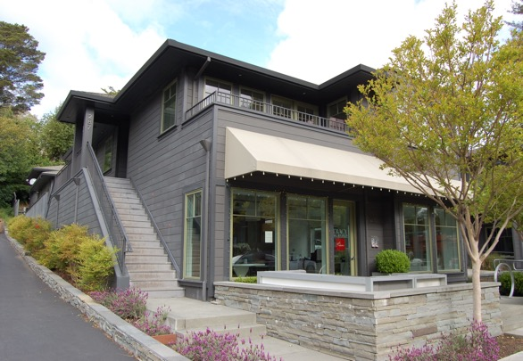
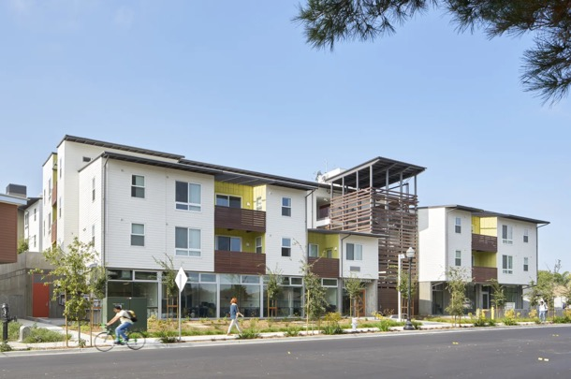
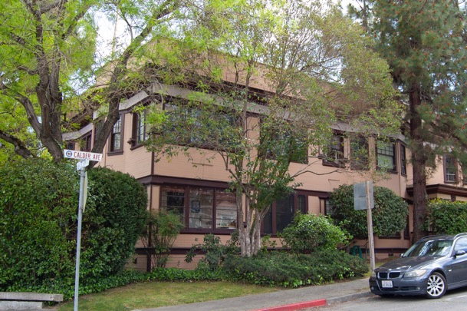
Guess the Density! #3
Photo by Bruce Damonte, Courtesy MidPen Housing
Magnolia Avenue
Onizuka Crossing
Calder Ave
Match the number of homes per acre (DU/A) to the image you think it corresponds to.
45
DU/A
26
DU/A
11
DU/A
Notes:
Now for round 3!
Folks should be getting the hang of it by now, and are probably second-guessing their assumptions…

Slide 16
Guess the Density! #3 Answers
Photo by Bruce Damonte, Courtesy MidPen Housing
Magnolia Avenue
Onizuka Crossing
Calder Ave
11 DU/A
45 DU/A
26 DU/A
Notes:
This time the answers might be more aligned with what a passerby might expect. The highest number applies to the biggest building, and the lowest number to the smallest building. How many people got the answers correct?

Slide 17
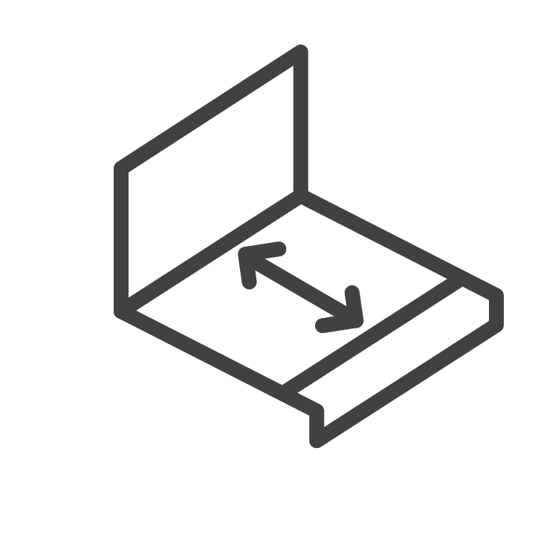


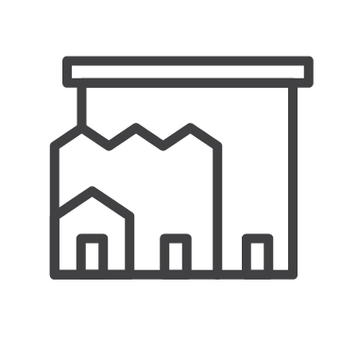
Generally, higher densities = bigger buildings
But not always! Buildings are shaped in different ways:
Limits on height and requirements for setbacks.
Floor area ratios that control the size of the building based on the size of the property.
Design standards and guidelines that shape the building’s architecture and its relationship to the street.
Notes:
This is an important slide. The purpose of this activity is NOT to make the case that density doesn’t matter. It does matter. And typically, higher densities result in bigger buildings. But it is very important to underscore that it is not always the case. A critical part of the conversation is being clear about the kind of housing we want to see in the community, and then putting in place the tools to create it. We shouldn’t be automatically opposed to increases in density, because it might actually help us create the things we want.

Slide 18
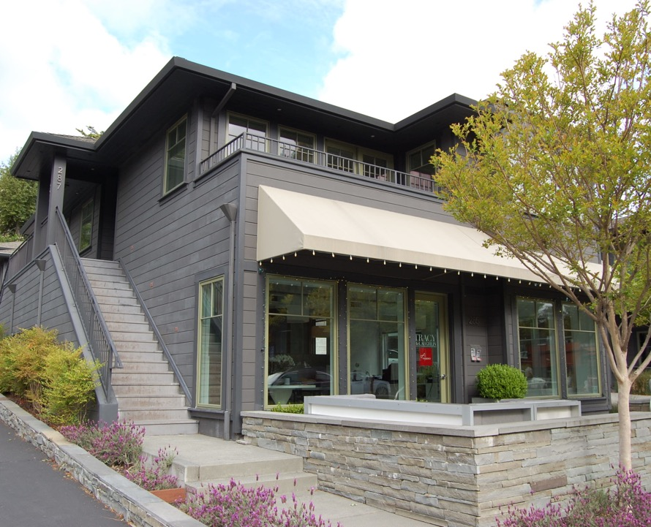
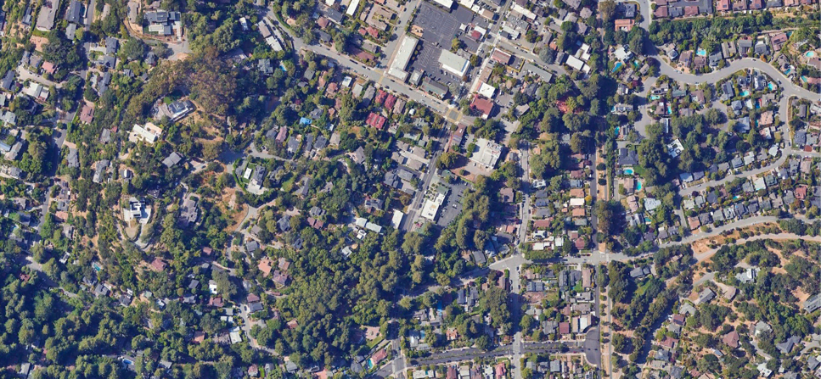
Magnolia Avenue
11
Homes per Acre (DU/A)
4 homes on a 0.4-acre lot
Market-rate housing
Mixed-use – small businesses below with houses above. In a mixed-density neighborhood near downtown and excellent green space
Maps Data: Google © 2023
Notes:
This slide provides information about the lowest density example in this set of housing developments. This example is from Larkspur in Marin County.

Slide 19
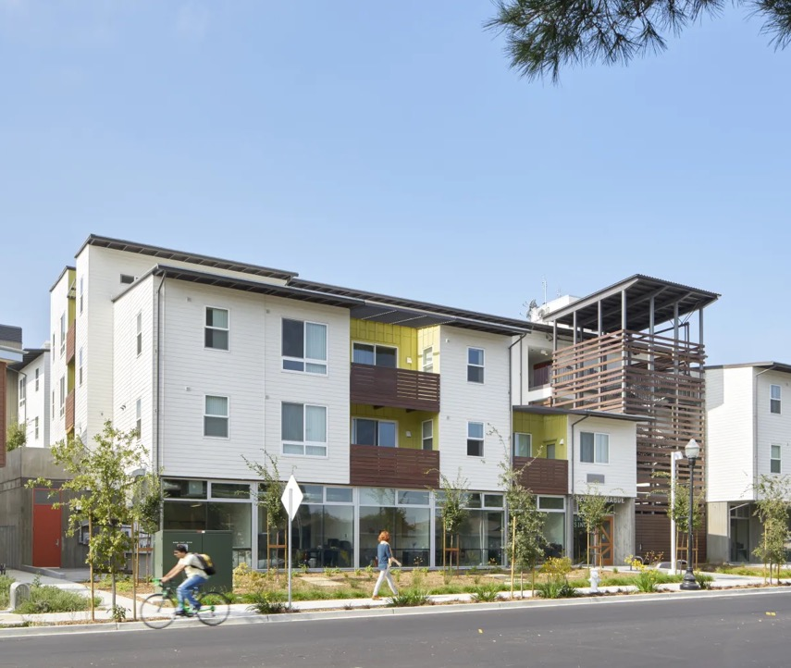
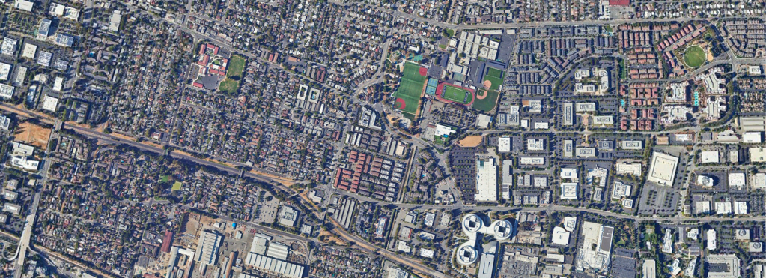
Onizuka Crossing
45
Homes per Acre (DU/A)
58 homes on an 1.3-acre lot
Affordable housing
Includes community rooms, computer labs, an exercise room and 1.6 parking spaces per home (93 total)
In a mixed-density neighborhood near transit, schools, parks and employers
Photo by Bruce Damonte, Courtesy MidPen Housing
Maps Data: Google © 2023
Notes:
This slide provides information about the highest density example in this set of housing developments. This example is from Sunnyvale in Santa Clara County.

Slide 20
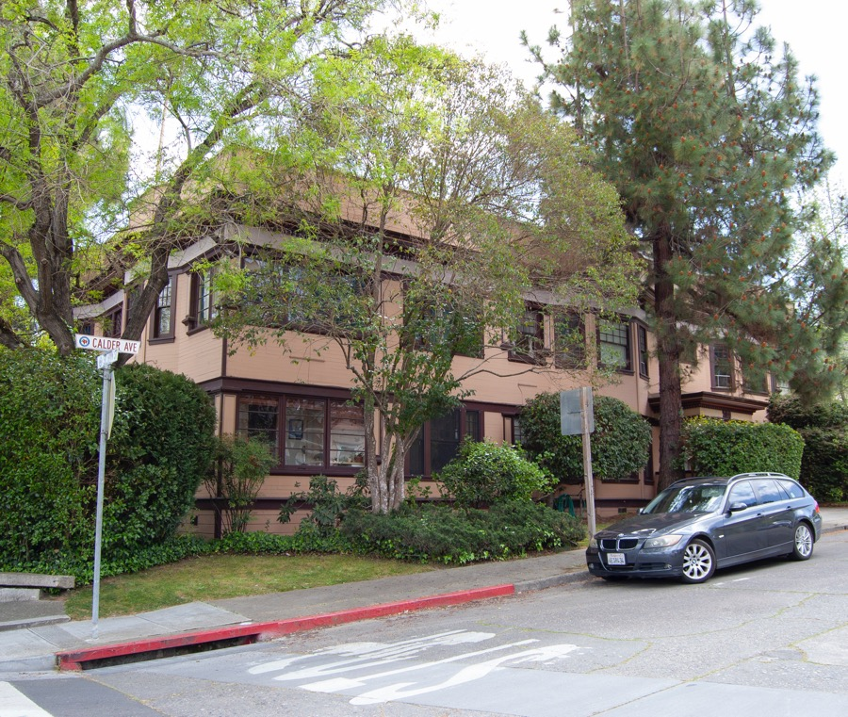
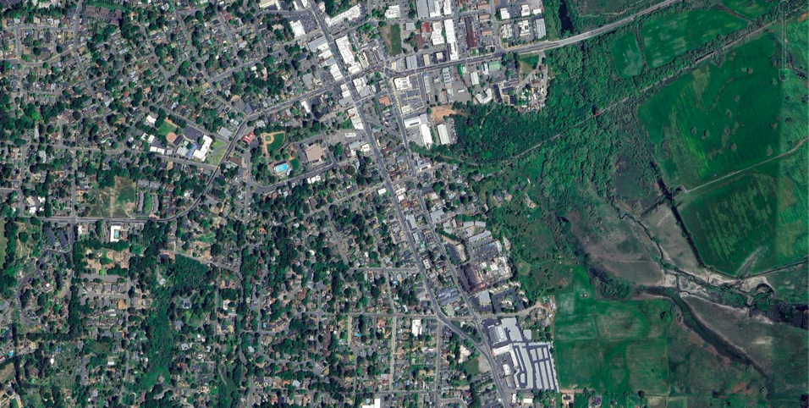
Calder Ave
26
Homes per Acre (DU/A)
6 homes on a .23-acre lot
On the edge of a single-family neighborhood near restaurants, grocery stores, green space, schools and a performing arts center
Won a local historic preservation award
Maps Data: Google © 2023
Notes:
This slide provides information about the middle density example in this set of housing developments. This example is from Sebastopol in Sonoma County.

Slide 21
Guess the Density: Community Example
Street Name
Street Name
Street Name
Match the number of homes per acre (DU/A) to the image you think it corresponds to.
##
DU/A
##
DU/A
##
DU/A
Notes:
The remainder of the slides in this deck provide templates for creating your own “Guess the Density!” slides using local examples. Be sure to select examples that can act as conversation starters and prompt productive conversations around shared community goals and potential or proposed changes to local zoning.
You may want to highlight housing that is well known and well-liked and explain the zoning changes required to encourage those types of housing. Older housing stock often offers good examples of attractively designed buildings with higher densities than most people may realize, but its also helpful and important to include more recent examples that are closer to what might actually get built. Refer to the User Guide for on image selection

Slide 22
Guess the Density: Community Example Answers
Street Name
Street Name
Street Name
## DU/A
## DU/A
## DU/A

Slide 23
What’s the point?
Exclamation!
Details
Details
And more details

Slide 24

Street Name
##
Homes per Acre (DU/A)
## homes on a ##-acre lot
Type of housing
Description of amenities
Description of neighborhood
Notes:
Use these slide templates to provide details about the community examples you chose.

Slide 25

Avenue Name
##
Homes per Acre (DU/A)
## homes on a ##-acre lot
Type of housing
Description of amenities
Description of neighborhood
Notes:
Use these slide templates to provide details about the community examples you chose.

Slide 26

Boulevard Name
##
Homes per Acre (DU/A)
## homes on a ##-acre lot
Type of housing
Description of amenities
Description of neighborhood
Notes:
Use these slide templates to provide details about the community examples you chose.

Slide 27
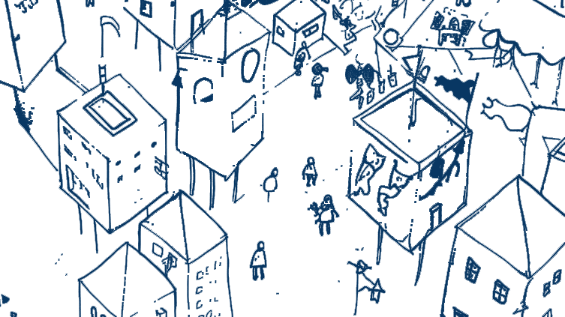
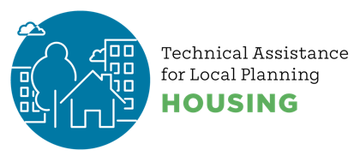


Thanks for joining the conversation!
created by
Notes:
Use this as a closing slide. Feel free to delete the credit logos, and/or add your own.

Slide 28
Postscript
This resource was created to support local government staff in having constructive conversations about housing with their communities.
Related materials, including speaker notes and hi-resolution images, can be found at https://abag.ca.gov/technical-assistance/housing-density-design-resources
All images in this presentation may be re-used. Certain images have a corresponding citation – if re-publishing that image in other contexts, duplicating that citation is required.
Notes:
This slide provides information about the slide deck, other resources, and permissions for using the images in the deck. Delete this slide from your public-facing presentation.
For information about this material, please reach out to:
Clair A. McDevitt
Associate PIO, REAP Programs
cmcdevitt@bayareametro.gov

