Slide 1
Objective Design Standards
Sample slides for a presentation introducing or considering adoption of objective design standards
Public Hearing
DATE

Slide 2
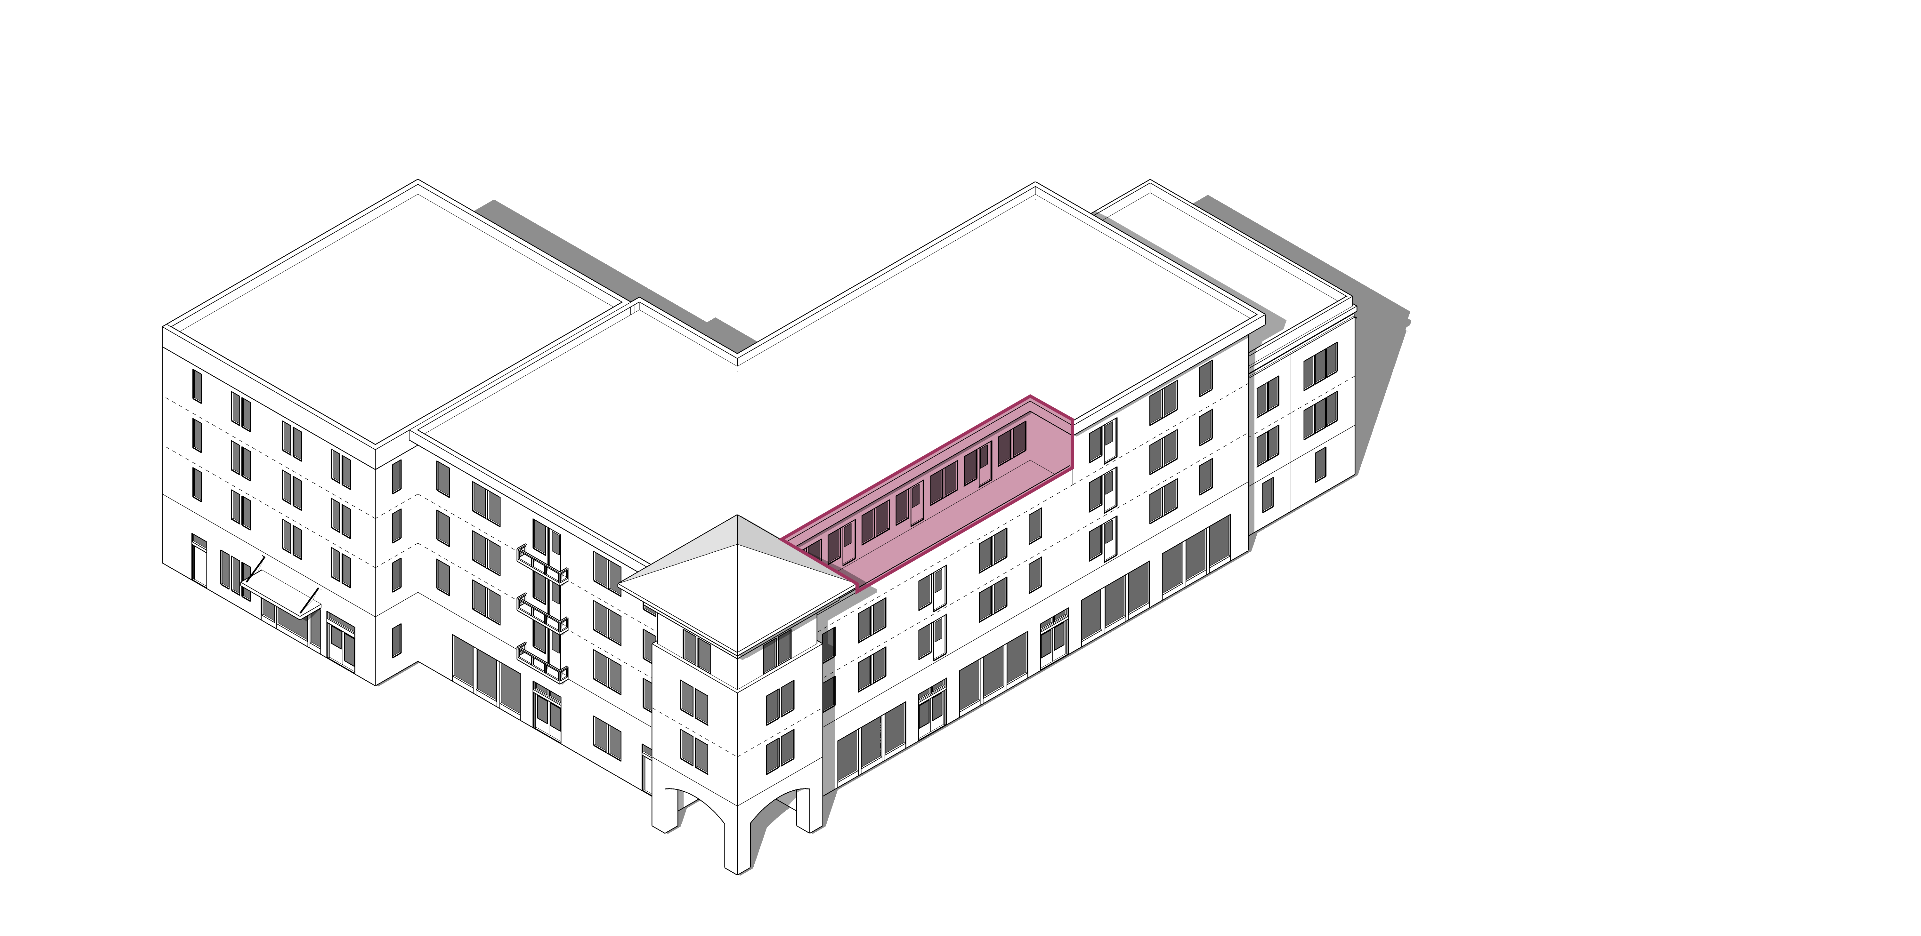
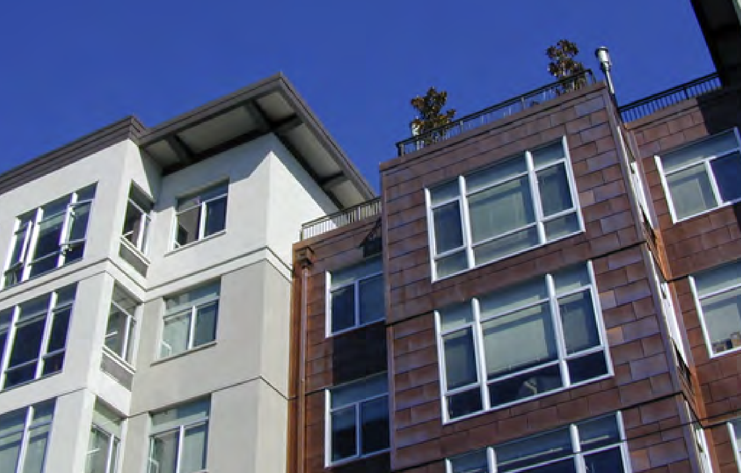
Agenda
Purpose
Policy Context
Existing Regulations
Best Practices
Financial Feasibility Impacts
Environmental Review
Next Steps

Slide 3
Purpose
Given changes in state law, subjective design guidelines cannot be enforced for housing projects undergoing streamlined review.
Objective design standards provide a way to:
  Continue to enforce our community’s design values
  Create predictability in the review process
  Enable streamlining for housing and mixed-use projects

Slide 4
State Law Context
State Law has reduced the amount of discretion jurisdictions have to review housing projects undergoing streamlined review. For some projects, jurisdictions must rely solely on objective standards:
  SB 35 Project Streamlining
  SB 330 Housing Crisis Act
  AB 2162 Supportive Housing Streamlined Approval
  AB 2011 Affordable Housing and High Road Jobs Act
  SB 684 Small Sites Streamlining

Slide 5
Local Policy Context & Neighborhood Planning
Housing Element Policies
  [insert jurisdiction-specific language here]
General Plan Policies
  [insert jurisdiction-specific language here]
Objective standards address design at a building level
Continuing to implement broader urban design policies is essential to support neighborhood and citywide planning

Slide 6
What are Objective Design Standards?
Narrowly defined by the state: “a design standard that involves no personal or subjective judgment by a public official and is uniformly verifiable by reference to an external and uniform benchmark or criterion available and knowable by both the development applicant or proponent and the public official before submittal of an application.” (Gov. Code 66330(a)(7))
[example - insert jurisdiction-specific image/ language here

Slide 7
Applicability
[example - insert jurisdiction-specific language here, including applicability to non-residential uses and single-family homes or duplexes]
Multi-family housing and residential mixed-use projects (3+ units)

Slide 8
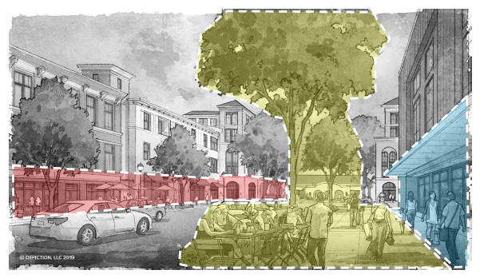
Best Practices
Intent Statement
Guidance
Objective Standard
Tailored to Local Context: Standards should help implement adopted housing and urban design policies and principles
Comprehensive Topics: Address both building design (e.g., massing, articulation) and site design (e.g., parking, open space)

Slide 9
Best Practices
Complementary Graphics: To explain and illustrate written standards
Interdepartmental Coordination: Especially for topics that span multiple divisions (e.g., stormwater)

Slide 10
Existing Regulations and Potential Changes
Example evaluation of existing regulations and potential modifications
Focus is on design standards, but jurisdiction may consider broader changes to zoning regulations to ensure objectivity
Process/Regulation | Objective | Subjective | Potential Changes
Development standards | ✔ |  | Minor changes for clarification
Design Guidelines |  | ✔ | Transform subjective guidelines
Other regulations (e.g., lighting) | ✔ | ✔ | Minor changes for clarification
Use regulations | ✔ |  | Minor changes for clarification
Design Review Findings |  | ✔ | Develop objective findings
Conditions of approval | ✔ | ✔ | Minor changes for clarification

Slide 11
Balancing Housing Costs and Design Benefits
Design standards can impact project feasibility:
  More rigorous construction techniques (e.g., upper story stepbacks that alter the building’s structural needs)
  More architectural complexity (e.g., patterns of recesses and projections)
Need to weigh potential effects on project feasibility against design benefits

Slide 12
Environmental Review
[Example – Revise, as Appropriate]
Proposed ordinance revisions represent implementation of adopted plans and policy
Anticipated to be exempt under CEQA and covered by CEQA documents prepared for the Housing Element
Ordinance aims to facilitate implementation of state law and would not increase development beyond what was analyzed in the Housing Element

Slide 13
Next Steps
[Example – Revise, as Appropriate]
Community outreach
Draft ordinance and preliminary graphics

