Slide 1
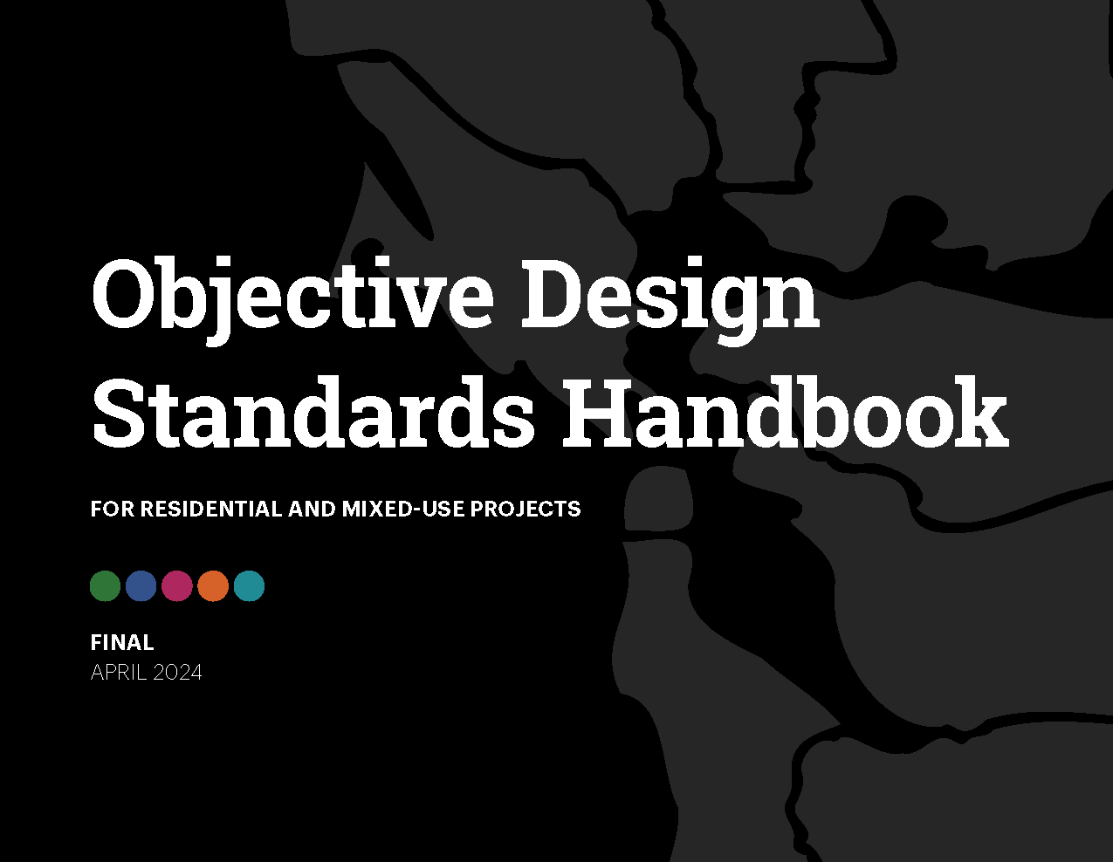
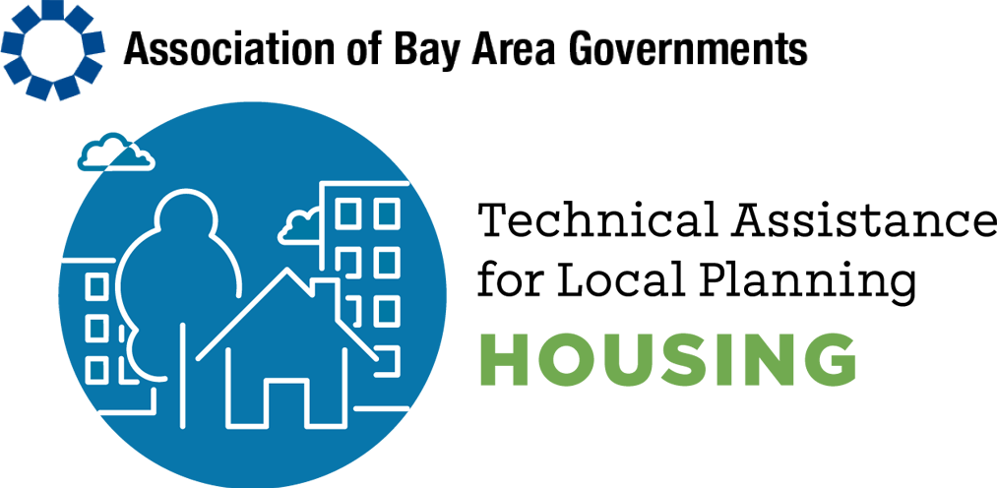
Presentation of
Objective Design
Standards Handbook
Notes:
Change with High res imagery

Slide 2
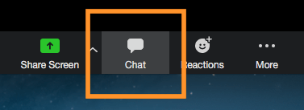
Agenda
Introduction
Overview of Handbook
  Design Standards
  Financial Feasibility
Example Chapter: Building Design
Questions & Answers
Notes:
Change font and bullet color

Slide 3
Presenters ​
Jean Eisberg, AICP, Lexington Planning​
Stefan Pellegrini, RA, AICP, LEED AP, Opticos Design​
Alex Steinberger, Cascadia Partners​

Slide 4
Purpose
Given changes in state law, subjective design guidelines cannot be enforced for housing projects undergoing streamlined review
Objective design standards provide a way to:
  Continue to enforce our community’s design values
  Create predictability in the review process
  Enable streamlining for housing and mixed-use projects
Notes:
Mountain View
Orinda
SF
Redwood City

Slide 5
State Law Context
State Law has reduced the amount of discretion jurisdictions have to review housing projects undergoing streamlined review. For some projects, jurisdictions must rely solely on objective standards:
  SB 35 Project Streamlining
  SB 330 Housing Crisis Act
  AB 2162 Supportive Housing Streamlined Approval
  AB 2011 Affordable Housing and High Road Jobs Act
  SB 684 Small Sites Streamlining
Notes:
Mountain View
Orinda
SF
Redwood City

Slide 6
Local Context & Neighborhood Planning
Foundation for developing objective design standards:
  General Plan urban design policies
  Design guidelines
  Housing Element programs
Objective standards address design at a building level
Continuing to implement broader urban design policies is essential to support neighborhood and citywide planning
Notes:
Mountain View
Orinda
SF
Redwood City

Slide 7

Handbook and Customizable Resources
Website: https://abag.ca.gov/technical-assistance/objective-design-standards-handbook-residential-and-mixed-use-projects
Handbook
Illustrative graphics (image files)
Word exports of handbook
InDesign version of handbook
Staff Report template
Presentation template

Slide 8
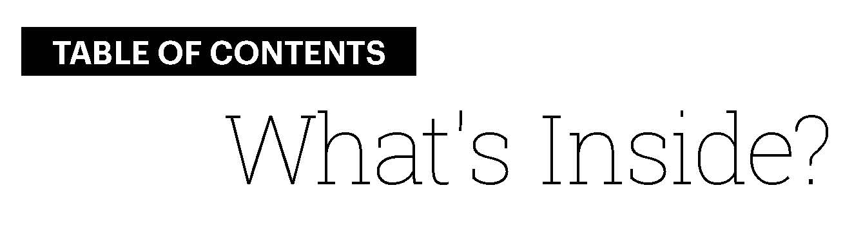

Table of Contents

Slide 9
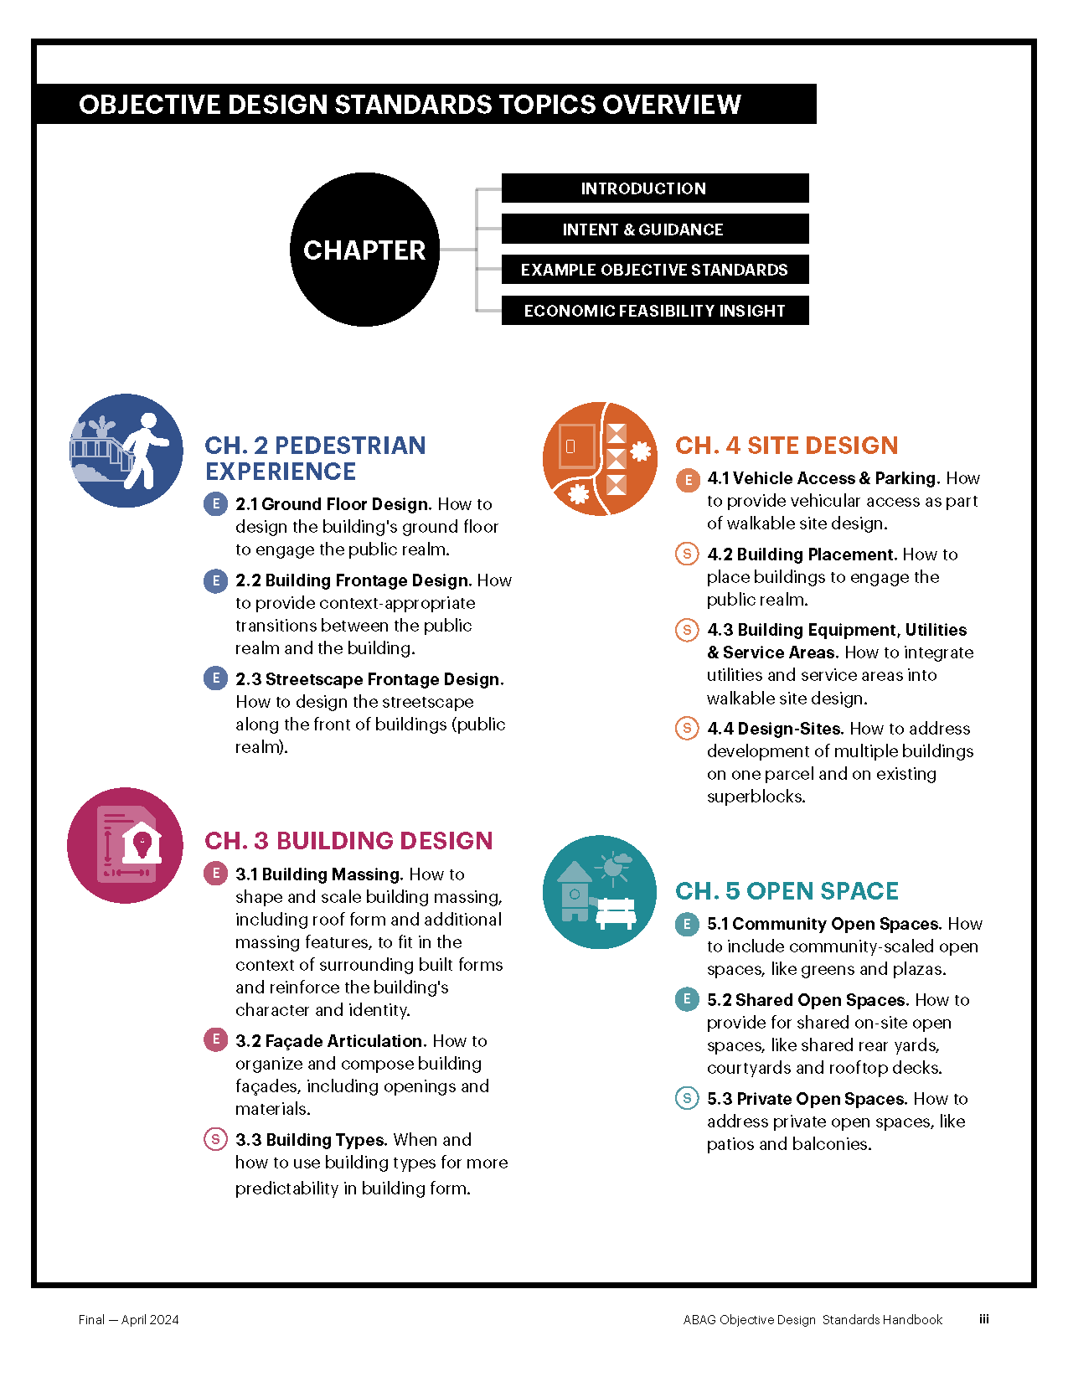
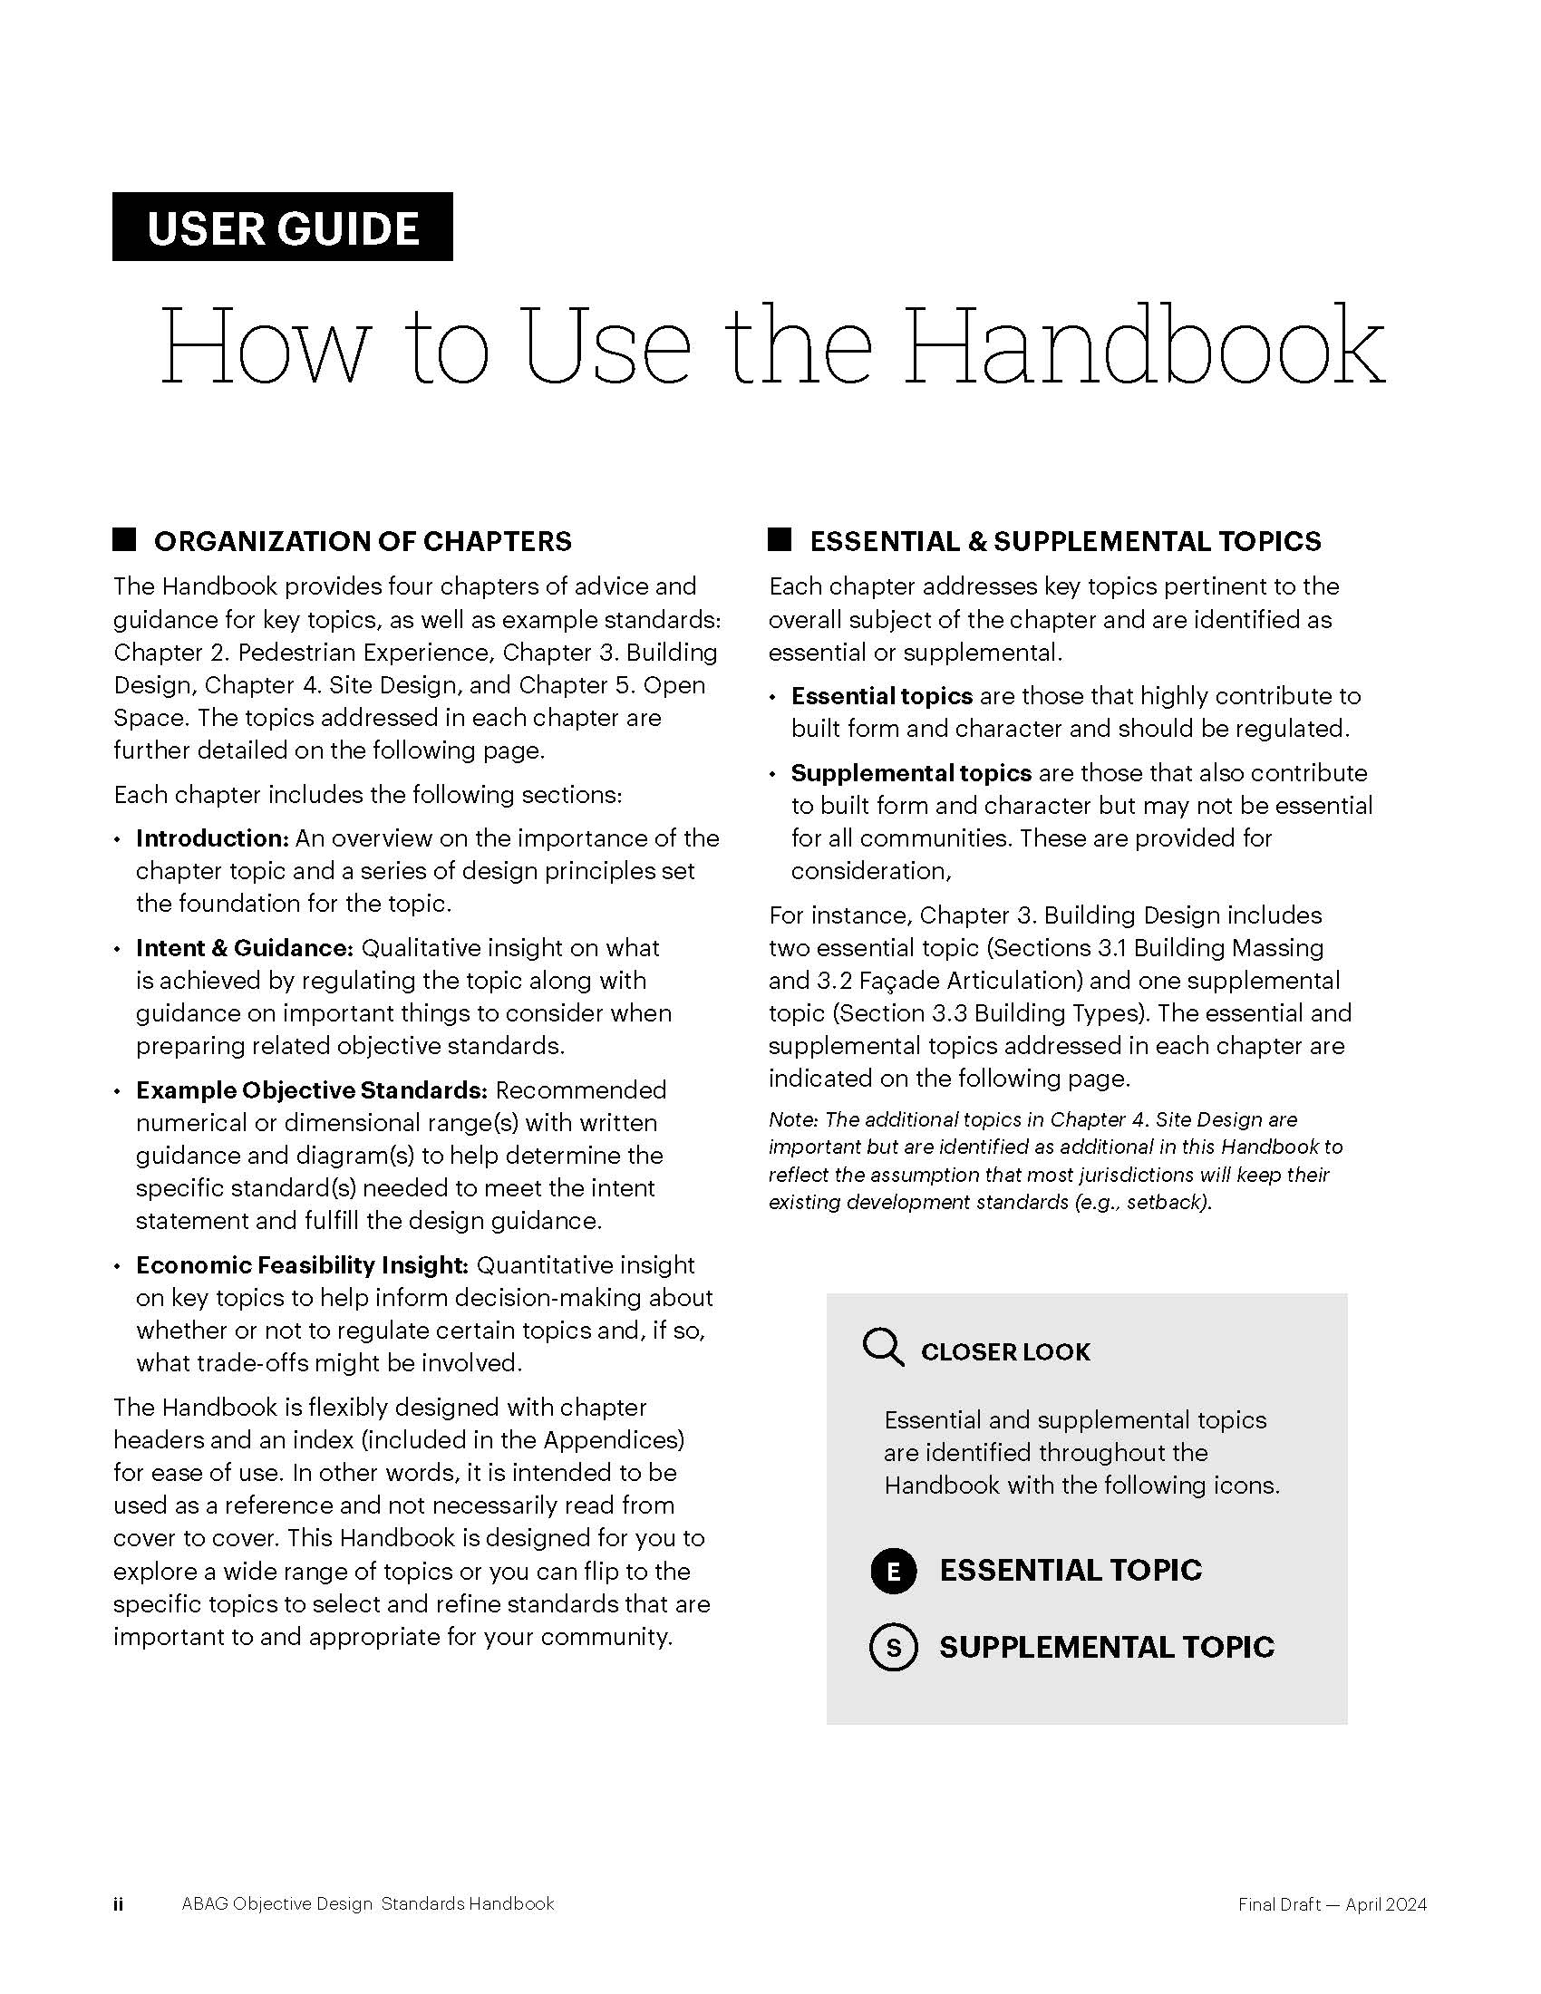
Organization of Chapters
Introduction
Intent & Guidance
Example Objective Standards
Economic Feasibility
Essential & Supplemental Topics
Essential Topics
Supplemental Topics

Slide 10
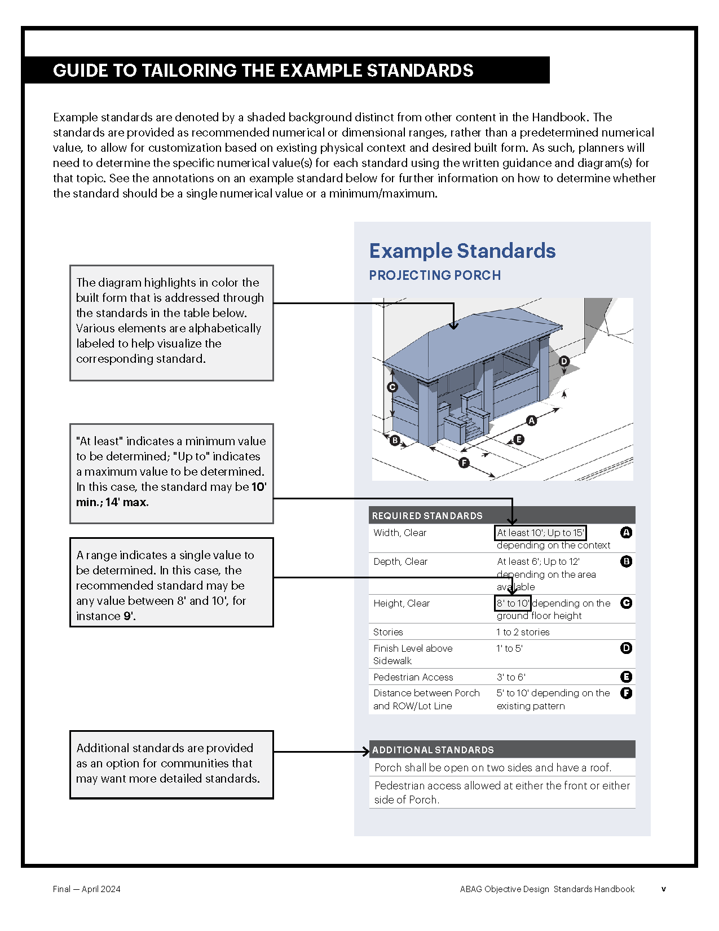
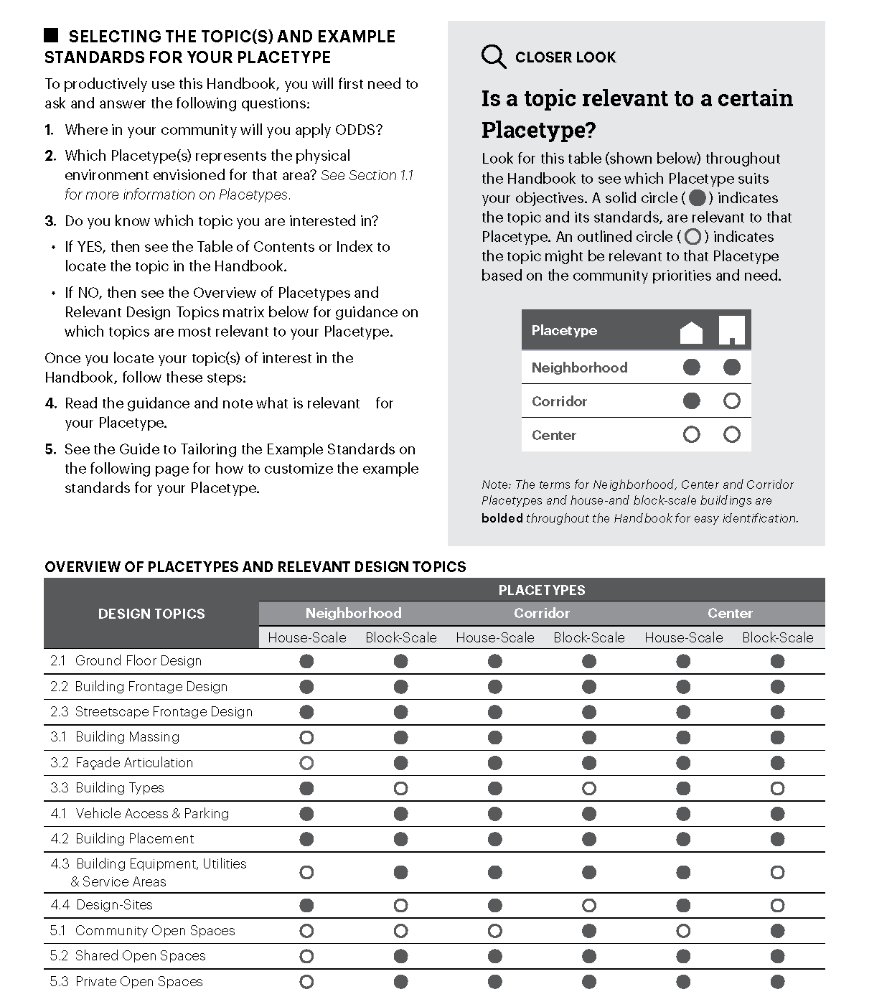

Slide 11
Poll Question
What is the status of Objective Design Standards in your community?
Do not yet have objective design standards
Already adopted objective design standards
Adopted and want to refine objective design standards
Not applicable

Slide 12
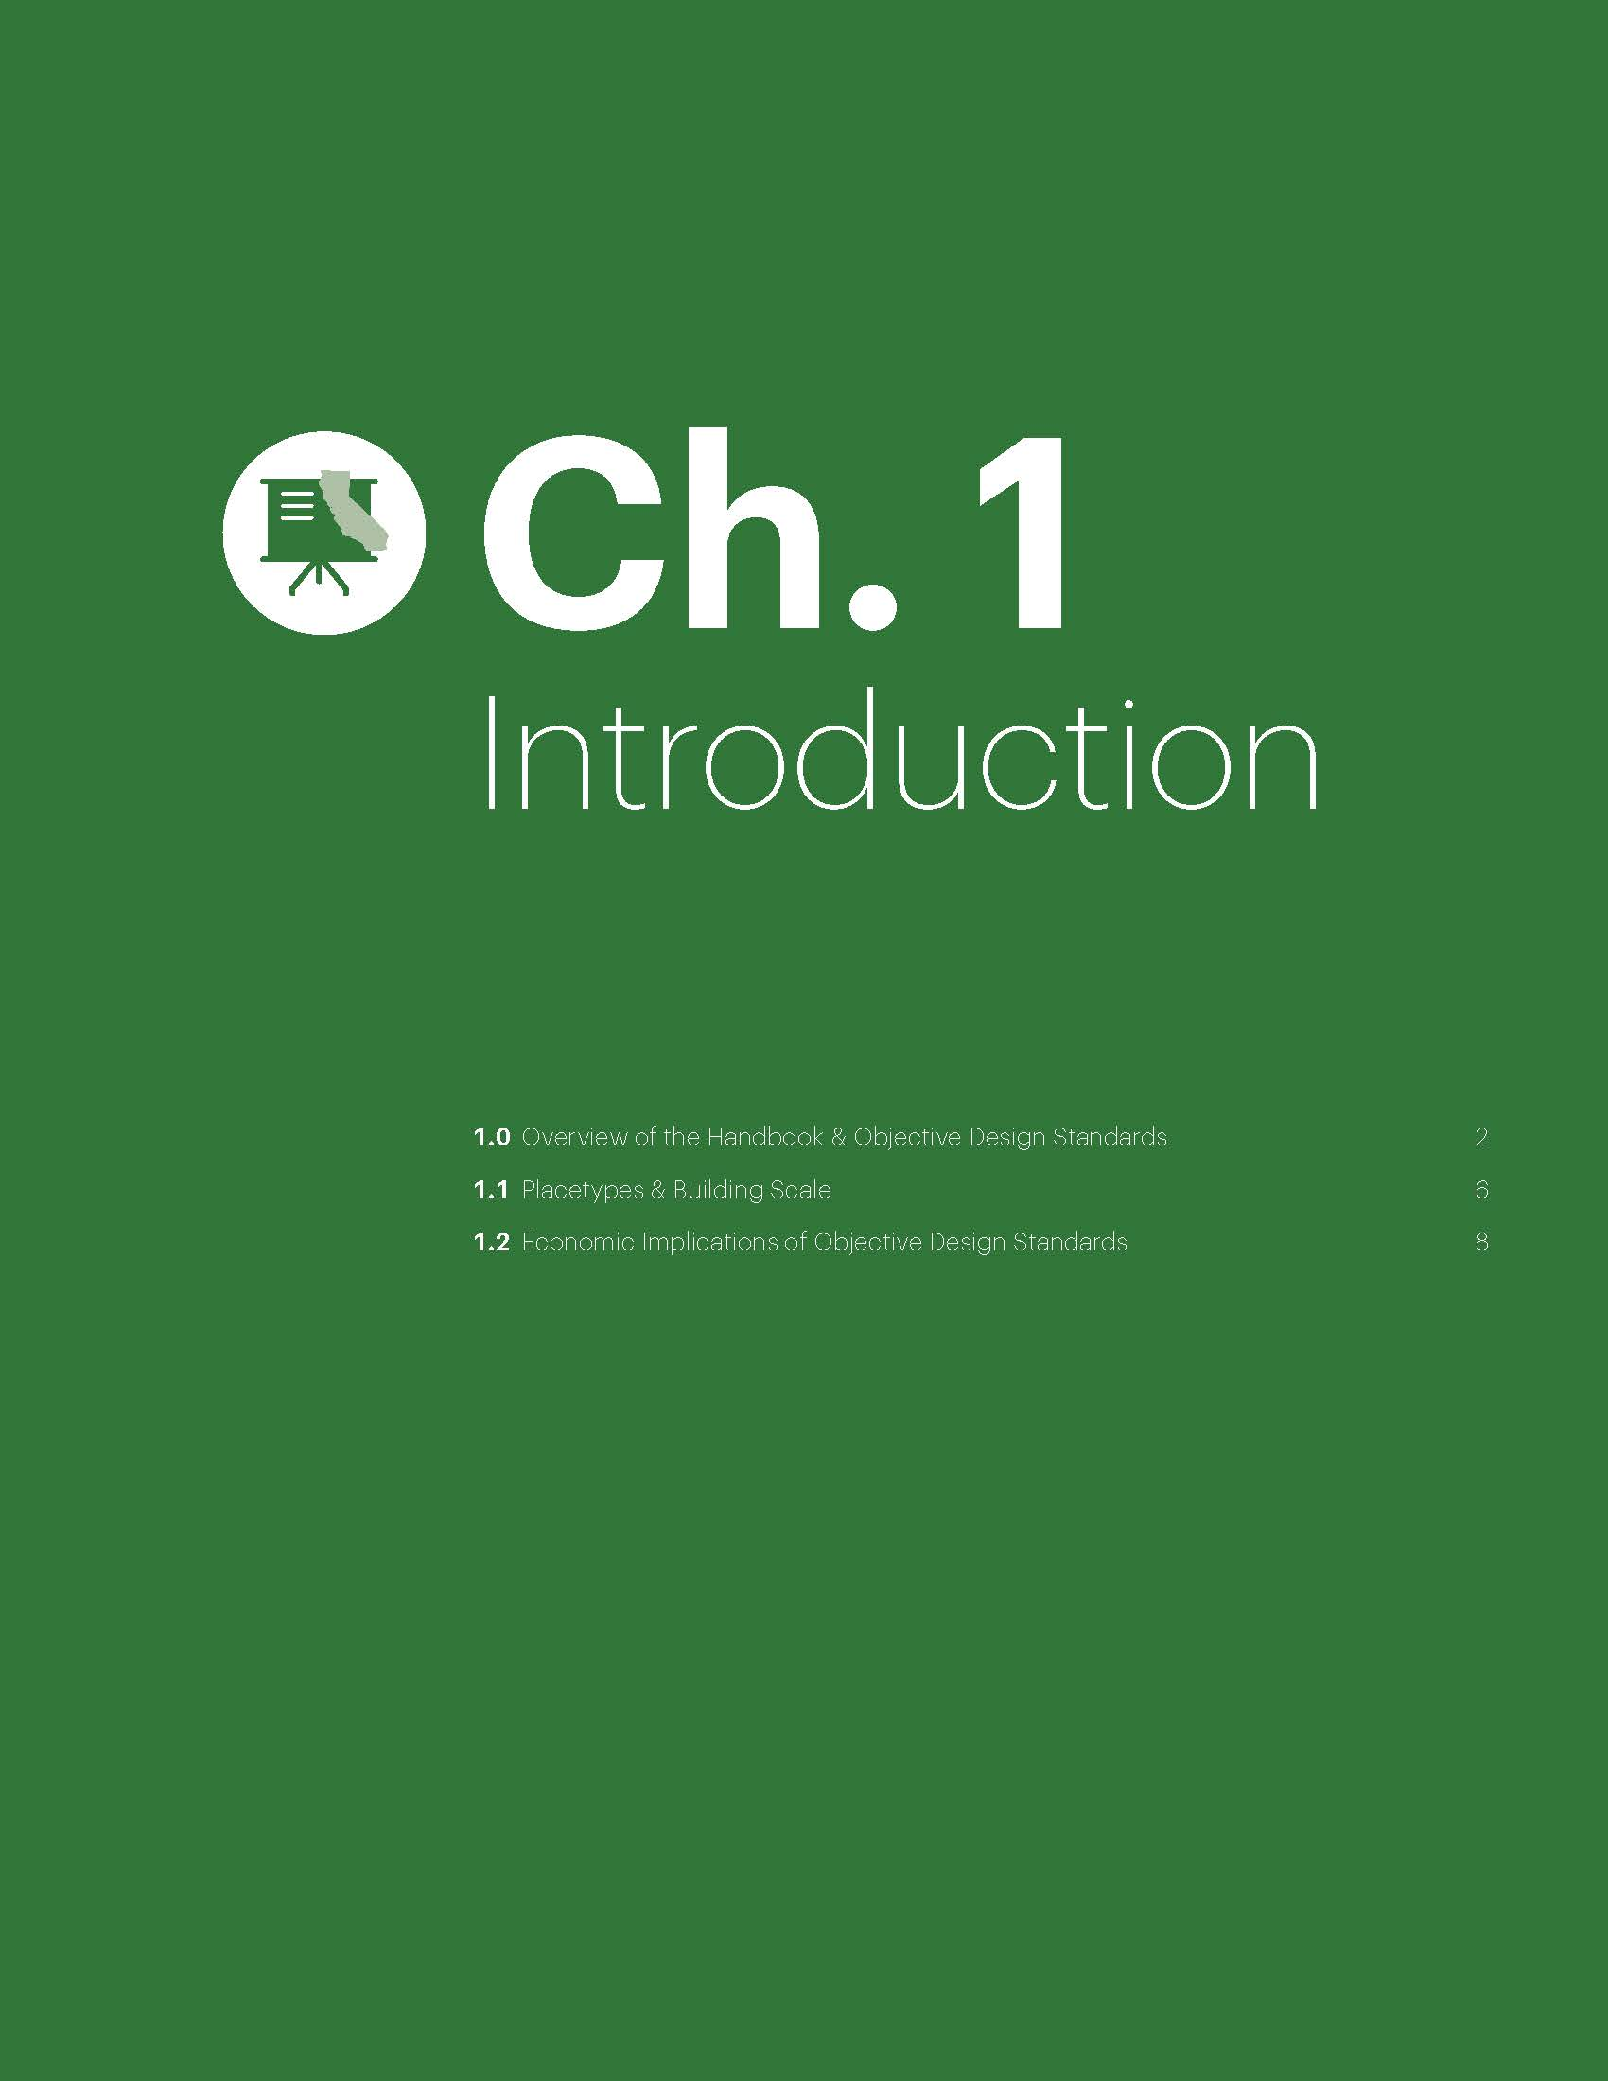
1.0 Overview of the Handbook & Objective Design Standards
1.1 Placetypes & Building Scale
1.2 Economic Implications of Objective Design Standards

Slide 13
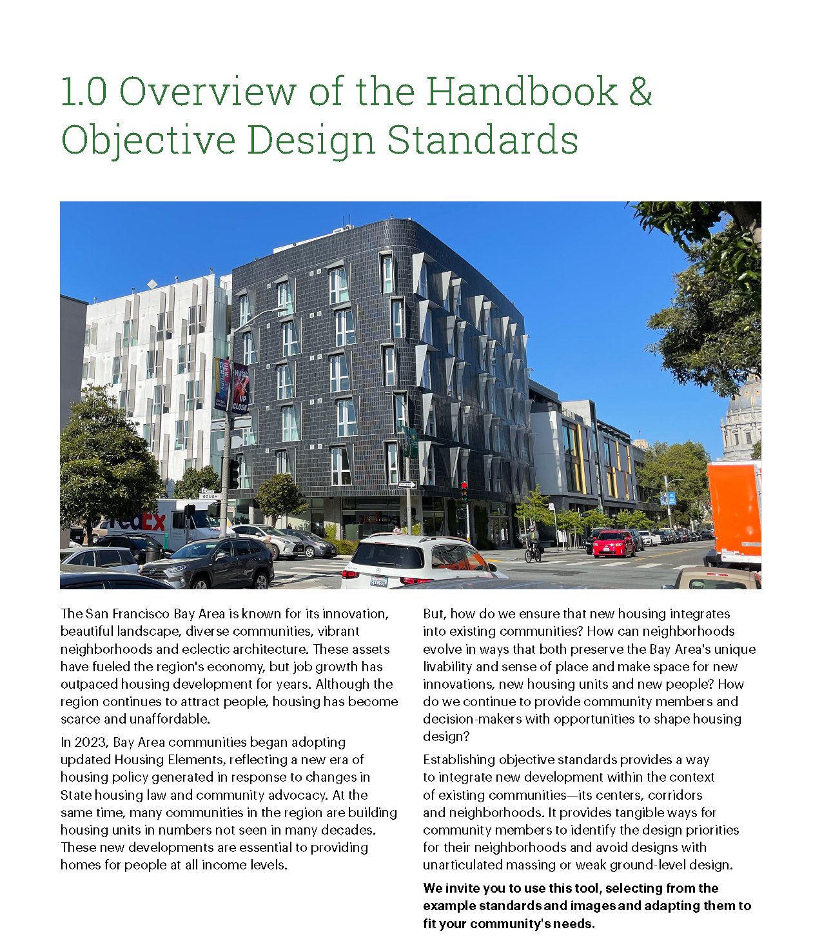
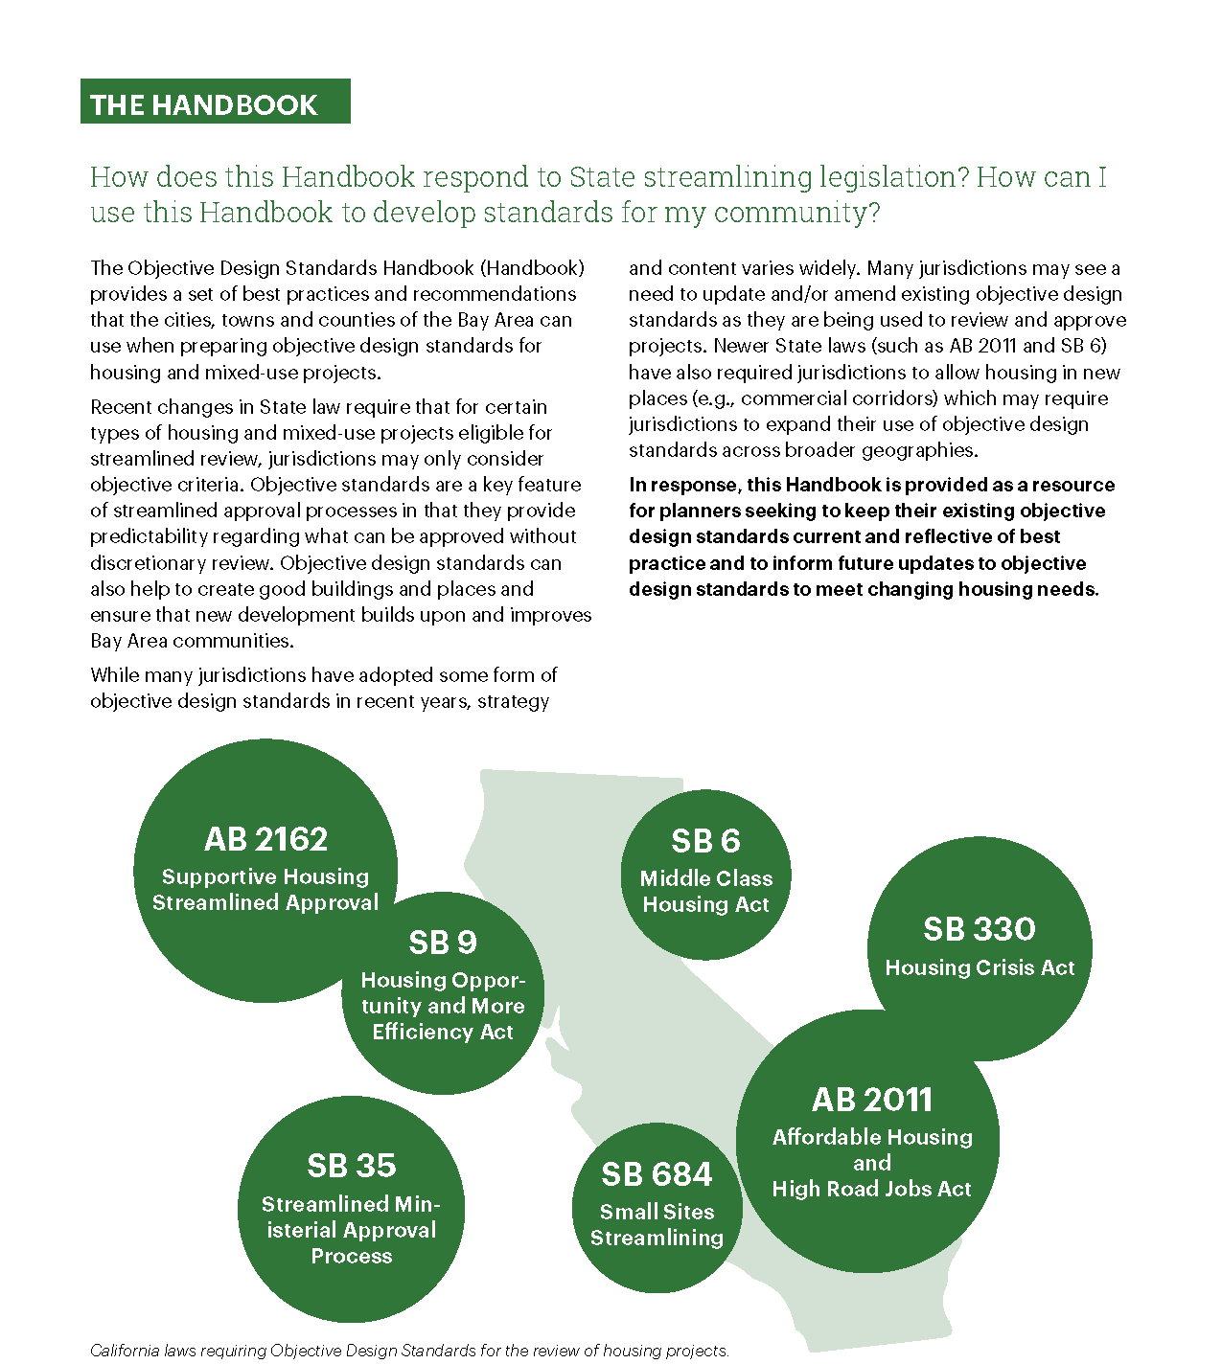

Slide 14
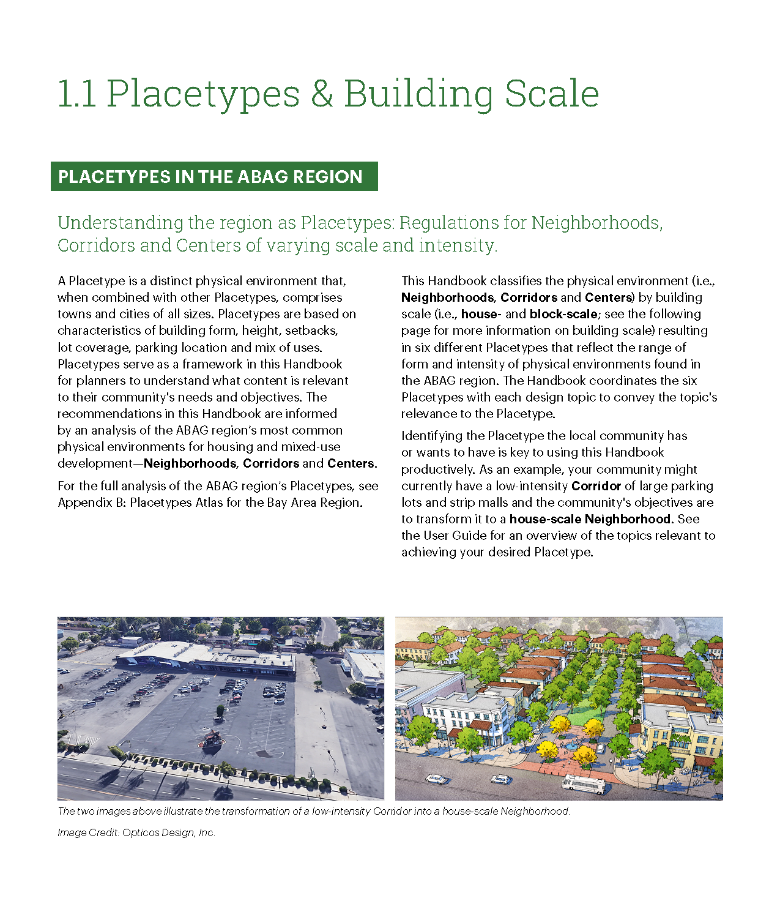
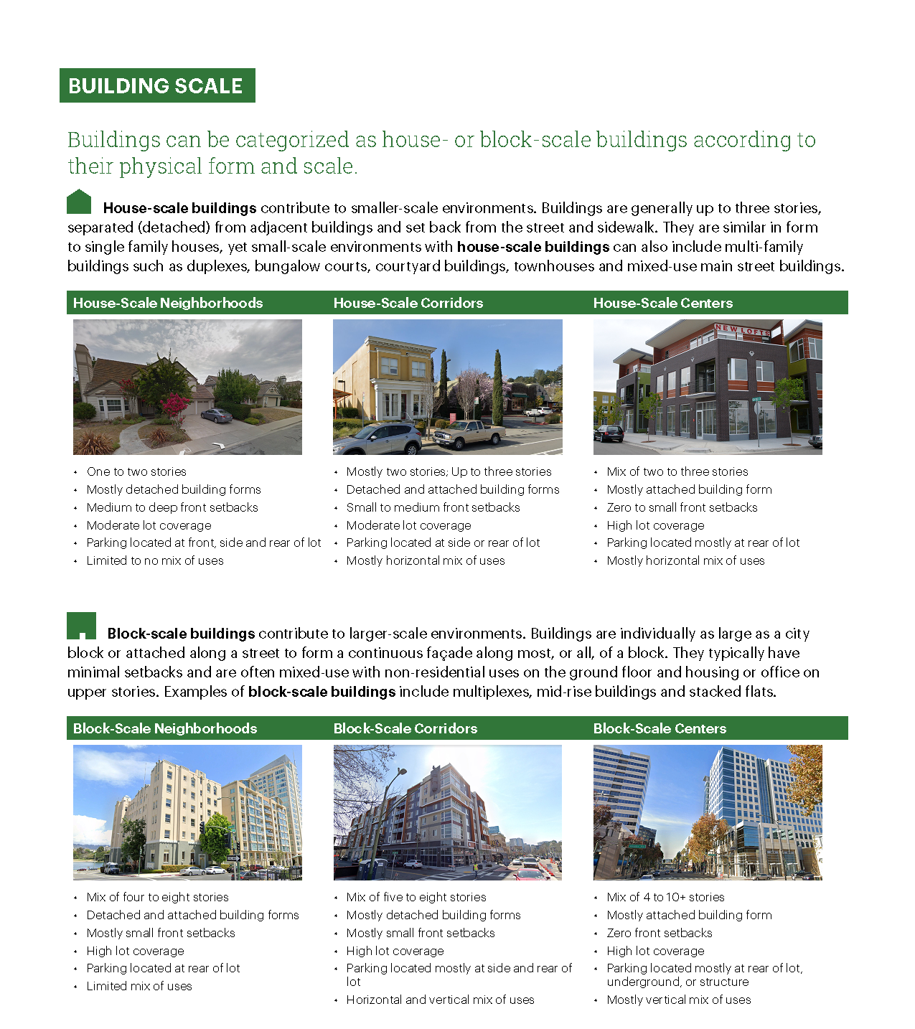

Slide 15
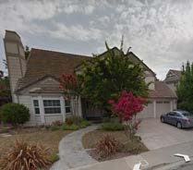
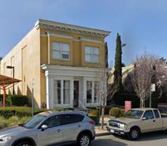
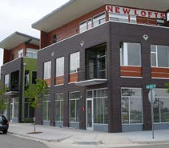
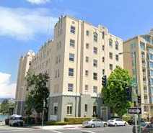
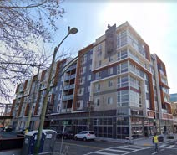
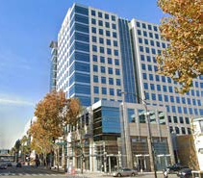
Poll Question
Which of the Handbook’s six Placetypes are relevant to your community? (select all that apply)
A. House-scale Neighborhood | B. House-scale Corridor | C. House-scale Center | D. Block-scale Neighborhood | E. Block-scale Corridor | F. Block-scale Center | G. N/A

Slide 16
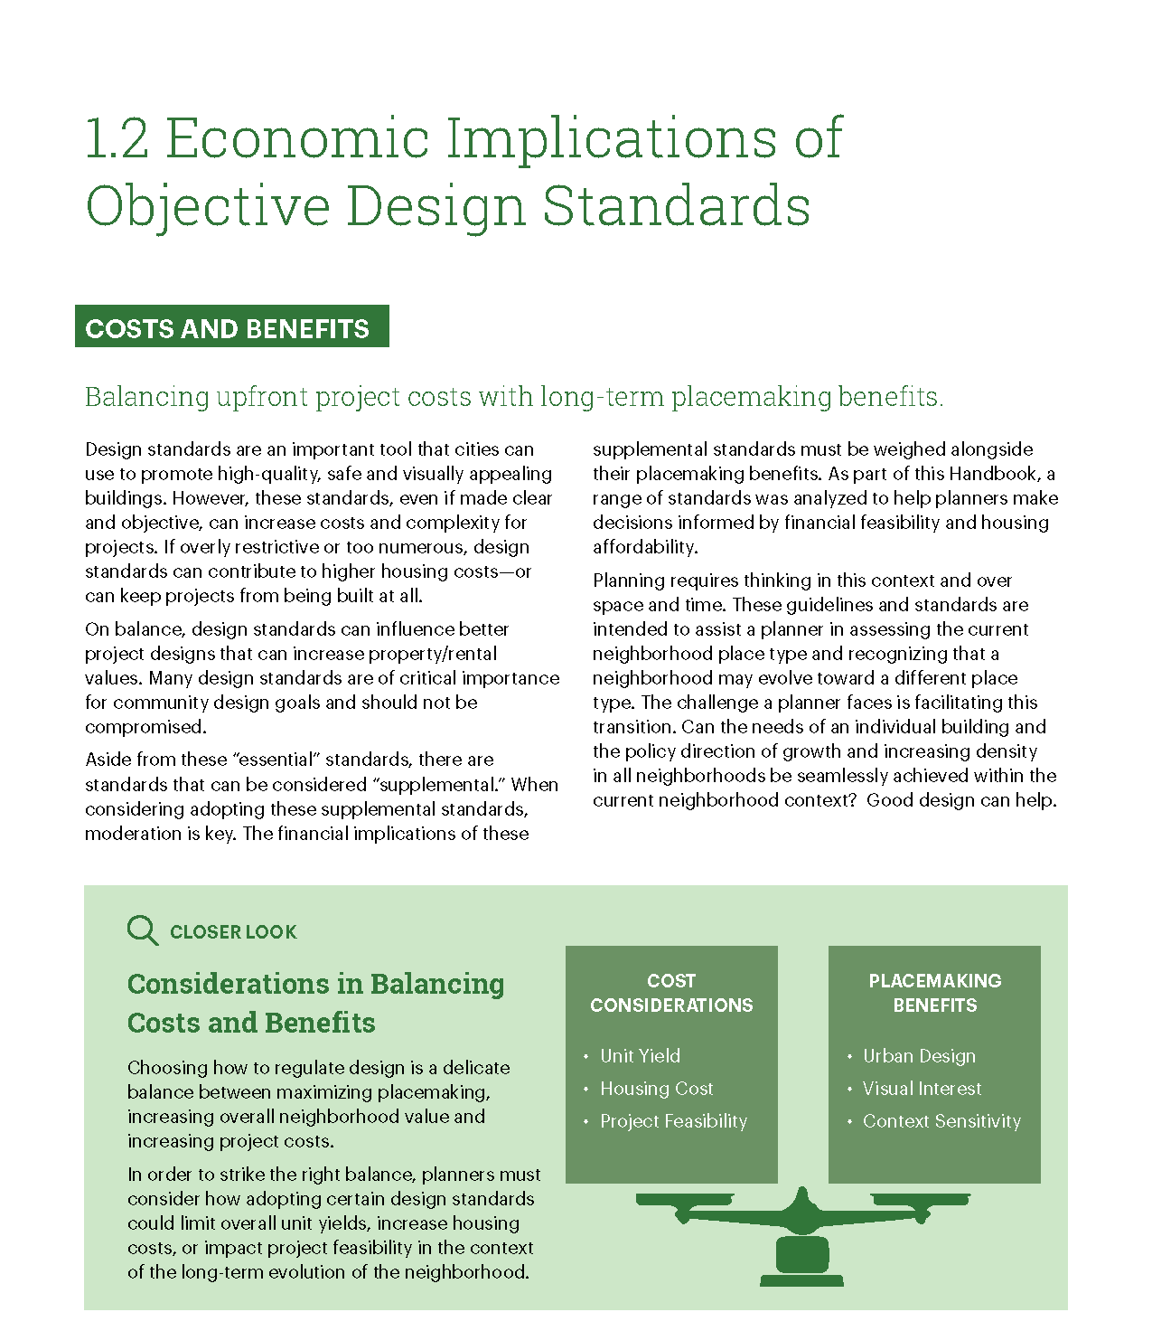
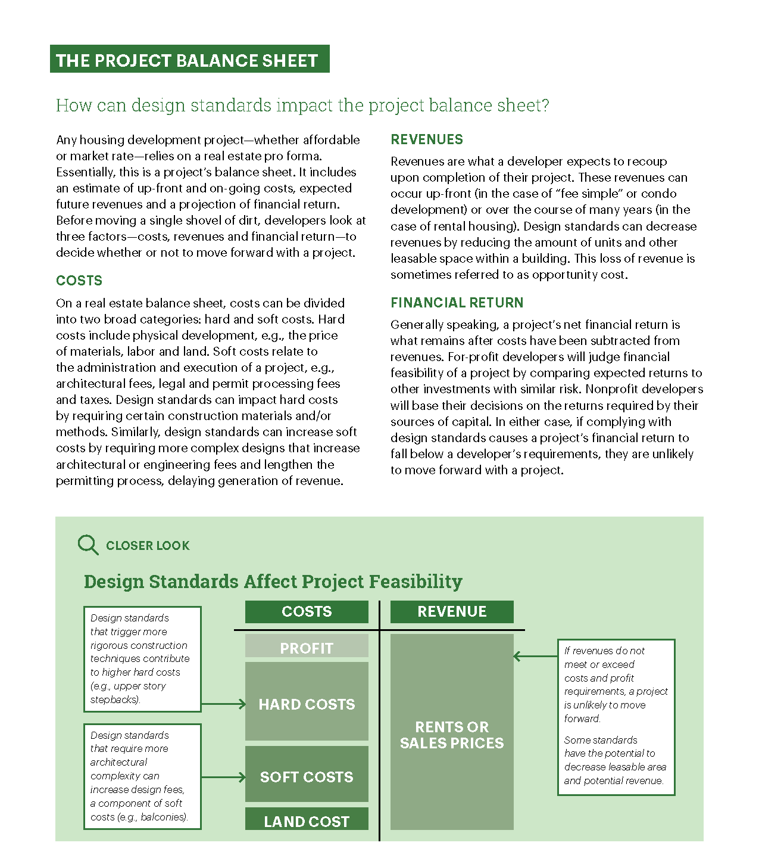

Slide 17
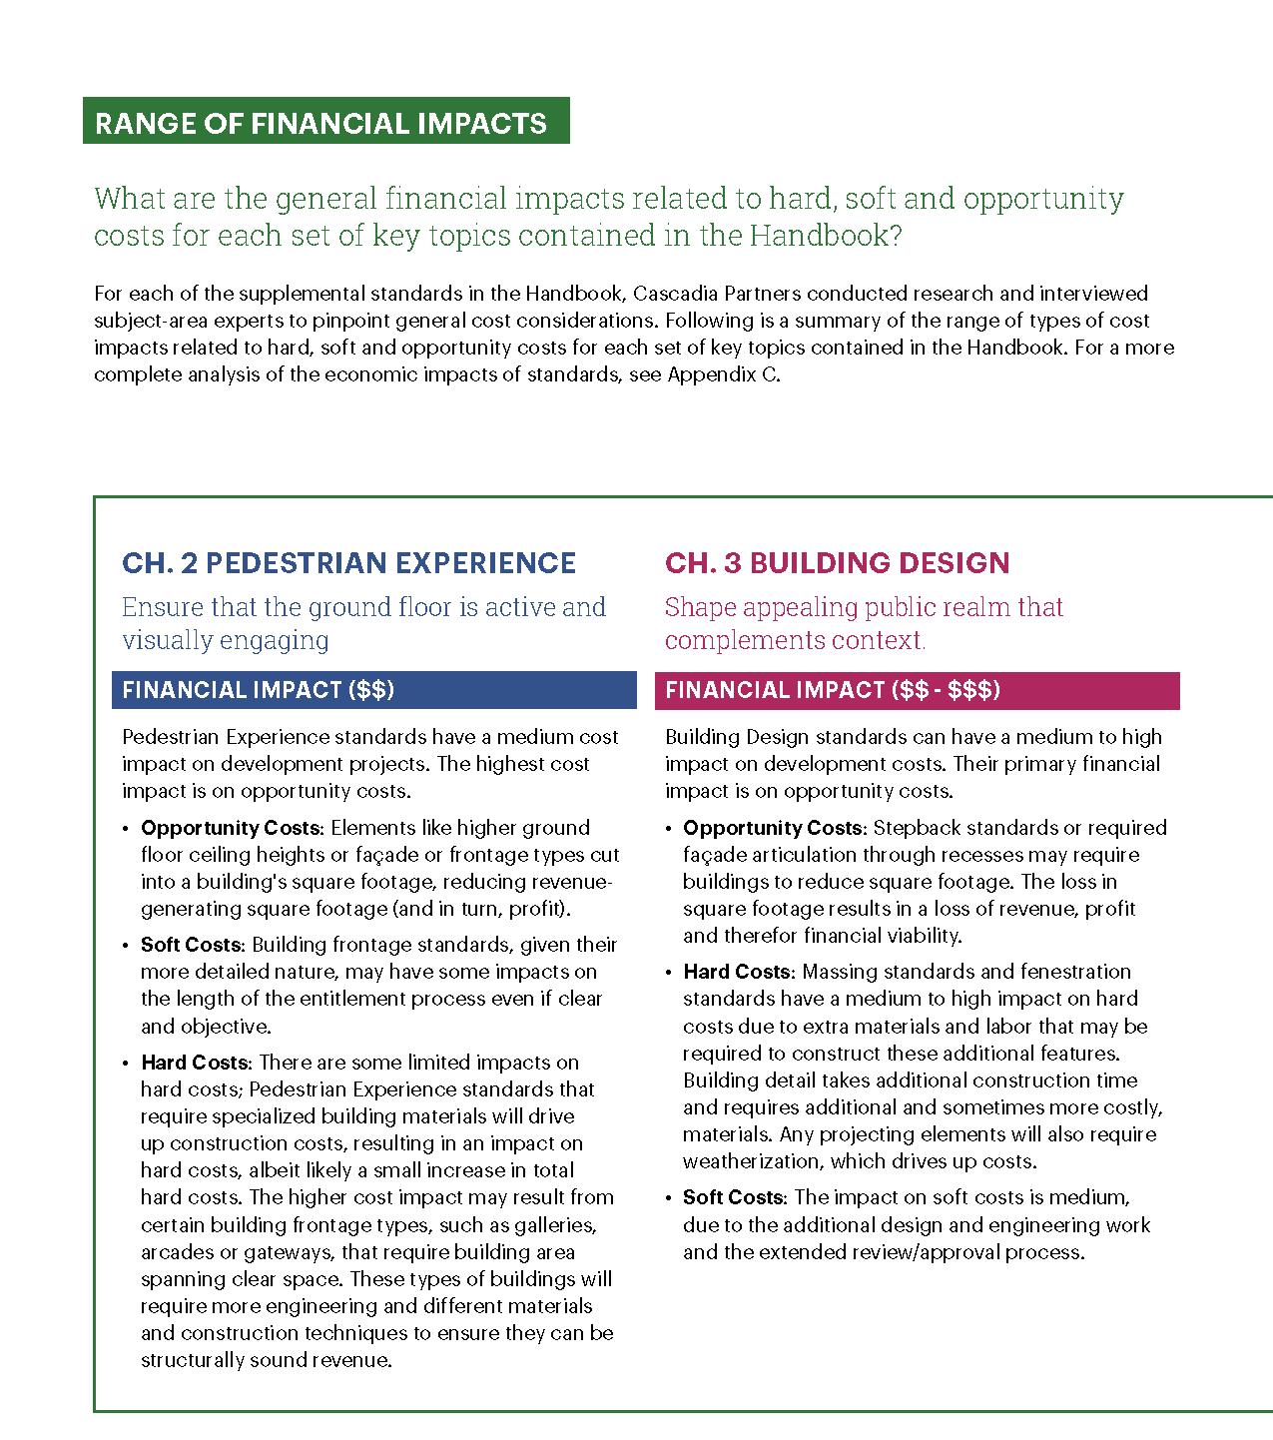
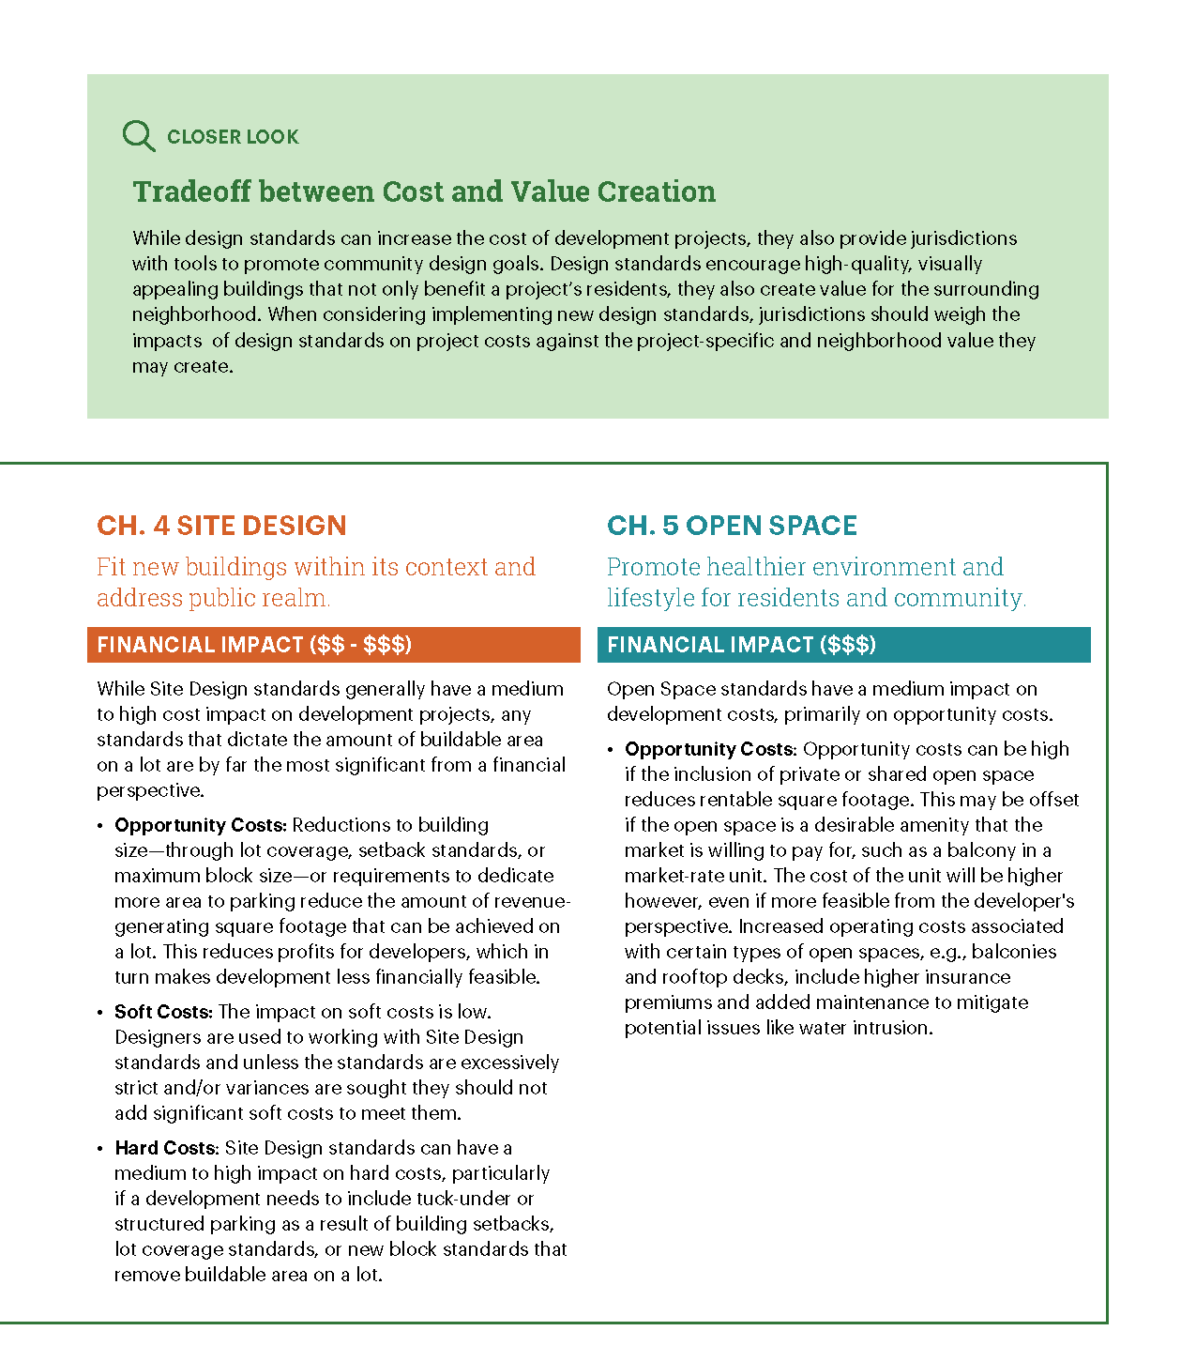
Notes:
Add next spread

Slide 18
Poll Questions
Have you considered the financial feasibility of housing projects when developing design standards?
Yes
No
N/A

Slide 19
Questions & Answers

Slide 20
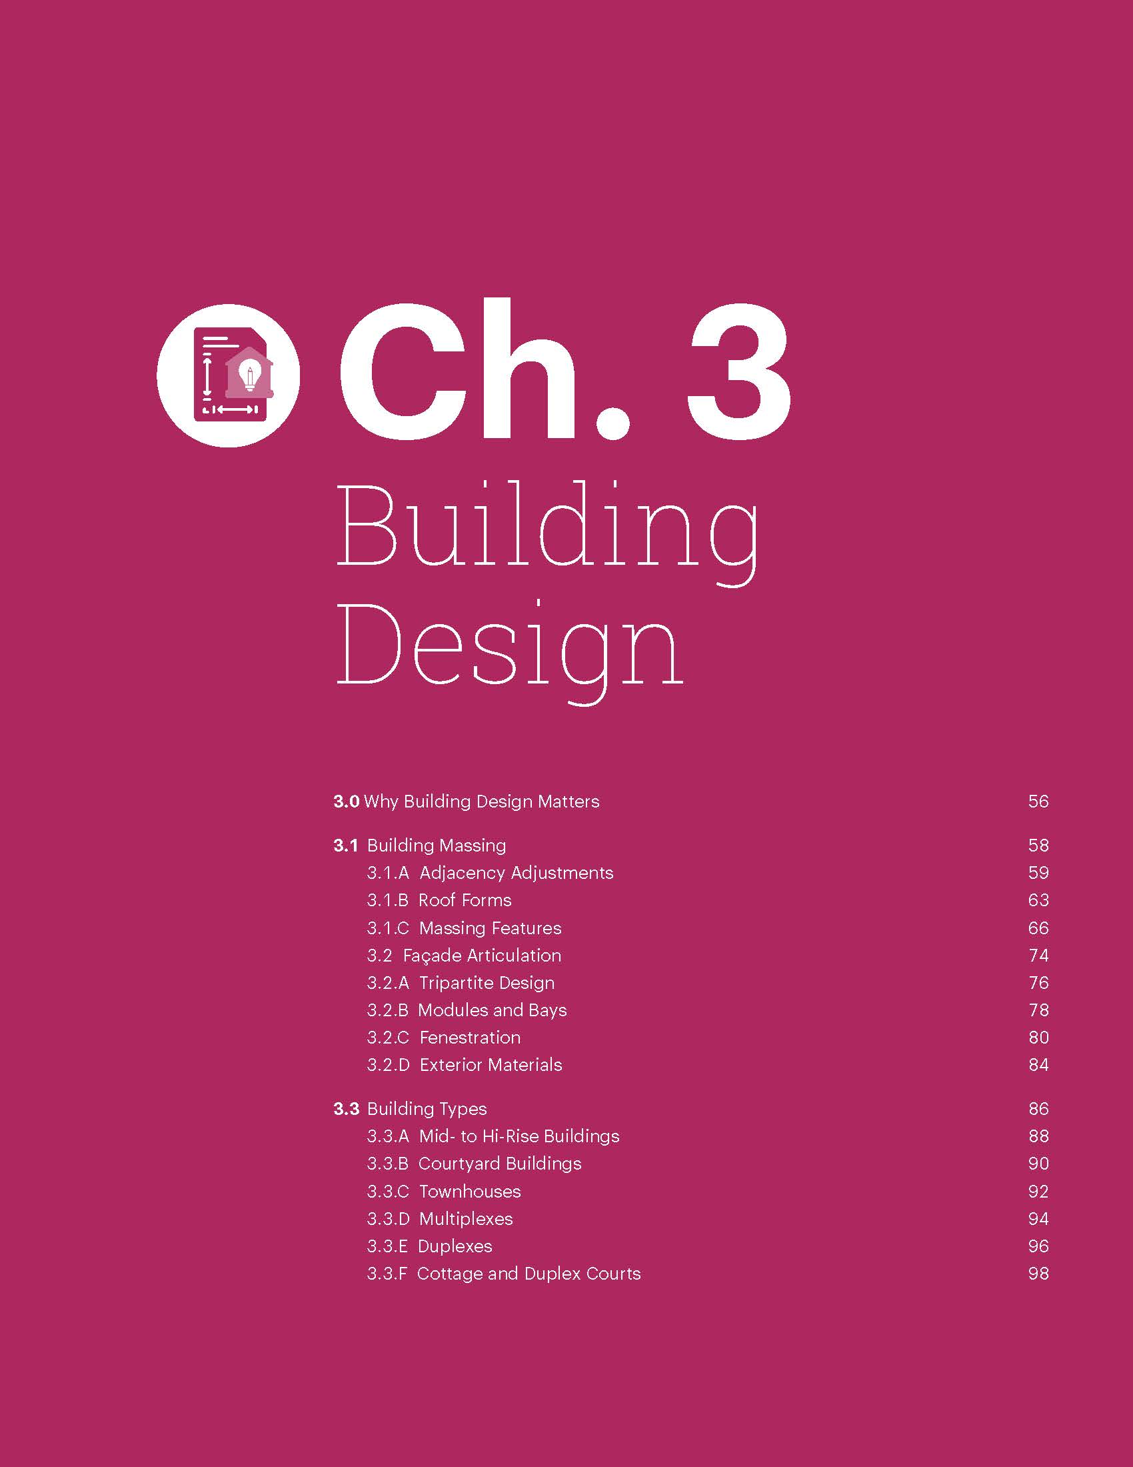
3.0 Why Building Design Matters
3.1 Building Massing
3.1.A Adjacency Adjustments
3.1.B Roof Forms
3.1.C Massing Features
3.2 Façade Articulation
3.2.A Tripartite Design
3.2.B Modules and Bays
3.2.C Fenestration
3.2.D. Exterior Materials
3.3 Building Types
3.3.A Mid- to Hi-Rise Buildings
3.3.B Courtyard Buildings
3.3.C Townhouses
3.3.D Multiplexes
3.3.E Duplexes
3.3.F Cottage and Duplex Courts

Slide 21
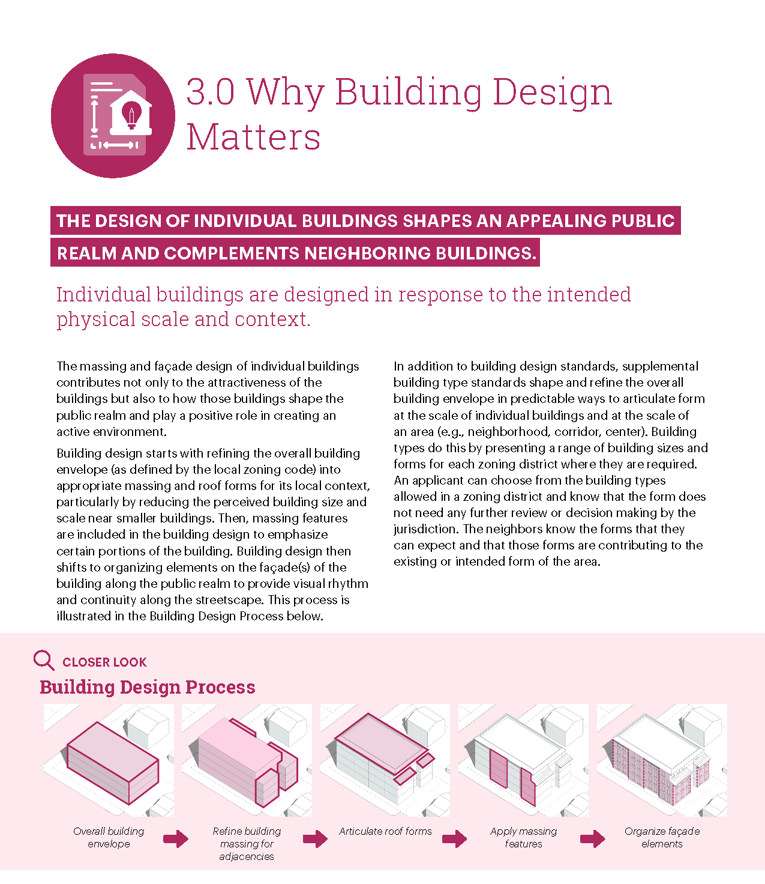
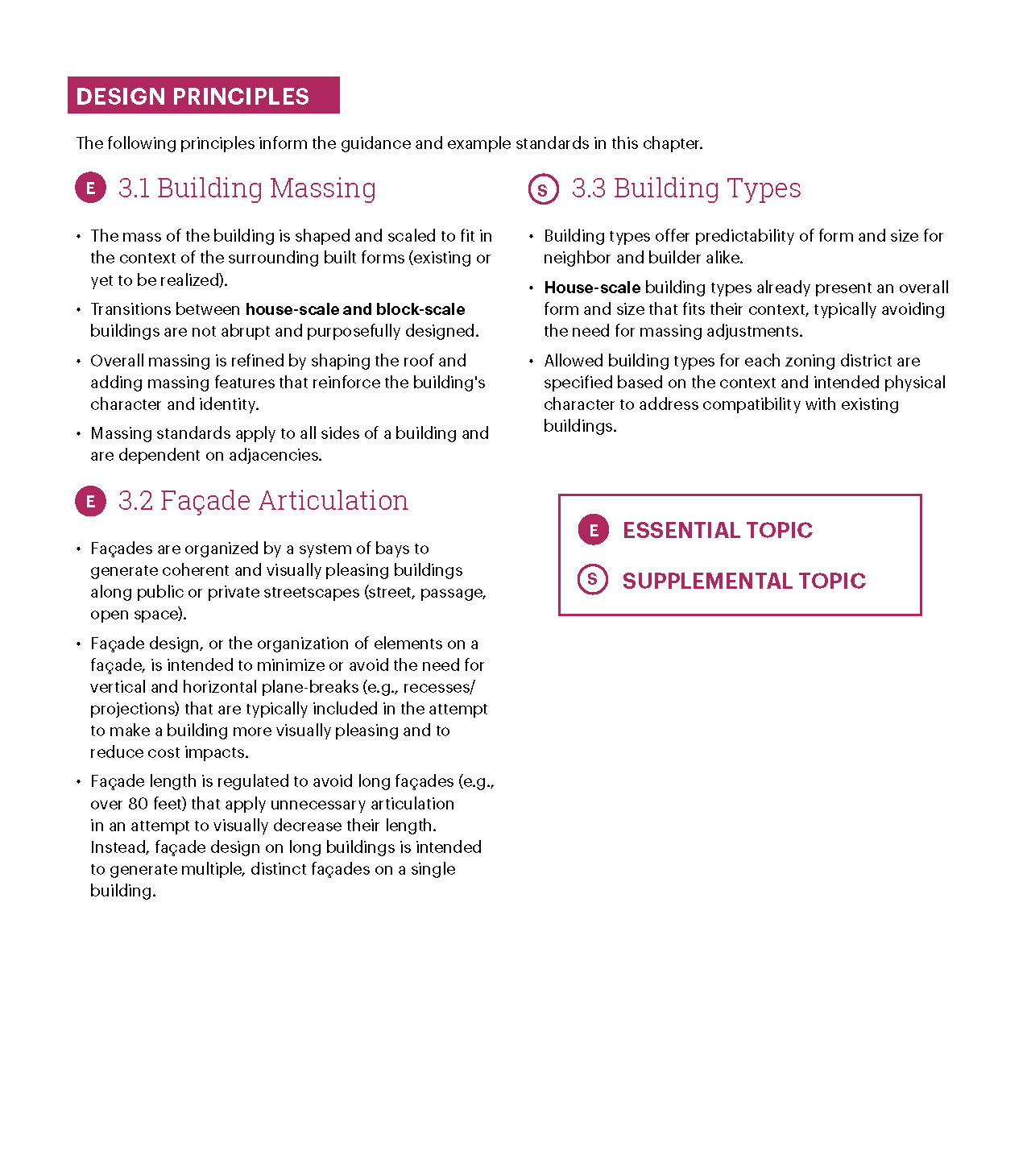

Slide 22
Poll Question
What is important to your community in addressing building design? (select all that apply)
Context-sensitive infill buildings
Transitions between lower- and higher-intensity buildings
Articulation and reducing blank walls
Active ground floor
Which approach do your standards include?
Typical (e.g., recess/projection required every 30 feet)
Modules

Slide 23
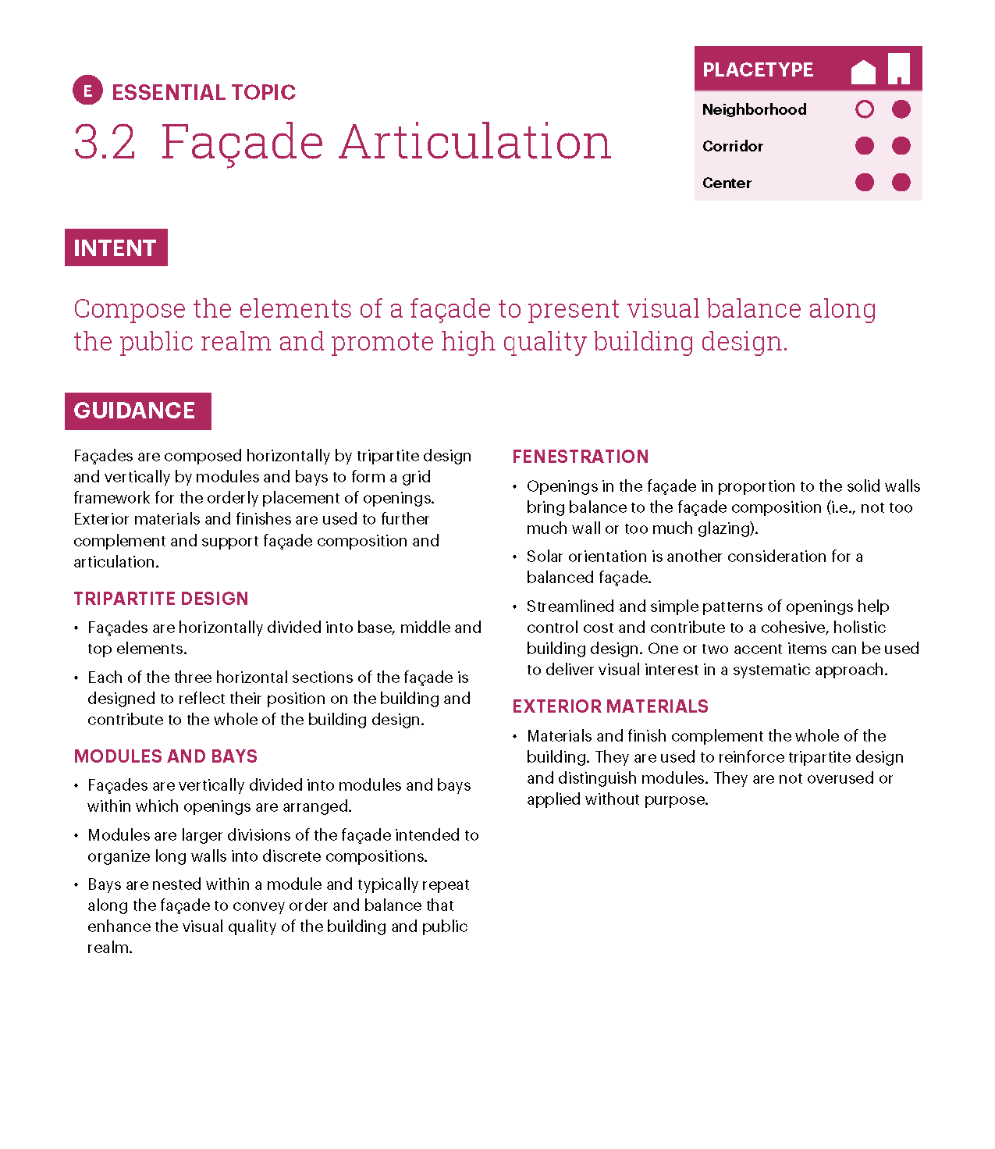
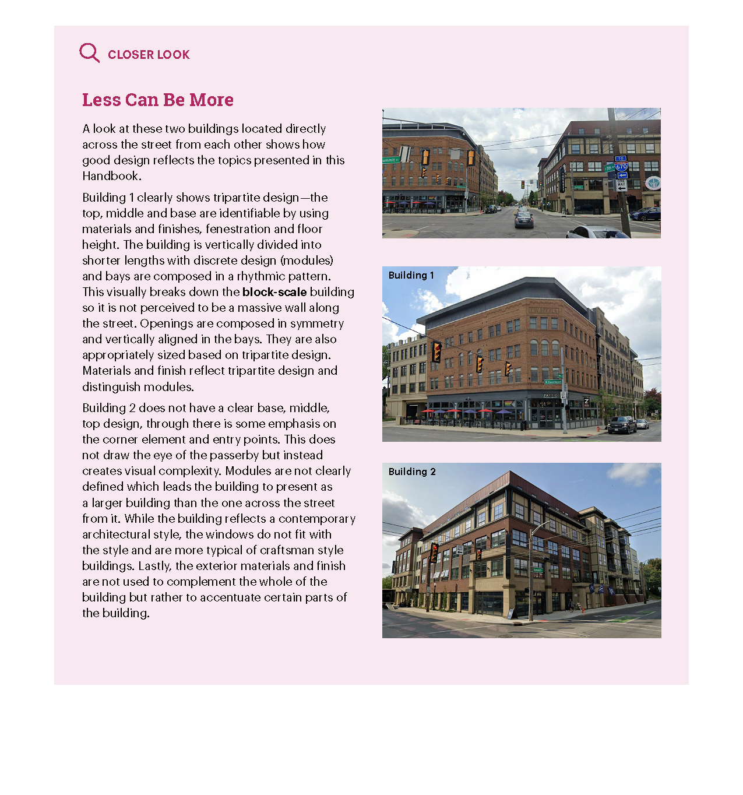

Slide 24
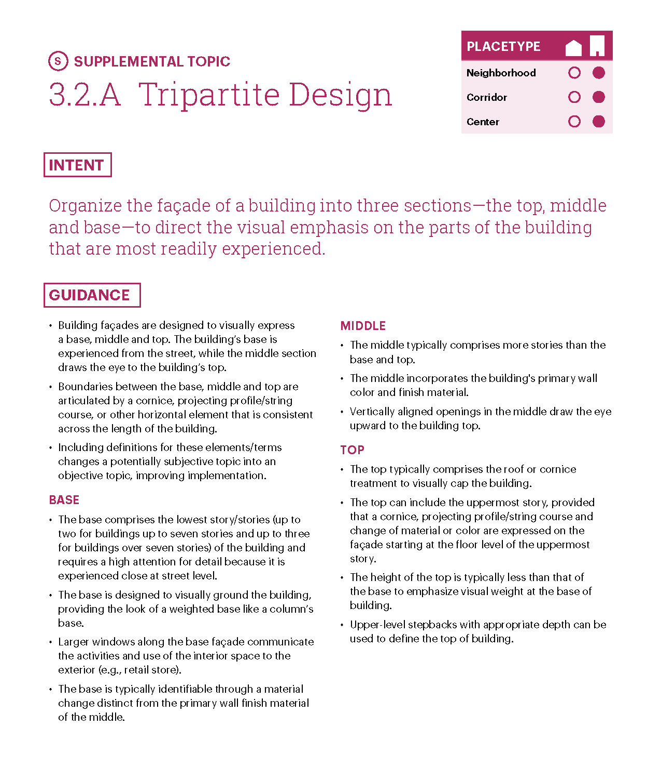
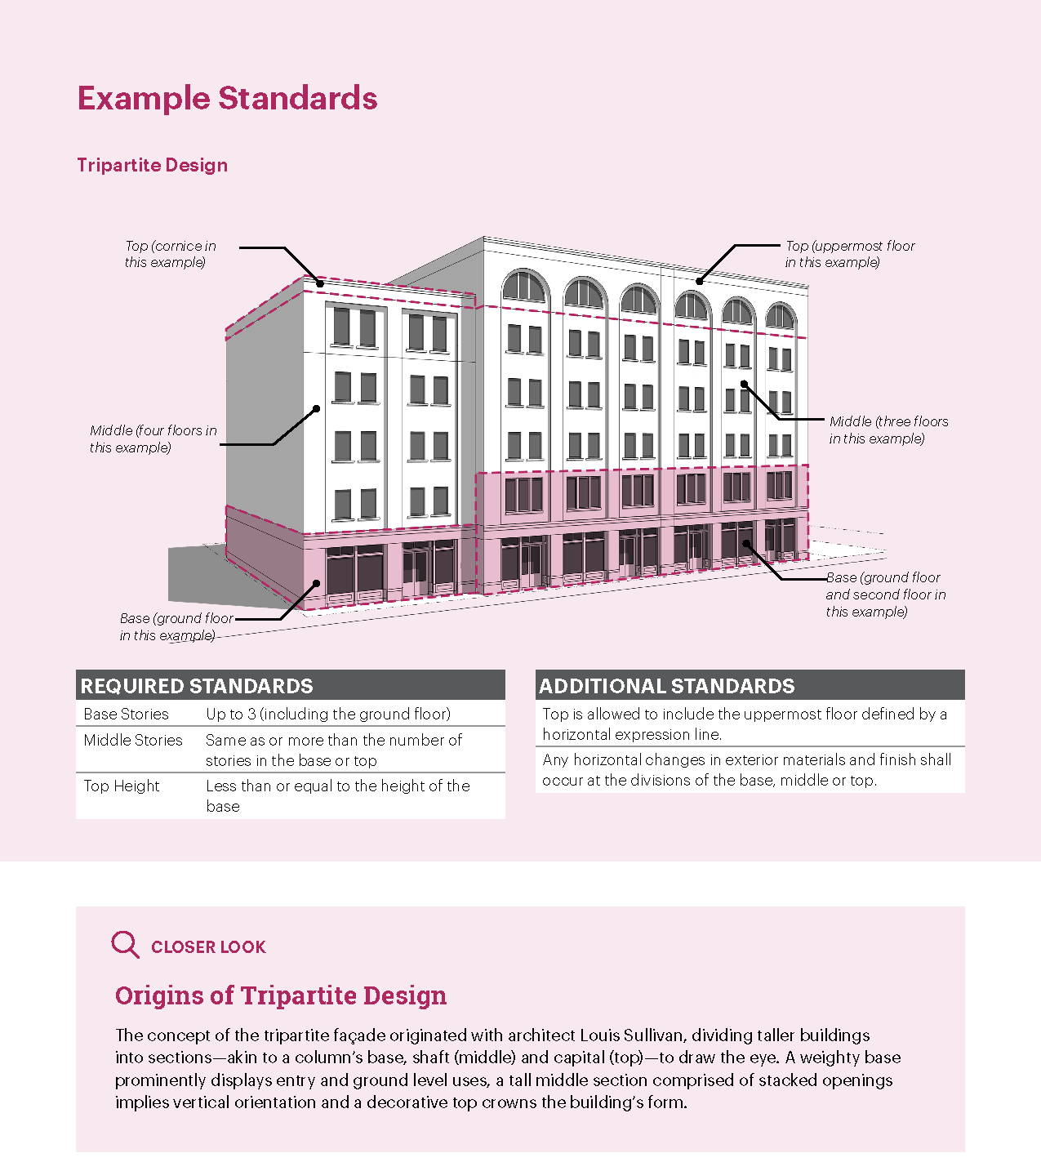
Top (Cornice)
Middle (3 Floors)
Base (Ground Floor & 2nd Story)

Slide 25
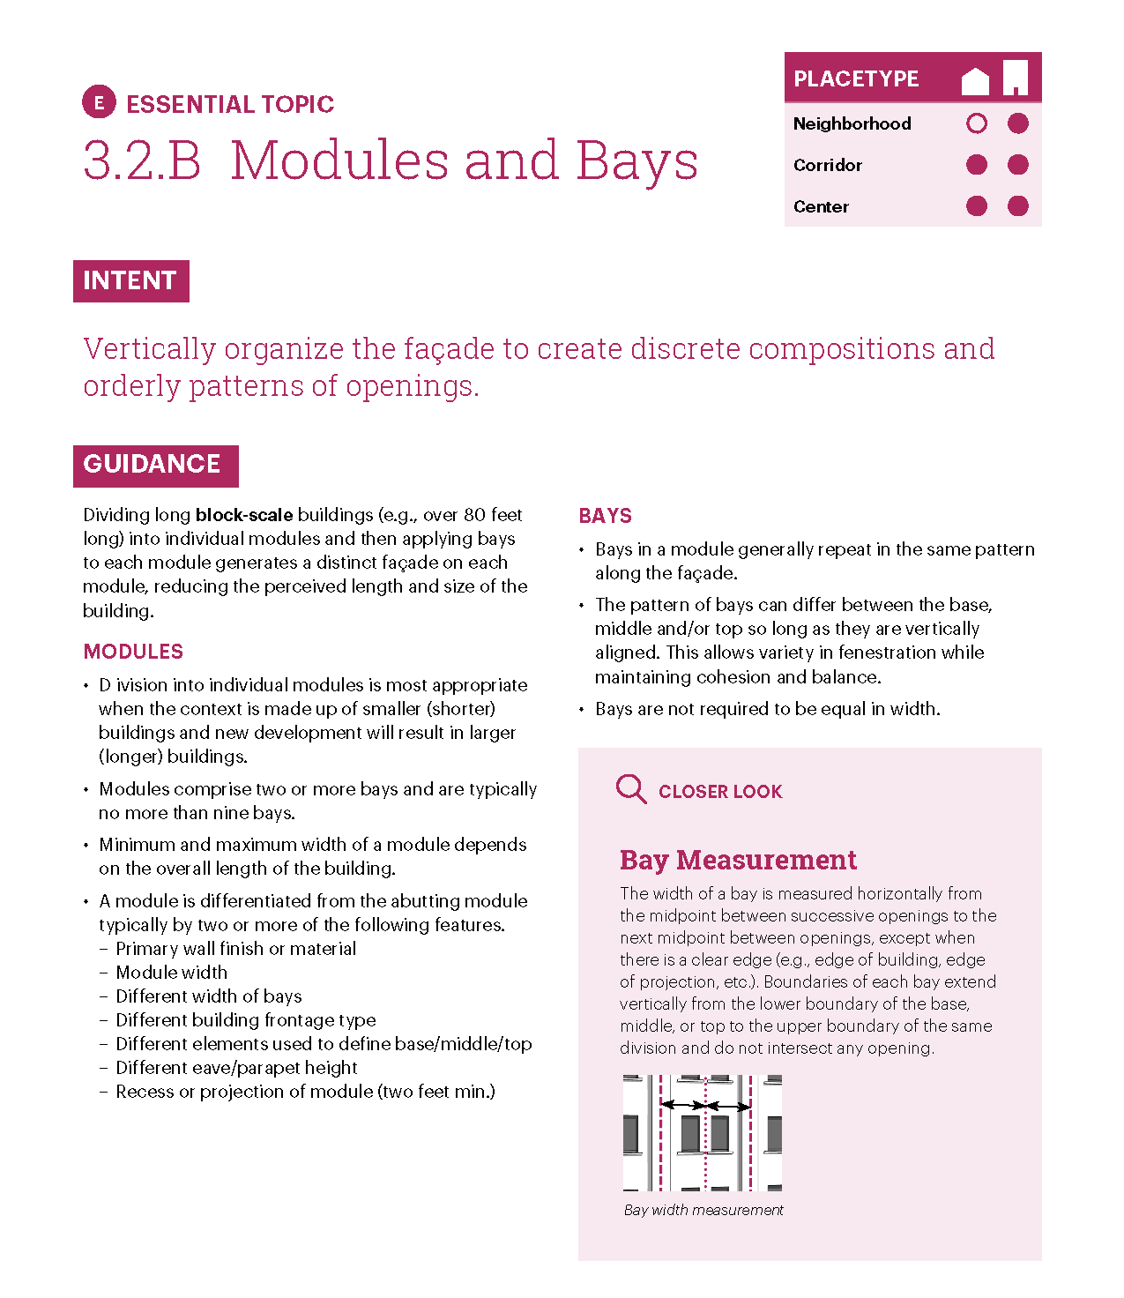
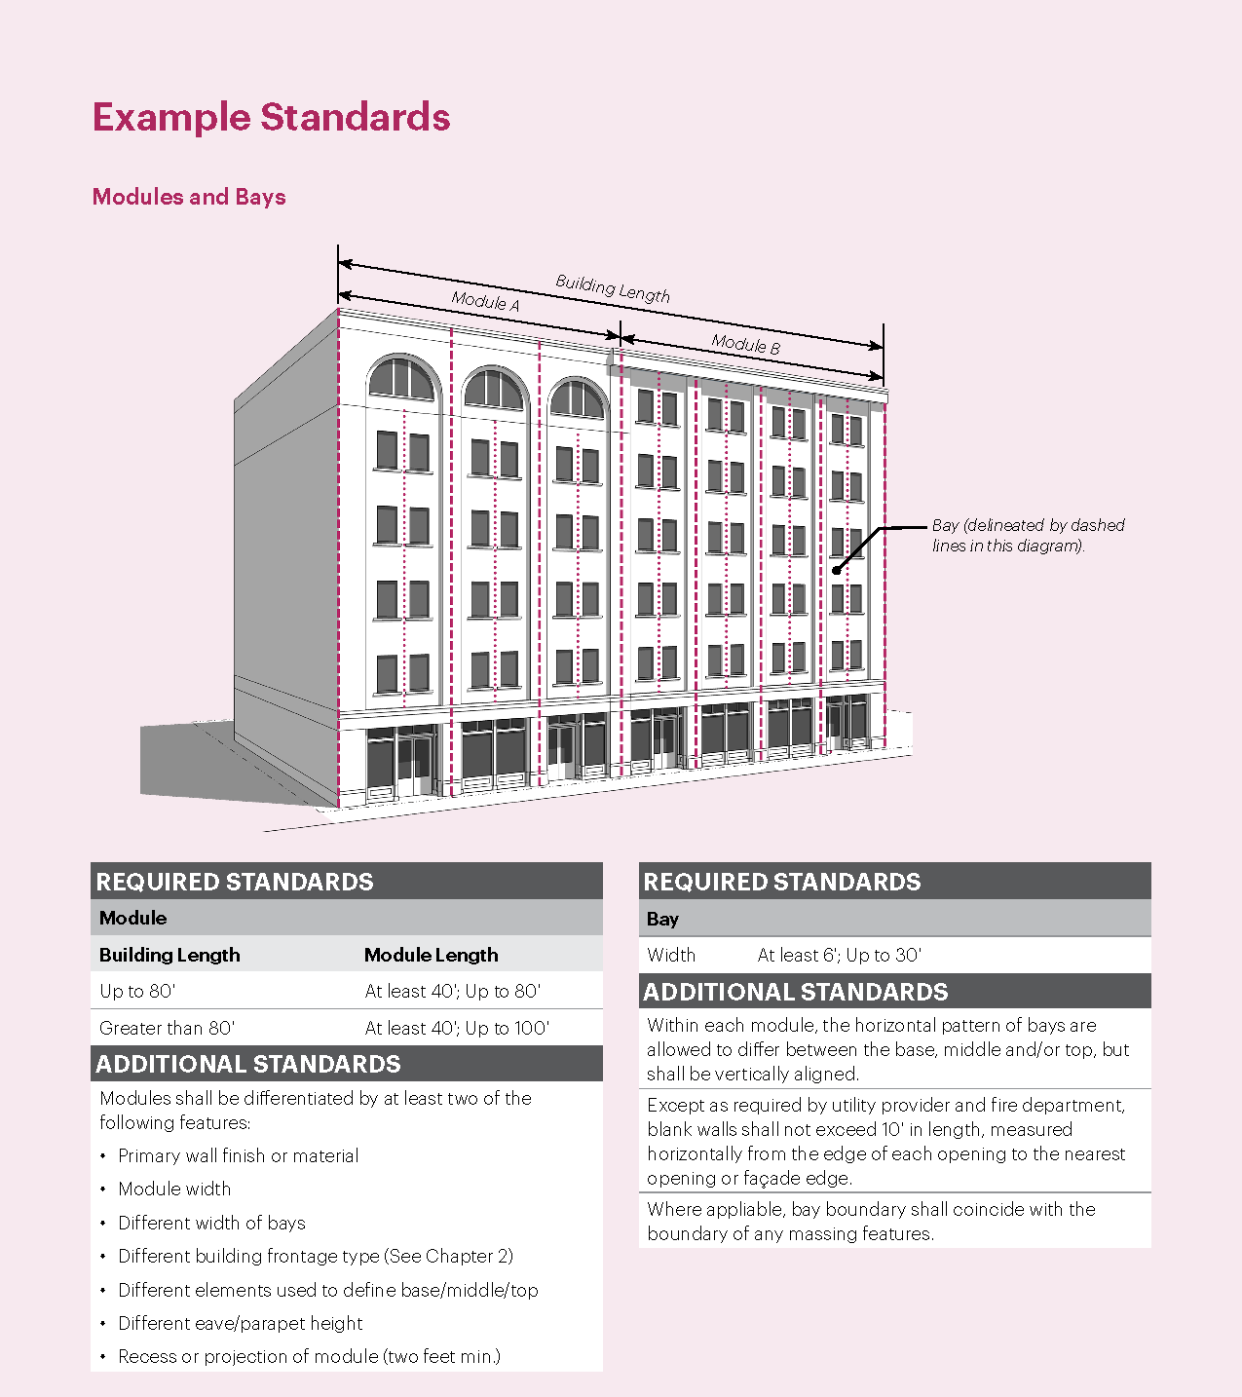

Slide 26
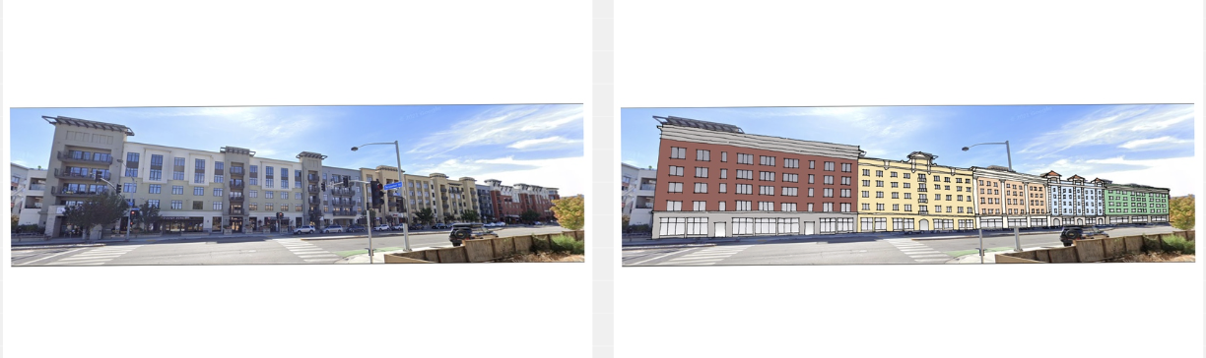
Comparing Façade Articulation Approaches
Typical Approach
Results in unnecessary articulation that still looks like one large building
Modules Approach
Results in distinct façades
without unnecessary articulation

Slide 27
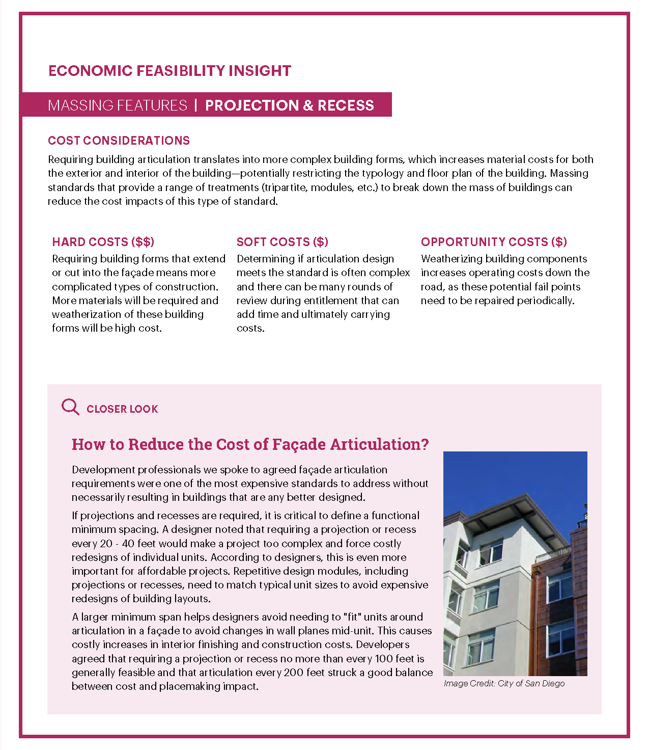

Slide 28
Questions & Answers

