Slide 1
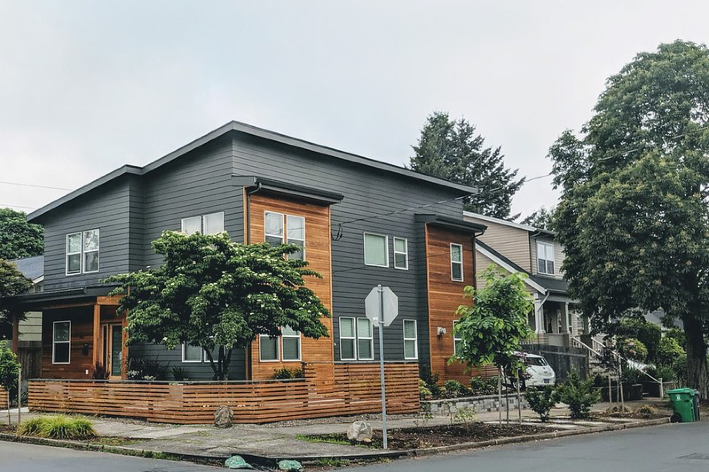




Zoning for Affordability
Communicating with the Public and Electeds
November 2, 2023
Association of
Bay Area Governments
Image: Siteline Institute

Slide 2
Agenda
Introduction
Overview of Public Process
Exercise: Communicating with the Public on Challenging Issues
Presentation Template
Closing and Evaluation
Goal: To help staff prepare for the process of communicating the complexities of inclusionary housing policies with the public and elected officials.
  Please introduce yourself by typing your name and jurisdiction into the chat

Slide 3





Example Process
Planning Commission
Draft Ordinance
Feasibility Study
Ordinance Approval
(Council Discussion)
Stakeholder Convening(s)
Initial Council Study Session
Notes:
Council Study Session
Public Information meeting
Developer Information session
Planning commission study session
Staff Report
Videos?

Slide 4
Example Study Session Outline
What is Inclusionary Housing?
(Why are we updating our ordinance?)
(Results to date from our program)
What counts as ‘affordable?’
Housing Needs
  RHNA/Housing Element
Understanding the Economics
  Feasibility Studies
What do other jurisdictions do?
Key Policy Elements
  On site Requirement
  Compliance Alternatives
    fee in lieu
  Incentives (Including State Bonus)
  Term of Affordability
  Monitoring/Stewardship
What will be the process?

Slide 5
Other Policy Design Topics
Exemptions
Rounding/fractional units
Design/Amenities
Timing
Clustering
Zones/target area
Rental, ownership or both
Schedule for Updates

Slide 6
Example Staff Report Outline
What is Inclusionary Housing?
(Why are we updating our ordinance?)
(Results to date from our program)
What counts as ‘affordable?’
Housing Needs
  RHNA/Housing Element
Understanding the Economics
  Feasibility Studies
  Summary of Findings
What do other jurisdictions do?
Key Policy Elements
  On site Requirement
    Staff Recommendation
  Compliance Alternatives
    Staff Recommendation
  Incentives
    Staff Recommendation
  Term of Affordability
    Staff Recommendation
  Monitoring/Stewardship
    Staff Recommendation

Slide 7
Hard Questions

Slide 8
Hard Questions (2 of 2)
There are a few questions that routinely come up that can be particularly challenging to address
Is it better for the city to require onsite units or allow a fee in lieu?
Does requiring affordable units push up the cost of market rate housing?
Do affordable housing requirements become a barrier to getting housing built?

Slide 9
Small Group Exercise
Each person takes has 2 minutes to prep, 3 minutes to answer one of the questions the way they would at a City Council meeting, 1-2 to debrief.
Questions:
Is it better for the city to require onsite units or allow a fee in lieu?
Does requiring affordable units push up the cost of market rate housing?
Do affordable housing requirements become a barrier to getting housing built?

Slide 10
Presentation Template

Slide 11
Presentation Template (1 of 3)
What is Inclusionary Housing?
Why are we updating our ordinance?
Results to date from our program
What counts as ‘affordable?’
Housing Needs
  RHNA/Housing Element
Understanding the Economics
  Feasibility Studies
What do other jurisdictions do?
Key Policy Elements
  On site Requirement
  Compliance Alternatives
    fee in lieu
  Incentives (Including State Bonus)
  Term of Affordability
  Monitoring/Stewardship
What will be the process?

Slide 12
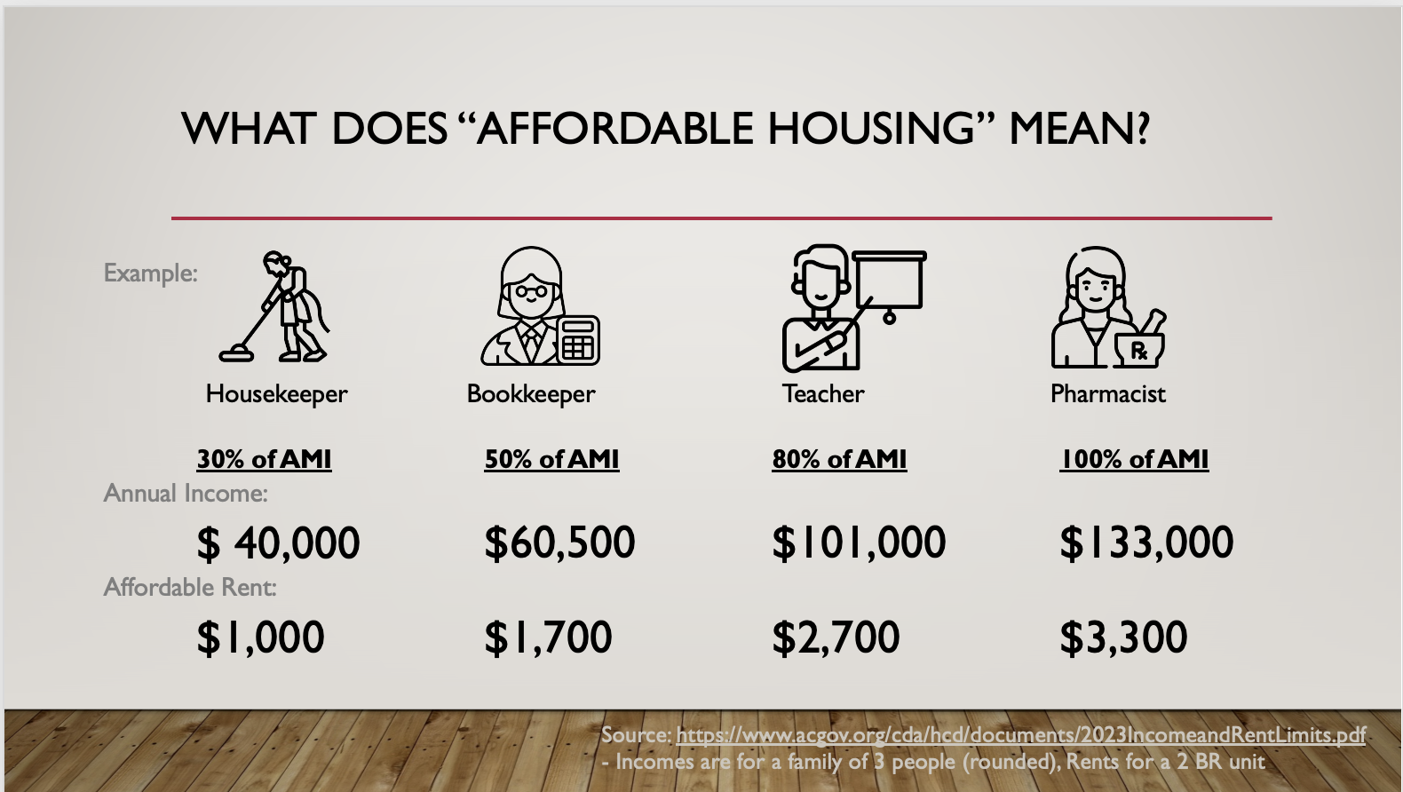
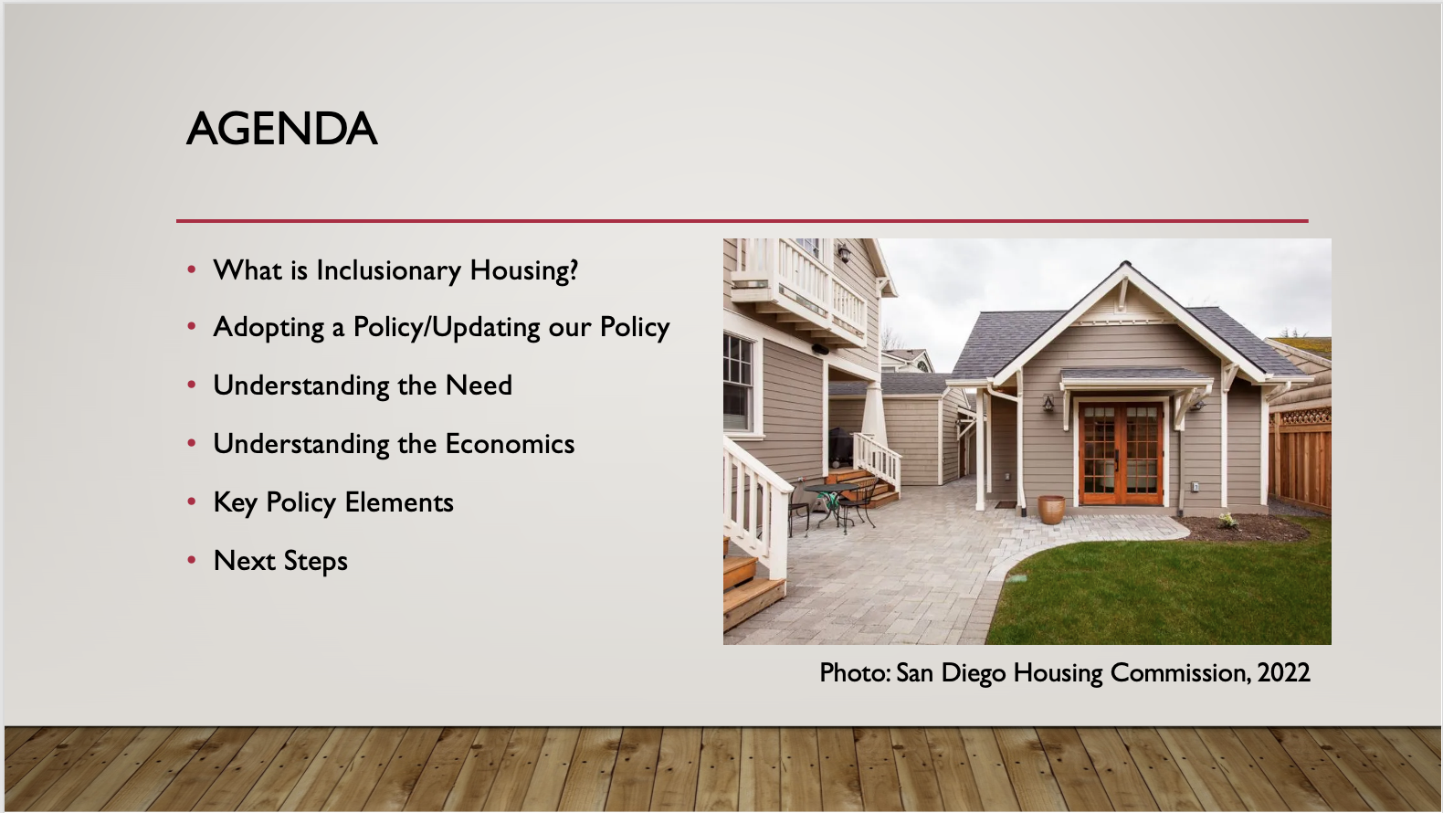
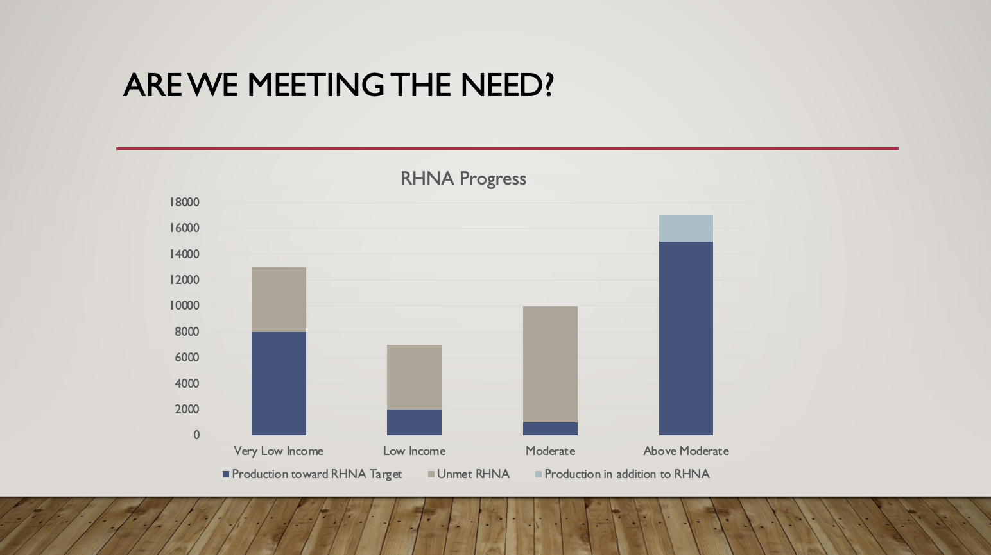
Presentation Template (2 of 3)

Slide 13
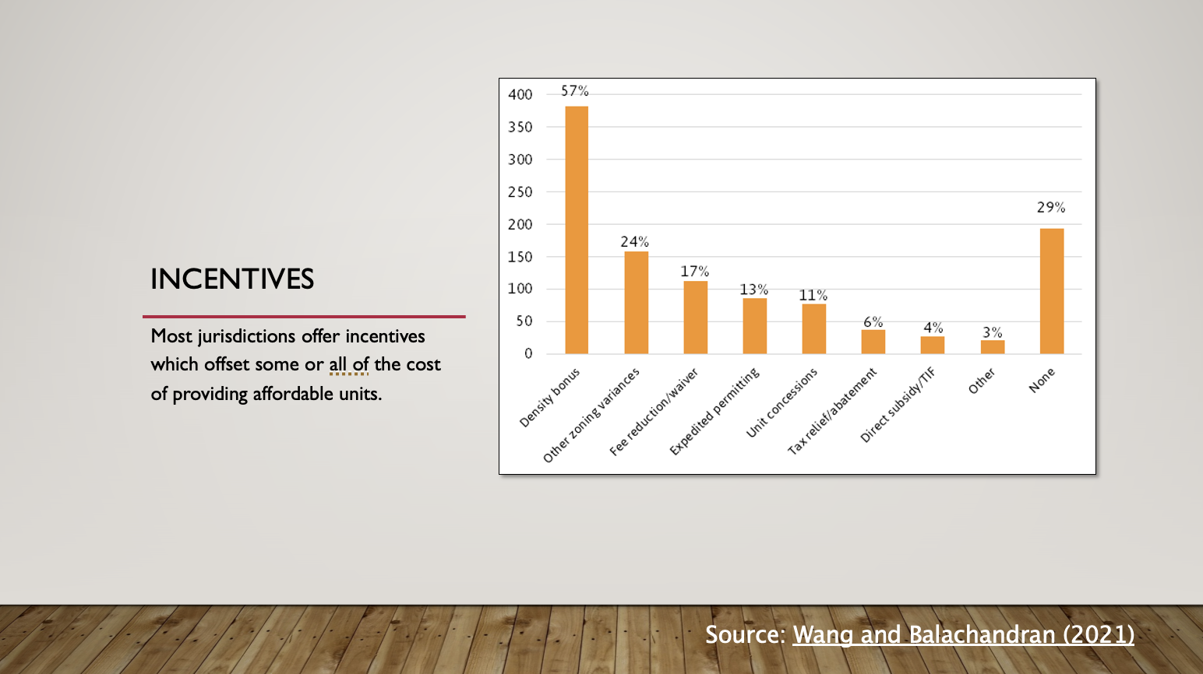
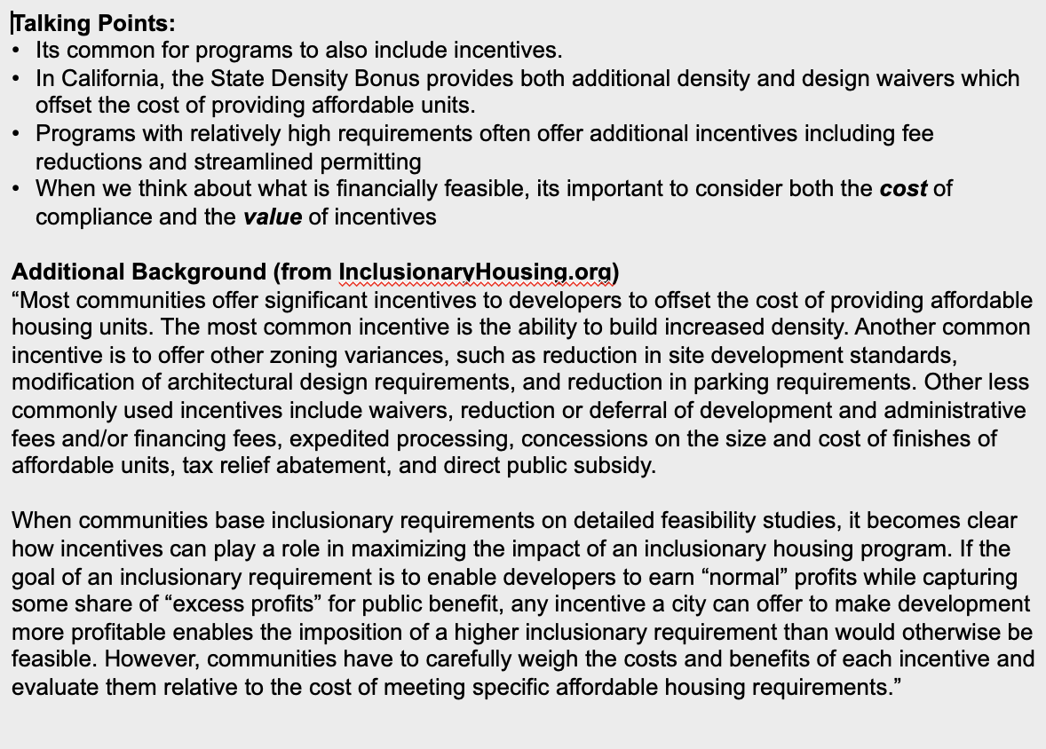
Presentation Template (3 of 3)

Slide 14
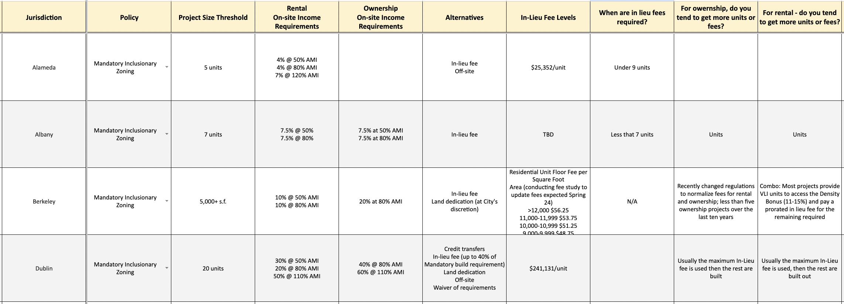
Bay Area IZ Policy Inventory
Inventories for each county available at:
https://abag.ca.gov/technical-assistance/zoning-affordability-work-group

Slide 15
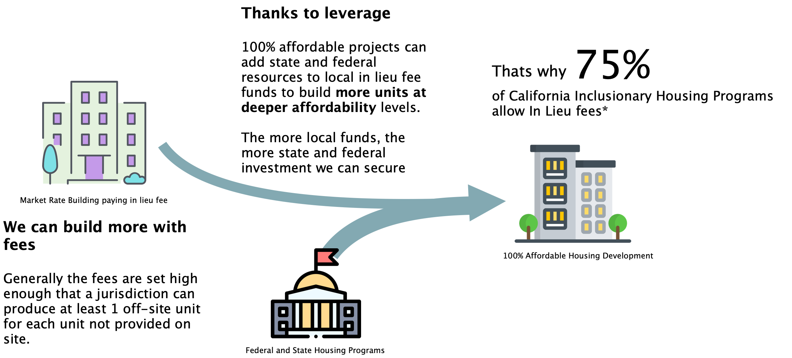
FAQ: Do Fees allow developers to get out of paying for affordable housing?
* Source: Wang, R., and S. Balachandran. "Inclusionary housing in the United States” Lincoln Institute of Land Policy (2019).
Notes:
* Source: Wang, R., and S. Balachandran. "Inclusionary housing in the United States” Lincoln Institute of Land Policy (2019).

Slide 16
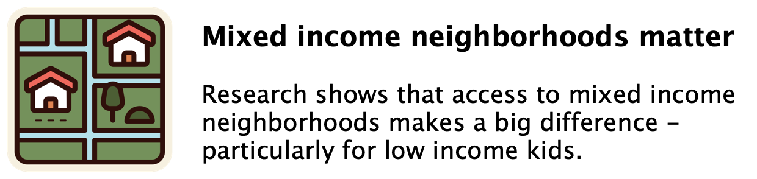
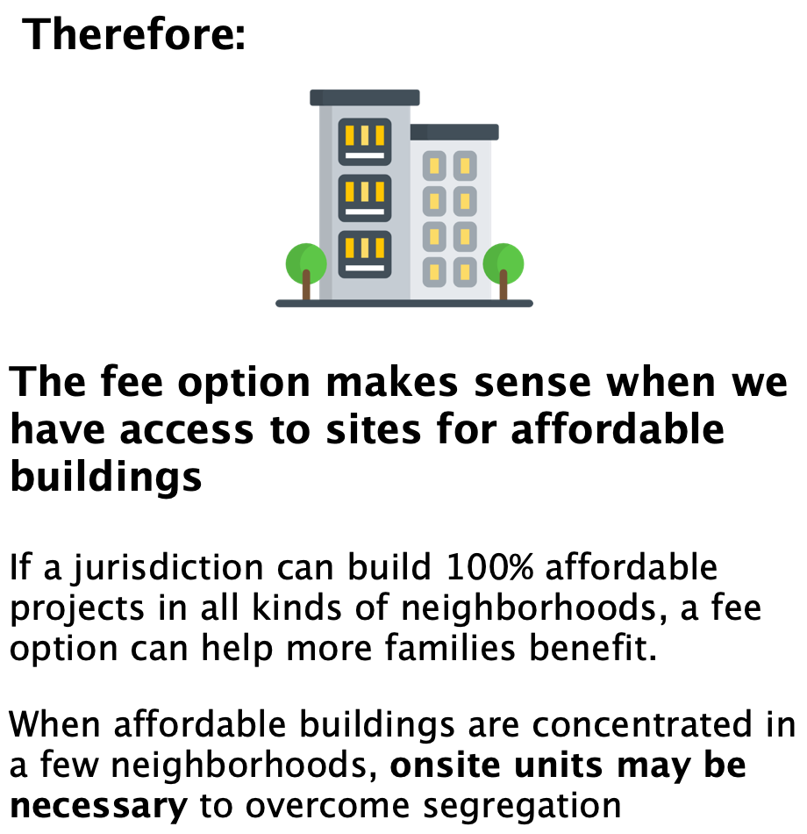
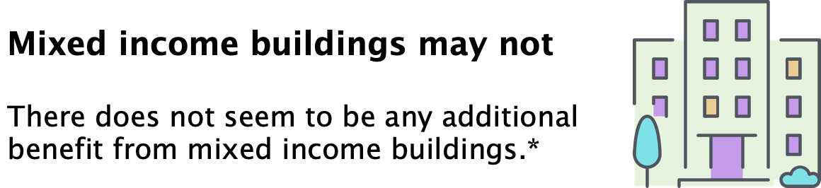
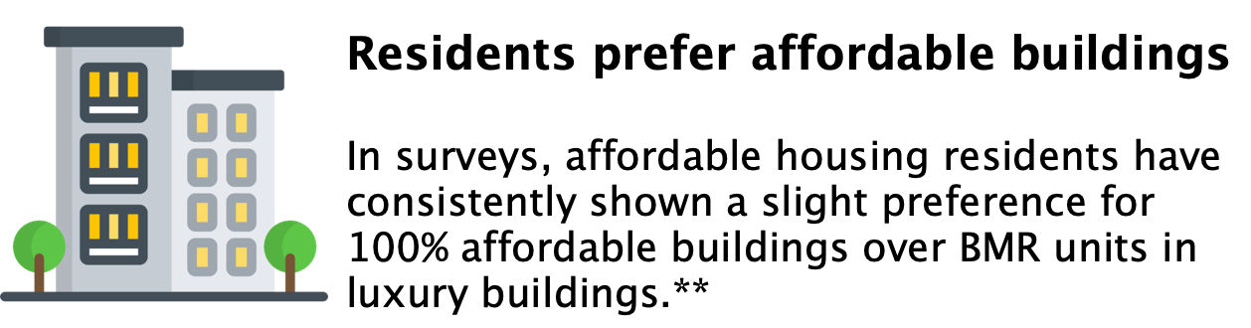
FAQ: Are onsite units the only way to provide economic integration?
* Urban Institute, “Effects from Living in Mixed-Income Communities for Low-Income Families: A Review of the Literature.” 2011. ** National Initiative on Mixed Income Communities “Resident Experiences of Exclusion and Bias in Inclusionary Housing in Cambridge, MA” 2022.

Slide 17
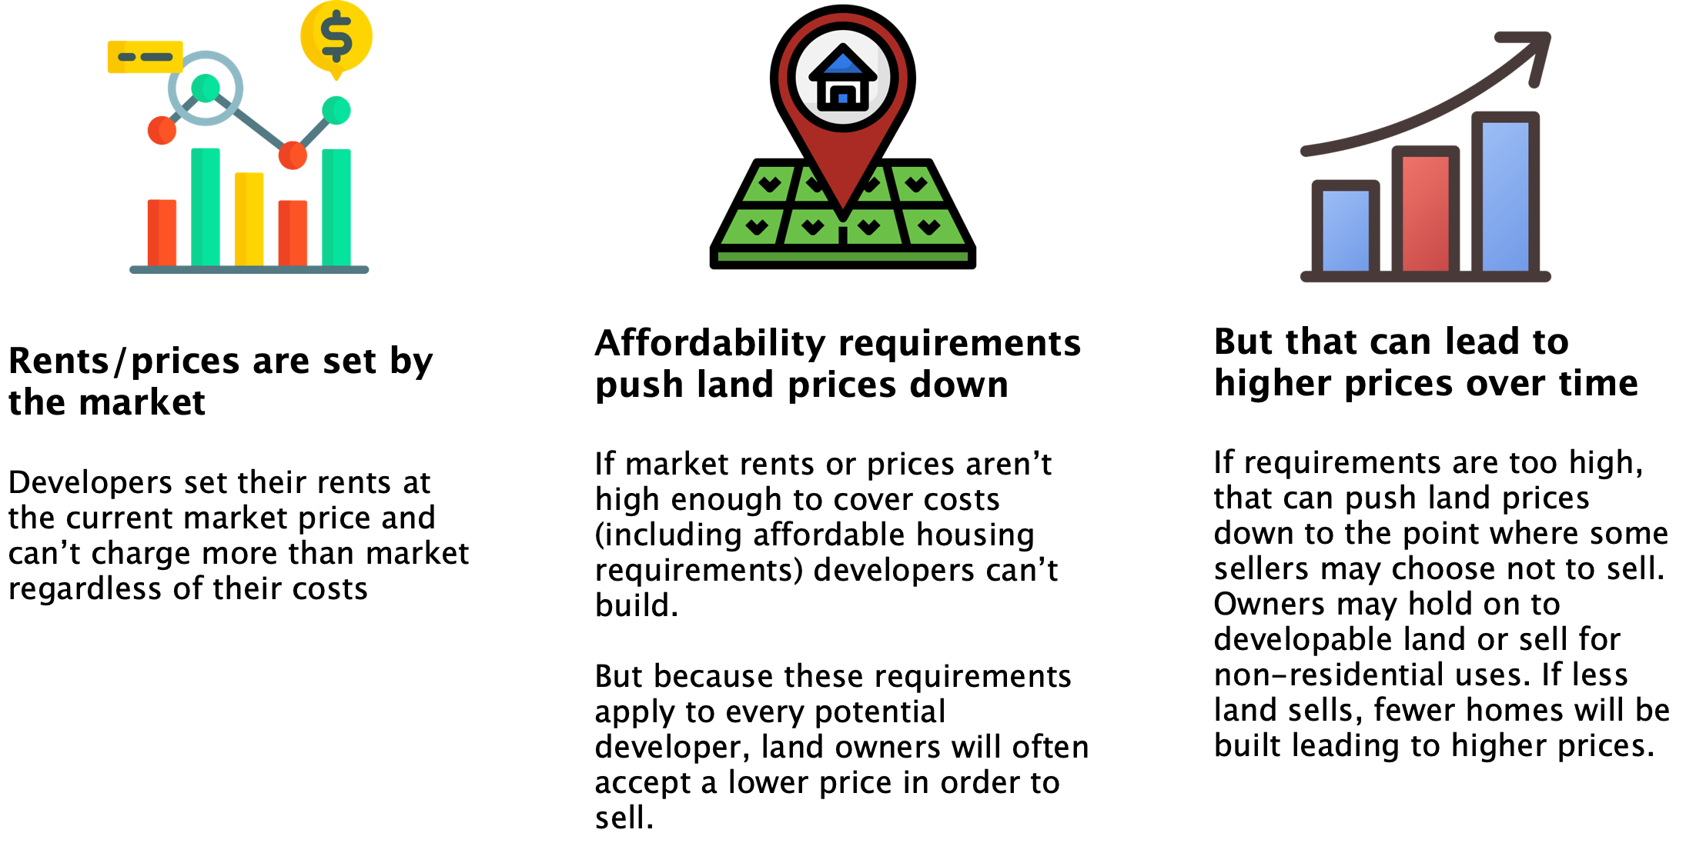
FAQ: Will developers just raise market rents to pay for affordable units?
Notes:
Background:
Street Level Advisors has created a short video illustrating the ideas on this slide: https://youtu.be/E74KzU2_7HA

Slide 18
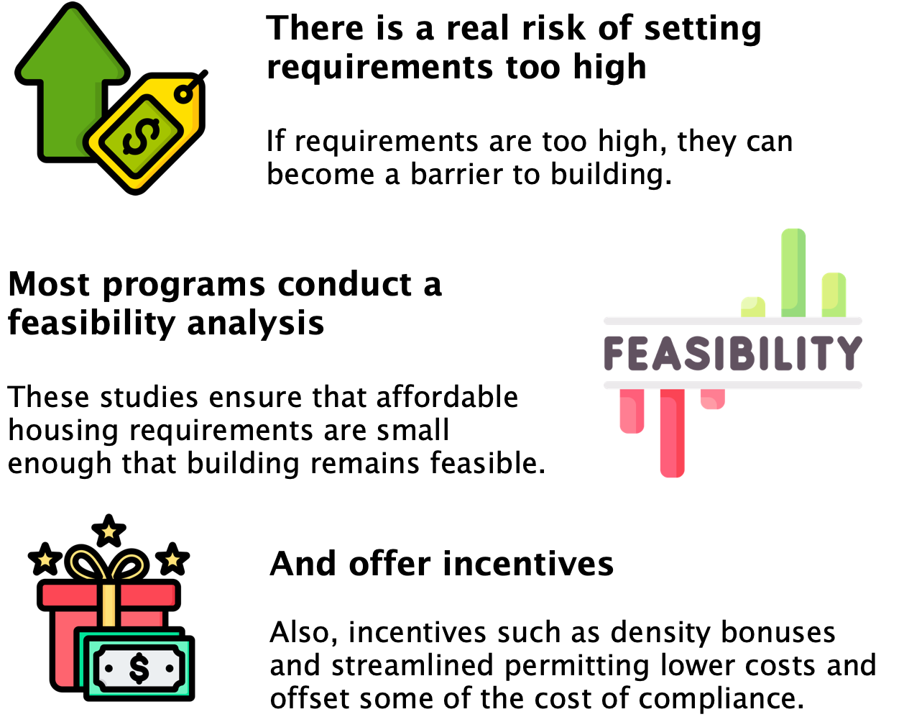
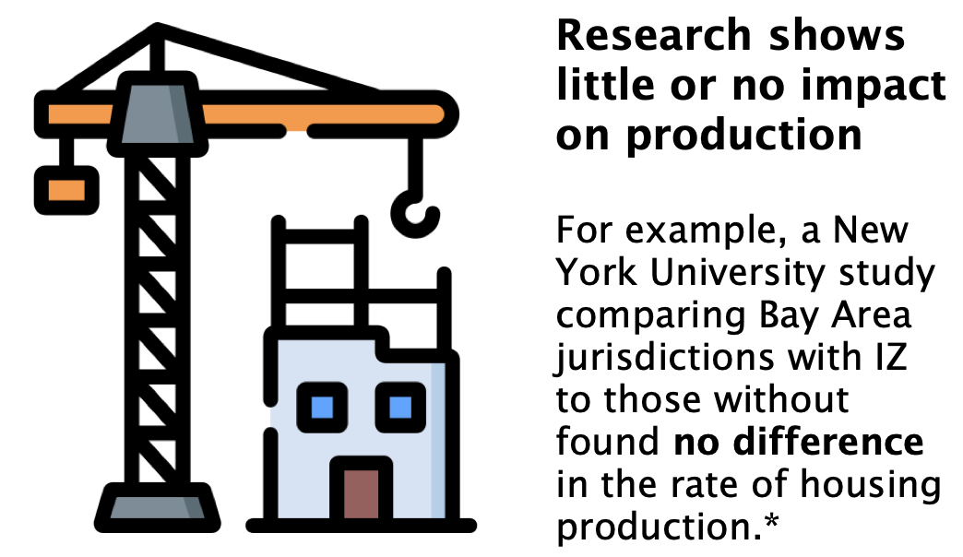
FAQ: will affordable housing requirements make housing too expensive to build?
* Furman Center for Real Estate at NYU, The Effects of Inclusionary Zoning on Local Housing Markets: Lessons from the San Francisco, Washington DC and Suburban Boston Areas, 2008

Slide 19
Office Hours
  Use Calendly Link to reserve a time for 1-1 consultation
  https://calendly.com/joshabrams/zoning-for-affordability

