Slide 1
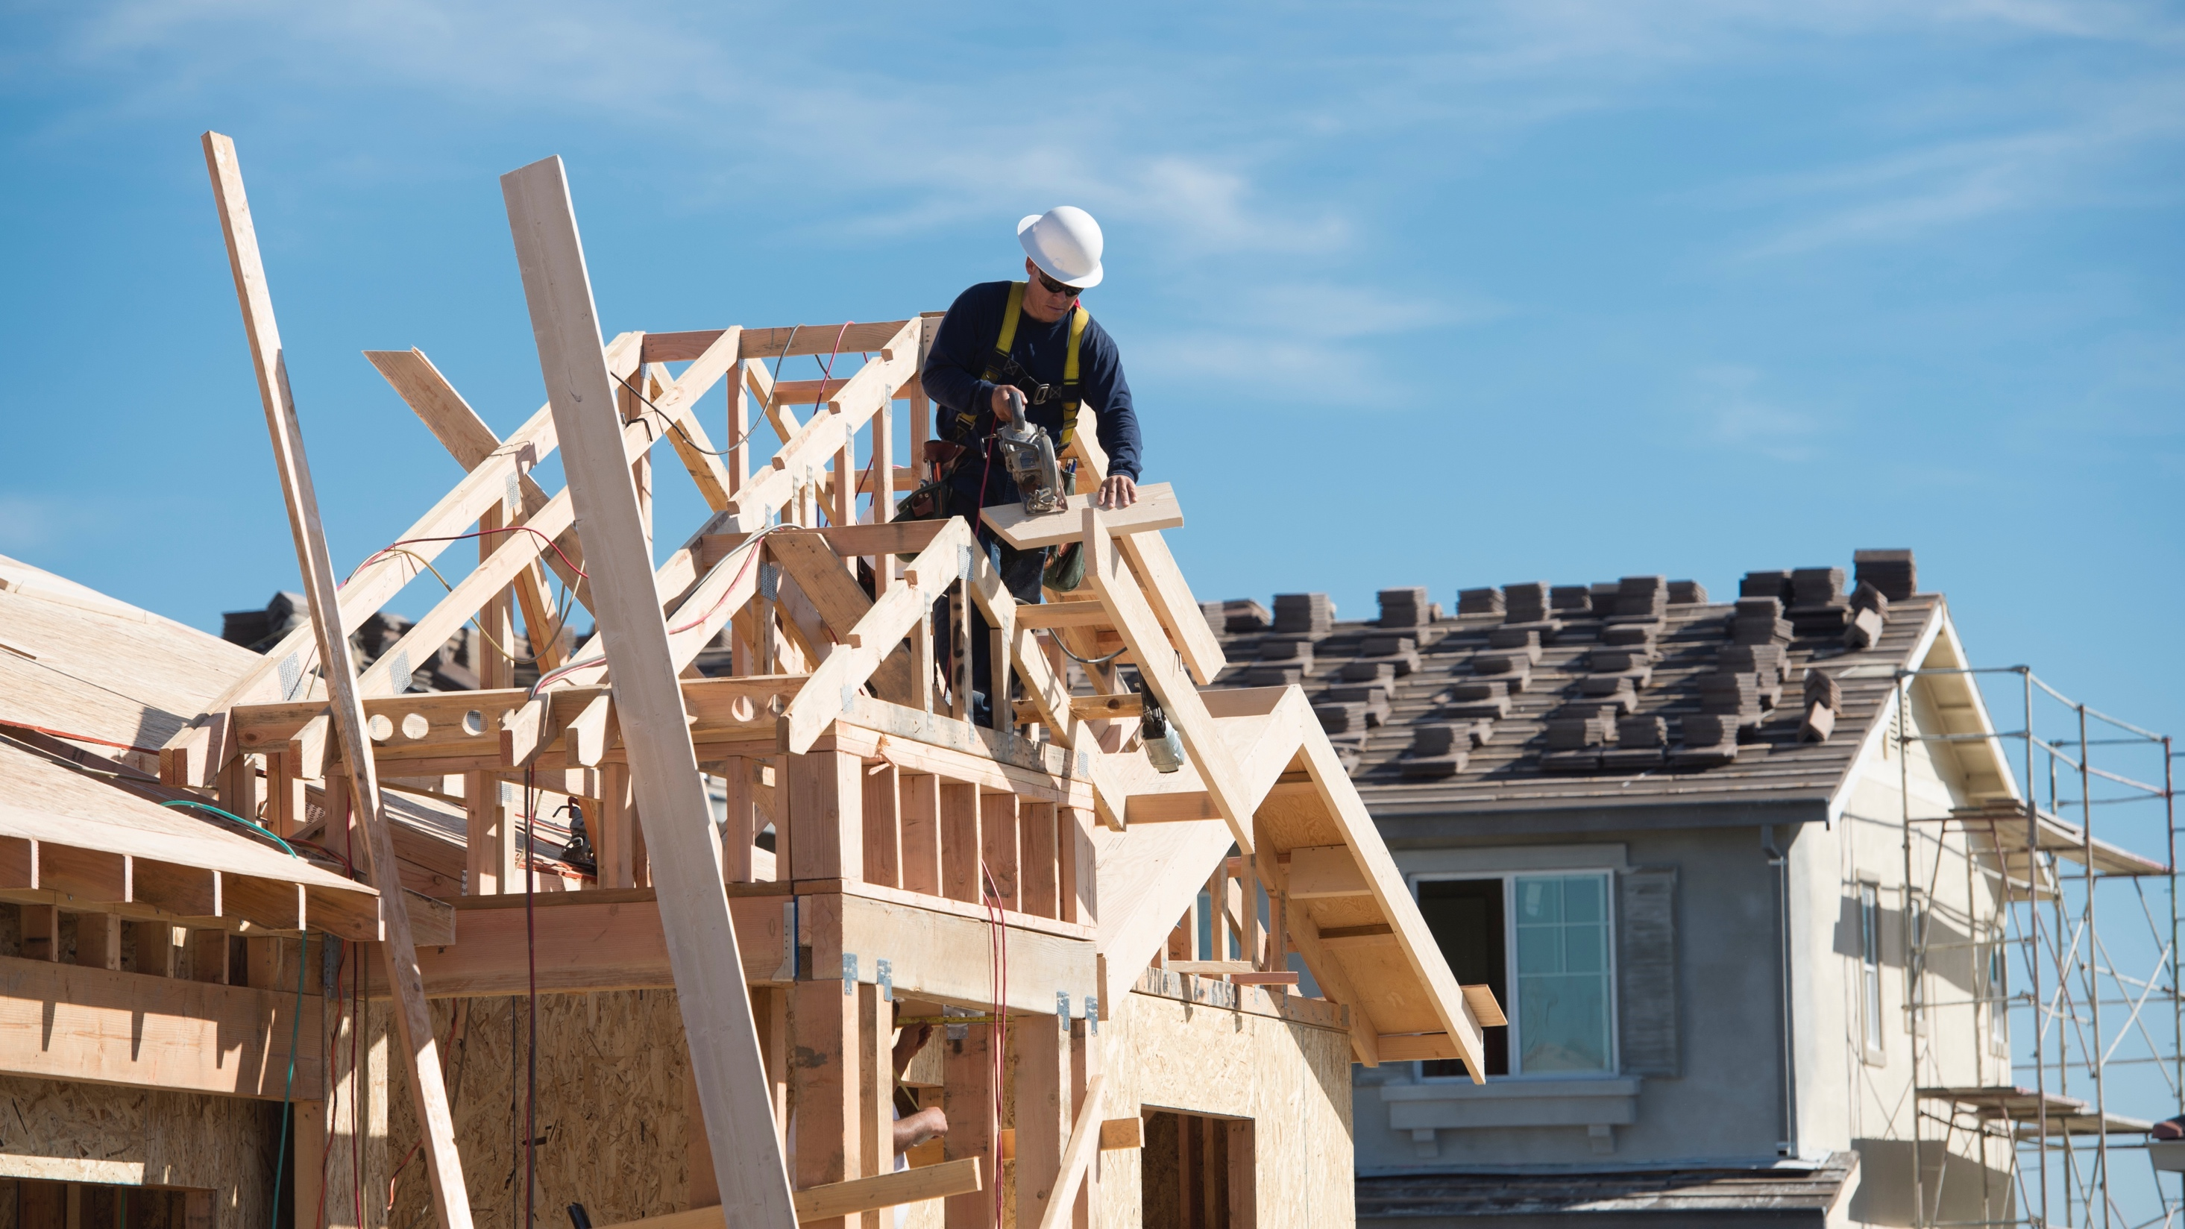
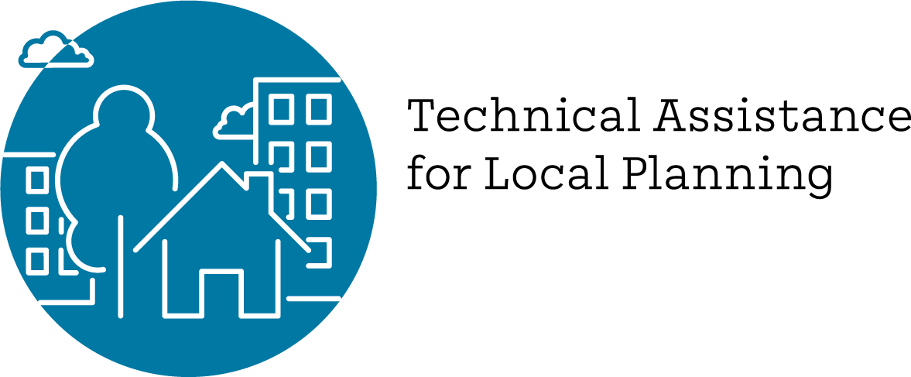
2023 Potential New Housing Legislation Overview

Slide 2
Density Bonus Law
AB 1287 Expands max number of concessions to 5. Allows density bonuses of up to 88.75% for a project that includes 25% VLI. High Impact

Slide 3
Accessory Dwelling Units
AB 976 Permanently prohibits owner occupancy rules. High Impact
AB 1332 Requires local jurisdiction to develop a program for the preapproval of ADU plans by January 1, 2025. High Impact

Slide 4
Development Projects
AB 1218 Expands replacement housing requirements to non-residential developments. High Impact

Slide 5
Land Use and Zoning (1)
AB 747 Amends the Surplus Land Act to allow local jurisdictions to bypass affordable housing requirement for economic development. High Impact
SB 894 Jurisdictions must allow shared parking if deemed feasible. High Impact

Slide 6
Land Use and Zoning (2)
SB 423 Extends SB 35 until 2036 and amends the labor standards. Applies to coastal zones and local governments without HCD-approved housing element. High Impact

Slide 7
Land Use and Zoning (3)
SB 684 Jurisdictions must ministerially approve a parcel map or a tentative and final map for 10 units or less that meets specified requirements and must issue building permits before the final map is recorded. High Impact

Slide 8
Land Use and Zoning (4)
AB 821 Requires local jurisdictions, if asked, to make zoning consistent with general plan within 180 days for non-residential projects.
AB 1308 Prohibits a jurisdiction from increasing the parking minimum for single-family residences for most remodels.
AB 1317 Requires landlords to “unbundle” parking costs from rent. Only applies in Bay Area to Alameda and Santa Clara Counties.

Slide 9
Additional Lower Impact Bills
AB 1490 Establishes new rights for applicants to reuse existing structures to provide lower income housing..
SB 469 Expands exemptions from the state constitution's Article 34 requirement for TCAC and other funded programs
AB 1307 Noise by occupants is not a CEQA impact for residential projects.
AB 1505 Allows certain federal funds to augment the Seismic Retrofitting Program for Soft Story Multifamily Housing.
AB 309 Creates the California Housing Authority, as an independent state body, to develop mixed-income social housing developments on state-owned property, preempts local zoning on up to 3 properties.

Slide 10
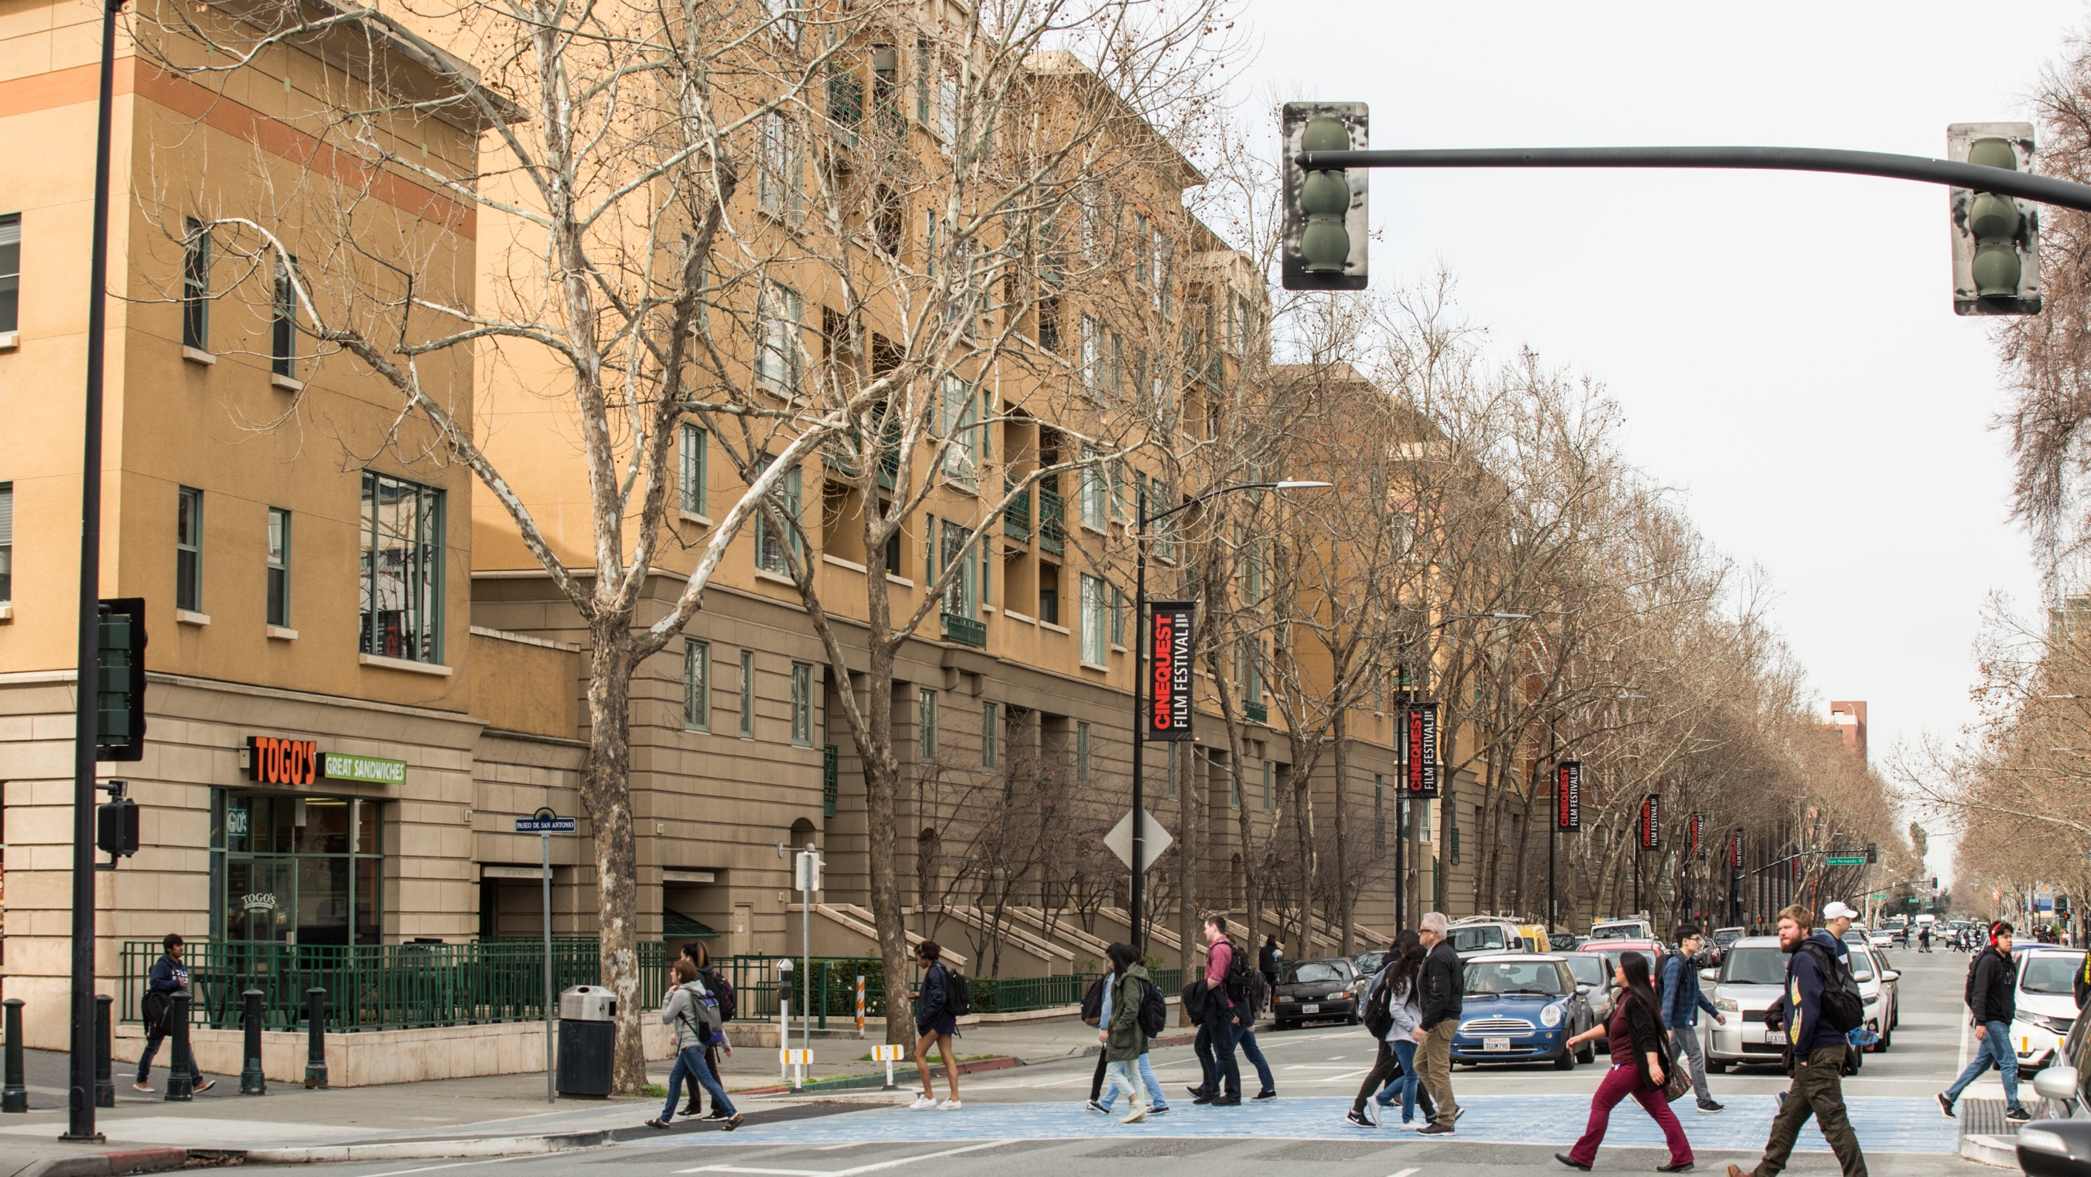
Contact Information
For more information, contact the Regional Housing Technical Assistance Program, HousingTA@bayareametro.gov

