Slide 1
Housing Element Annual Progress Report Form and Submittal
California Department of Housing and Community Development
Housing Policy Development
January 2023
Notes:
Thank you for your interest in this online training for the Housing Element Annual Progress Report or APR.
John Nuch, Housing Policy Division
Co-presenting with colleague Manuel Hurtado, also in Housing Policy Division
Intro to the APR and walk through the various tables
Afterward, Tom for Q&A
Hopefully this presentation will help you to successfully submit the APR for your jurisdiction.
-----
Thank you for your interest in this online training for the Housing Element Annual Progress Report, which from here on out be referred to as the APR.
My name is John and I'll be co-presenting with my colleague Ashley in HCD’s housing policy development division.
After providing you with an introduction to the APR and walking you through the various tables, we will hand it over to Tom for a Q&A session.
HCD collects the APR from all cities and counties in California. This presentation is intended to ensure a successful APR submission from your jurisdiction.

Slide 2
Learning Objectives
  Major changes
  Background and context
  APR Benefits
  Overview of Tables
  Helpful features of the form
  How to Submit APRs
Notes:
During this webinar, you will gain a stronger sense of:
The background and context behind this process
Changes for the 2022 version of the APR form
Benefits of completing the APR
Overview of various tables
Helpful features of the form
How to Submit APR’s
-----
Start by talking about our primary learning objectives. During this webinar, you will gain a stronger sense of:
The background and context behind this process
Changes for the 2022 version of the APR form
Benefits of completing the APR
Table Overview
Helpful features of the form
How to Submit APR’s

Slide 3
New reporting requirements
Reporting on progress in meeting extremely low-income housing need now included in Table B
Reporting of certain units converted to moderate income for RHNA credit on Table F2
Reporting on SB9 projects in Table I
Reporting of student housing that received a density bonus on Table J

Slide 4
Overview and Legal Context
Government Code Section 65400 requires each jurisdiction to prepare an annual progress report (APR) on its status and progress in implementing its housing element
The form remains largely the same as last year. However, there are several new reporting requirements. Importantly, the APR now requires reporting on all units constructed and lot splits approved pursuant to Chapter 162, Statues of 2021 (SB9). There are also new requirements to report on student density bonus developments and units converted to moderate income.
For HCD: complete APR forms can be uploaded directly into our database or emailed to apr@hcd.ca.gov
For OPR: complete APR forms must be emailed to opr.apr@opr.ca.gov
The 2022 APR is due April 1, 2023.
Notes:
Giving some context…..
All jurisdictions in CA (that is: city or county) are required to prepare an Annual Progress Report on the progress they’ve made to implement their adopted Housing Elements
That requirement is located in Section 65400 of the Government Code (https://leginfo.legislature.ca.gov/faces/codes_displaySection.xhtml?lawCode=GOV&sectionNum=65400)
Section 65400 stipulates that the report must be submitted to both HCD and OPR.
**Jurisdictions are also required to complete a separate APR for their General Plans and submit that to HCD and OPR annually. However, this webinar will only focus on the HE APR**
For the 2022 APR form, the format of the form has not changed from the 2021 APR form, but there are several new requirements which we’ll go over.
Like last year, you can upload the completed form directly to our database (https://apr.hcd.ca.gov/APR) or email it to apr@hcd.ca.gov. If you need your jurisdiction’s username and password combination, it should be the same as last year, and if you need it again, just email us and we will provide it.
For the HE APR submission to OPR, please email the completed Excel workbook to OPR at opr.apr@opr.ca.gov!!
The 2022 APR is due April 1, 2023.
------
Each jurisdiction (that is: city or county) must prepare an APR on the status and progress in implementing its housing element. This requirement comes from Government Code Section 65400. This report must be submitted to both HCD and the Governor's Office of Planning and Research, or OPR. Please note that each jurisdiction must also complete a General Plan APR and submit that annually. However, this training will only focus on the Housing Element APR
Aside from one new requirement due to AB 2345, the requirements and format of the form have not changed from the 2020 APR. As was the case last year, you may upload the form directly into our database or email it to apr@hcd.ca.gov
The APR is due each year on April 1st. The 2022 APR is due to HCD and OPR by April 1, 2023.

Slide 5
APR Benefits
Several funding programs require up-to-date submission of APRs, including Caltrans Sustainable Communities Grant and PLHA funds
APRs are a vehicle for reporting housing element implementation and progress in meeting Regional Housing Need Allocation (RHNA) to the public and decision makers.
Data from APRs is used to make HCD’s SB35 determination
Notes:
Before we go any further let me go over some of the benefits of submitting APRs. APRs are woven into numerous state oversight and funding programs.
Several funding programs require up-to-date submission of APRs, including for the Caltrans Sustainable Communities Grant and Permanent Local Housing Allocation (PLHA) funding program.
APRs are how jurisdictions report progress in implementing the housing element and meeting the Regional Housing Need Allocation (RHNA). The data helps HCD understand successes and challenges from cities and counties statewide. And this information can help inform future housing policy.
Finally, data from APRs is used to make HCD’s SB35 determination, also known as the Streamlined Ministerial Approval Process.

Slide 6
Previewing the Tables
All tables will report on activity that happens in the 2022 Calendar year
Table A - Housing Development Applications Submitted
Table A2 - Annual Building Activity Report Summary - New Construction, Entitled, Permits and Completed Units
Table B - Regional Housing Needs Allocation Progress – Permitted Units Issued By Affordability
Table C – Sites Identified or Rezoned to Accommodate Shortfall Housing Need
Table D - Program Implementation Status
Table E – Commercial Development Bonus
Table F – Units Rehabilitated, Preserved and Acquired for Alternative Adequate Sites
Table F2 – Units Converted to Moderate Income
Table G – Locally Owned Sites
Table H – Locally Owned Surplus Land Inventory
Table I – SB9 units and lot splits
Table J – Units Converted to Moderate Income
Notes:
This is an overview of the form to orient you to the topics for each table. We have Tables A through H, which are each represented by a sheet within an Excel workbook.
A detailed explanation of each Table’s requirements can be found in the instructions. The instructions are your definitive source for guidance.

Slide 7
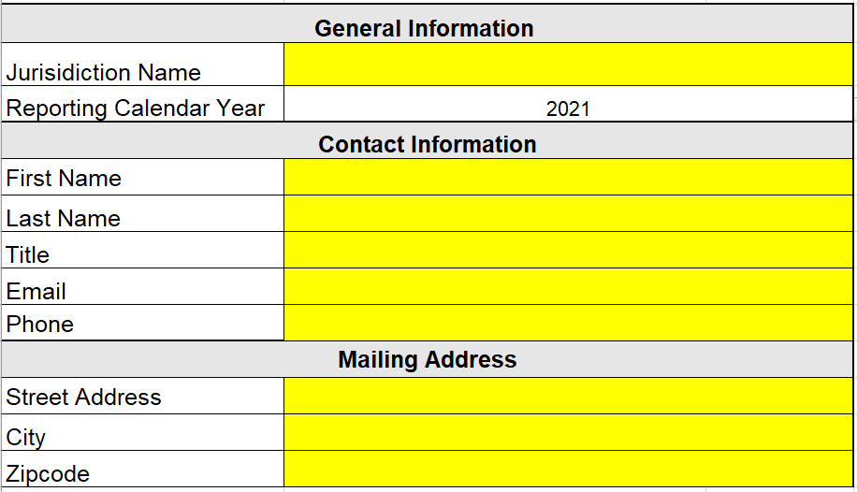
Start Here Tab
Please fill out all information
Cells highlighted in yellow are required
Notes:
Start Here tab
Enter the jurisdiction name and all contact information, including the mailing address.
There is some conditional formatting in the form =
Required cells are highlighted in yellow
Some cells only become yellow once part of the row or table is filled out….
That is, once certain tables or rows start being completed, there are accompanying cells in that row that must be completed.
Yellow also goes away when you've provided the requisite information, so any yellow in your APR should be a flag for you.
All tables have required fields but they get triggered IF you start to fill out the table.
So, if you have no activity to report in a table because it does not apply to your jurisdiction or your jurisdiction doesn’t have activity to report from the reporting year that is relevant to that table, leave it blank. No need to add any notes, eg “Nothing to Report” or "NA" because this will cause yellow highlighting to erroneously show up in your APR.
-----
Start Here tab
Enter the jurisdiction name and all contact information, including the mailing address.
And this is your first preview of some of the conditional formatting in the form. Required cells are the cells highlighted in yellow. In addition, some cells only become yellow once part of the row or table is filled out. That is, once certain tables or rows start being completed, there are accompanying cells in that row that must be completed. The yellow also goes away when you've provided the requisite information, so any yellow in your APR should be a flag for you.
As we will remind several times throughout this presentation, all tables have required fields IF they are not left blank. Cells become highlighted yellow when they are required to be completed. Tables that do not apply to your jurisdiction must be left blank. This happens when a jurisdiction does not have related activity to report from the calendar year. So, if you have no activity to report in a table, leave that blank. Please do not add any notes, such as “Nothing to Report” or "NA" because this will cause a lot of incorrect yellow highlighting to show up in your APR.

Slide 8
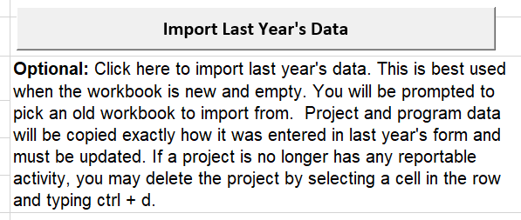
Start Here Tab - Importer
Notes:
The APR form has an importer button.
This copies over information you entered on a previous year's form
Useful if you have housing developments that have moved through the planning and building process beyond what was reported in the prior year’s APR submission so you just need to add the additional activity that occurred for a project during the current reporting year.
E.g. you reported a project as being entitled during the previous reporting year and that’s all, but this current reporting year it received a building permit so that portion needs to be reported >>> the importer will copy over all project information from last year’s form, meaning you just need to complete the additional building activity that occurred.
Note: the importer will copy most tables. You can delete any information copied by the importer by selecting a cell in the row and typing ctrl + d.
---
Form features an importer, which can copy over information you entered on a previous year's form. This can be handy if you have housing developments that have moved through the planning and building process, and you just need to add additional activity for a project. For example, if you reported a project as being entitled last year, and this year you need to report it received a building permit, the importer copies over all project information from last year’s form, leaving you with only needing to complete the additional building activity that occurred. Please note, the importer will copy most tables. You can delete any information copied by the importer by typing ctrl + d if it is no longer necessary to report that information, since it occurred last year.

Slide 9
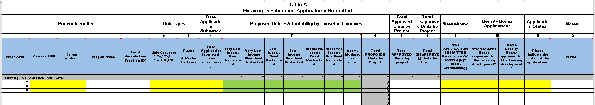
Overview of Table A
Table A – Housing Development Applications Submitted
  Includes data on housing units and developments for which an application was deemed complete during the reporting year
Notes:
Table A is for any development applications completed during the reporting year
Includes: applications for planning approval and applications for development permits – applications for building permits are no longer required to be reported in Table A
Cells in yellow are required, cells in green are required if applicable
In photo as eg for green --- enter the units into the appropriate affordability level and leave the rest blank
New additions to Table A:
Two columns asking if a project requested a density bonus and if that density bonus was approved
One column asking about the status of the application (approved, pending, disapproved, withdrawn)
Table A - Housing Development Applications Submitted
Includes data on any development application that includes residential units for which the application was deemed complete during the reporting year.
The application may have been initially submitted in a prior year , but only list the application in the table if it was demined complete during the reporting year

Slide 10
Overview of Table A2
Table A2 - Annual Building Activity Report Summary - New Construction, Entitled, Permits and Completed Units
  Includes data on net new housing units and developments that have received any one of the following:
    An entitlement
    A building permit or a
    Certificate of occupancy or other form of readiness
Notes:
On Table A2 you will report projects that completed entitlements, received a building permit, or obtained a certificate of occupancy during the reporting year. If there was no entitlement, you still report on this table.
The same properties may be included in both Table A and A2
RHNA credit is given based on the building permits section of the table
You can include projects from prior years, but this is not required
Only enter the unit numbers in the applicable portion of the form. If you enter a unit number, you will be required to enter a date.
You will enter the number of new units and if there were units demolished on the property as part of the project, enter the number of units demolished or destroyed in the demolished/destroyed column – for example, if a duplex is demolished to build a 4 plex, you’d report all 4 of those new units and report the 2 units in the destroyed/demolished column.
If you select below market-rate non-deed restricted you will need to provide an explanation for how this was determined, for example by looking at comparable properties.
We have an affordability calculator on our website to help with this: https://www.hcd.ca.gov/community-development/housing-element/docs/affordability-calculator-2021.xlsx
For something to count as a unit, it must have separate living quarters for each household. If communal cooking/eating spaces are the only option in a given development, those units are group quarters.
Means that Homekey projects count as housing and can be reported on the APR.
Several new columns have been added to Table A2 that must be completed only for projects that were granted a density bonus.
These columns request additional information on the number and types of incentives granted to the project.
Table A2 - Annual Building Activity Report Summary - New Construction, Entitled, Permitted and Completed Units
This table includes data on net new housing units and developments that have received any one of the following:
An entitlement. Net new means that any units existing on the project site that currently exist, or were demolished in order to complete the current project, must not be included on the report. For example, if a duplex is demolished in order to build a 4 plex, then only 2 net new units were created, and only those 2 should be reported. Please note: although the form asks for information about any units demolished or destroyed that are associated with a new development, the number of units demolished or destroyed is not subtracted from the number of new units created. Therefore, you must only list the number of net-new units created in the entitlement, permit, or certificate of occupancy section.
RHNA credit is given for units entered into the building permit section of this table
Any time you report an entitlement, building permit or certificate of occupancy, you must also share project identifier information. Vice versa, any time you report project identifier information, you need to tell us about an entitlement, building permit or certificate of occupancy.
Please note, you are only required to report activity that occurred in the reporting calendar year. Some jurisdictions opted to report the entire history of each permit that occurred before the reporting year. That is acceptable, but not required.

Slide 11
Overview of Tables B & C
Table B - Regional Housing Needs Allocation & Extremely Low-Income Need Progress – Permitted Units Issued By Affordability
  Provides a summary of prior permitting activity reported to HCD in the current planning cycle, including permitting activity for the calendar year being reported. Now includes a column that show units permitted since the start of the RHNA projection period.
Table C - Sites Identified or Rezoned to Accommodate Shortfall
  Only applies if the jurisdiction identified an unaccommodated need of sites from the previous planning period, has shortfall of sites as identified in the housing element; or is identifying additional sites required by no net loss law
Notes:
Table B
[Read Table B section]
Table B auto-populates. You do not need to fill out any information.
Table B will populate for the current year from Table A2 and will pull from past years based on prior APRs.
Therefore, you need to fill out your jurisdiction and the year on the Start Here tab to populate Table B.
Contact HCD via email if you identify errors in Table B
Changing data in the table will not change data in HCD’s system
You will likely need to update information on a past APR.
Table C
Table C only applies if you rezoned sites due to a program in the housing element or as required by no-net loss law during the reporting year.
Do not report sites that were rezoned outside of the reporting year.
If the table doesn’t apply to you, please leave it blank. Don’t enter N/A.
Table B - Regional Housing Needs Allocation Progress – Permitted Units Issued By Affordability
Table B is auto populated it provides a summary of prior permitting activity in the current planning period as well as activity for the calendar year reported.
This data is taken from APR’s submitted in prior years. If the data in Table B does not match your records, contact HCD.
You can write over any of the permit information from prior years in this table. However, making changes to this table will NOT change HCD’s records.
To reiterate, if any data in table B does not match your records, contact HCD. To change data that HCD has in the database, you may need to resubmit or revise a prior year APR.
Table C – Sites Identified or Rezoned to Accommodate Shortfall
Only applicable if you rezoned sites due to a program in the housing element or as required by no-net loss law during the reporting year. Do not report sites that were rezoned outside of the reporting year.

Slide 12
Overview of Table D and Table E
Table D - Program Implementation Status
  Report the status/progress of housing element programs
  Use the importer to copy program name and objective. Update the status as appropriate.
  Include all programs that are listed in the housing element.
  Table E – Commercial Density Bonus Approved
  - Not for residential density bonus developments
  - For commercial property granted a density bonus as a result of partnering with a residential developer.
Notes:
Table D reports the status of implementing all housing element programs. This table is required for all jurisdictions and must include a separate entry for EVERY program in the housing element.
We understand that the formatting of this table sometimes causes difficulties. There are character limits for each of the cell; please try to have your entries be concise and to the point within this character limitation. If you run into any issues, please feel free to reach out to our team and we can suggest a few things for you try.
Importing your entries from last year’s form, and then just updating the implementation status, may also make filling out Table D easier.
Table E is for Commercial properties with a density bonus approved. Please do not enter in residential density bonus development. Table E is intended for commercial properties granted a density bonus as a result of parterning with a residential developer.

Slide 13
Overview of Tables F & F2
Table F - Units Rehabilitated, Preserved and Acquired for Alternative Adequate Sites
  Report units that have been substantially rehabilitated, converted from non-affordable to affordable by acquisition, and preserved
Table F2 – Units Converted to Moderate Income (New for 2022)
- Units reported on this table must meet requirements specified in Government Code 65400.2
Notes:
Table F is for reporting units that have been Rehabilitated, Preserved and Acquired for Alternative Adequate Sites.
Alternative Adequate Sites is a provision of Housing Element Law that allows jurisdictions to get credit for preservation activities and reduce the number of sites identified in the Housing Element.
Table F includes two sides – the left side is for you to share information only and does not tie to credit towards RHNA. This section of the table is unlocked and we recommend that jurisdictions fill it out for your own records so you can keep track of any rehabilitated and preserved units.
The right side of the table applies if the jurisdiction used the alternative adequate sites option in the housing element review and has units to credit towards RHNA. Contact HCD if you think this applies to you. Additional documentation will be required and HCD will assist you in completing the form.
Table F2 is a new sheet for 2022: The legislature has created a new path for getting credit toward a jurisdiction’s moderate income RHNA for units that were converted from being deed restricted to moderate income households. Units must meet specific conditions described in Government Code 65400.2.
At this point, I will be handing off the presentation to my colleague Manuel. Manuel, take it away. ☺

Slide 14
Overviews of Table G and H
Table G – This Table applies if jurisdiction included a locally owned site in the housing element sites inventory and has disposed of the property
Table H – Report all locally owned land that is either designated surplus or is in excess of foreseeable needs. Requires parcel ID information and current uses on the property
Notes:
Table G reports on Locally Owned Sites that were included in the housing element sites inventory that were disposed of by the jurisdiction. Table G most likely doesn’t apply to most jurisdictions. A site must meet three conditions to be included in this Table. It must:
Be a locally owned site,
Have been included in the Housing Element Sites Inventory, and
Must have been disposed of by the jurisdiction.
Table H requires that local jurisdictions provide an inventory of all locally owned surplus, exempt surplus, or excess land. If your jurisdiction has these types of land, you are required to report the APN, address, and a few other fields.

Slide 15
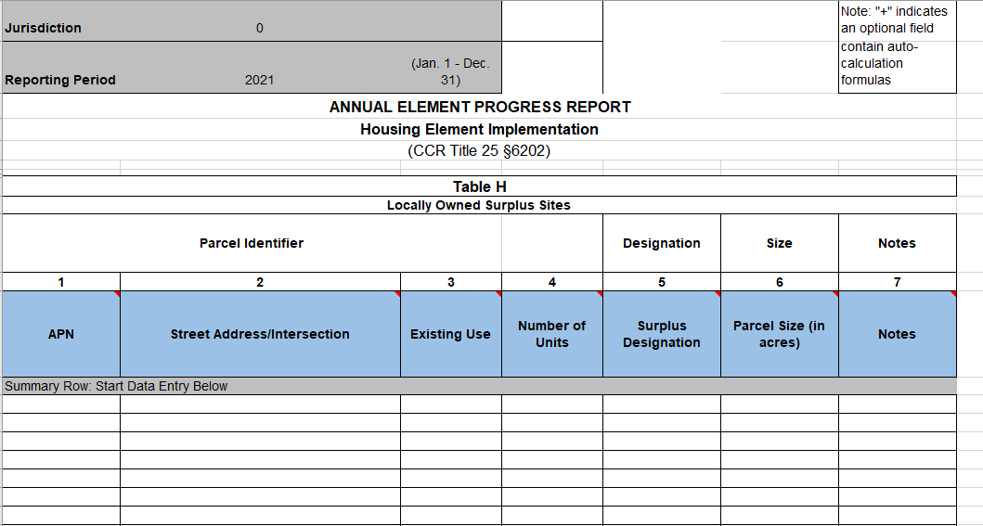
Table H
Local governments are now required to complete an inventory of all locally owned surplus, exempt surplus, or excess land
Notes:
Table H was just added a few years ago due to changes enacted by AB 1255. This table requires that local jurisdictions provide an inventory of all locally owned surplus, exempt surplus, or excess land. If your jurisdiction does have these types of land, you are required to report the APN, address, and a few other fields.

Slide 16
Overviews of Table I and J
Table I – SB9 Units and Lot Splits (New for 2022)
  Requires reporting on all units constructed and lot splits approved pursuant to SB9
Table J – Student Housing that Received Density Bonus (New for 2022)
  Student housing development for lower income students for which was granted a density bonus pursuant to subparagraph (F) of paragraph (1) of subdivision (b) of Section 65915
Notes:
Table I – Chapter 162, Statutes of 2021 (SB9) requires ministerial approval of certain housing developments within a single-family zone that contain no more than 2 units, as well as ministerial approval for a parcel map for an urban lot split in a single-family zone. Units constructed and urban lot splits approved pursuant to SB9 are required to be reported on Table I of the APR form. Table I requires parcel identifier information, and a column to indicate if you are reporting a unit constructed or a lot split. If you are reporting a unit constructed, please indicate the number of units.
For units constructed: The unit must only be reported on this table once it is constructed which would be when a (certificate of occupancy is issued). Only report newly created units. For example, if an existing single-family home is converted into two units, only report one unit in this section. If a duplex is newly constructed on a property with no existing units, report two units in this section. If units are demolished on the site, please enter the number of newly constructed units.
Also note that any application for a unit must be reported in Table A, and any entitled(approved) unit, permitted unit, or constructed unit must also be reported in Table A2.
Table J – Only report student housing development for lower income students that was granted a density bonus pursuant to subparagraph (F) of paragraph (1) of subdivision (b) of Section 65915. Likely a very narrow group of housing developments qualify to be reported on this table. Please ensure developments meets all specified requirements before including it on this table.

Slide 17
Summary Tables
  This does not need to be filled out, but is auto calculated for your information
  Summarized projects approved using streamlined ministerial approval process (SB 35 Streamlining) and number of applications submitted.
Notes:
The Summary Tables auto-populate with information on both:
projects approved using a streamlined ministerial process and
the number of applications submitted.
The Summary Tables are only there for your own information – they auto-populate with information already provided and can be easily printed for your own records.
An important thing to remember is that the totals in the Summary Tables are counted based on the dates provided in earlier tables. So for example, building permits will only be counted if the year the building permit was issued matches the reporting period for that APR. If you notice the totals aren’t adding up to the right number, check to make sure you’ve entered the correct years.
If you see an error in any formula on this page, contact HCD.

Slide 18
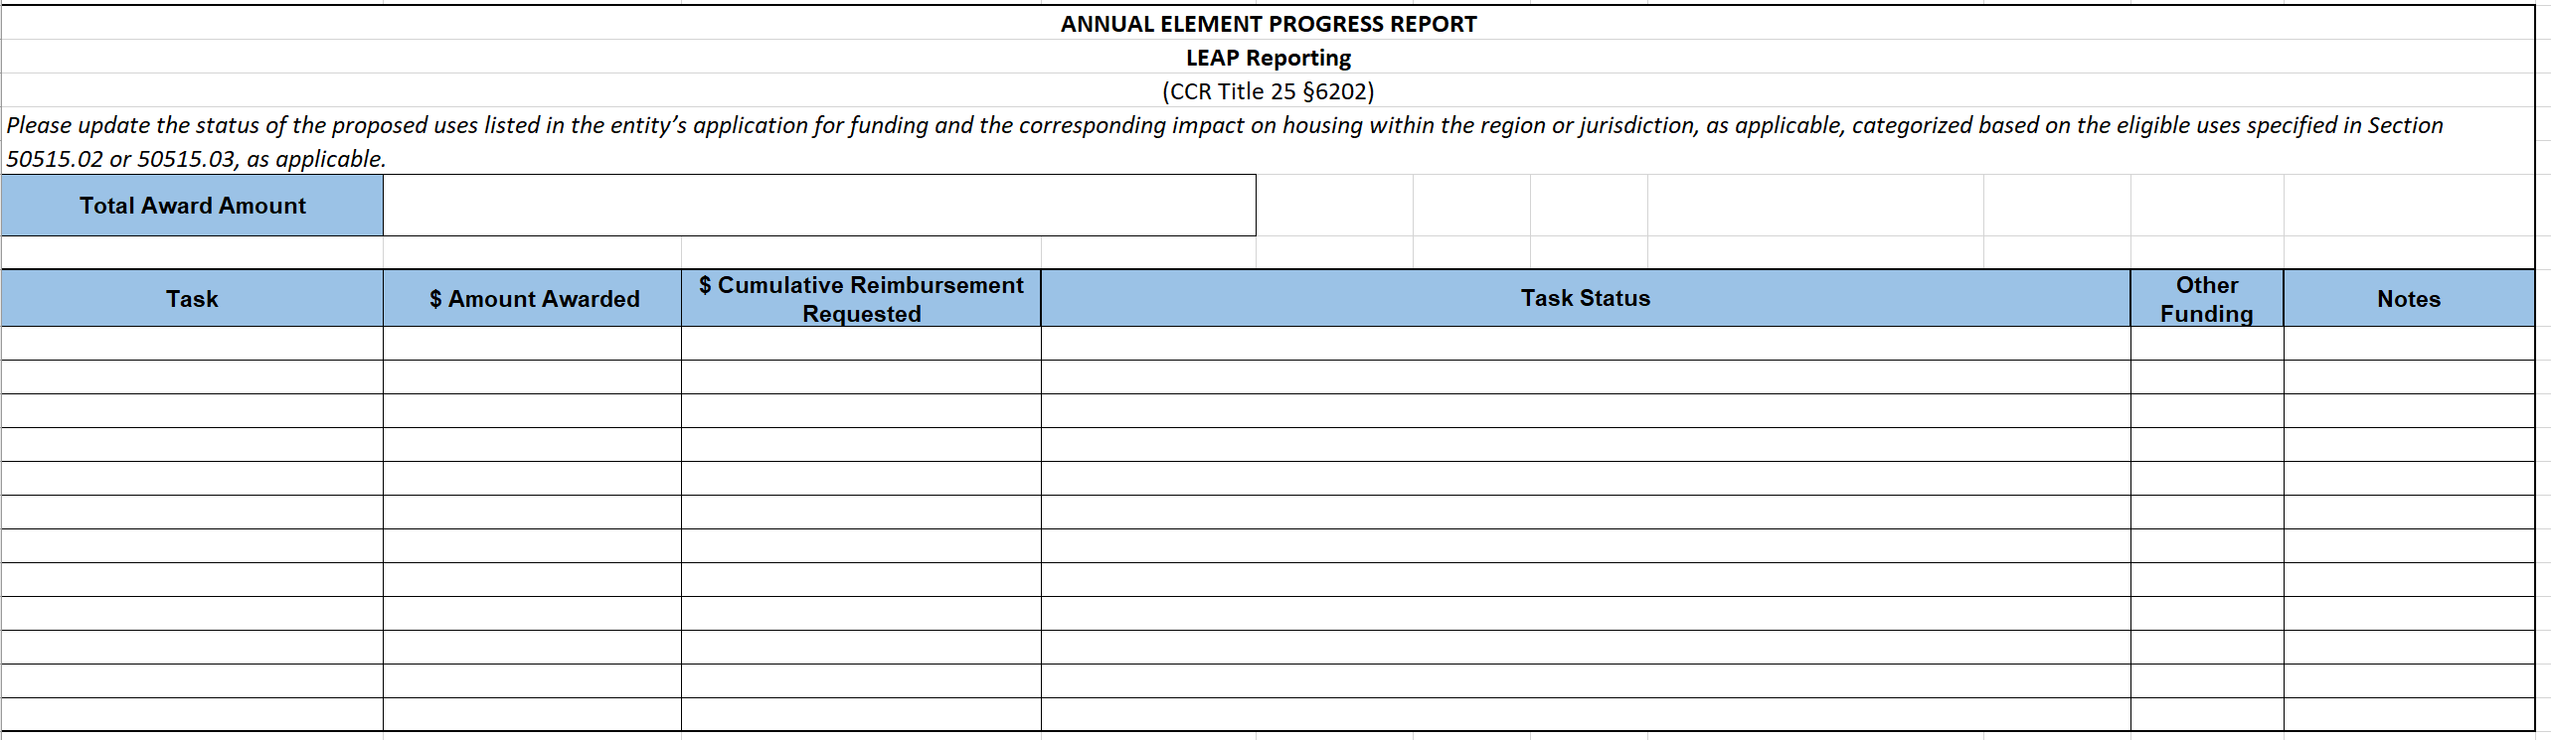
LEAP Reporting
If you are the recipient of a LEAP grant, you are required to report on the status of the grant in the APR
Notes:
If you are the recipient of a LEAP grant, you are required to report on the status of the grant in the APR.
The tasks described here should match the tasks described in your LEAP application.
One thing to note is that you should only start reporting after you’ve executed a contract with HCD.

Slide 19
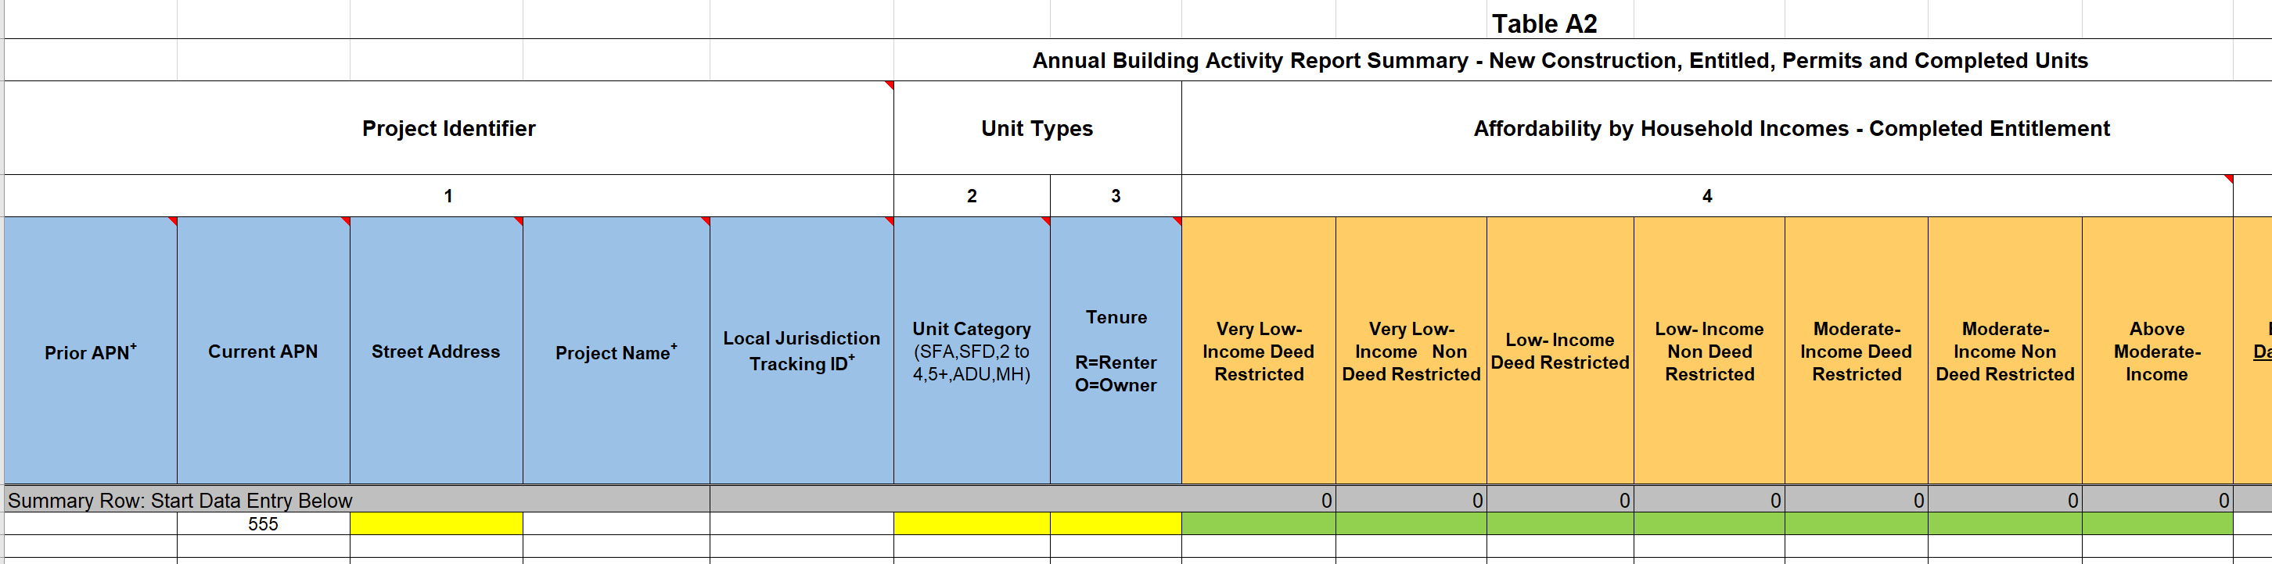
Conditional Formatting in Form
Required fields become highlighted yellow once any cell in that row gets completed.
Cells that are highlighted green are only required if that section applies to the project
Additional fields become highlighted yellow depending on what is being entered in the row.
Notes:
The most common reason that APR submissions fail is due to missing information, but the conditional formatting in the form helps you identify areas where this might be the case.
Anything in the form that is required is highlighted in yellow. Anything that is green is only required if the fields apply to your project.
So for example, in Table A2, once an APN is listed for a project, the required fields (in this case street address and unit count) become highlighted in yellow. But the section in orange is highlighted in green because it is only required if you’ve issued an entitlement during the reporting year.

Slide 20
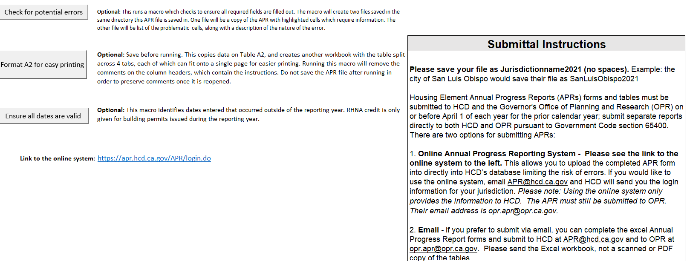
Finish Here Tab
Notes:
The Finish Here tab contains several additional tools that may assist you in completing the APR form. The first tool is a validator, which will run a check of all required information. The Validator will create two files: so, one file is a copy of the APR with problematic cells highlighted. The second file will be a list of problematic cells, with the exact cell number with the error.
The second tool helps format Table A2 for printing. Since Table A2 has so many columns, printing it onto one page is not easy. This tool will create a workbook with 4 tabs, one for each reportable activity, and one with project identifier information.
The 3rd tool is a date checker. This will highlight in orange any dates that occurred outside of the reporting year. You can leave those activities in the form, but to ultimately get credit for those units, they must be reported on the APR for the same calendar year.

Slide 21
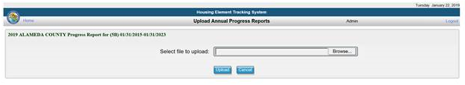
How to Submit APRs
Online Annual Progress Reporting System is available to submit 2022 APRs and is located at https://apr.hcd.ca.gov/APR
APRs can also be emailed to APR@hcd.ca.gov
  Send the electronic version as an Excel workbook attachment. Do not send a scanned copy of the tables.
No longer accepting APRs by mail.
Notes:
There are two ways to submit your APRs:
First, HCD has an online system that allows you to upload the form yourself. If you don’t know your username or password, please reach out and we can send it to you. The link to the online system is in the APR form.
You can also submit 2022 APRs via email to apr@hcd.ca.gov. Please send an excel workbook attachment and not a pdf copy.
For the Housing Element APR to OPR, please email the completed Excel workbook to OPR at opr.apr@opr.ca.gov!!

Slide 22
APR Enforcement – New Provisions
AB 2097 gives HCD authority to refer violations of Government Code 65400 to the Attorney General
HCD now has authority to request corrections to the APR and reject an APR should corrections not be made
Notes:
AB 2097 gives HCD authority to refer violations of Government Code 65400 to the Attorney General
HCD now has authority to request corrections to the APR and reject an APR should corrections not be made

Slide 23
Reminders For Future Planning
Please note that the 2023 APR is due 4/1/2024
The 2023 APR will be required to include reporting on all projects permitted to SB 6 and AB 2011. The 2023 APR will also require reporting whether each housing development was subject to ministerial or discretionary review.
HCD encourages the practice of tracking housing developments approved pursuant to those bills in order to facilitate reporting
Notes:
[can just read off the slide here]

Slide 24
Additional Reminders
APRs are due April 1st
SB35 Determination will be published in June 2023
Questions or comments can be submitted to APR@hcd.ca.gov
More information about APRs is on our website at: https://www.hcd.ca.gov/planning-and-community-development/annual-progress-reports
Notes:
Again, all 2022 APRs are due by April 1, but HCD is here to help. If you run into any issues during the submittal process, please don’t hesitate to reach out to us. Our team is actively monitoring our email box and is happy to help in any way we can.
We are really excited about the collection of this data, and we appreciate all of the work that jurisdictions will be making to provide this data. Just like jurisdictions, HCD is working really hard to adapt to the new requirements set forth by the legislature.
Thank you for your time today! If anyone has any questions, we’ll be happy to discuss more during the Q&A.
I'll hand it over to Tom for questions.
***END HERE***

Slide 25
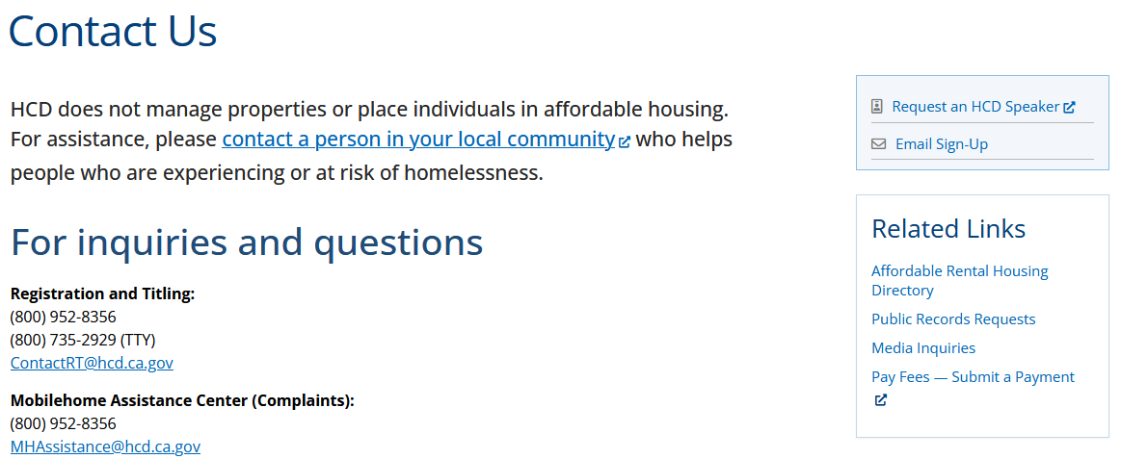
Sign up for HCD announcements at www.hcd.ca.gov/contact-us/email-signup
Stay in the Know
Notes:
Our Communications division is excellent at pushing announcements.
If you have not subscribed, I encourage you to sign up for our emails.

