Slide 1

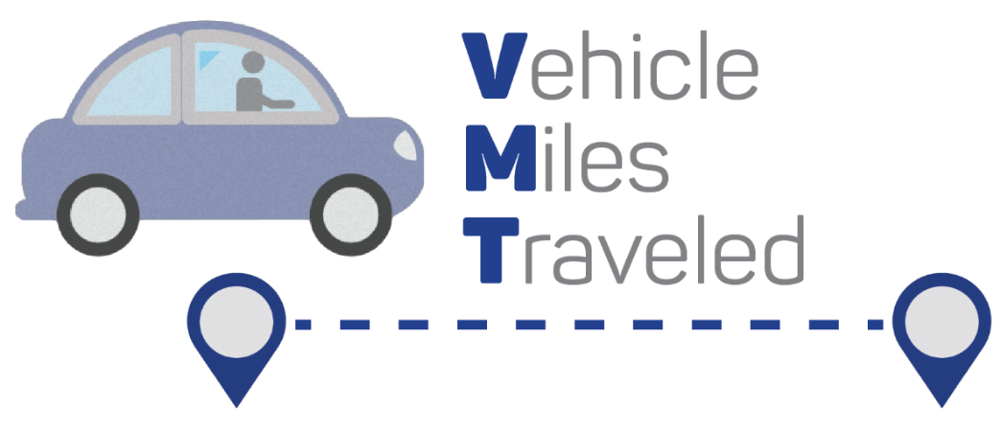
User Guide
How to Use this Slide Deck
This slide deck is designed to help you facilitate discussions with key external stakeholders, such as Planning Commission and City Council, to move towards policy adoption. The key concepts of SB 743 and VMT analysis are simply described and talking points accompany each slide.
Outline
Introduction
Objectives and Glossary
VMT Analysis Overview
SB 743 basics
Intro to VMT as a metric
VMT Analysis Process:
VMT analysis and practical example
Targeted questions/prompts to reinforce key screen and threshold concepts, guiding staff in assessing a project’s VMT impacts
Adoption Strategy:
Policy requirements
Notes:
How to Use this Slide Deck
This slide deck is designed to help you facilitate discussions with key external stakeholders such as Planning Commission and City Council, to move towards policy adoption. The key concepts of SB 743 and VMT analysis are simply described and talking points accompany each slide.

Slide 2

Module 3
Path to Policy Adoption & Intro to VMT Mitigation

Slide 3
Introduction

Slide 4


Key Objectives
What is SB743?
Why use VMT?
Overview of VMT analysis process
Pathways to VMT policy adoption
Guidance for screens and thresholds
Notes:
Today’s presentation is organized around the following topics, with the primary objective being to establish baseline knowledge and vocabulary around SB 743 and VMT policy. We will also provide an overview of the VMT analysis process along with a hypothetical and local example, outline pathways to VMT policy adoption, and provide guidance for defining screens and thresholds.

Slide 5









Glossary
CEQA
The California Environmental Quality Act requires proposed discretionary projects to disclose to the public any significant environmental effects caused by the project through study preparation, stakeholder input, and final analysis report, resulting in a negative declaration (no impact), mitigated negative declaration (impact mitigated through specified actions), or full environmental impact report.
Floor Area Ratio (FAR)
Measurement of a building's floor area in relation to the size of the building’s lot/parcel.
LOS
Level of service performance measurement assigns street intersections/segments letter grades (A-F) based on number of cars and driver delay.
Mitigation
Feasible measures required as part of the approval process to reduce impacts below the threshold of significance.
State Policy Guidance
California Governor’s Office of Planning and Research.
Screening Thresholds
Also known as screens, these are used to quickly identify if a project is expected to cause a less-than-significant impact, without conducting a detailed study.
Thresholds of Significance
Used to determine whether an impact is significant or not.
Significant Impact
An impact exceeding the threshold of significance, requiring mitigation.
VMT Vehicle miles traveled.
Notes:
Here is a glossary of common terms used when discussing SB 743 and VMT policy. We will be using these terms throughout today’s presentation. Please refer to this slide as needed .

Slide 6
VMT Analysis Overview
Notes:
VMT Analysis Overview
SB 743 basics
Intro to VMT as a metric

Slide 7

What is Senate Bill 743?
VMT ANALYSIS
Changes focus
of transportation impact analysis in CEQA from measuring…
Impacts
To
DRIVERS
TO
Impacts
Of
DRIVING
Notes:
SB 743 changes the focus of transportation impact analysis in CEQA from measuring impacts to drivers, to measuring the impact of driving.

Slide 8
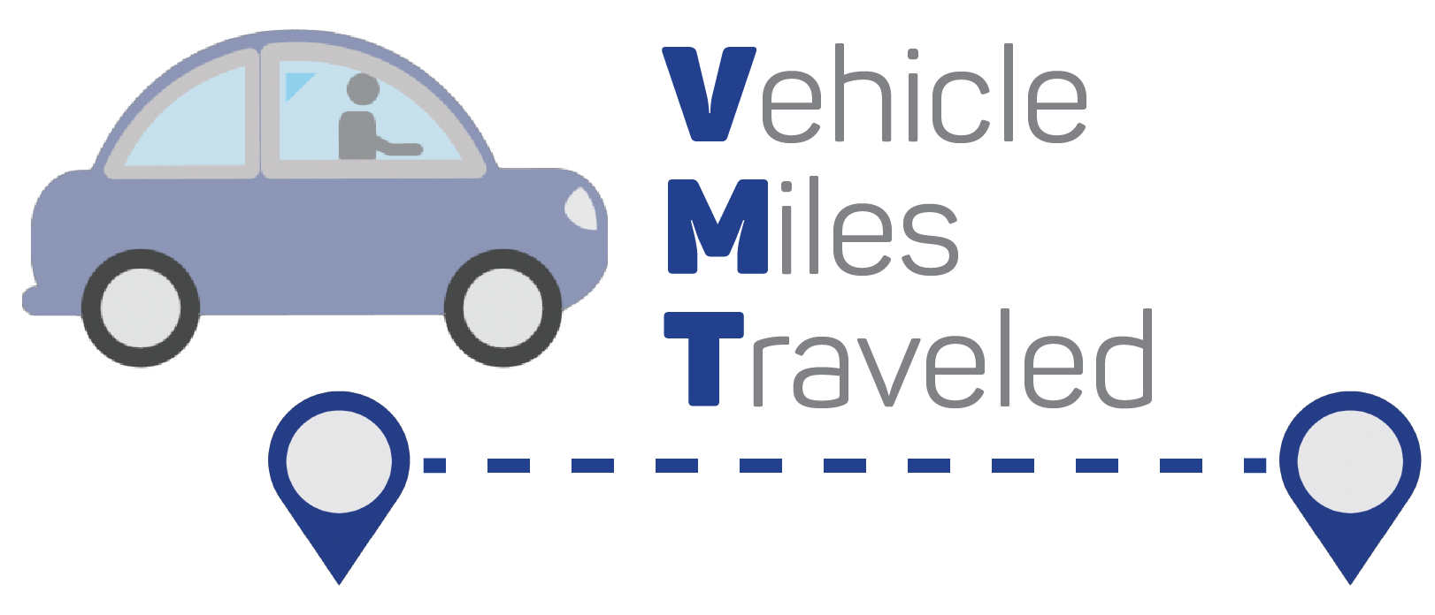
What is Senate Bill 743?
VMT ANALYSIS
The Governor’s Office of Planning and Research (OPR) recommended Vehicle Miles Traveled (VMT) be used to measure transportation impacts under CEQA.
Notes:
The Governor’s Office of Planning and Research (OPR) recommended that Vehicle Miles Traveled (or VMT) be used to measure transportation impacts under CEQA.
This is because the VMT metric can support the three statutory goals: “the reduction of greenhouse gas emissions, the development of multimodal transportation networks, and a diversity of land uses.”

Slide 9

What is Senate Bill 743?
VMT ANALYSIS
JULY 2020
Compliance was required
in July 2020
Notes:
Compliance was required in July 2020, which means LOS may no longer be cited as a finding of significance in CEQA.

Slide 10
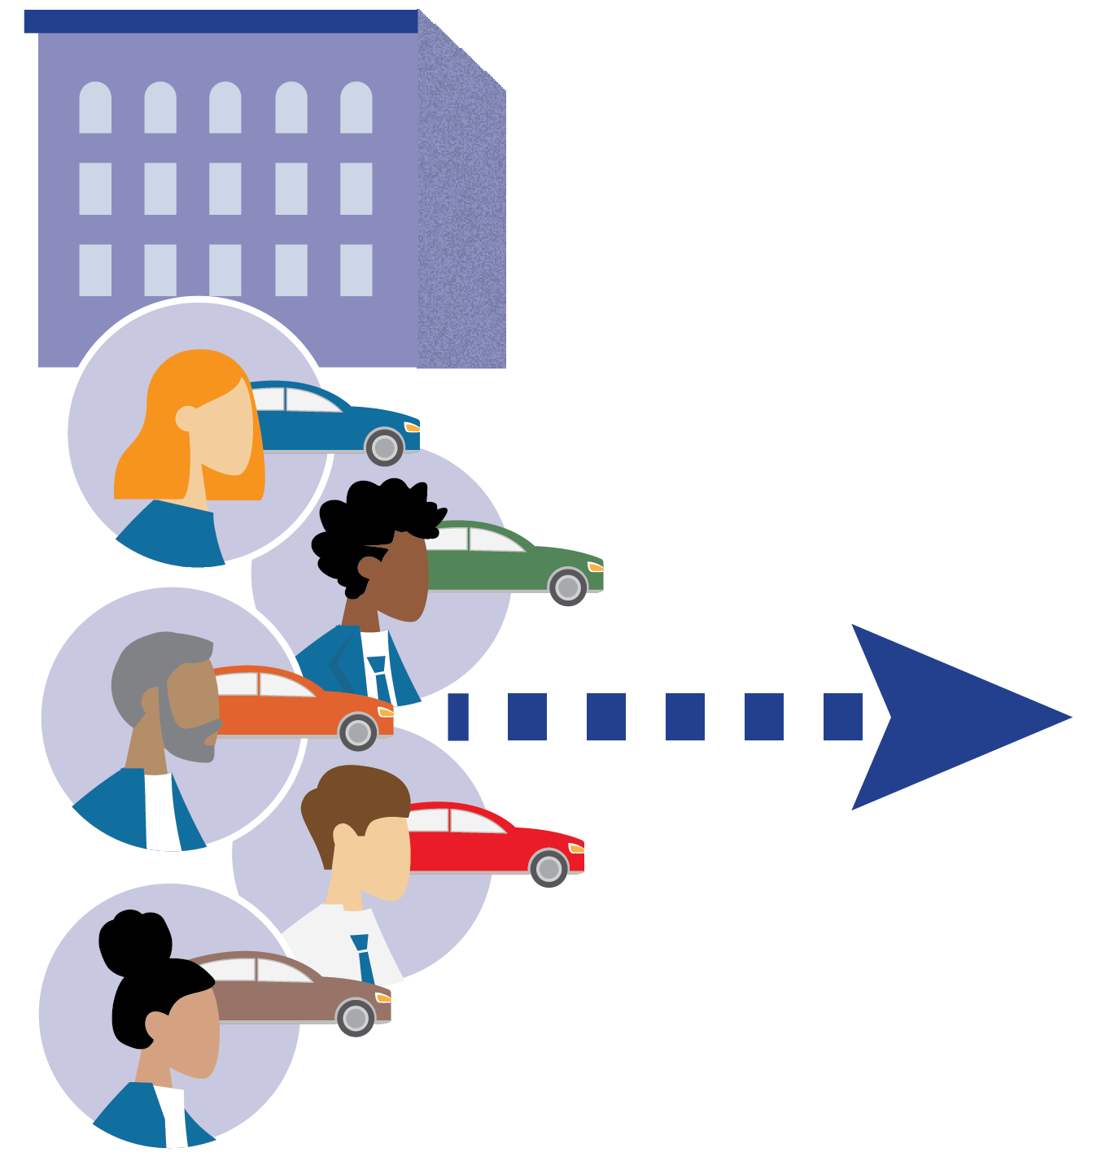
What is Vehicle Miles Traveled (VMT)?
Section 1
VMT ANALYSIS
VMT measures total amount of driving generated by a project
Notes:
Instead of measuring traffic Level of Service (LOS), we now measure the amount of driving generated by a project using VMT. VMT provides a measure of travel efficiency of a land use project.
(Again, this supports the three statutory goals: “the reduction of greenhouse gas emissions, the development of multimodal transportation networks, and a diversity of land uses.”)

Slide 11

What is Vehicle Miles Traveled (VMT)?
Section 1
VMT ANALYSIS
VMT estimates are based on regional travel patterns –­­­ which reflect transportation infrastructure, transit service, and land use
Notes:
[Read from slide]

Slide 12

What is Vehicle Miles Traveled (VMT)?
Section 1
VMT ANALYSIS
Better connects environmental impact measurement to State greenhouse gas emissions reduction goals
Notes:
Historically, the use of LOS in environmental review has moved us further away from local goals and priorities for land use development and economic activity. VMT better connects environmental impact measurement to State greenhouse gas emissions reduction goals.

Slide 13
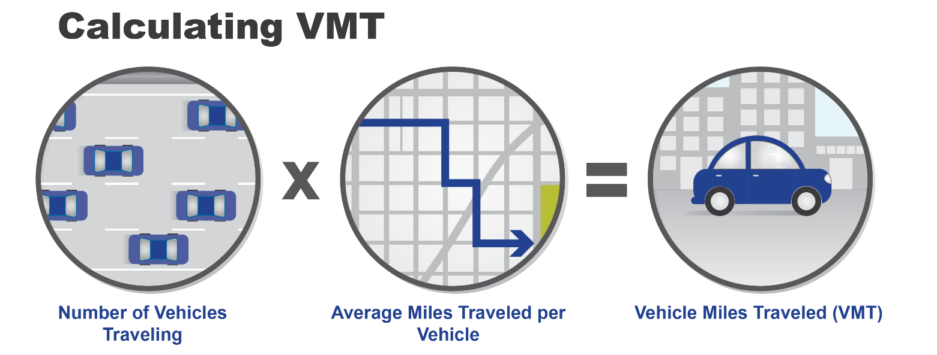
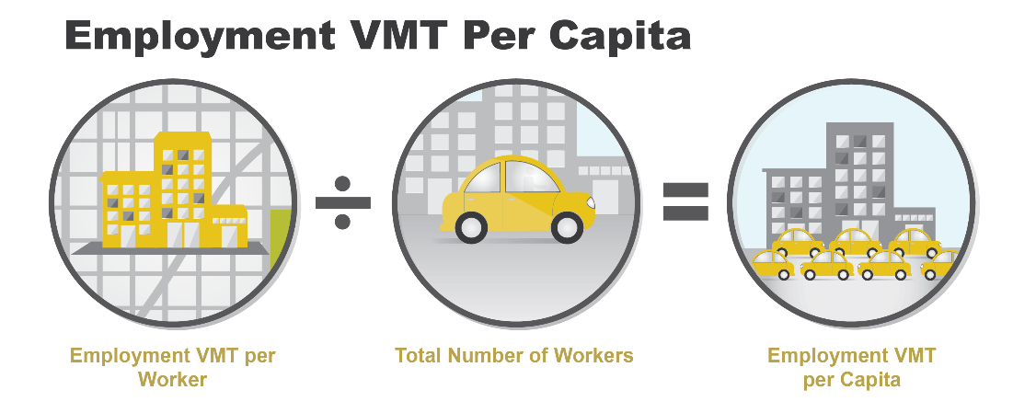
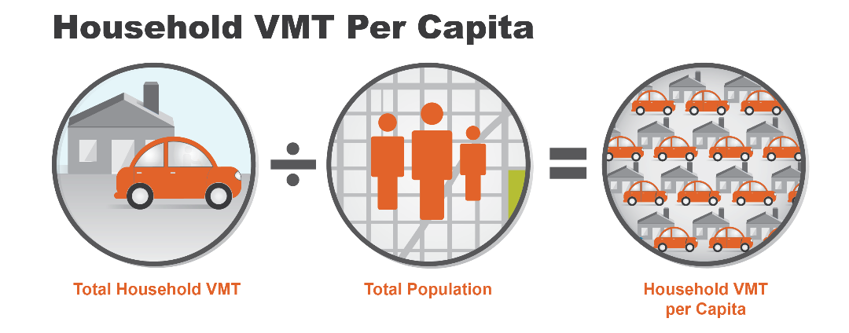
What is Vehicle Miles Traveled (VMT)?
Section 1
VMT ANALYSIS
Can be measured using existing calculations from a regional travel demand model.
Does not typically require additional calculation.
Notes:
VMT is simply the total number of vehicles traveling times the average miles traveled per vehicle.
When calculating the transportation impacts of residential and office projects, OPR recommends using VMT per capita (residential) and VMT per employee (office). VMT per capita is the total household VMT in an area divided by the total population. VMT per employee is the total work trip VMT in an are divided by the total employee population.
VMT can be measured using existing calculations from a regional travel demand model and does not typically require additional calculations. Model calculations are informed by existing and future land uses, transportation networks, and travel patterns.

Slide 14
VMT Analysis Process
Notes:
VMT Analysis Process:
VMT analysis and practical example
Targeted questions/prompts to reinforce key screen and threshold concepts, guiding staff in assessing a project’s VMT impacts

Slide 15
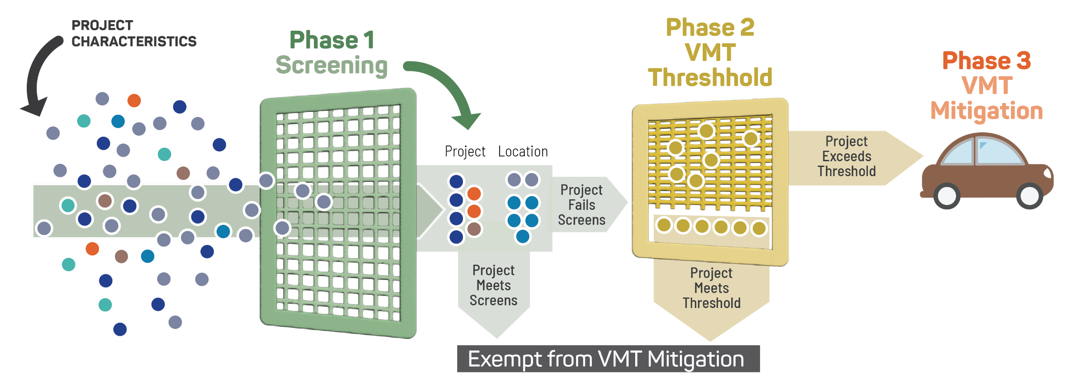

Summary of VMT Analysis Process for CEQA
VMT ANALYSIS
Is the Project Exempt from
VMT Guidelines?
Is the Project Above or Below the
VMT Threshold?
If Above Threshold,
Apply Mitigation
and Re-evaluate:
Is VMT still above the threshold?
If still above threshold, EIR is required
Notes:
The following slides provide an overview of the VMT analysis process for CEQA. It looks complicated but we urge you to focus on the 3 main phases, which include:
Screening
VMT Threshold
and VMT Mitigation.
The following slides will break down each Phase in greater detail.

Slide 16
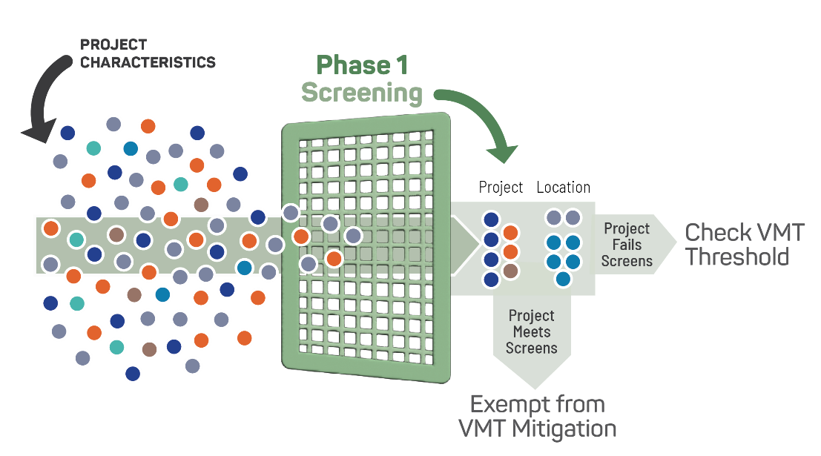
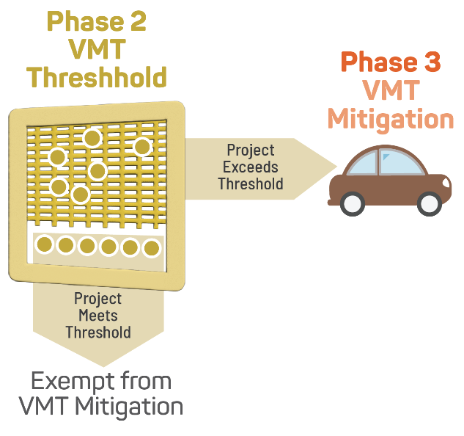
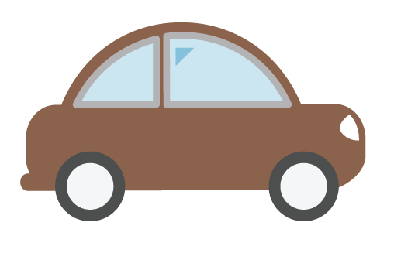
VMT Policies to Adopt for CEQA Review
Section 1
VMT ANALYSIS
VMT-based Screens
VMT-based
CEQA thresholds
VMT Mitigation
Applies to land use and transportation projects
Helps agencies quickly identify low-VMT projects exempt from analysis (no CEQA transportation impact)
Saves staff time by streamlining the review process
Projects with significant VMT impacts require mitigation to avoid or substantially reduce the impact.
Approach provides guidance to developers while offering benefits to on-site and neighboring communities
Provides objective measure to achieve state GHG reduction goals and reduce VMT, while enabling all communities to grow
Notes:
VMT-based screens, or Phase 1, applies to land use and transportation projects and helps agencies quickly identify low-VMT projects exempt from analysis. It saves staff time by streamlining the review process.
VMT-based thresholds, or Phase 2, provides an objective measure to achieve state GHG reduction goals and reduce VMT, while enabling all communities to grow.
VMT Mitigation, or Phase 3, requires that projects with significant VMT impacts undergo mitigation to avoid or substantially reduce the impact. Identifying an approach provides guidance to developers while offering benefits to on-site and neighboring communities.

Slide 17
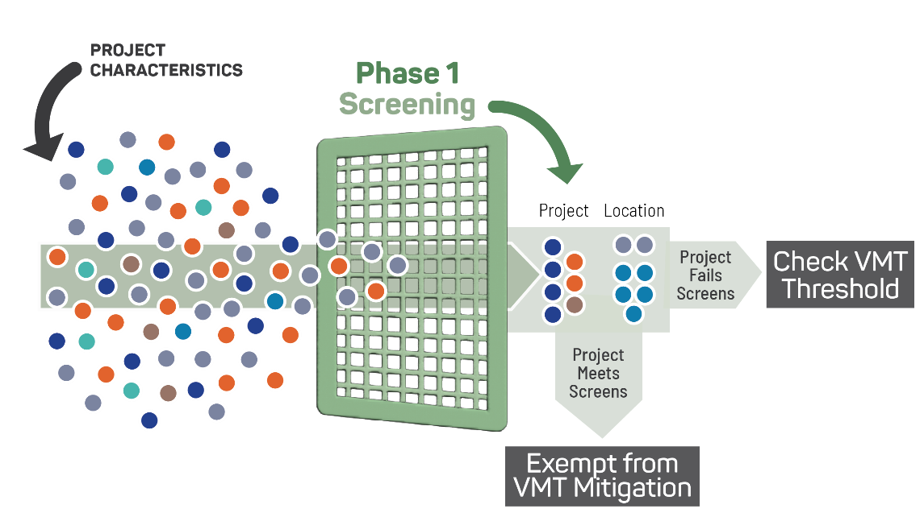
Defining Screens: OPR Recommendations
Section 1
VMT ANALYSIS
Screens are informed by project characteristics and location.
Project Screens recommended by OPR for streamlining analysis exclude projects based on such factors as:
Below a determined size
100% affordable housing
Located in low VMT zones
Located near high frequency transit
Is local serving retail
Is a public facility
Screens help to quickly identify when a project should be expected to cause a less-than-significant impact without conducting a detailed study
Notes:
By defining screens, city staff and developers can quickly identify low-VMT projects that do not require any CEQA transportation analysis. These low-VMT projects are presumed to have no significant impact and therefore do not require conducting a detailed study or mitigation.
Low-VMT project types and low-VMT locations can be prioritized and provide predictable development opportunities. Similarly, transportation projects that reduce VMT can also be screened out.

Slide 18
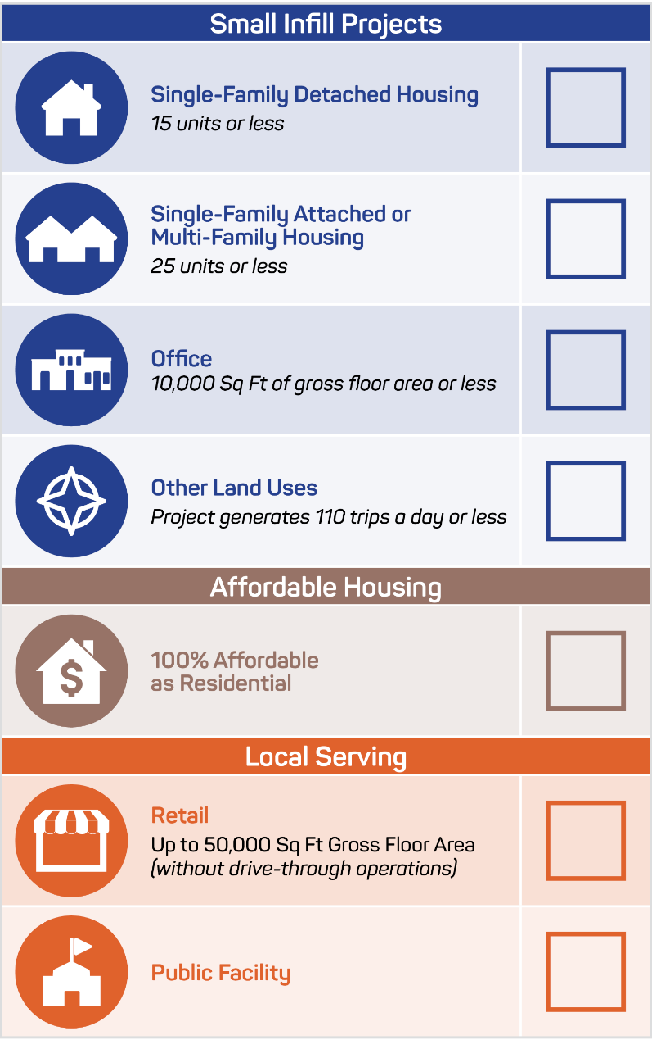
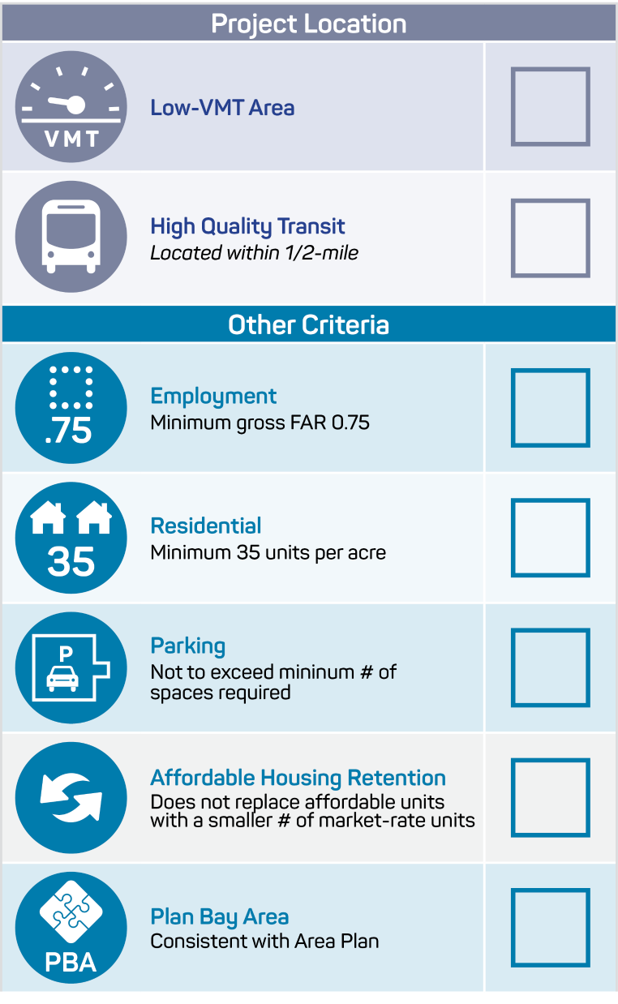
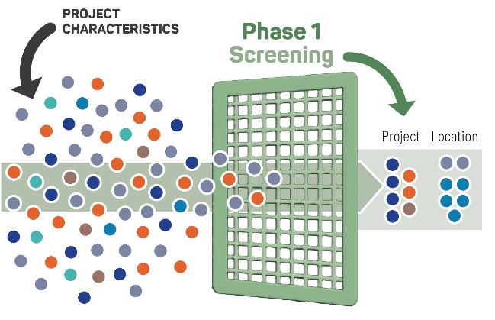
Defining
Screens
Section 1
VMT ANALYSIS
Project-Based Screens
Location-Based Screens
Must pass one of these screens before considering
Other Criteria
OPR Recommended Screening Criteria
A site with existing rail transit station, a ferry terminal served by bus or rail services, or the intersection of 2+ major bus routes with a frequency of 15 min or less during peak commute periods
From OPR’s example criteria, the presumption of no significant impact might not be appropriate if density is greater than 0.75 FAR, which is similar to 35 du/acre.
If located in a lower density area, the maximum density must be met.
Notes:
Here is a comprehensive overview of different types of screens. There are two types of screens, project-based screens and location-based screens. Project-based screens for residential and office projects include: small infill projects, affordable housing, and local serving retail and public facilities.
Location-based screens screen out projects located in a low-VMT area or within ½ mile of high-quality transit. The state defines high-quality transit as a rail station, a ferry with bus service, or any transit that gets 15 minute frequencies or better during commute hours.
In addition to the location, the project must meet additional criteria in order to presume a less-than-significant impact. Our jurisdiction has some flexibility in defining these criteria, however, they must be defensible. OPR recommended additional criteria for Location-Based screens include:
Density
Minimum gross floor area ratio (FAR) of 0.75 for employment projects
Minimum of 35 units per acre for residential projects (Note, OPR does not name an exact requirement for minimum du/acre, but this is consistent with the intention of the recommendation and may be customized to best match TOD density for local jurisdictions)
If located in an area that has a maximum density below 0.75 FAR or 35 units per acre, the maximum density allowed and/or the required density for a TOD must be met,
Parking: No more than the minimum number of parking spaces required
Does not replace affordable residential units with a smaller number of moderate or high-income residential units
Consistent with Plan Bay Area and the applicable Sustainable Communities Strategy

Slide 19
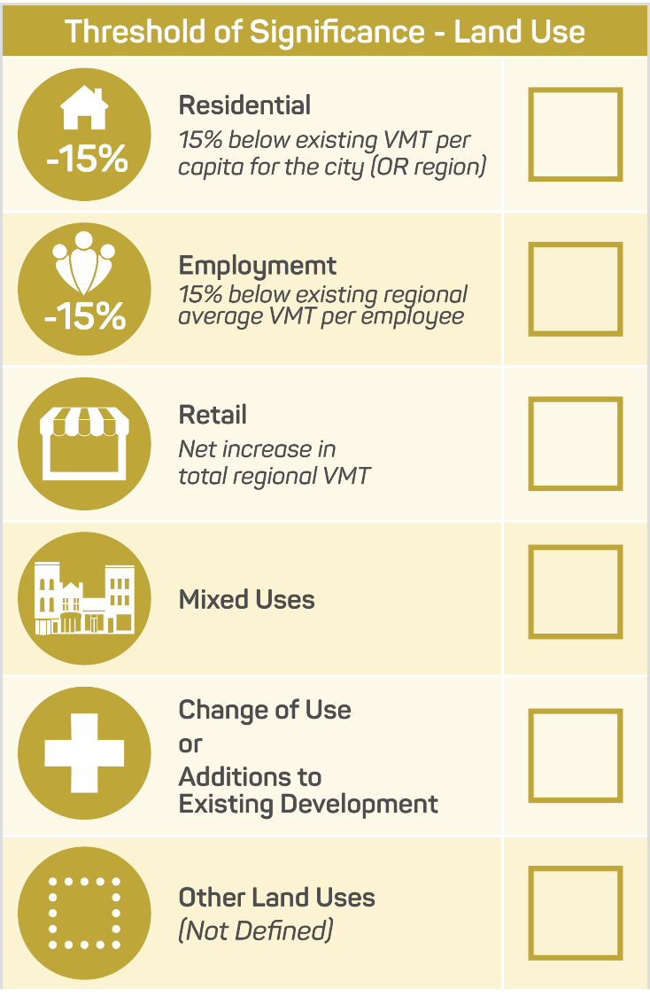
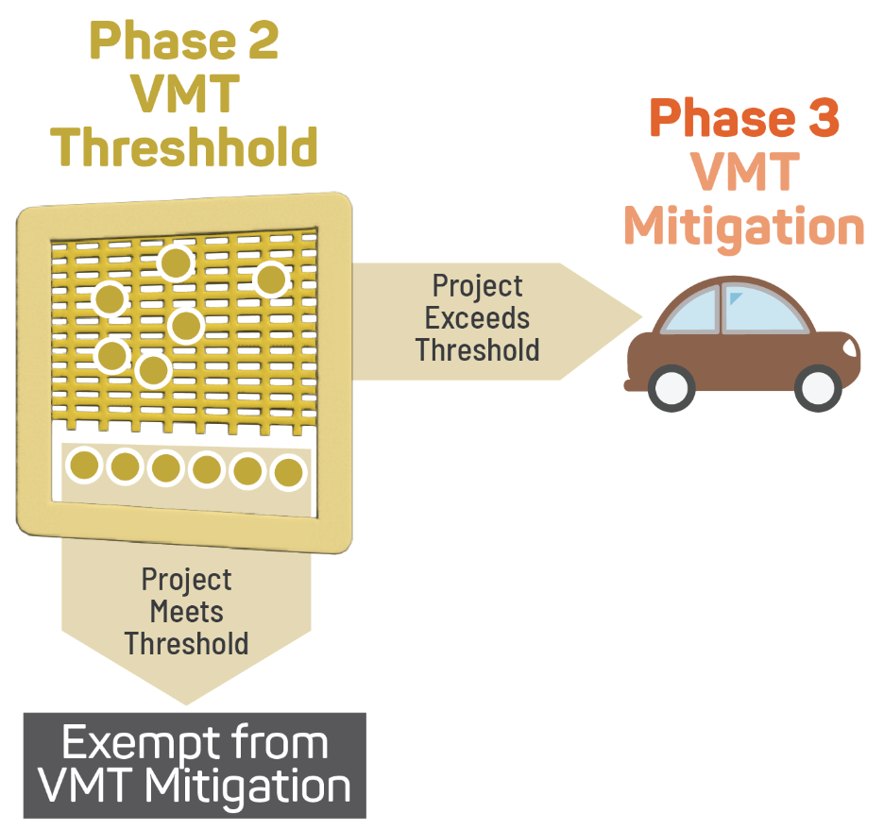
Defining Thresholds – OPR Recommendations
Section 1
VMT ANALYSIS
Thresholds of Significance
Used to determine whether an impact is significant or not.
Each land use component analyzed independently, applying the significance threshold for each category in this table.
Analyzed independently, applying the significance threshold for each category in this table.
Determined on a project-by-project basis, after identifying relevant precedence and project proxies.
Notes:
We will need to adopt VMT thresholds for different types of land uses. The thresholds of significance shown here are recommended by OPR for residential, office, retail, and mixed-use land use projects. These recommendations align with the state’s long-range GHG modeling and is considered defensible.
We recognize that there are unique land uses and unique contexts to consider, but the OPR guidance will cover most needs, and can be the basis for most unique project types.

Slide 20
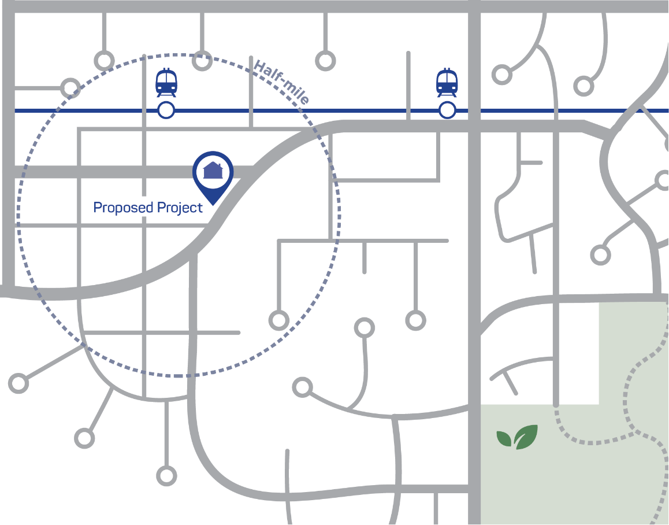
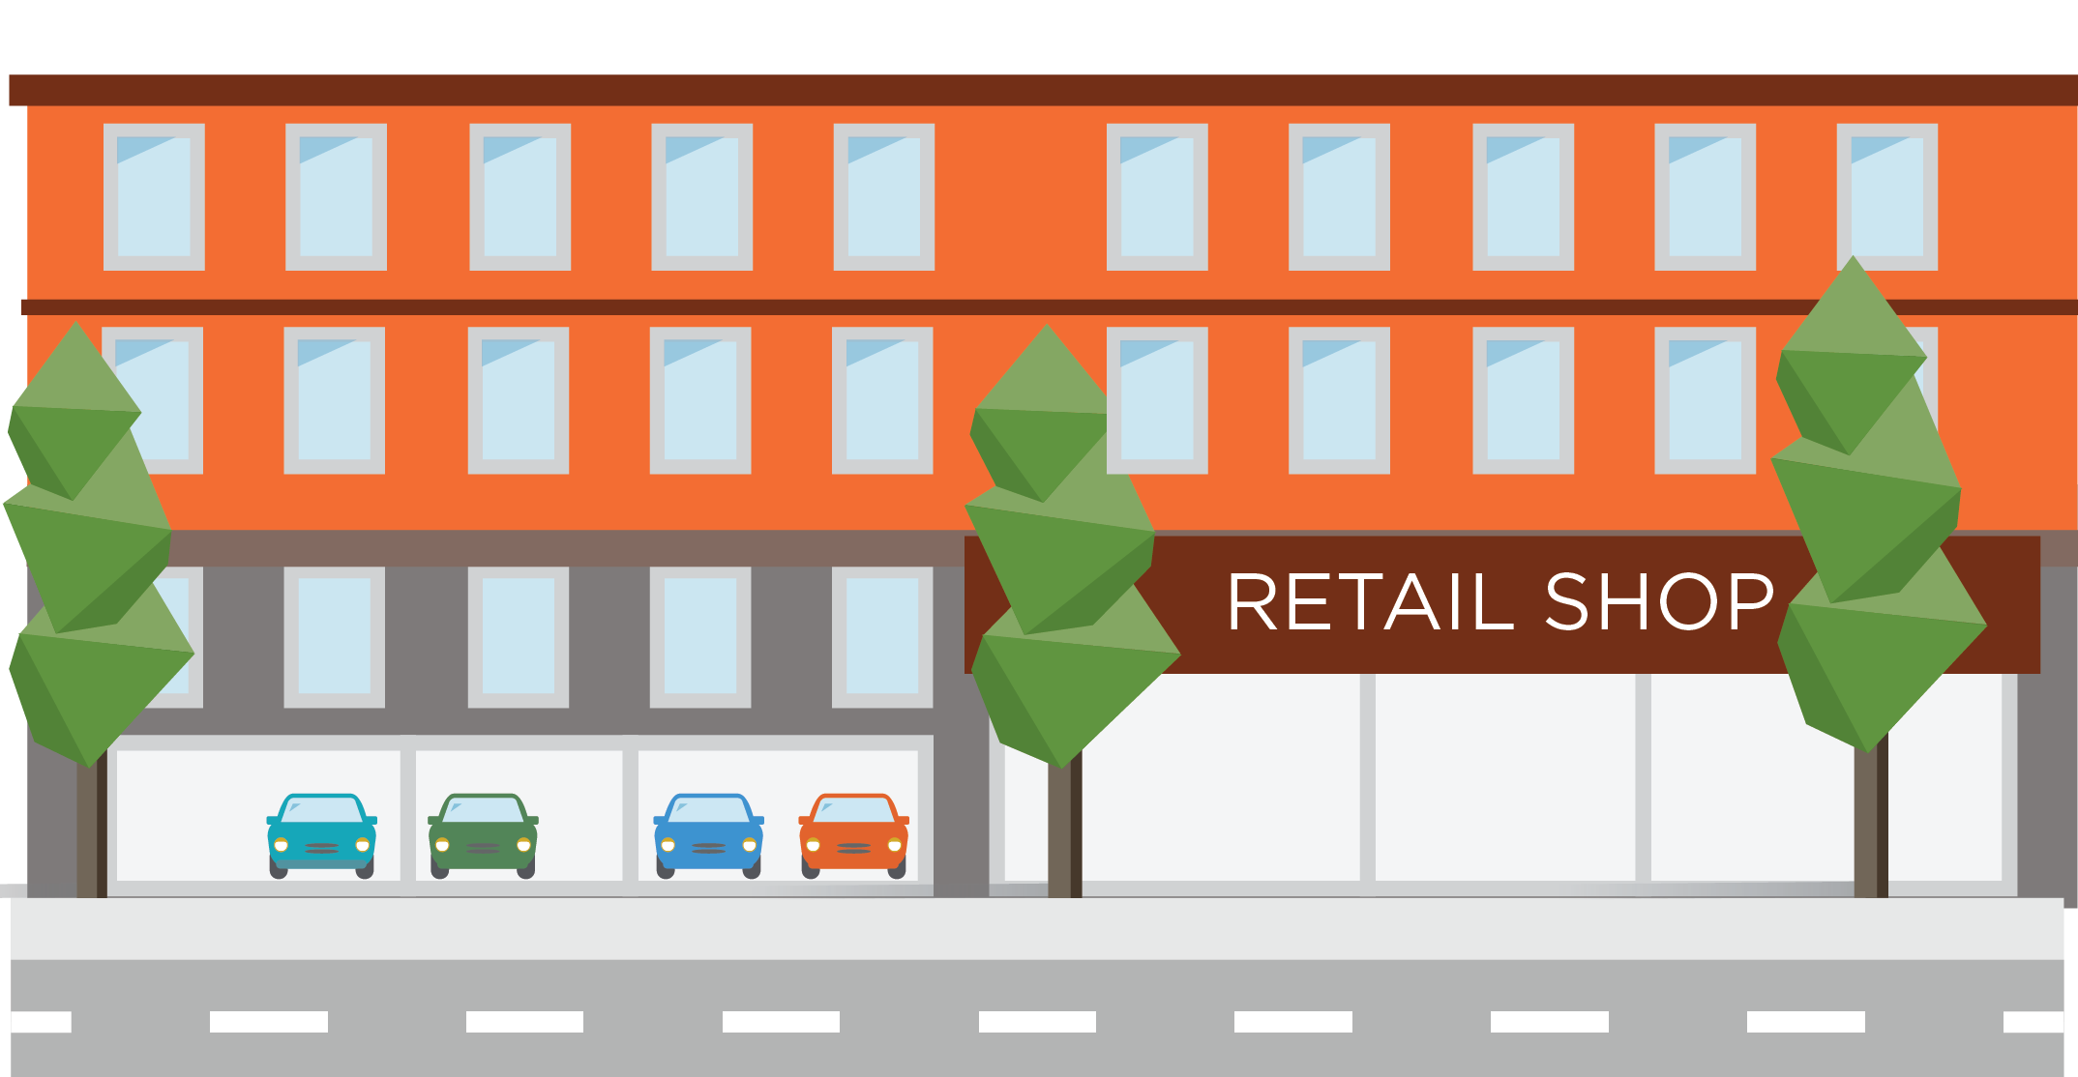

Phase 1 Screens
VMT ANALYSIS example
A planner receives a proposed project on their desk with these specifications…
Mixed-use residential development with 472 units
  18 units/acre
  10% affordable housing
  20,000 Sq Ft retail
  Located 0.3 mi from train station
  1.0 parking stall per unit
Notes:
To demonstrate how Screens and Thresholds are applied, let’s look at a hypothetical example.
Assume a planner receives a proposed project on their desk with these specifications:
Mixed-use residential development with 472 units
Residential density: 18 units/acre
10% affordable housing with 1.0 parking stall per unit
Retail: 20,000 Sq. Ft.
Located 0.3 miles from a transit station

Slide 21
Phase 1 Screens
Mixed-use residential development with 472 units
VMT ANALYSIS example
Because the project is mixed-use, Residential and Retail components must be assessed individually
  RESIDENTIAL
  18 units/acre
  RESIDENTIAL
  10% affordable housing
  RETAIL
  20,000 Sq Ft retail
  RESIDENTIAL/RETAIL
  Located 0.3 mi from
  train station
  RESIDENTIAL
  1.0 parking stall per unit
Notes:
Based on the project description, the proposed project is mixed-use with Residential and Retail components. OPR guidance recommends assessing each land use type individually.
Let’s start with the residential components of the project, which are highlighted with green boxes.

Slide 22
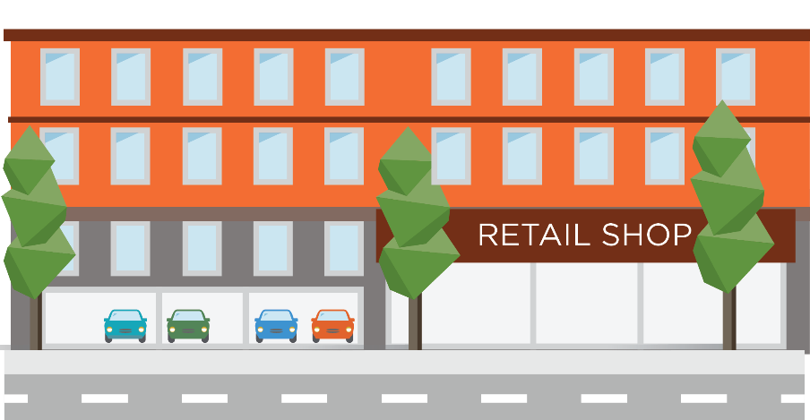
Phase 1 Screens
Mixed-use residential development with 472 units
VMT ANALYSIS example
Project-Based Screens
Let’s check the Project-Based screen first, starting with Residential use…
Not Applicable
Fails Requirement
FAILS
Not Applicable
Residential portion of Project-Based screen
does not qualify for exemption
Residential elements that are relevant to the Project-Based screens:
Not Applicable
  472 Attached Units
FAILS
Not Applicable
Not Applicable
Notes:
Let’s check the Project-Based Screen first for the residential elements of the project. The 472 attached units do not meet any of the Small Infill Project screens. All other project-based screens do not apply.
In conclusion, the residential portion of the proposed project does not meet the Project-Based screens and therefore does not qualify for the Project-Based screens exemption. Additional VMT analysis may be needed.

Slide 23
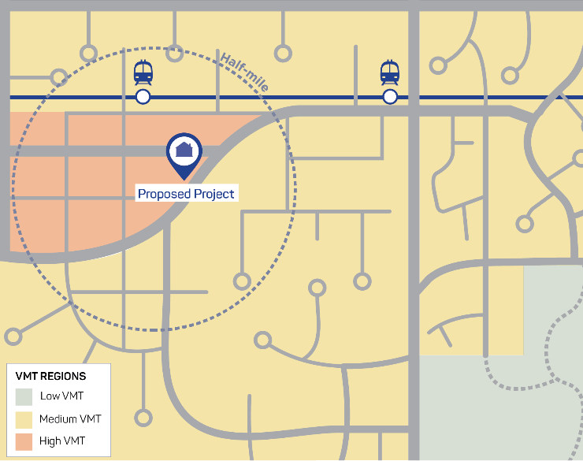
Phase 1 Screens
Mixed-use residential development with 472 units
VMT ANALYSIS example: Phase 1
Location-Based Screens
Now let’s check the Location-Based screen for Residential use…
FAILS
Project is not in a Low-VMT area
Must pass one of these screens before considering
Other Criteria
Meets Requirement
Residential elements that are relevant to the Location-Based screens:
Fails Requirement
Since all Other Criteria must be met, the Residential portion of Location-Based screens might NOT be exempt from further
VMT analysis
Must pass ALL
Other Criteria
FAILS
  0.3 mi from train station
  18 residential units/acre
Next, we need to check the Retail Screens for the project.
Notes:
Moving on to the Location-Based screens for the residential elements of the project, the proposed project site is located within ½ mile from the train station and therefore meets the High-Quality Transit Screen.
In order to be exempt from further VMT analysis, the project must meet other density and parking criteria. With 18 residential units per acre, the proposed project does not meet the minimum density requirement.
In conclusion, the residential portion of the proposed project does not meet all the criteria for the Location-Based screens and therefore may require further VMT Analysis.

Slide 24
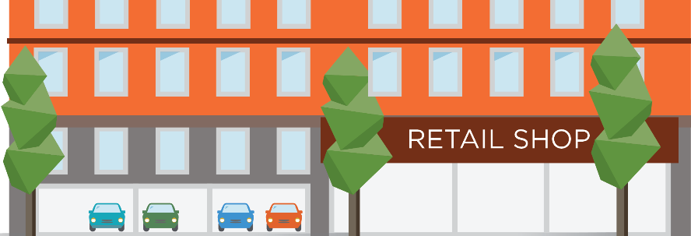
Phase 1 Screens
Mixed-use residential development with 472 units
VMT ANALYSIS example
Project-Based Screens
Not Applicable
Not Applicable
Let’s apply the same
Project-Based screens to the project’s Retail elements…
Retail portion of Project-Based screen
qualifies for exemption from further VMT analysis
Not Applicable
Not Applicable
Retail project elements relevant to the Location-Based screens include:
  20,000 sq ft retail
Not Applicable
Meets Requirement
Now let’s check the Retail Location-Based screens
Not Applicable
Notes:
Now let’s look at the retail elements of the project. The retail components of this mixed-use project meet the criteria for the local-serving retail screen, which screens out retail projects up to 50,000 square feet of gross floor area. Since the local-serving retail screen is met, the retail portion of the proposed project qualifies for exemption from further VMT analysis.
Projects only need to meet the criteria for one screen to be screened out, but for practice, let’s demonstrate how the other screens might apply to the retail elements of the project.

Slide 25

Phase 1 Screens
Mixed-use residential development with 472 units
VMT ANALYSIS example
Location-Based Screens
Checking for Location-Based
retail screens…
FAILS
Project is not in a Low-VMT area
Must pass one of these screens before considering
Other Criteria
Meets Requirement
Not Applicable
Retail project elements relevant to the Location-Based screens:
The Retail portion of the project
is ALSO exempt from further VMT analysis based on proximity to transit.
Not Applicable
Must pass ALL
Other Criteria
  0.3 mi from train station
Meets Requirement
Project ALREADY screened out for local-serving retail. It is also within 0.5 mi of
high-quality transit.
Not Applicable
Not Applicable
Notes:
The retail element of the project is already screened out for local serving retail. This applies in any location so there is no need to screen it a second time.
However, for the sake of reviewing all screening criteria that could be relevant for this example, we’ll look at the Location-Based screens. The retail element also meets the High-Quality Transit screen because it is located within 0.5 miles of high-quality transit, and it does not include excessive parking (in this case, there is no dedicated parking for the retail element).

Slide 26


Phase 1 Screens Summary
Mixed-use residential development with 472 units
VMT ANALYSIS example
  Retail is screened out
  Some requirements are met
  Some are not applicable
Location-Based Screens
Project-Based Screens
Meets Residential Requirement
Meets Retail Requirement
Fails Residential Requirement
Fails Residential Requirement
  Overall, the Residential element fails the screens because of the Low-VMT area and Residential density screens.
Phase 2: Now, it’s time to check the applicable Residential VMT Thresholds to see if those qualify for exemption.
Notes:
In sum, the residential and retail screening results reveal the residential components of the project is NOT EXEMPT from further VMT analysis. We will move on to Phase 2 of the VMT Analysis Process to understand the project’s impact relative to thresholds of significance.

Slide 27
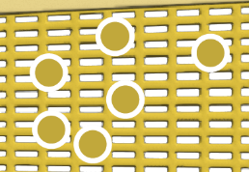
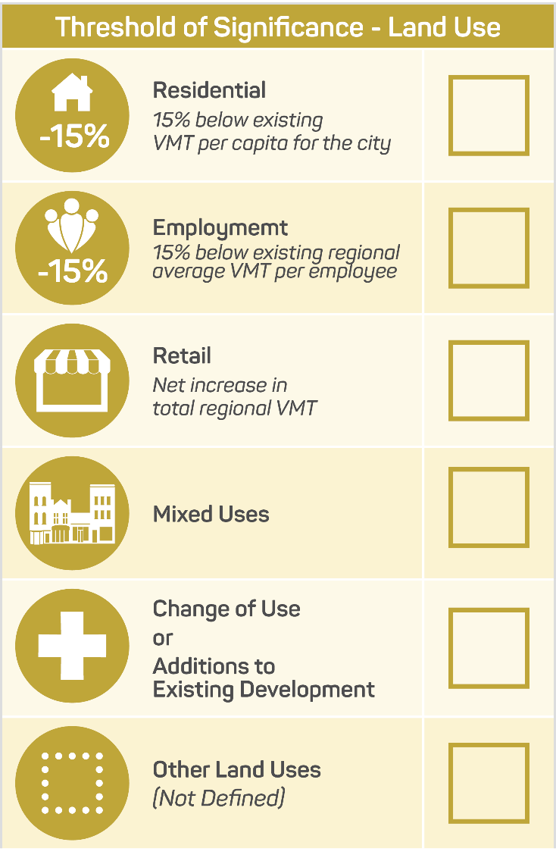
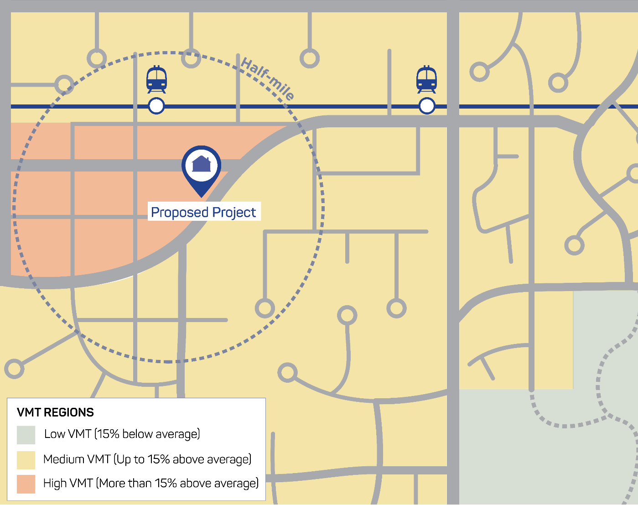
Phase 2 Thresholds of Significance
Mixed-use residential development with 472 units
VMT ANALYSIS example
In phase 2 we determine the project’s VMT and determine if it’s above or below the threshold …
The project’s Retail portion has screened out, but Residential elements failing Phase 1 Screening require additional analysis.
Calculate project area VMT per capita/employee
Fails Residential Requirement
Expected VMT per capita for the residential component exceeds the threshold of significance
Is it 15% below existing VMT
per capita for the City/region
for the residential portion of the project?
Not Applicable
Not Applicable
FAIL
High VMT location requires further analysis and possible mitigation
Not Applicable
Not Applicable
Not Applicable
Notes:
For Phase 2 of VMT analysis, we look at the project’s VMT and determine whether it’s above or below the threshold of significance. To do this, calculate the project area VMT per capita or per employee using a county-provided VMT calculator or tool and determine whether it is 15% below the existing VMT per capita for the City (or region) for the residential element of the project.
The expected VMT per capita for the residential component of the project exceeds the threshold of significance. CEQA requires further analysis to understand the project’s impact and to determine mitigation.

Slide 28
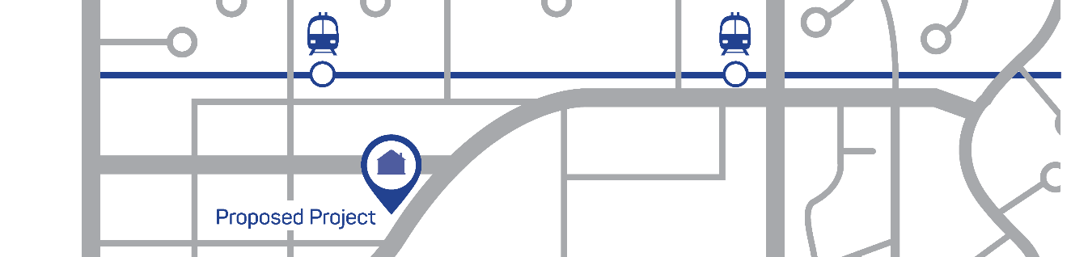
Phase 3 Mitigation
Mixed-use residential development with 472 units
VMT ANALYSIS example
In this phase, we determine options for project VMT mitigation in two categories:
Site-Specific Features
Increase residential density​
Commute trip reduction programs​
Price or unbundle parking​
Provide parking “cash-out” ​
Limit parking supply​
Integrate affordable housing​
Provide ridesharing program​
Provide subsidized transit passes
Community-Based Measures
Provide community-based travel planning​
Charge for public parking​
Provide pedestrian network improvements​
Construct or improve bicycle facilities​
Expand transit network or service​
Improve bus stops and other transit
Supportive roadway treatments​
Implement a carshare program​
Implement bike or scooter share program (conventional or electric)
Notes:
Because the project’s Residential element was not screened and did not meet the VMT threshold, the project requires mitigation.
VMT impact mitigation strategies generally take the form of Transportation Demand Management (TDM) measures. TDM measures include strategies related to parking, transit usage, encouraging a mix of land uses on site, and promoting the use of active transportation and higher-occupancy vehicle modes.
VMT mitigation measures include both site-specific and community-based measures. Examples of VMT mitigations are listed here.
Important to note, in this case, because of the proximity to transit and the potential to screen based on project location, the city and developer could revisit the project description and increase density to pass that initial screen. If the newly defined project is dense enough to meet TOD criteria, it would be screened out based on location, and no other mitigation would be necessary.

Slide 29
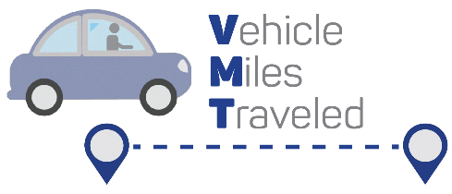




Phase 3 Mitigation
Mixed-use residential development with 472 units
VMT ANALYSIS example
Determine land use place type based on project location
Urban
Suburban Center
Suburban
PLACEHOLDER FOR Screenshot of County-specific Tools
Calculate & Apply VMT Mitigation Measures
Use local Mobility Management Tools
Mitigations can include TDM, VMT banks, VMT fees, VMT exchanges
MITIGATION SUCCESSFUL
Mitigated Negative Declaration Issued
SIGNIFICANT VMT IMPACT REMAINS
Project sponsor addresses impacts
Further Mitigation Options:
Seek statement of overriding consideration
Change location to lower VMT area
Adjust other project aspects to lower screening score(s) (e.g., more affordable housing, etc.)
Notes:
To determine the appropriate mitigation measures, determine the land use place type based on the project’s proposed location. Then calculate and apply the VMT Mitigation Measures using local mobility management tools. If mitigation is successful, a Mitigated Negative Declaration is issued. If significant VMT impacts remain, the project sponsor must address these impacts. This can be done by seeking a statement of overriding consideration, changing the location of the project to a low-VMT area, or adjusting other project aspects to lower screening scores.
Facilitation guide: add a screenshot of your county-specific VMT calculator tool, if available.

Slide 30
Adoption Strategy and Implementation

Slide 31

Policy Requirements
Adoption Strategy & Implementation
Prepare
Confirm SB743 requirements
Define
Define local VMT data resources
Adopt
Adopt VMT thresholds
Implement
Review threshold and screening guidelines
Review existing local CEQA process and related policies
Identify VMT mitigation tools and resources
Identify supporting policy needs (e.g., TDM, parking or safety)
Define non-CEQA analysis requirements (e.g., LOS)
Adopt VMT mitigation approach
Define local VMT thresholds
Define local VMT analysis screens
Adopt screening criteria
SB 743 requires VMT-based significance criteria
Define VMT analysis screens and VMT thresholds for common land uses
Remove LOS-based analysis from CEQA policy
Typical Engagement
Internal Staff
Decision Makers
Internal Staff,
may need Decision Maker input
Notes:
These are the steps you will take for compliance with SB 743. After reviewing guidelines and local VMT data to define local VMT thresholds and analysis screens, the next step is to bring the recommended thresholds, screening criteria, and mitigation approach to decision-makers.
Identifying additional resources for VMT mitigation, or other supportive policy needs, will come later.

Slide 32
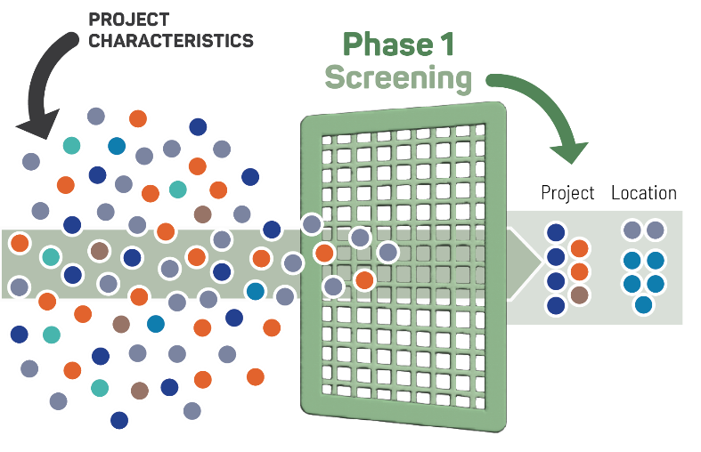
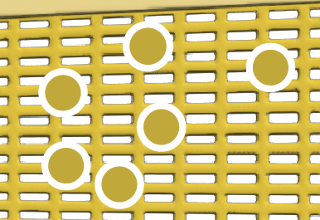
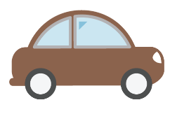
Adoption Strategy & Implementation
The Basics: VMT Policies to adopt for CEQA Review
Adopt VMT-based CEQA Thresholds
  Thresholds provide an objective measure to achieve state GHG reduction goals and reduce VMT while enabling all communities to grow.
Adopt VMT-based Screens for land use and transportation projects
  Screens help agencies quickly identify low-VMT projects that do no need analysis (no CEQA transportation impact).
  Saves staff time by streamlining the review process.
Identify a VMT mitigation approach
  Projects with significant VMT impacts require mitigation to avoid or substantially reduce the impact.
  Identify a VMT mitigation approach provides guidance to developers while offering benefits to on-site and neighboring communities.
Notes:
It's just 3 steps, but really the first two steps are most critical. Here are why each of these steps matters.
To adopt a VMT policy, your jurisdiction will need to adopt VMT-based thresholds and VMT-based screens. Your jurisdiction will need to adopt VMT thresholds for different types of land uses. Transportation thresholds also need to be changed. Most Bay Area jurisdiction sponsored transportation projects do not increase VMT and therefore has a less-than-significant impact.
Establishing screens will help you streamline the VMT review process for projects that don’t need additional analysis.
Finally, identifying the VMT mitigation approach will allow for consistency and clarify with VMT analyses and required TDM measures.

Slide 33



Policy Requirements
Adopting Thresholds of Significance
Adoption Strategy & Implementation
Adopt new VMT thresholds for Transportation Analysis in CEQA
Thresholds of Significance
OPR recommends a significance threshold of 15% below existing average daily VMT per capita for most land uses.
Retail and Transportation projects should not increase total regional VMT.
This is based on CARB models calculating GHG reductions needed to achieve state climate goals
VMT is based on location and typically determined by a travel demand model
Notes:
When defining new VMT thresholds for Transportation Analysis in CEQA, OPR recommends a significance threshold of 15% below existing average daily VMT per capita for most land uses. VMT is based on location and typically determined by a travel demand model.
For retail and transportation projects, total regional VMT should not increase.

Slide 34

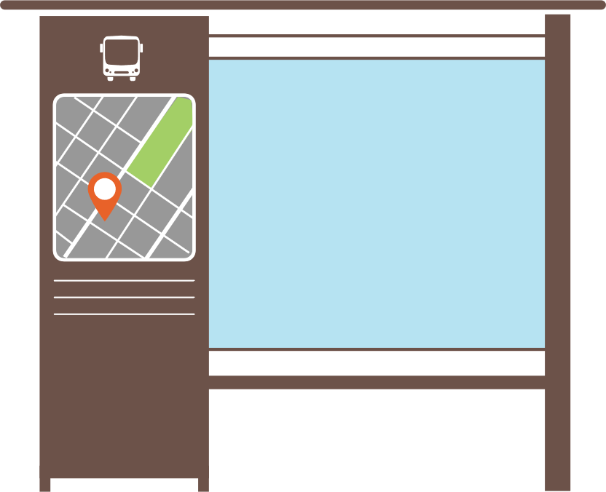

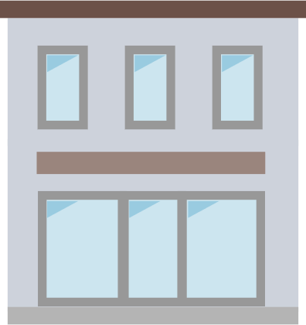



Adopting Screening Criteria
Adoption Strategy & Implementation
Adopt VMT analysis screening criteria
OPR Recommends establishing screens to streamline analysis for projects, including:
Small Project Screen Projects that are below a determined size (<110 daily trips)
Affordable Housing Screen Projects that provide 100% affordable housing
Location Based Screen Projects located in low VMT zones
Major Transit Screen Projects are located near major transit stop
Retail and Services Local projects
Notes:
When determining VMT analysis screening criteria, OPR recommends establishing the following screens to streamline analysis for most projects, including: a small project screen, affordable housing screen, location-based screens, major transit screens, and local service retail screens.

Slide 35
Thank You!

