Slide 1


How to Address
HCD Comments for Certification
Regional Housing Technical Assistance Program
September 27, 2022

Slide 2
Agenda
Speakers
  Michael Forbes, Westlake Village
  Eric Singer, Citrus Heights
  Marika Poynter, Irvine
  Alejandro Sánchez-López, Long Beach
Moderated Discussion – Josh Abrams, Baird + Driskell
Questions & Answer Session
Breakout Room Discussions
City Case Studies: Key Lessons for Working with HCD

Slide 3
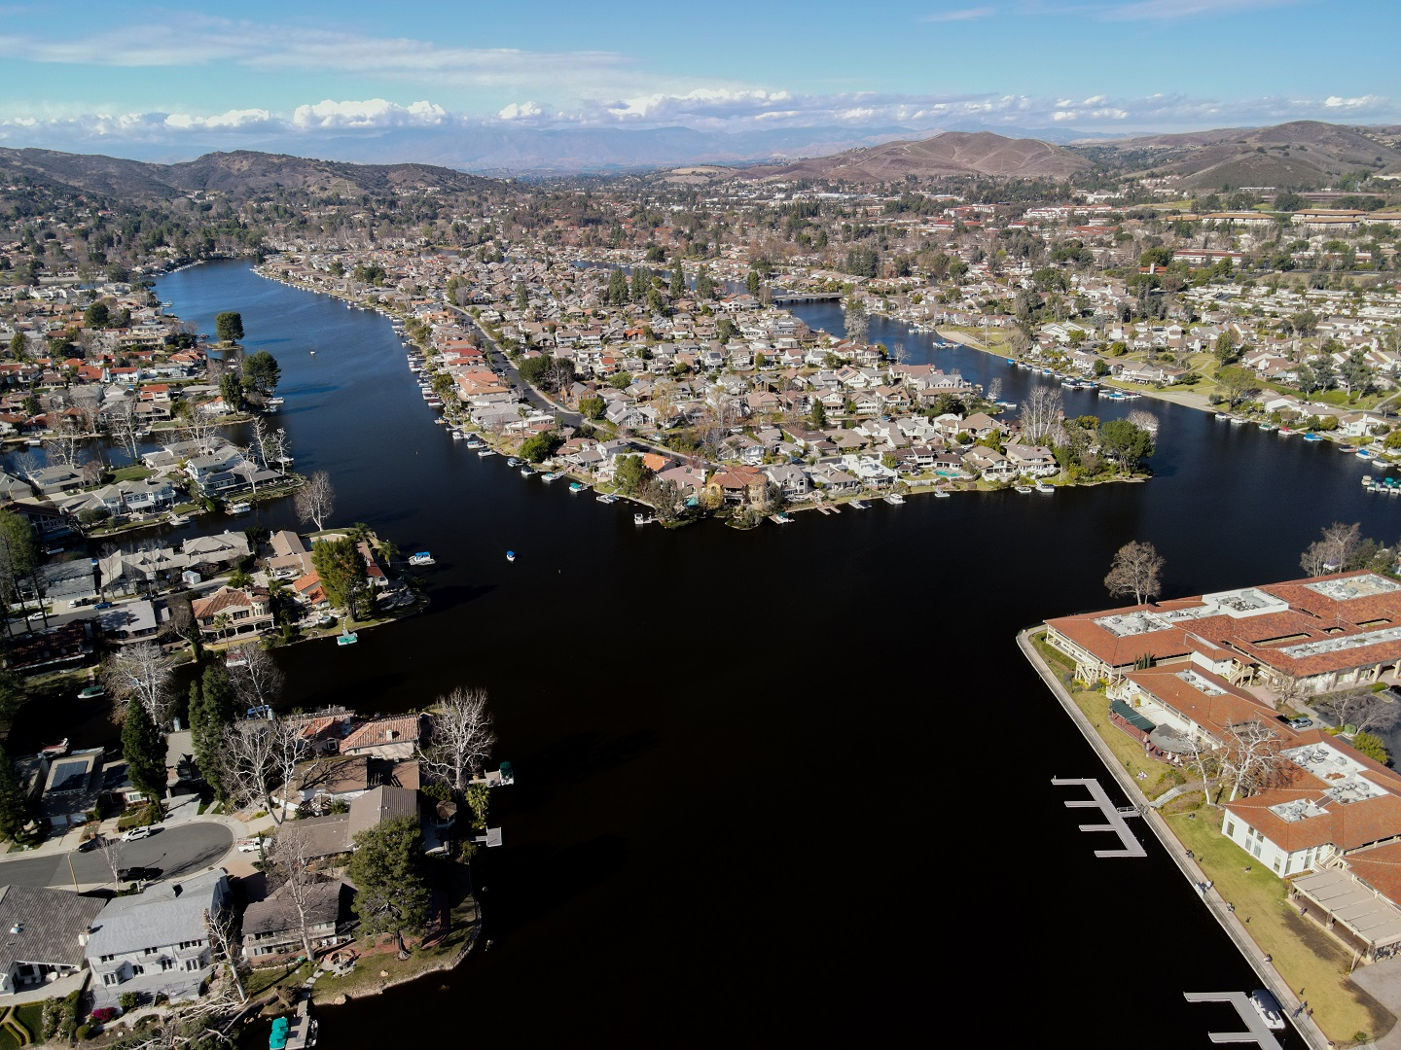
Westlake Village
RHNA 142
Major Strategies:
Adopted a specific plan to allow residential and mixed-use development in a commercial area
Relied on redevelopment of non-vacant parcels

Slide 4
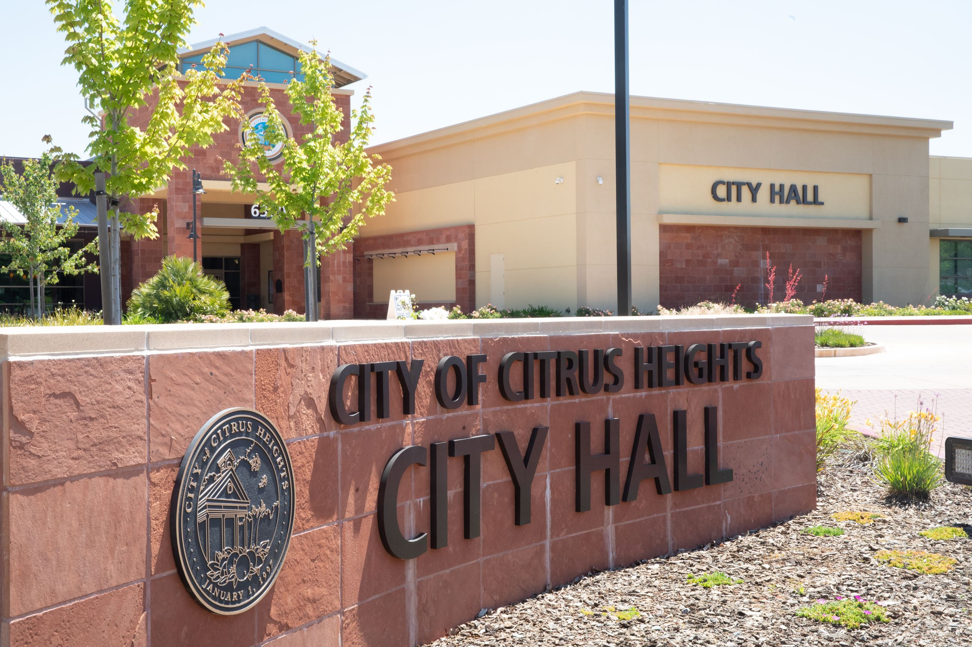
Citrus Heights
RHNA 700
Major Strategies:
Utilized specific plans and entitled projects
Developed a preapproved ADU program
Relied on redevelopment of non-vacant parcels

Slide 5
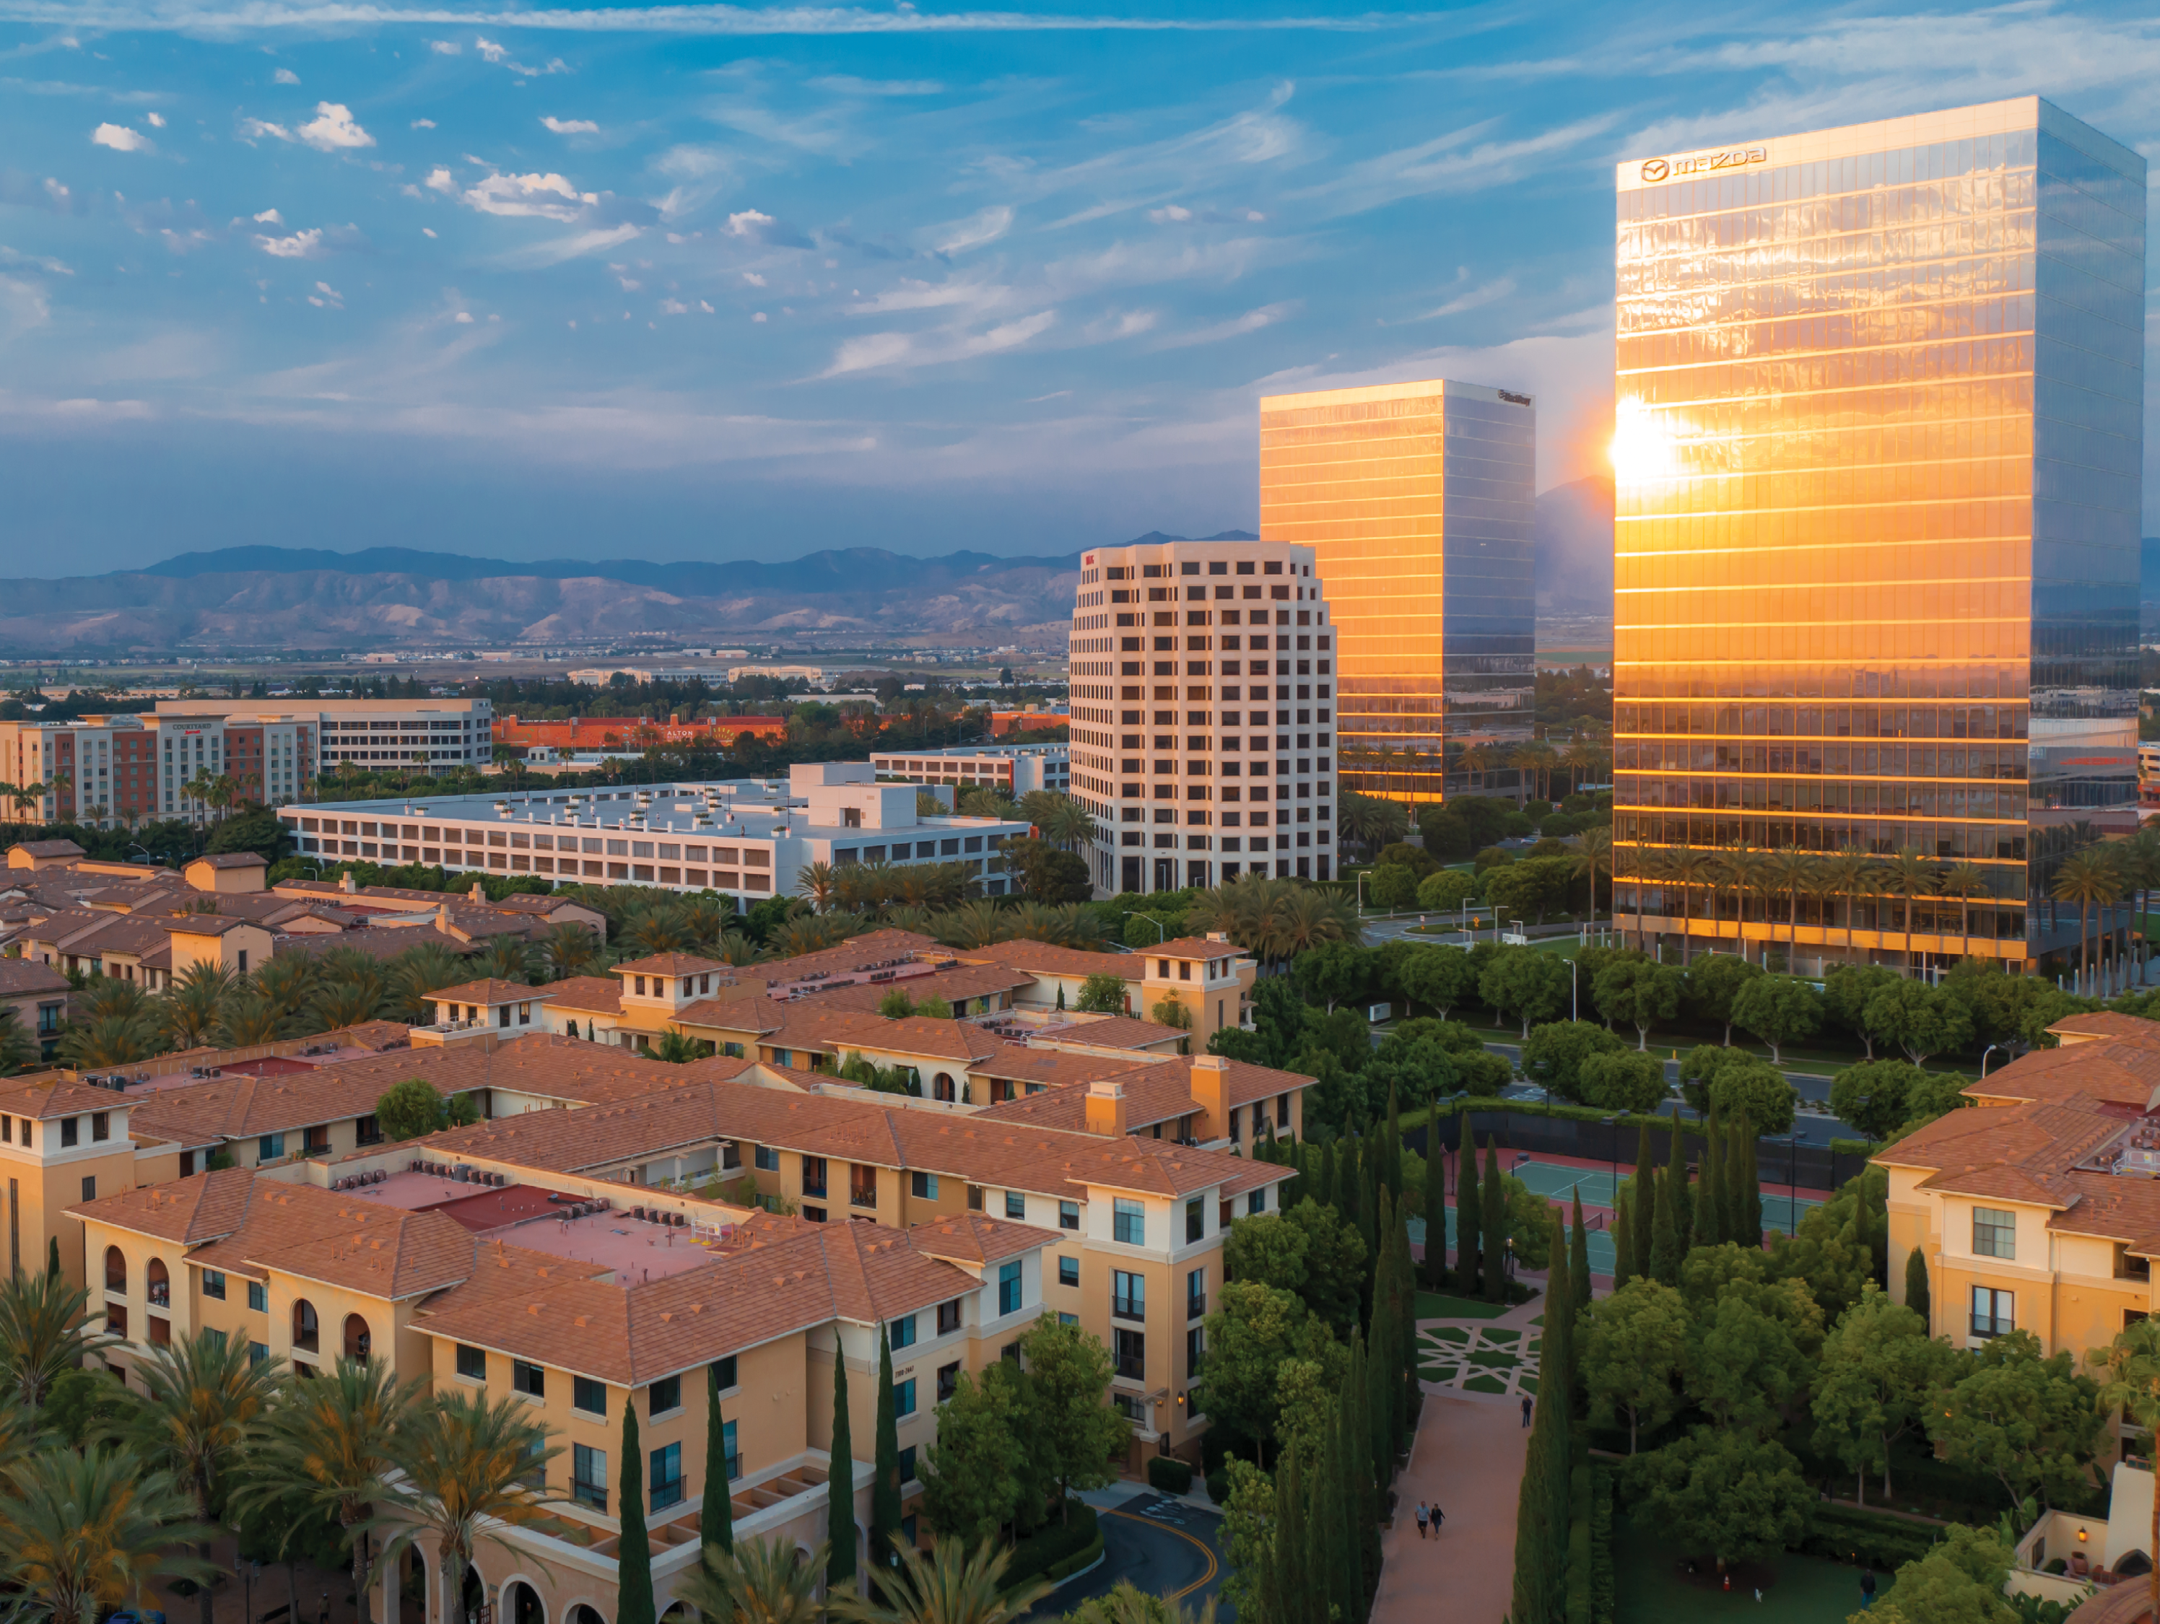
Irvine
RHNA 23,000
Major Strategies:
Used large parcels for high-density and affordable housing
Created overlays in commercial zones
Encouraged development on religious sites
Relied on redevelopment of non-vacant sites

Slide 6

Long Beach
RHNA 28,500
Major Strategies:
Used the recently completed Land Use Element as a roadmap
Used programs and policies to encourage new residential development in high-opportunity areas
Relied on redevelopment of non-vacant sites

Slide 7

Break Out Rooms

Slide 8
Case Studies: Key Lessons for working with HCD
Continue to work while HCD reviews your draft (data, documentation, outreach)
Respond wisely by considering when to add programs and when to add explanation
Keep in close contact and use informal reviews. Discuss proposed changes before making updates
Keep detailed notes of your discussions with HCD
Ask for examples and language to use from cities with certified housing elements

Slide 9
Thank You.
For more information, contact HousingTA@bayareametro.gov
Notes:
Thank you for joining us today. Check the RHTA website for more information on upcoming webinars, including an overview of new housing laws and a media training, both later this year.

