Slide 1
Connecting the Dots between Housing and Energy
March 28, 2022

Slide 2
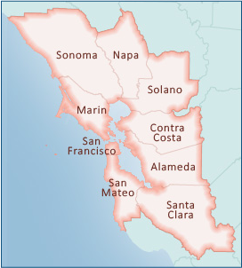
Bay Area Regional Energy Network (BayREN)
BayREN is:
  one of three regional energy networks (RENs) in California funded by the CPUC
  a collaboration of the nine counties that make up the San Francisco Bay Area
  focused on energy efficiency and related efforts

Slide 3
BayREN Programs
Home + Single Family Program
Multifamily Program
Water Upgrades $ave Program
Green Labeling Program
Business Program
Codes & Standards Program
Heat Pump Water Heater Program

Slide 4
Regional Accomplishments and Impact
9 Counties, 101 Cities
Programs focused on
  Energy efficiency upgrades
  Electrification upgrades
  Water energy nexus
  Raising awareness among real estate and contractor industry
  Energy code compliance

Slide 5
Connecting Energy and Housing

Slide 6

Why?
Energy is important for housing quality
  Reduced air infiltration, moisture
  Improved resilience
Energy affects housing cost
  Reduced utility bills – many energy improvements pay for themselves
Consistency between local government plans & policies

Slide 7
Codes and Standards
How?
  Connect Local Housing & Energy Items
    Talk with sustainability staff
    Incorporate actions from Climate Action Plan and other documents into Housing Element
    Consider recommended text, goal, and programs in BayREN flyer

Slide 8
For more information:
Website: https://www.bayren.org/
Notes:
KK to present

