Slide 1
Housing Element Annual Progress Report Form and Submittal
California Department of Housing and Community Development
Housing Policy Development
January 2022
Notes:
Thank you for your interest in this online training for the Housing Element Annual Progress Report, which from here on out be referred to as the APR.
My name is Ava and I'll be co-presenting with my colleague Ashley in HCD’s housing policy development division. After providing you with an introduction to the APR and walking you through the various tables, we will hand it over to Tom for a Q&A session.
HCD collects the APR from all cities and counties in California. This presentation is intended to ensure a successful APR submission from your jurisdiction.

Slide 2
Learning Objectives
  Background and context
  Major Changes
  APR Benefits
  Overview of Tables
  Helpful features of the form
  How to Submit APRs
Notes:
Start by talking about our primary learning objectives. During this webinar, you will gain a stronger sense of:
The background and context behind this process
Changes for the 2021 version of the APR form
Benefits of completing the APR
Table Overview
Helpful features of the form
How to Submit APR’s

Slide 3
Overview and Legal Context
Government Code Section 65400 requires each jurisdiction to prepare an annual progress report (APR) on its status and progress in implementing its housing element
Aside from the new requirement due to AB 2345 the requirements and format of the form remain largely unchanged from last year. We have added some features intended to make filling the form out easier.
Complete APR forms can be uploaded directly into our database.
The 2021 APR is due April 1, 2022.
Notes:
Each jurisdiction (that is: city or county) must prepare an APR on the status and progress in implementing its housing element. This requirement comes from Government Code Section 65400. This report must be submitted to both HCD and the Governor's Office of Planning and Research, or OPR. Please note that each jurisdiction must also complete a General Plan APR and submit that annually. However, this training will only focus on the Housing Element APR
Aside from one new requirement due to AB 2345, the requirements and format of the form have not changed from the 2020 APR. As was the case last year, you may upload the form directly into our database or email it to apr@hcd.ca.gov
The APR is due each year on April 1st. The 2021 APR is due to HCD and OPR by April 1, 2022.

Slide 4
Major Changes to APRs
Old APR form
  2017 and Prior Years
    Focuses reporting on building permits issued
New APR form
  2018 and Beyond
    Includes additional information based on new requirements
Building permits will continue to be counted as progress towards RHNA
Notes:
Some of you may recall that the APR form underwent major changes starting with the 2018 report. Prior to 2018, the APR focused largely on reporting building permits issued. This changed because in 2017, SB 35 and AB 879 amended Government Code to include additional requirements for the APR, and the 2018 APR form incorporated changes from those laws. We won’t go over all those changes today, but you can refer to SB 35 and AB 879 that were passed in the 2017 legislative session for more information.
In 2020, AB 2345 added an additional requirement related to reporting on density bonus projects. We have revised the form as well as the instructions to include these new requirements.
The APR form for 2017 and prior years is available by emailing HCD at apr@hcd.ca.gov

Slide 5
APR Benefits
Several funding programs require up-to-date submission of APRs, including Caltrans Sustainable Communities Grant and PLHA funds
APRs are a vehicle for reporting housing element implementation and progress in meeting Regional Housing Need Allocation (RHNA) to the public and decision makers.
Data from APR’s is used to make HCD’s SB35 determination
Notes:
Before we go any further let me go over some of the benefits of submitting APRs. APRs are woven into numerous state oversight and funding programs.
Several funding programs require up-to-date submission of APRs, including for the Caltrans Sustainable Communities Grant and Permanent Local Housing Allocation (PLHA) funding program.
APRs are how jurisdictions report progress in implementing the housing element and meeting the Regional Housing Need Allocation (RHNA). The data helps HCD understand successes and challenges from cities and counties statewide. And this information can help inform future housing policy.
Finally, data from APRs is used to make HCD’s SB35 determination, also known as the Streamlined Ministerial Approval Process.

Slide 6
Previewing the Tables
Table A - Housing Development Applications Submitted
Table A2 - Annual Building Activity Report Summary - New Construction, Entitled, Permits and Completed Units
Table B - Regional Housing Needs Allocation Progress – Permitted Units Issued By Affordability
Table C – Sites Identified or Rezoned to Accommodate Shortfall Housing Need
Table D - Program Implementation Status
Table E - Units Rehabilitated, Preserved and Acquired for Alternative Adequate Sites
Table F – Commercial Development Bonus Approved
Table G – Locally Owned Sites
Table H – Locally Owned Surplus Land Inventory
All tables will report on activity that happens in the 2021 Calendar year
Notes:
This is an overview of the form to orient you to the topics for each table. We have Tables A through H, which are each represented by a sheet within an Excel workbook.
A detailed explanation of each Table’s requirements can be found in the instructions. The instructions are your definitive source for guidance.

Slide 7
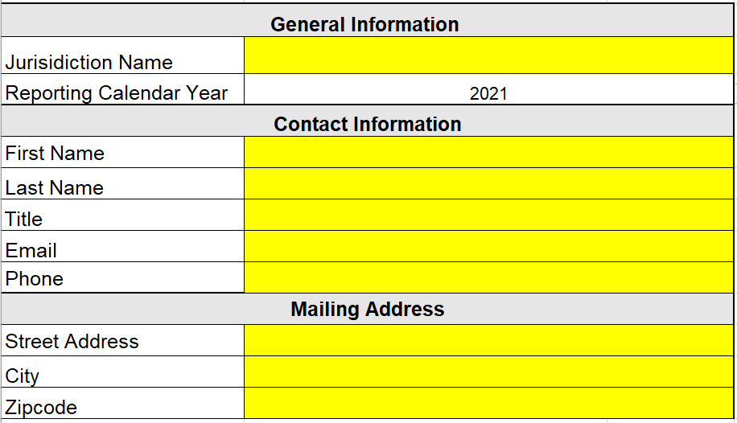
Start Here Tab
Please fill out all information
Cells highlighted in yellow are required
Notes:
First up…the Start Here tab
You enter the jurisdiction name and all contact information, including the mailing address.
And this is your first preview of some of the conditional formatting in the form. Required cells are the cells highlighted in yellow. In addition, some cells only become yellow once part of the row or table is filled out. That is, once certain tables or rows start being completed, there are accompanying cells in that row that must be completed. The yellow also goes away when you've provided the requisite information, so any yellow in your APR should be a flag for you.
As we will remind several times throughout this presentation, all tables have required fields IF they are not left blank. Cells become highlighted yellow when they are required to be completed. Tables that do not apply to your jurisdiction must be left blank. This happens when a jurisdiction does not have related activity to report from the calendar year. So, if you have no activity to report in a table, leave that blank. Please do not add any notes, such as “Nothing to Report” or "NA" because this will cause a lot of incorrect yellow highlighting to show up in your APR.

Slide 8
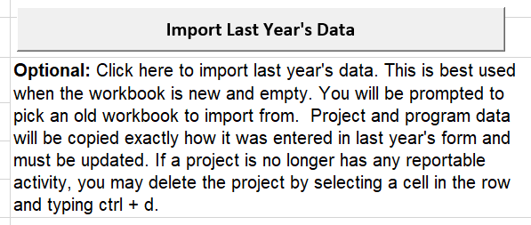
Start Here Tab - Importer
Notes:
The form features an importer, which can copy over information you entered on a previous year's form. This can be handy if you have housing developments that have moved through the planning and building process, and you just need to add additional activity for a project. For example, if you reported a project as being entitled last year, and this year you need to report it received a building permit, the importer copies over all project information from last year’s form, leaving you with only needing to complete the additional building activity that occurred. Please note, the importer will copy most tables. You can delete any information copied by the importer by typing ctrl + d if it is no longer necessary to report that information, since it occurred last year.

Slide 9
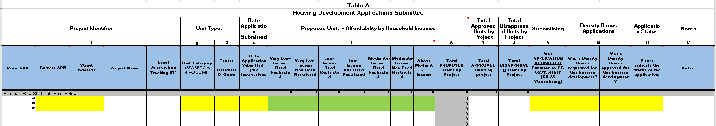
Overview of Table A
Table A – Housing Development Applications Submitted
  Includes data on housing units and developments for which an application was deemed complete during the reporting year
Notes:
Table A is for any development applications deemed complete during the reporting year
This includes applications for planning approvals and development permits – building permit applications are no longer required to be reported in Table A
Fields in yellow are required, fields in green are required if applicable
Enter the units into the appropriate affordability level and leave the rest blank
If unsure, provide an educated guess on whether properties will be renter or owner occupied
New additions to Table A include the following:
Two columns asking if a project requested a density bonus and if that density bonus was approved
One column asking about the status of the application (approved, pending, disapproved, withdrawn)
Table A - Housing Development Applications Submitted
Includes data on any development application that includes residential units for which the application was deemed complete during the reporting year.
The application may have been initially submitted in a prior year , but only list the application in the table if it was demined complete during the reporting year

Slide 10
Overview of Table A2
Table A2 - Annual Building Activity Report Summary - New Construction, Entitled, Permits and Completed Units
  Includes data on net new housing units and developments that have received any one of the following:
    An entitlement
    A building permit or a
    Certificate of occupancy or other form of readiness
Notes:
On Table A2 you will report projects that completed entitlements, received a building permit, or a certificate of occupancy during the reporting year. You still report on the table if there was no entitlement.
Properties may be included in both Table A and A2
RHNA credit is given based on the building permits section of the form
You can include projects from prior years but this is not required (reminder to important past form)
Only enter the unit numbers in the applicable portion of the form. If you enter a unit number, you will be required to enter a date.
You should enter the number of new units, and if there were units demolished on the property as part of the project, enter the number o f units demolished or destroyed in the demolished/destroyed column – for example, if a duplex is demolished to build a 4 plex, you’d only report those all 4 new units and 2 units in the destroyed/demolished column. This is a change from previous years intended to make the form easier to complete.
If you select below market-rate non-deed restricted you will need to provide an explanation for how this was determined, for example by looking at comparable properties.
We have an affordability calculator on our website to help with this
For something to count as a unit, it must have individual cooking and eating space. If communal meals are the only option, the units are group quarters.
Homekey projects that have been converted to have kitchenettes can count.
Several new columns have been added to Table A2 that must be completed only for projects that were granted a density bonus. These columns request additional information on the number and types of incentives granted to the project.
Table A2 - Annual Building Activity Report Summary - New Construction, Entitled, Permitted and Completed Units
This table includes data on net new housing units and developments that have received any one of the following:
An entitlement. Net new means that any units existing on the project site that currently exist, or were demolished in order to complete the current project, must not be included on the report. For example, if a duplex is demolished in order to build a 4 plex, then only 2 net new units were created, and only those 2 should be reported. Please note: although the form asks for information about any units demolished or destroyed that are associated with a new development, the number of units demolished or destroyed is not subtracted from the number of new units created. Therefore, you must only list the number of net-new units created in the entitlement, permit, or certificate of occupancy section.
RHNA credit is given for units entered into the building permit section of this table
Any time you report an entitlement, building permit or certificate of occupancy, you must also share project identifier information. Vice versa, any time you report project identifier information, you need to tell us about an entitlement, building permit or certificate of occupancy.
Please note, you are only required to report activity that occurred in the reporting calendar year. Some jurisdictions opted to report the entire history of each permit that occurred before the reporting year. That is acceptable, but not required.

Slide 11
Overview of Tables B & C
Table B - Regional Housing Needs Allocation Progress – Permitted Units Issued By Affordability
  Provides a summary of prior permitting activity reported to HCD in the current planning cycle, including permitting activity for the calendar year being reported.
Table C - Sites Identified or Rezoned to Accommodate Shortfall
Only applies if the jurisdiction identified an unaccommodated need of sites from the previous planning period, has shortfall of sites as identified in the housing element; or is identifying additional sites required by no net loss law
Notes:
Table B
Table B auto-populates. You do not need to fill out any information.
Table B will populate for the current year from Table A2 and will pull from past years based on prior APRs.
You need to fill out your jurisdiction and the year on the Start Here tab to population.
Contact HCD via email if you identify errors in Table B
Changing data in the table will not change data in HCD’s system
You will likely need to update information on a past APR.
Table C
Table C only applies if you rezoned sites due to a program in the housing element or as required by no-net loss law during the reporting year.
Do not report sites that were rezoned outside of the reporting year.
If the table doesn’t apply to you, please leave it blank. Don’t enter N/A.
I'll hand it over to Ashley to review the remaining tables.
Table B - Regional Housing Needs Allocation Progress – Permitted Units Issued By Affordability
Table B is auto populated it provides a summary of prior permitting activity in the current planning period as well as activity for the calendar year reported.
This data is taken from APR’s submitted in prior years. If the data in Table B does not match your records, contact HCD.
You can write over any of the permit information from prior years in this table. However, making changes to this table will NOT change HCD’s records.
To reiterate, if any data in table B does not match your records, contact HCD. To change data that HCD has in the database, you may need to resubmit or revise a prior year APR.
Table C – Sites Identified or Rezoned to Accommodate Shortfall
Only applicable if you rezoned sites due to a program in the housing element or as required by no-net loss law during the reporting year. Do not report sites that were rezoned outside of the reporting year.

Slide 12
Overview of Tables D & E
Table D - Program Implementation Status
  Report the status/progress of housing element programs
Table E - Commercial Development Bonus Approved
  Only applies if the jurisdiction approved any commercial development bonuses
Notes:
Thanks, Ava. So I will continue to walk through the tables in the APR form.
Table D reports the status of implementing all housing element programs. This table is required for all jurisdictions and must include a separate entry for EVERY program in the housing element.
We understand that the formatting of this table sometimes causes difficulties. If you run into any issues, please feel free to reach out to our team and we can suggest a few things for you try.
Importing your entries from last year’s form, and then just updating the implementation status, may also make filling out Table D easier.
Table E reports commercial development bonuses approved during the reporting year. This form likely will not apply to most jurisdictions.

Slide 13
Overview of Tables F & G
Table F - Units Rehabilitated, Preserved and Acquired for Alternative Adequate Sites
  Report units that have been substantially rehabilitated, converted from non-affordable to affordable by acquisition, and preserved
Table G – This Table applies if jurisdiction included a locally owned site in the housing element sites inventory and has disposed of the property
Notes:
Table F is for reporting units that have been Rehabilitated, Preserved and Acquired for Alternative Adequate Sites.
Alternative Adequate Sites is a provision of Housing Element Law that allows jurisdictions to get credit for preservation activities and reduce the number of sites identified in the Housing Element.
Table F includes two sides – the left side is for you to share information only and does not tie to credit towards RHNA. This section of the table is unlocked and we recommend that jurisdictions fill it out for your own records so you can keep track of any rehabilitated and preserved units.
The right side of the table applies if the jurisdiction used the alternative adequate sites option in the housing element review and has units to credit towards RHNA. Contact HCD if you think this applies to you. Additional documentation will be required and HCD will assist you in completing the form.
Table G reports on Locally Owned Sites that were included in the housing element sites inventory and that were disposed of by the jurisdiction. Table G likely doesn’t apply to most jurisdictions. Again, a site must meet three conditions to be included in this Table. It must:
Be a locally owned site,
Have been included in the Housing Element Site Inventory, and
Have been disposed of by the jurisdiction.

Slide 14
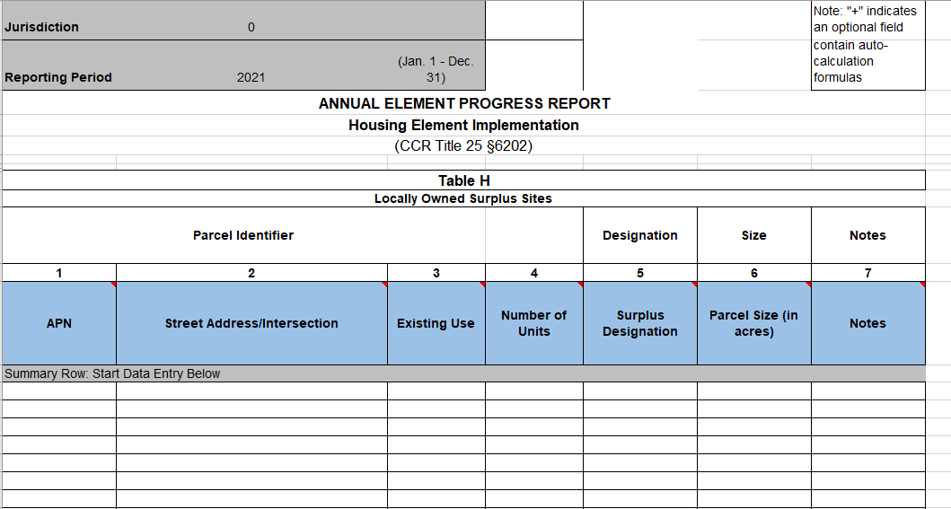
Table H
Local governments are now required to complete an inventory of all locally owned surplus, exempt surplus, or excess land
Notes:
Table H was just added last year due to changes enacted by AB 1255. This table requires that local jurisdictions provide an inventory of all locally owned surplus, exempt surplus, or excess land. If your jurisdiction has locally owned surplus land, you are required to report the APN, address, and a few other fields.

Slide 15
Summary Tables
  This does not need to be filled out, but is auto calculated for your information
  Summarized projects approved using streamlined ministerial approval process (SB 35 Streamlining) and number of applications submitted.
Notes:
The Summary Tables auto-populate with information on both (1) projects approved using a streamlined ministerial process and (2) the number of applications submitted.
The Summary Tables are only there for your own information – they auto-populate with information already provided and can be easily printed for your own records.
An important thing to remember is that the totals in the Summary Tables are counted based on the dates provided in earlier tables. So for example, building permits will only be counted if the year the building permit was issued matches the reporting period for that APR. If you notice the totals aren’t adding up to the right number, check to make sure you’ve entered the correct years.
If you see an error in any formula on this page, contact HCD.

Slide 16
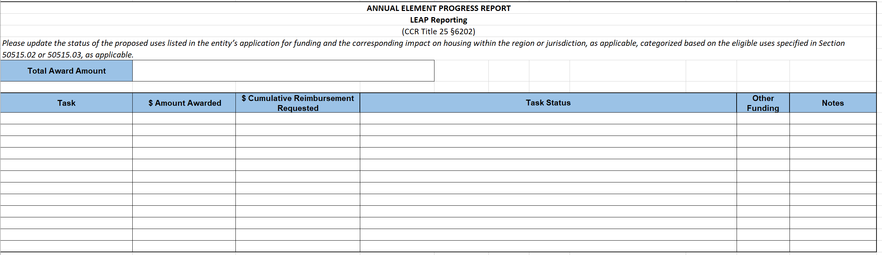
LEAP Reporting
If you are the recipient of a LEAP grant, you are required to report on the status of the grant in the APR
Notes:
If you are the recipient of a LEAP grant, you are required to report on the status of the grant in the APR.
The tasks described here should match the tasks described in your LEAP application.
The one thing to note is that you should only start reporting after you’ve executed a contract with HCD.

Slide 17
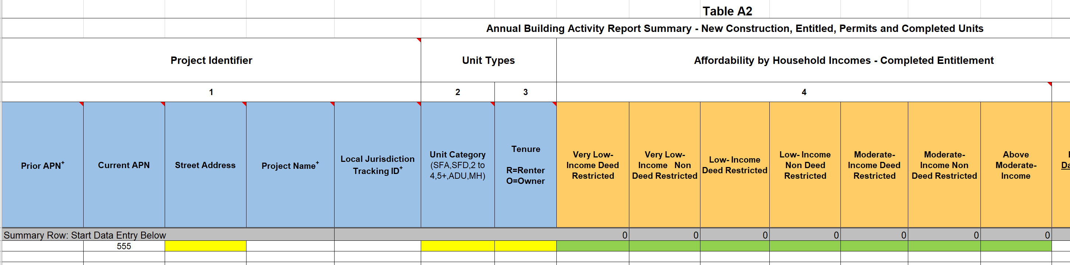
Conditional Formatting in Form
Required fields become highlighted yellow once any cell in that row gets completed.
Cells that are highlighted green are only required if that section applies to the project
Additional fields become highlighted yellow depending on what is being entered in the row.
Notes:
The most common reason that APR submissions fail is due to missing information, but the conditional formatting in the form helps you identify areas where this might be the case.
Anything in the form that is required is highlighted in yellow. Anything that is green is only required if the fields apply to your project.
So for example, in Table A2, once an APN is listed for a project, the required fields (in this case street address and unit count) become highlighted in yellow. But the section in orange is highlighted in green because it is only required if you’ve issued an entitlement during the reporting year.

Slide 18
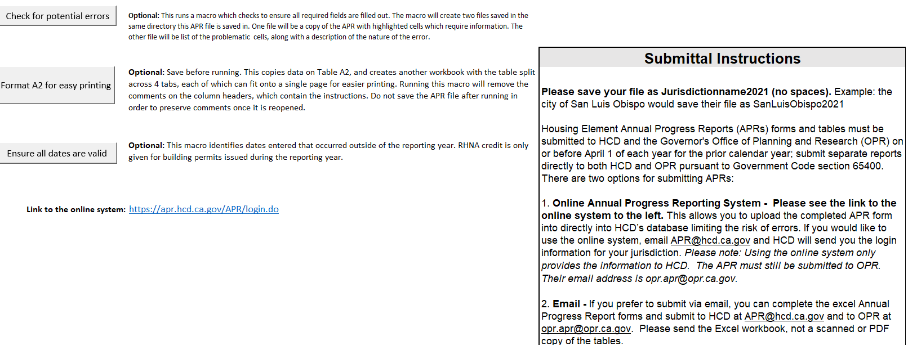
Finish Here Tab
Notes:
The Finish Here tab contains several additional tools that may assist you in completing the APR form. The first tool is a validator, which will run a check of all required information. The Validator will create two files: one file is a copy of the APR with problematic cells highlighted. The second file will be a list of problematic cells, with the exact cell number with the error.
The second tool helps format Table A2 for printing. Since Table A2 has so many columns, printing onto one page is not easy. This tool will create a workbook with 4 tabs, one for each reportable activity, and one with project identifier information.
The 3rd tool is a date checker. This will highlight in orange, dates which occurred outside of the reporting year. You can leave these activities in the form, but to ultimately get credit for those units, they must be reported on the APR for the same calendar year.

Slide 19
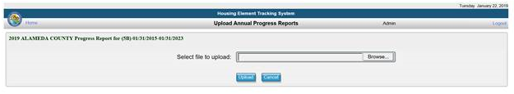
How to Submit APRs
Online Annual Progress Reporting System is available to submit 2021 APRs and is located at https://apr.hcd.ca.gov/APR
APRs can also be emailed to APR@hcd.ca.gov
  Send the electronic version as an Excel workbook attachment. Do not send a scanned copy of the tables.
No longer accepting APRs by mail.
Notes:
There are two ways to submit your APRs:
First, HCD has an online system that allows you to upload the form yourself. If you don’t know your username or password, reach out and we can send it to you.
You can also submit 2021 APRs via email to apr@hcd.ca.gov. Please send an excel workbook attachment and not a pdf copy.

Slide 20
Reminders
APRs are due April 1st
SB35 Determination will be published in June 2022
Questions or comments can be submitted to APR@hcd.ca.gov
More information about APRs is on our website at: https://www.hcd.ca.gov/community-development/annual-progress-reports.shtml
Notes:
Again, all 2021 APRs are due by April 1, but HCD is here to help. If you run into any issues during the submittal process, please don’t hesitate to reach out to us. Our team is actively monitoring our email box and happy to help in any way we can.
We are really excited about the collection of this data, and we appreciate all of the work that jurisdictions will be making to provide this data. Just like jurisdictions, HCD is working really hard to adapt to the new requirements set forth by the legislature.
Thank you for your time today! If anyone has any questions, we’ll be happy to discuss more during the Q&A.
I'll hand it over to Tom for questions.
***END HERE***

Slide 21
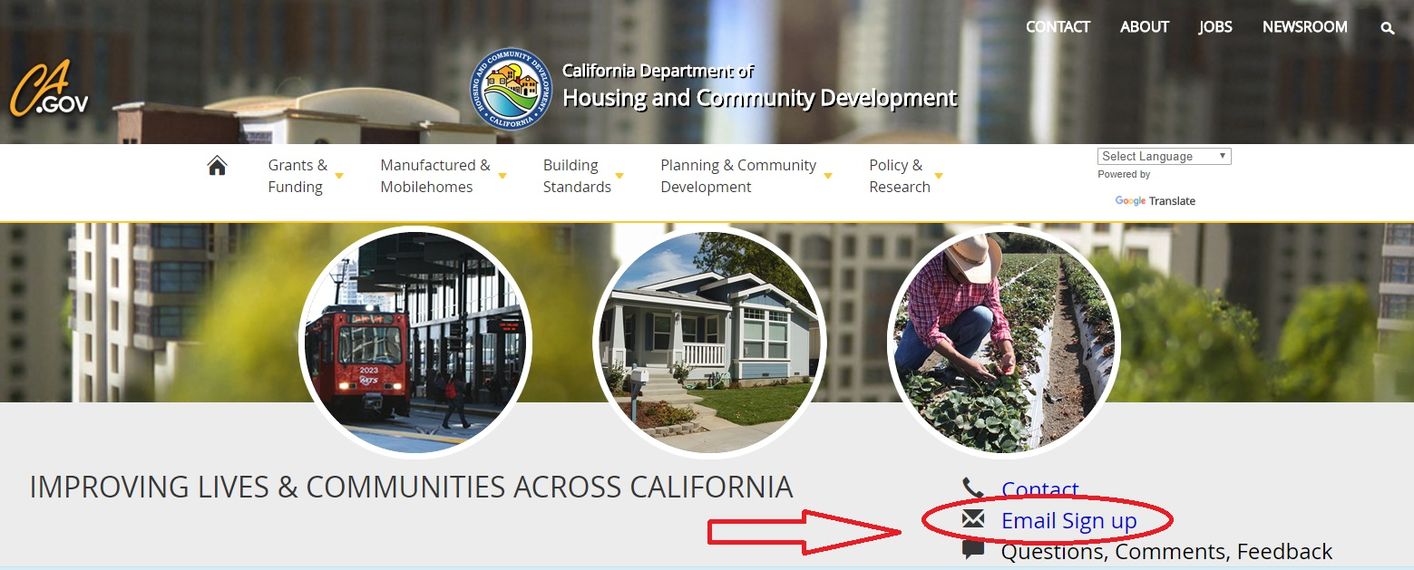
Sign up for HCD announcements at www.hcd.ca.gov
Stay in the Know
Notes:
Our Communications division is excellent at pushing announcements.
If you have not subscribed, I encourage you to sign up for our emails.

