Slide 1
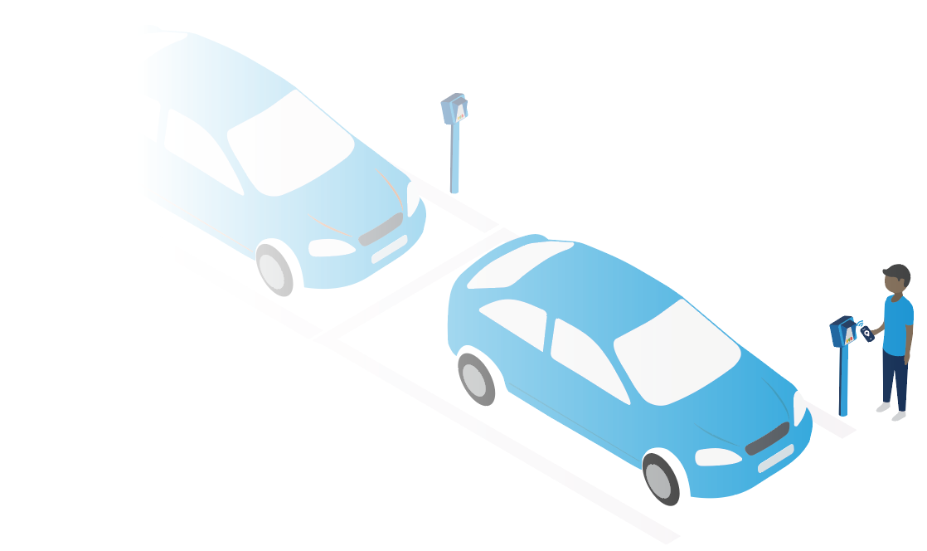
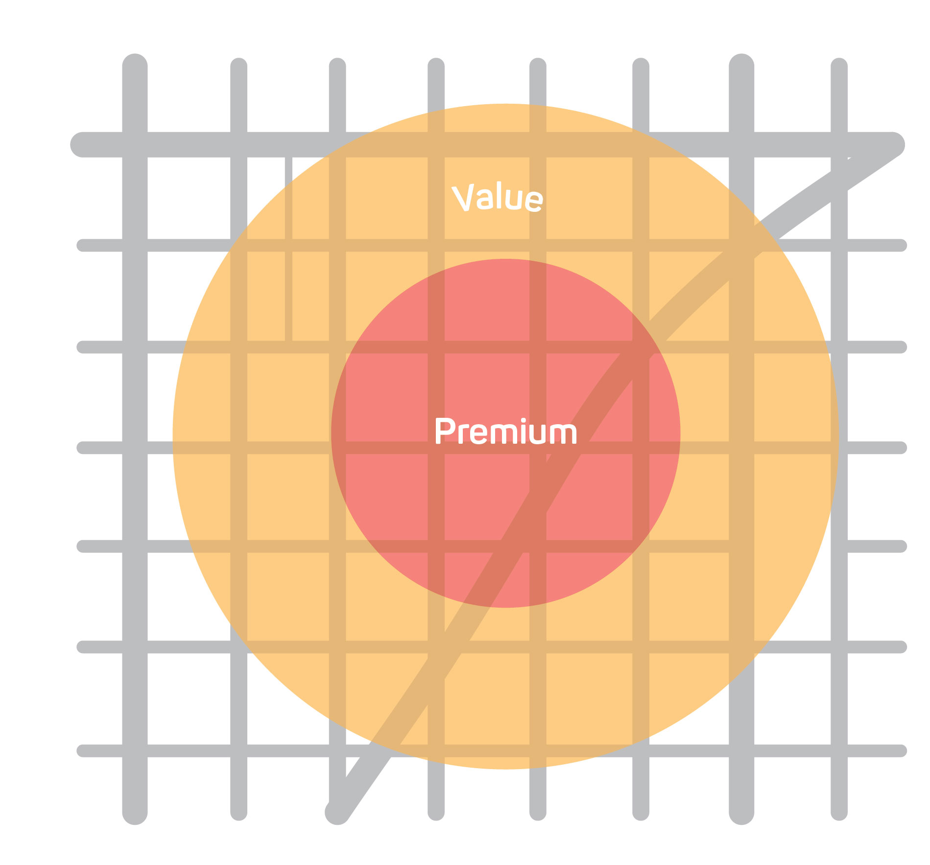
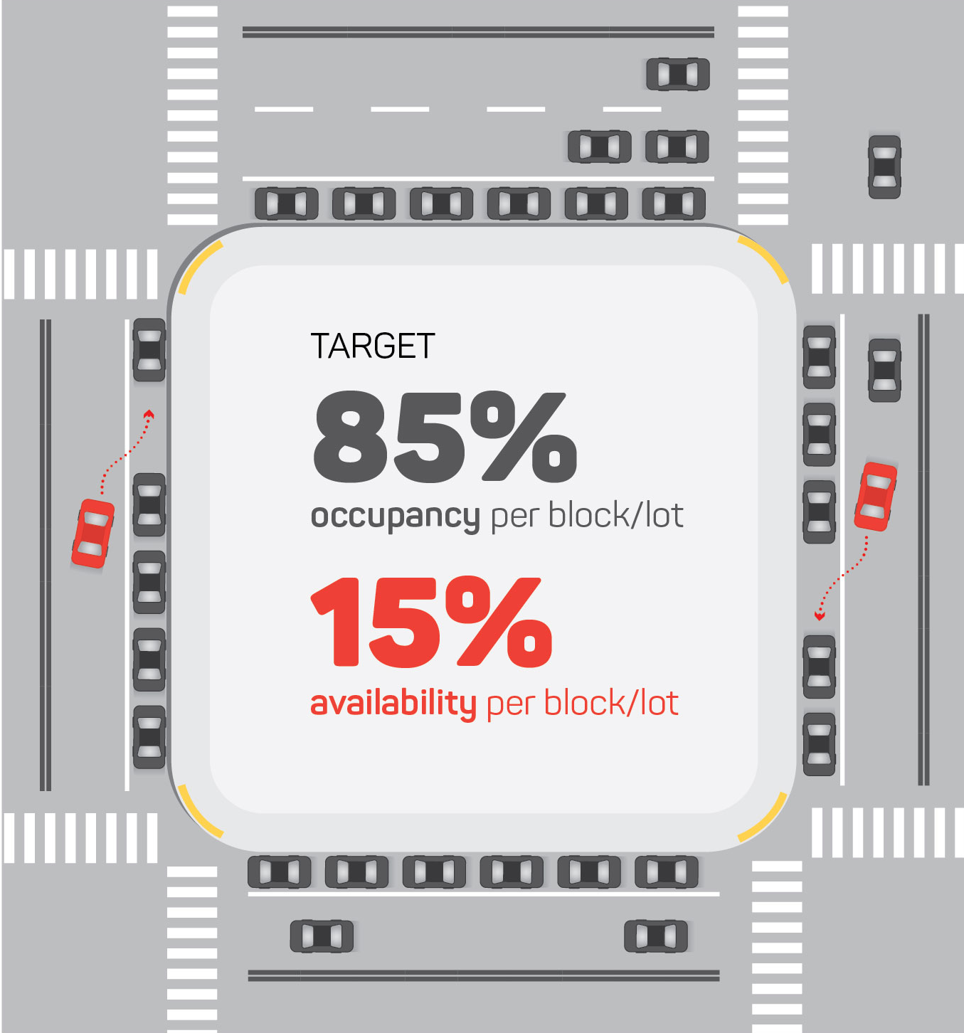
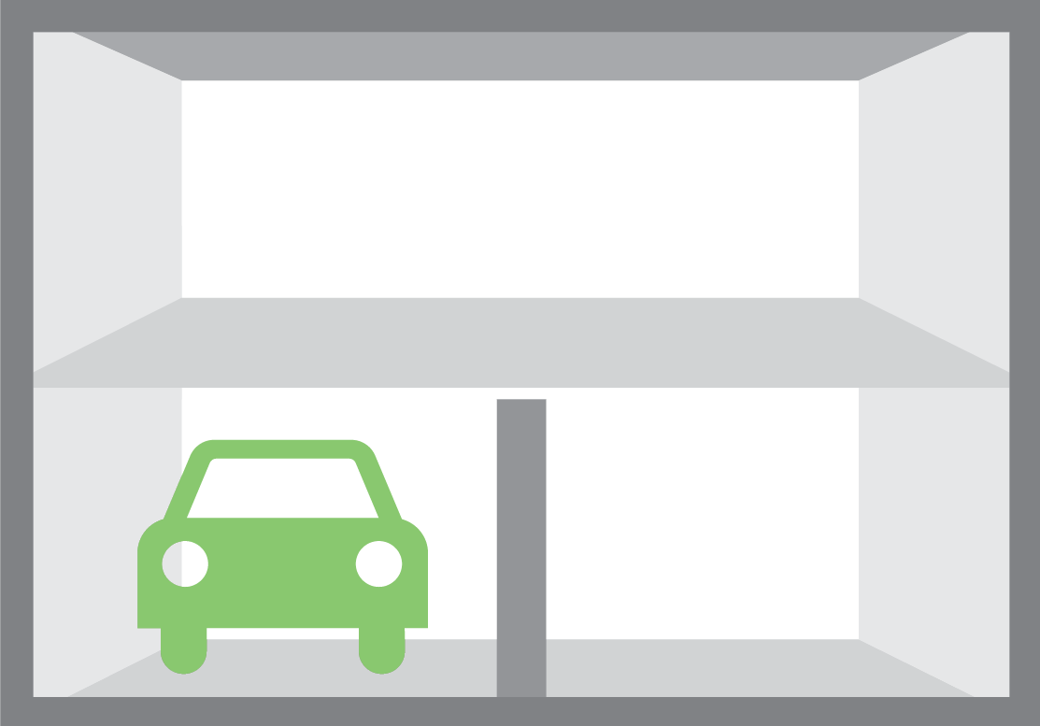
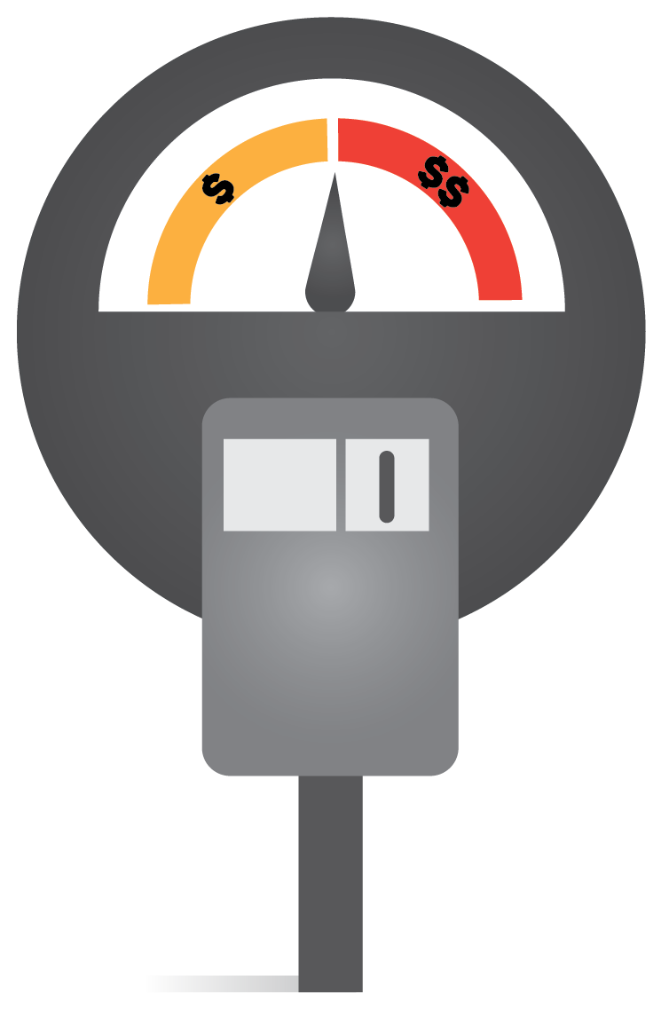

^{How Would}
^{LEARN MORE BY VISITING:}
^{Demand-Responsive Pricing}
^{[insert website]}
^{OR CONTACT:}
^{Work in [Insert City]?}
^{[insert website]}
Demand-responsive pricing charges the lowest possible rate to achieve availability targets—matching price and demand to ensure there is always an open parking space nearby to someone searching for parking.
Static parking prices are replaced with demand-based prices that are adjusted over time based on parking demand – more convenient or “in demand” spaces cost more than less convenient parking spaces.
The ideal on-street parking occupancy rate is around 85%, which leaves roughly one to two spaces available per block. For off-street facilities where turnover is less frequent, the ideal rate is approximately 90-95%, which ensures supply is optimally utilized. To achieve these rates, cities decrease hourly rates where utilization is lower than the target and increase hourly rates in areas where utilization is higher than the target.
With demand-responsive pricing in place, there can be less emphasis on time limits to create turnover. Extending parking time limits makes parking more convenient for drivers. For example, a 4-hour limit gives ample time for visitors to visit multiple businesses without rushing back to their vehicle or risking a parking ticket. Some cities with demand-responsive pricing have found they can remove time limits altogether.
^{Which}
Bay Area cities have implemented this?
Berkeley
Santa Rosa
Redwood City
San Francisco
San Mateo
Walnut Creek
¹
Eligible parking zones or blocks are identified based on existing demand for parking.
²
On-street pricing is set to achieve a goal of 85% occupancy with 15% availability on every block, at any given time.
³
Off-street facilities have an occupancy goal of 90-95%, and should be priced lower than higher demand on-street parking.
^{Why is it Recommended?}
^{Benefits Summary}
Researchers have determined that the ideal parking availability rate is about 15%, which means there will be roughly 1-2 spaces available per block at all times.
Other cities have seen increases in parking availability and decreases in meter rates
Demand-responsive parking pricing reduces the reliance on time limits, which results in fewer citations and a more positive parking experience for drivers.
Aligns price and demand to ensure there is always an open space.
Makes it easier to find a parking space.
Reduces circling for parking.
Reduces congestion and improves traffic flow and air quality.
Creates lower rate parking options.

