Slide 1
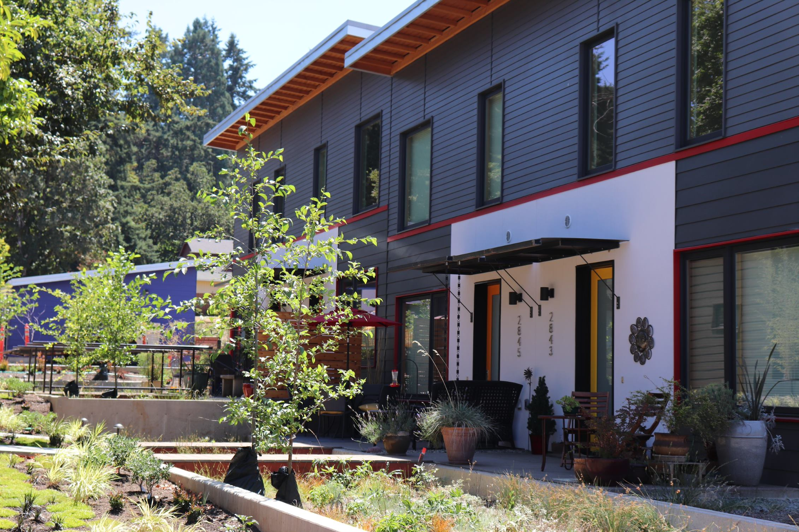
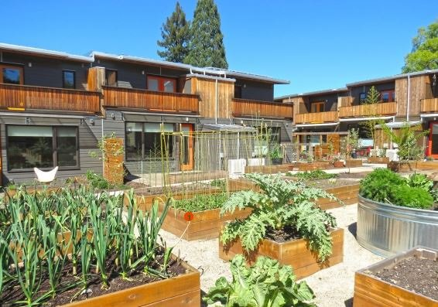
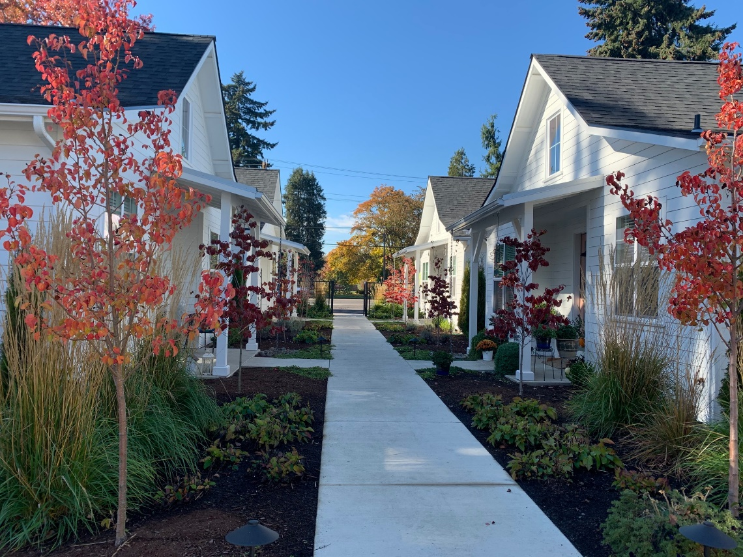
Middle Housing Implementation Case Study:
Eugene, Oregon

Slide 2
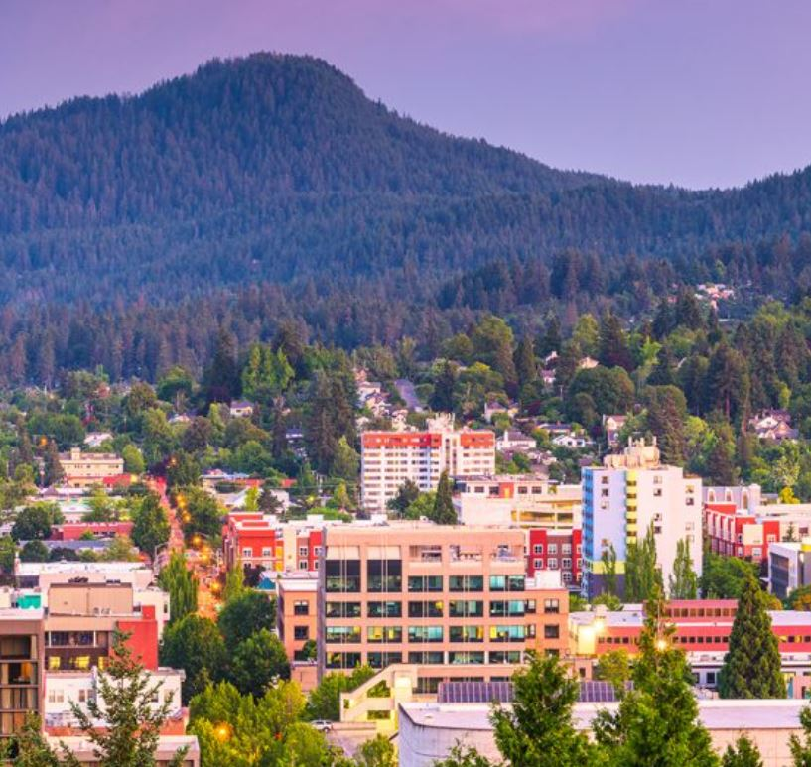
Eugene: Context
Mid-size city (176,000),
~2 hours south of Portland
In 2019, Oregon required all cities over 25,000 to allow middle housing in areas zoned for single-family homes
Image credit: City of Eugene

Slide 3
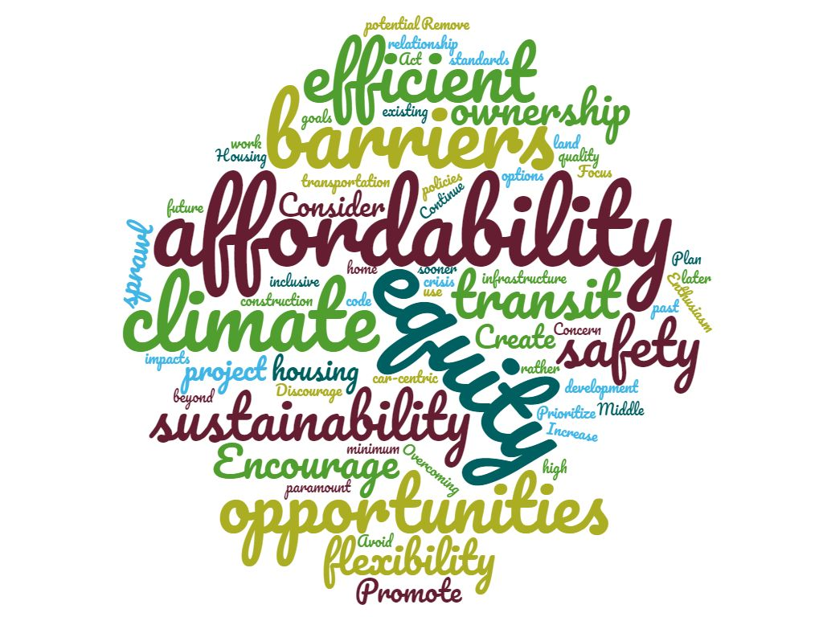
Eugene: Approach and Objectives
High-level goals:
Comply with state law
Further equity and long-term affordability
Enable housing availability and diversity of type
Image credit: City of Eugene
Emphasis on outreach to under-represented communities

Slide 4
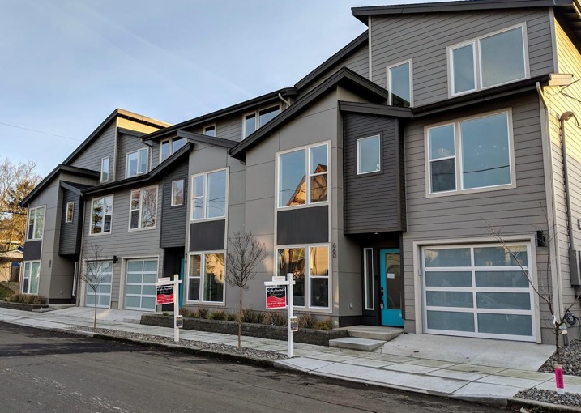
Eugene: Desired Outcomes
Strategy: focus on outcomes, ask a diverse range of people
From policy-makers:
“Housing is more equitably distributed”
“Balancing the needs of all of our community members”
“Encourage good design”
“Preserve walkability, bikeability, urban forests,
parks, neighborhood services, and transit”
From local stakeholders:
“Create ownership and wealth building opportunities”
“Improve livability and affordability”
From organizations representing underserved communities:
Housing is equitably distributed
Bias about housing types and who lives in them is addressed
People feel welcome in neighborhoods
Opportunities for multigenerational households
Housing is close to schools, parks, transit and other amenities
Housing is safe and high quality and affordable to more people
Ownership and wealth building opportunities are created

Slide 5




Levels of Implementation Considered
Eugene’s Framework for Code Amendments
ALLOW: Meet minimum state standards.
ENCOURAGE: Remove code barriers, increase flexibility.
INCENTIVIZE: Minimal regulation. Apply bonuses and incentives.
Image credit: City of Eugene

Slide 6
Middle Housing Affordability in Eugene
With lower parking, higher density, some new middle housing affordable here
Most new middle housing affordable here
Income graphic source: Lane County Affordable Housing Action Plan, Better Housing Together, 2020
Notes:
For market rate new construction, both single family and middle housing will mostly be affordable to households earning at least $60k per year.
Adding more housing at moderate prices as the community grows helps keep prices of existing homes and rents from escalating out of reach of existing residents.
Median HH income (2019 ACS, City of Eugene): $50,962
HUD MFI (family of 3) 2020 for Lane County: $63,000

Slide 7
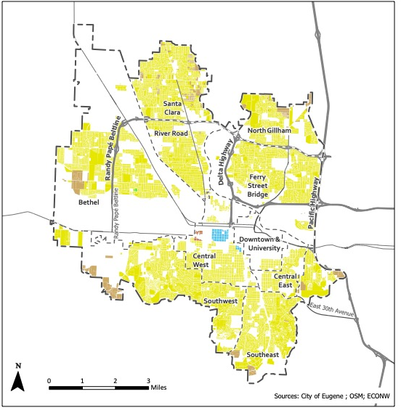
Eugene’s Regulatory Approach
Current draft:
Allow middle housing in all zones that allow single-family housing
Encourage smaller & more affordable units
  No parking requirement near transit
  Possible density bonuses for small units
Basic objective design standards
Zones that allow primarily single-family housing

Slide 8
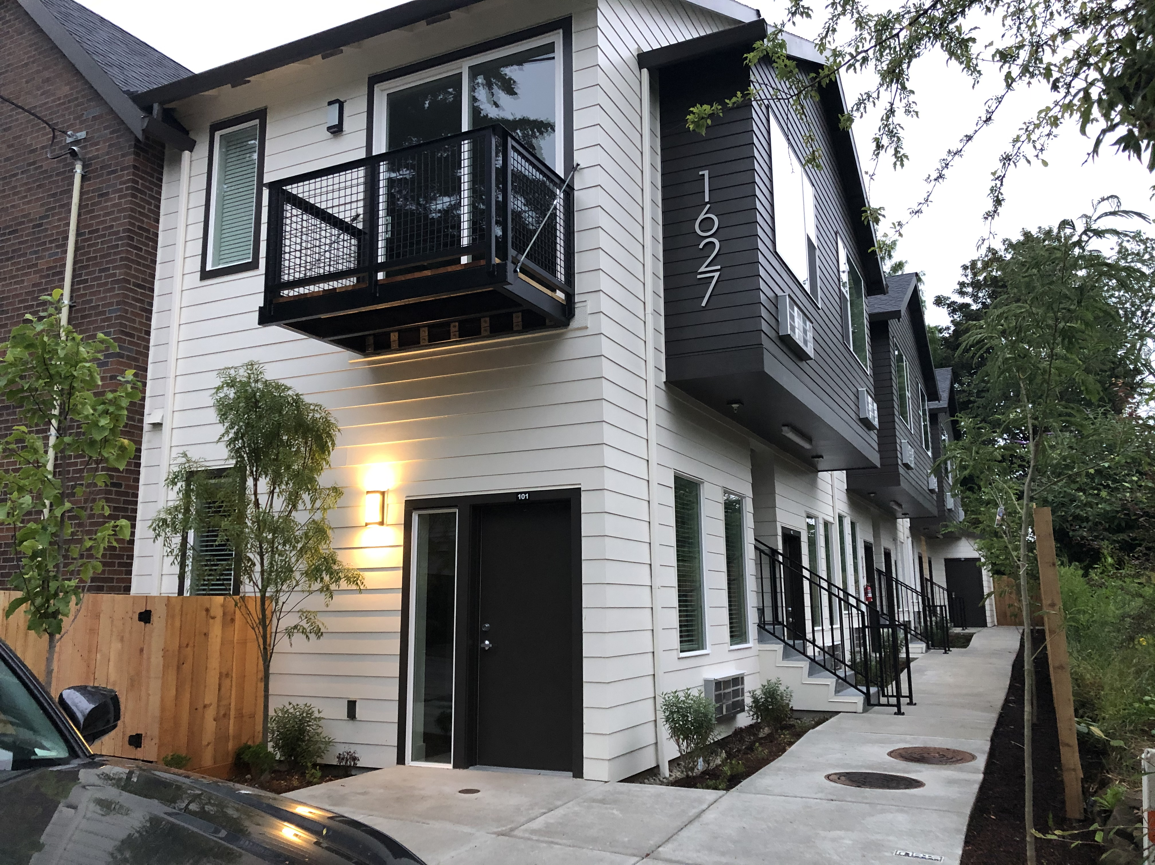
Middle Housing Opportunities & Challenges: Zoning Code
Parking consumes space, impacts small sites most
Middle housing units often smaller, but need to allow a reasonable unit size to make development feasible
Some doors facing the street helps with design, but need to allow some units to face side / courtyard
Parking, open space, unit size limits important for cottage cluster
Image credit: ECONorthwest
Image credit: ECONorthwest

Slide 9
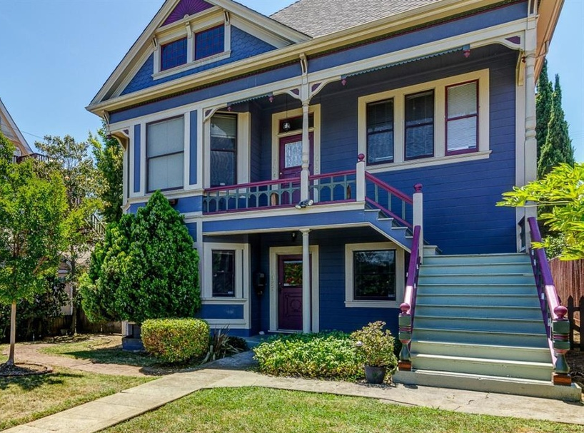
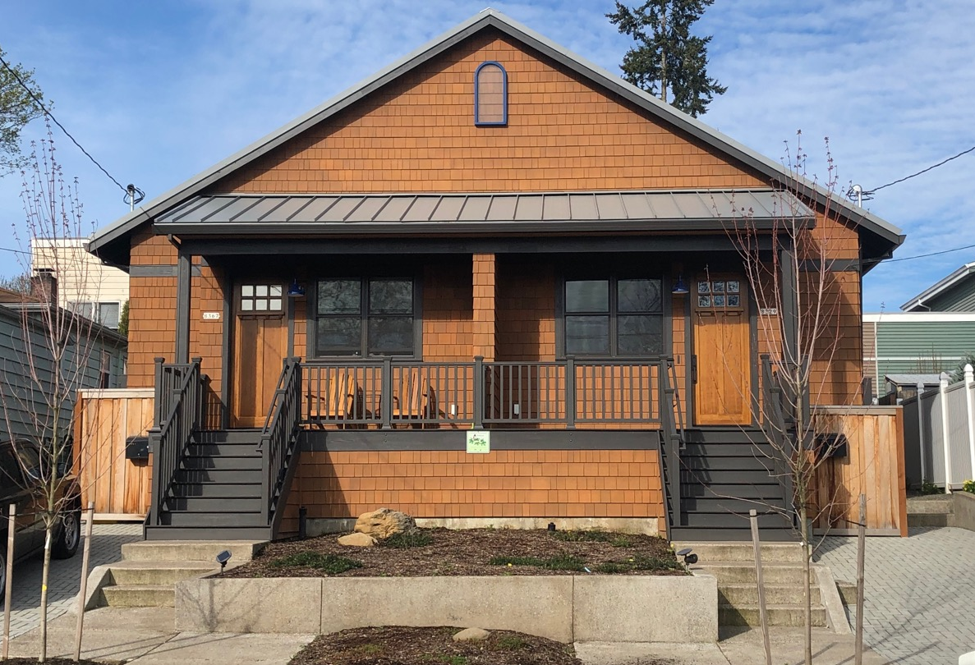
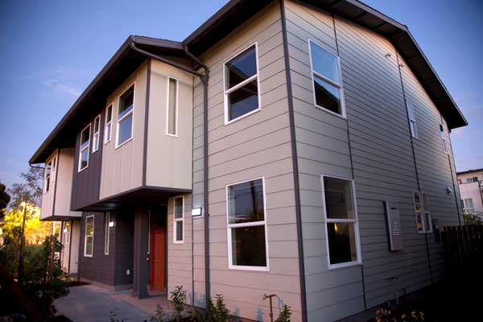
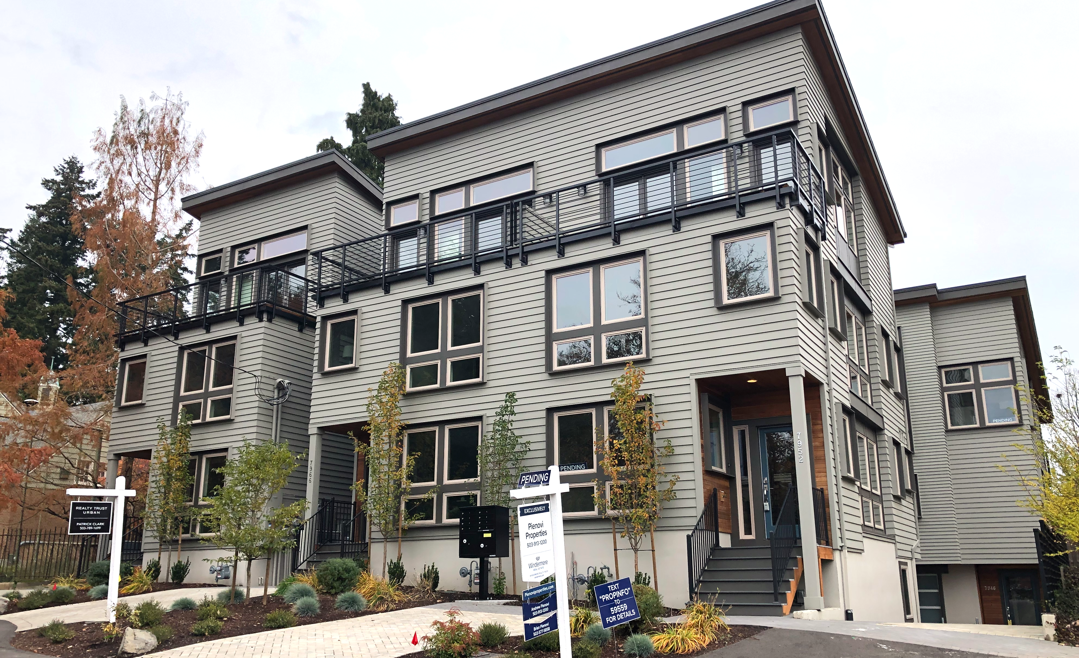
Middle Housing Opportunities & Challenges: Other Factors
Building code is a challenge for triplex / fourplex / multiplex conversion
Impact fees, utility connections, street frontage improvements impact middle housing feasibility
Middle housing options matter to affordable housing developers; similar considerations apply
Townhomes face fewer obstacles outside the zoning code than plexes
Image credit: Redfin
Image credit: ECONorthwest
Image credit: Habitat for Humanity Bay Area
Image credit: ECONorthwest

