Slide 1

Final Regional Housing Needs Allocation (RHNA) Methodology and Appeals of Draft RHNA Allocations
Meeting Name
Date

Slide 2

RHNA Background
Meeting Name
Date

Slide 3
What is RHNA?
Since 1969, State law requires that all jurisdictions must plan to meet the housing needs of everyone in the community.
HCD identifies total number of units, across all income groups, for which the region must plan for the eight-year RHNA period (2023 to 2031).
ABAG collaborates with local governments and stakeholders to develop a formula to assign each community a share of the Bay Area’s housing need.
Each local government must update Housing Element of General Plan and zoning to show how it plans to accommodate its share of the regional need.
3
Notes:
All jurisdictions in California must plan to meet the housing needs of everyone in their community.
Although RHNA is a state mandate, it involves the collaboration of regional agencies like ABAG as well as local governments.
The California Department of Housing and Community Development tells the Bay Area how many housing units it needs for an 8-year period – for this cycle from 2023 to 2031.
This total need number is divided into 4 income categories that cover households at all income levels.
ABAG works with local governments, stakeholders and members of the public to develop a methodology or formula for assigning a share of the housing need to each local government in the Bay Area.
Each local government must then update the Housing Element of its General Plan and its zoning to show how it plans to accommodate its RHNA.

Slide 4
What are the statutory objectives of RHNA?
Increase housing supply and mix of housing types, tenure, and affordability in all cities and counties in an equitable manner
Promote infill development and socioeconomic equity, protect environmental and agricultural resources, encourage efficient development patterns, and achieve GHG reduction targets
Promote improved intraregional jobs-housing relationship, including balance between low-wage jobs and affordable housing
Balance disproportionate household income distributions (more high-income RHNA to lower-income areas and vice-versa)
Affirmatively further fair housing
4
Notes:
The RHNA Plan must meet five objectives that recognize the importance of comprehensively planning for housing in ways that also promote equity, strengthen the economy, improve connections between jobs and housing, and protect the environment.
The last objective—Affirmatively Further Fair Housing—is a new addition for this RHNA cycle—probably one of the most important recent changes to Housing Element Law.
Although RHNA has always been based on the principle that every community should do its “fair share” to provide homes for people at all income levels, the addition of this new objective makes this concept more explicit.
According to HCD’s guidance on this topic, the two basic principles of affirmatively furthering fair housing are overcoming patterns of segregation and fostering inclusive communities that provide access to opportunity for all people.

Slide 5
What’s new for this RHNA cycle?
Greater emphasis on social equity
Higher total regional housing need
Expanded HCD oversight on methodology & allocations
More factors to consider in allocations (overpayment, overcrowding, greenhouse gas target, jobs-housing fit)
New requirements for identifying eligible sites for Housing Elements
5
Notes:
Social equity: new requirement to affirmatively further fair housing applies not only to the RHNA Plan, but to local Housing Elements as well.
Higher housing need: HCD must now include data about overcrowded households, households that are paying more than 30% of their income for housing, and a target vacancy rate when determining the region’s total need.
HCD oversight: HCD now must review the draft methodology and it can appeal a jurisdiction’s draft allocation.

Slide 6
Bay Area RHNA Progress: 1999-2019
RHNA |  | Permits | Percent of RHNA Permitted
Cycle | Total Need | Permits Issued | All | Very Low Income | Low Income | Moderate Income | Above Moderate Income
1999-2006 | 230,743 | 213,024 | 92% | 44% | 79% | 38% | 153%
2007–2014 | 214,500 | 123,098 | 57% | 29% | 26% | 28% | 99%
2015-2023* | 187,990 | 121,973 | 77% | 19% | 28% | 40% | 144%
2023-2031** | 441,176 | TBD | TBD | TBD | TBD | TBD | TBD
Data for 1999-2014 compiled by ABAG. Data for 2015-2023 from Annual Progress Reports compiled by HCD as of October 6, 2020.
* Only includes permits issued in 2015-2019.
** Issued by HCD in June 2020.
6
Notes:
The Regional Housing Needs Determination is separated into four income categories that cover households at all income levels:
Very Low Income, which includes households with incomes between zero and 50% of the area median income
Low Income, which is households between 50% and 80% of area median income
Moderate Income, which is households between 80% and 120% of area median income and
Above Moderate, which is households making more than 120% of area median income
For the current 2015-2023 RHNA cycle, the data covers the first 5 years of the 8-year period.

Slide 7
What are the primary steps in the process?
Public
Comment
Local Housing Element Updates
Public
Comment
Final Allocation
Public
Comment
January 2023
Draft Allocation
End of 2021
Allocation Methodology
Spring 2021
Fall 2020/Spring 2021
PUBLIC COMMENT OPPORTUNITIES THROUGHOUT
7
Notes:
The heart of ABAG’s work on RHNA is developing the methodology to allocate a portion of housing needs to each city, town, and county in the Bay Area.
ABAG convened a Housing Methodology Committee made up of local elected officials and staff representing jurisdictions in every county in the Bay Area as well as stakeholders to advise ABAG on the RHNA methodology.
After ABAG adopted the final methodology in May 2021, it was used to develop a draft allocation for every jurisdiction.
After a jurisdiction receives its draft allocation, it has an opportunity to appeal its number to ABAG
For this cycle, a local government or HCD can appeal any jurisdiction’s allocation. After ABAG takes action on the appeals, it will issue the final allocation by the end of 2021.
Local jurisdictions will then update Housing Elements by January 2023, including identifying sites that are zoned with enough capacity to meet the RHNA allocation.
ABAG’s formal role within RHNA ends with the final allocation. ABAG does not have a say in approval of local jurisdictions’ Housing Elements, which is the responsibility of HCD.

Slide 8




Engagement with Stakeholders & the Public
Stakeholder Meetings
(HMC, etc.)
Meetings with Local Officials & Staff + Assistance with Housing Elements
Virtual Presentations and Webinars
Media Outreach
+ Web
8
8
Notes:
ABAG has been and will continue to engage with local governments, stakeholders and the public throughout the RHNA process.
During methodology development, monthly meetings of the Housing Methodology Committee, with regular updates to the ABAG Regional Planning Committee and Executive Board.
Presentations to existing meetings locally, such as Mayors and Councilmembers Conferences, League of California Cities meetings, planning director meetings.
Summary materials and other resources for local government staff and elected officials.
Focus groups with community-based organizations.
Multiple ABAG General Assemblies and webinars.
ABAG website: can sign up to receive updates about the RHNA process.

Slide 9
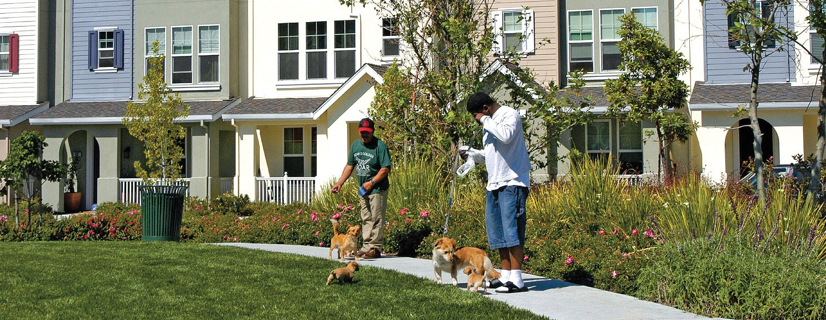
Final RHNA Methodology and Draft RHNA Allocations
Meeting Name
Date

Slide 10
RHNA Methodology Development Process
October 2019 to September 2020
Housing Methodology Committee (HMC) worked collaboratively and voted to recommend a Proposed RHNA Methodology.
October 15, 2020
ABAG Executive Board approved Proposed RHNA Methodology.
October 25 –
November 27, 2020
Public comment period on Proposed RHNA Methodology, including public hearing on November 12.
January 2021
ABAG Regional Planning Committee and Executive Board voted to include “equity adjustment” as part of the Draft RHNA Methodology.
February 11, 2021
As required by law, ABAG submitted Draft RHNA Methodology to HCD for review.
April 12, 2021
HCD confirmed Draft RHNA Methodology furthers statutory objectives.
May 20, 2021
ABAG Executive Board approved Final RHNA Methodology and release of Draft RHNA Allocations.

Slide 11
Highlights from HCD’s Findings from Review of Draft RHNA Methodology
“HCD has completed its review of the methodology and finds that the draft ABAG RHNA Methodology furthers the statutory objectives.”
“This methodology largely distributes more RHNA near jobs, transit and resources linked to long-term improvements of life outcomes… HCD applauds the use of objective factors specifically linked to the statutory objectives.”
“HCD commends ABAG for a robust methodology development process, with exceptional stakeholder engagement, through its Housing Methodology Committee.”
“HCD applauds the significant weighting of Access to High Opportunity Areas as an adjustment factor and including an equity adjustment in the draft methodology.”

Slide 12


Proposed RHNA Methodology Overview
Final 2023-2031 RHNA Methodology Overview
Total Regional Housing Need Determination (RHND) from HCD
441,176
STEP 1: Group RHND by income
VERY LOW
114,442
LOW
65,892
MODERATE
72,712
ABOVE MODERATE
188,130
STEP 2:
Factor weight = units allocated by factor
Allocation Factors for Very Low-
and Low-Income Units
Allocation Factors for Moderate-
and Above Moderate-Income Units
70% Access to High Opportunity Areas (AHOAs)
15% Job
Proximity – Auto (JPA)
15% Job
Proximity – Transit (JPT)
40% Access to High Opportunity Areas (AHOAs)
60% Job
Proximity – Auto (JPA)
126,234
27,050
27,050
104,337
156,505
STEP 3: Calculate jurisdiction’s units from each factor
Jurisdiction score on AHOAs factor
Jurisdiction score on JPA factor
Jurisdiction score on JPT factor
Jurisdiction score on AHOAs factor
Jurisdiction score on JPA factor
JURISDICTION BASELINE ALLOCATION
Share of households in Year 2050 from Plan Bay Area 2050 Final Blueprint
Allocation of VERY LOW
and LOW Units
Allocation of MODERATE and
ABOVE MODERATE Units
STEP 4:
Apply equity adjustment
Equity Adjustment redistributes lower-income units to ensure all 49 jurisdictions identified as exhibiting above average racial and economic exclusion receive an allocation of lower-income units that is at least proportional to its share of households in 2020
TOTAL JURISDICTION ALLOCATION
Notes:
The Final RHNA Methodology includes three primary components: the baseline allocation, factors and weights, and the equity adjustment.
The baseline allocation is used to assign each jurisdiction a beginning share of the 441,176 units that HCD assigned to the Bay Area as its regional housing needs determination.
The baseline allocation is based on each jurisdiction’s share of the region’s total households in the year 2050 from the Plan Bay Area 2050 Final Blueprint.
The methodology includes one set of factors and weights for allocating very low- and low-income units and a second set of factors and weights for allocating moderate- and above-moderate units.
Step 2 on this chart shows the three factors/weights for lower-income units on the left and the two factors/weights for higher-income units on the right.
The Access to High Opportunity Areas factor is based on the jurisdictions with a higher percentage of households living in areas designated High Resource or Highest Resource on the Opportunity Map developed by the State. The State evaluated census tracts using an index of 21 different indicators related to economic, educational and health outcomes.
The Job Proximity factors identify the number of jobs that can be accessed from a jurisdiction by a 30-minute auto commute or a 45-minute transit commute.
In total, the Access to High Opportunity Areas factor allocates 52% of the region’s RHNA, while factors related to job proximity allocate 48% of units.
In Step 3 of the methodology, each jurisdiction’s baseline allocation is adjusted based on how it scores on the different allocation factors. If a jurisdiction has more access to opportunity or better job proximity relative to the region, its allocation is adjusted upward. Otherwise, its allocation is adjusted downward.
Step 4 shows the equity adjustment, which gets applied after the methodology's factors and weights are used to determine a jurisdiction's allocation by income category.
More detail about the equity adjustment on the next slide.

Slide 13
Final 2023-2031 RHNA Methodology Overview
The Equity Adjustment ensures each jurisdiction identified as exhibiting above average racial and economic exclusion receives an allocation of lower-income RHNA units that is at least proportional to the jurisdiction’s share of households in 2020. It is applied after the methodology's factors and weights are used to determine a jurisdiction's allocation by income category.
Step 1: Does a jurisdiction exhibit racial and economic exclusion?
Divergence Index Score
Score ranges from 0 to 1, with higher score indicating more difference between jurisdiction’s racial demographics and the region
% Households Above 120% Area Median Income
Score ranges from 0% to 100%, with higher score meaning larger share of jurisdiction is higher-income
Composite Score
Example: a city with divergence index score of 0.3 and 40% of households above 120% AMI has composite score of 0.7
Jurisdiction is More Exclusionary if its Composite Score is above the regional median score of 0.694*
Step 2: For 49 More Exclusionary jurisdictions, does the jurisdiction receive a share of lower-income RHNA units that is at least proportional to the jurisdiction’s share of the region’s households in 2020?
Example: if a jurisdiction has 10% of the region’s households, it needs to receive at least 10% of the region’s lower-income RHNA
If yes, jurisdiction is not subject to Equity Adjustment
and no changes are made to the jurisdiction’s allocation
(31 jurisdictions).
If no, lower-income units are added to jurisdiction’s allocation until share of very low- and share of low-income RHNA units match share of 2020 households (18 jurisdictions).
Step 3: For the 60 Other jurisdictions, lower-income units are shifted to the
18 More Exclusionary jurisdictions whose allocations need to be increased.
Each jurisdiction in this group has its lower-income allocation reduced in proportion
to its share of the total lower-income units among the jurisdictions in the group of 60.
*Unless the jurisdiction’s median income is in the bottom 25% for the region, which filters out 5 jurisdictions.
Notes:
The equity adjustment identifies 49 jurisdictions that exhibit above average racial and economic exclusion.
A jurisdiction is identified as racially and economically exclusive if it scores above the regional median on a composite measure that adds together the jurisdiction’s divergence index score (which measures segregation by looking at how much local racial demographics differ from the region) and the percent of the jurisdiction’s households with household incomes above 120 percent of the area median income (AMI).
There are 5 jurisdictions with composite scores above the regional median that are excluded from the equity adjustment because the jurisdiction’s median income is in the bottom 25% for the region.
The equity adjustment increases lower-income RHNA units to some of these 49 jurisdictions, if needed to ensure the jurisdiction receives a lower-income unit allocation at least proportional to its share of the region’s total households in 2020.
If one of the 49 jurisdictions does not receive an allocation of lower-income units that is at least proportional, then lower-income units are redistributed from the remaining 60 jurisdictions in the region to increase that jurisdiction’s lower-income allocation until it is proportional.
Each jurisdiction in this “Other” group has its lower-income allocation reduced in proportion to its share of the total lower-income units among the jurisdictions in the group of 60.
In the Final RHNA Methodology, 18 of the 49 jurisdictions receive an increase as a result of the equity adjustment. Allocations for the other 31 jurisdictions were already at least proportional to their share of existing households, so the equity adjustment had no impact.
The equity adjustment does not have any effect on moderate- and above moderate-income units.

Slide 14
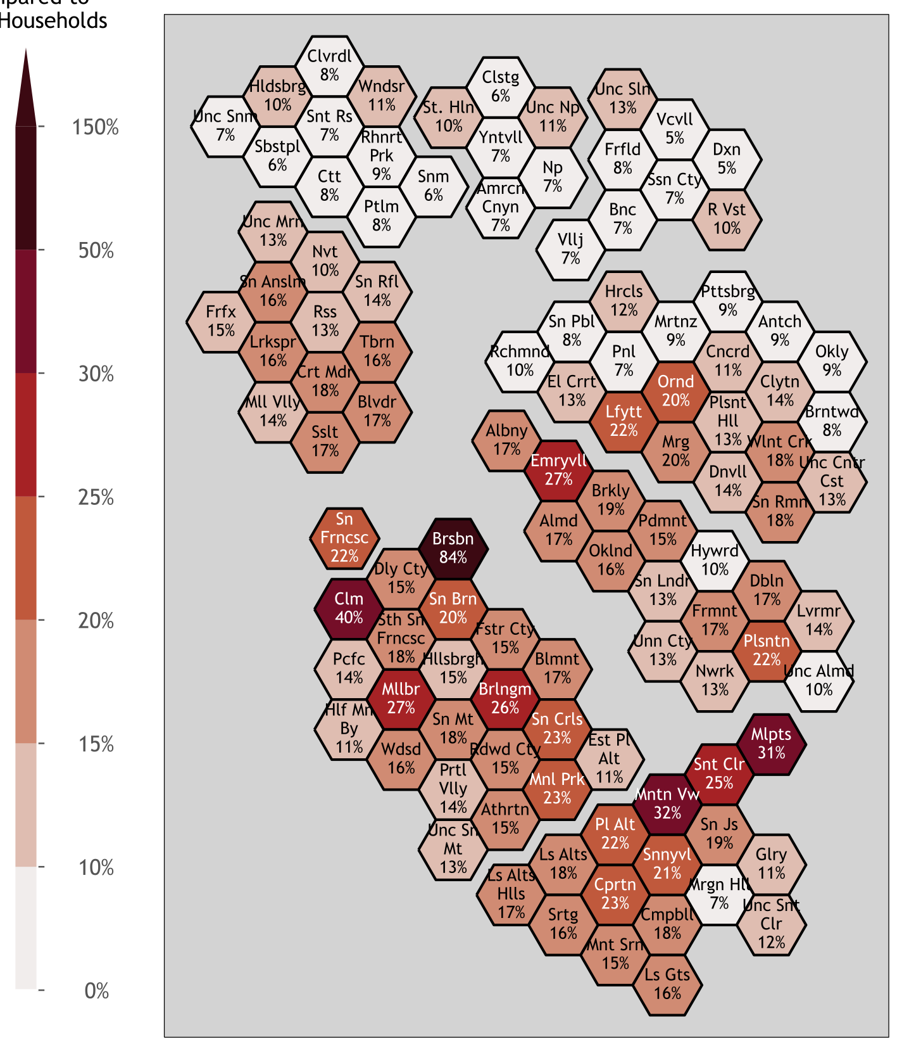
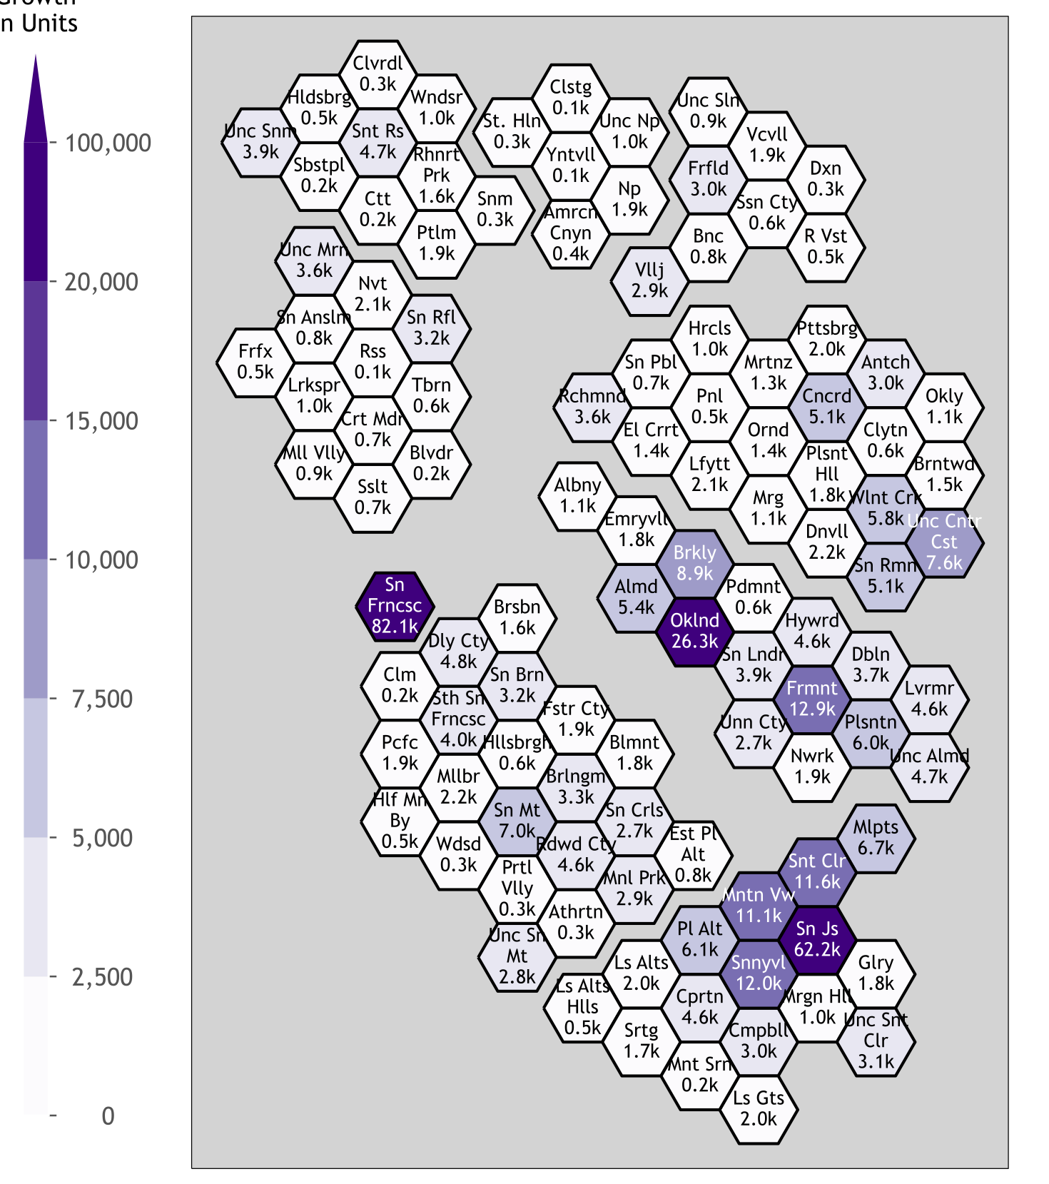
Draft RHNA Allocations
Jurisdiction Growth Rate Compared to 2020 Households
Jurisdiction Growth in Units
Notes:
Left: potential growth rate each jurisdiction would experience from the draft RHNA allocation relative to jurisdiction’s number of households in 2020.
Jurisdictions with the darkest brown experience the highest growth rates while those in the light grey experience the lowest growth rates.
The region as a whole will grow by 16% as a result of the regional housing need assigned for this RHNA cycle by HCD.
Right: total RHNA units from the draft RHNA allocation.
Jurisdictions with the darkest purple receive the largest total RHNA allocations, while those in light grey receive smaller allocations.
Distribution is fairly concentrated: 3 largest cities account for almost 40% of all RHNA units.
The 25 jurisdictions with the largest draft RHNA allocations account for 72% of all RHNA units.

Slide 15
Draft RHNA Allocations by County
 | 2023-2031 Final RHNA Methodology | 2023-2031 Final RHNA Methodology | 2015-2023 RHNA (Cycle 5) | Bay Area Households (2020) | Bay Area Jobs (2018)
Alameda | 88,997 | 20% | 23% | 21% | 20%
Contra Costa | 49,043 | 11% | 11% | 14% | 10%
Marin | 14,405 | 3% | 1% | 4% | 3%
Napa | 3,844 | 1% | 1% | 2% | 2%
San Francisco | 82,069 | 19% | 15% | 14% | 19%
San Mateo | 47,687 | 11% | 9% | 10% | 10%
Santa Clara | 129,577 | 29% | 31% | 23% | 27%
Solano | 10,992 | 2% | 4% | 6% | 4%
Sonoma | 14,562 | 3% | 4% | 7% | 5%
BAY AREA | 441,176 | 100% | 100% | 100% | 100%
* Totals may not sum to 100% due to rounding

Slide 16

RHNA Appeals Process
Meeting Name
Date

Slide 17
Key Milestones & Timeline:
RHNA Appeals Process Overview
Who can file an appeal? A jurisdiction or HCD can appeal a jurisdiction’s Draft RHNA Allocation.
  A jurisdiction can appeal its own allocation and/or another jurisdiction’s allocation.
What are the major steps in the appeals process?
A jurisdiction that is the subject of an appeal filed by another jurisdiction/HCD will have the opportunity to challenge the appeal at the appeal public hearing.
Jurisdictions/HCD have 45 days to submit an appeal in writing.
Jurisdictions/HCD have 45 days to comment on the appeals filed.
ABAG must conduct a public hearing to consider appeals and comments.
Per Government Code Section 65584.05
Notes:
Release of Draft RHNA Allocations initiates appeals phase of RHNA.
Government Code Section 65584.05 allows a jurisdiction or HCD to appeal the Draft RHNA Allocation for any Bay Area jurisdiction (except Solano County and its cities, where jurisdictions have formed a subregion that will conduct its own appeals process).
In past RHNA cycles, an appeal could only be brought by a jurisdiction appealing its own allocation. However, now HCD has the authority to bring an appeal, and a jurisdiction can also appeal another jurisdiction’s allocation.
An appeal may request an increase or decrease to a Draft RHNA Allocation.

Slide 18
Key Milestones & Timeline:
What is the Anticipated Appeals Schedule?
May 25, 2021
Following action by ABAG Executive Board, ABAG notifies jurisdictions/HCD about adoption of Final RHNA Methodology and Draft Allocations.
July 9, 2021
Deadline for jurisdictions/HCD to submit appeals to ABAG; ABAG notifies jurisdictions/HCD about appeals submitted.
August 30, 2021
Deadline for jurisdictions/HCD to comment on appeals submitted; ABAG notifies jurisdictions/HCD about comments received.
September and/or October
ABAG conducts public hearing to consider appeals and comments received; ABAG must notify jurisdictions at least 21 days prior to hearing.
October or
November
ABAG ratifies written final determination on each appeal and issues Final RHNA Allocations that include adjustments resulting from successful appeals.
November or December
ABAG Executive Board conducts public hearing to adopt Final RHNA Plan.

Slide 19


Filing an Appeal:
What are the Allowable Reasons for an Appeal?
An appeal can be filed only if:
  ABAG failed to adequately consider information submitted in the local jurisdiction survey.
  ABAG did not determine the jurisdiction’s allocation in accordance with its adopted methodology and in a manner that furthers, and does not undermine, the RHNA objectives.
  A significant and unforeseen change in circumstances has occurred in the local jurisdiction or jurisdictions that merits revision of information submitted as part of the local jurisdiction survey. Appeals on this basis shall only be made by the jurisdiction or jurisdictions where the change in circumstances has occurred.
By law, appeals cannot be based on:
  Any local ordinance, policy, voter-approved measure or standard limiting residential
  development.
  Underproduction of housing from the last RHNA cycle.
  Stable population numbers in a jurisdiction.

Slide 20

Filing an Appeal:
What are the Requirements for an Appeal?
By statute, appeals shall:
Be based on comparable data available for all affected jurisdictions and accepted planning methodology.
Be supported by adequate documentation.
Include a statement as to why the revision is necessary to further the RHNA objectives.
Be consistent with, and not to the detriment of, the development pattern in Plan Bay Area.
ABAG-MTC staff have developed a form for jurisdictions to use to submit an appeal

Slide 21
ABAG Consideration of Appeals:
What Have Other COGs Experienced?
Sacramento Region (SACOG) — 2020
Zero appeals
San Diego Region (SANDAG) — 2020
4 appeals
1 partially upheld (affecting 135 units)
Public hearing conducted in one day
Los Angeles Region (SCAG) — 2021
48 appeals
2 partially upheld (affecting 3,132 units)
46 hours of hearings held on 8 days, plus final meeting for ratifying decisions
ABAG — 2013 (prior cycle)
8 appeals
3 upheld (affecting 674 units)
Public hearing conducted in one day

Slide 22
ABAG Consideration of Appeals:
Hearing Procedures
ABAG must hold a public hearing to consider appeals. Depending on number of appeals, the hearing could occur over multiple days.
Appeals will be heard by the ABAG Administrative Committee, which will have final authority for decisions on appeals.
A committee member must recuse him/herself on an appeal affecting his/her jurisdiction.
The Administrative Committee will issue a preliminary determination on each appeal and then ratify final decisions at a meeting after close of the public hearing to ensure uniform decision-making.

Slide 23
ABAG Consideration of Appeals:
Hearing Structure
Applicant presentation. If multiple appeals for a jurisdiction, subject jurisdiction goes first if it filed an appeal. Can present jointly; 5 min per applicant.
Response by subject jurisdiction if it did not file appeal on its own behalf, (5 min if one appeal, 8 min if multiple).
Staff response (5 min).
Rebuttal by applicants and subject (if it did not file appeal). Limited to arguments/evidence presented by staff, (3 min for each applicant and subject).
Public comment (2 min per speaker, or as adjusted by the Chair).
Committee questions/discussion.
Committee motion for a determination on appeal.
Committee vote.
* The Chair may elect to grant additional time for any presentation, staff response, or rebuttal in the interest of due process and equity.
Notes:
The basic structure of the appeals hearing is for the applicant to make an initial argument, to which ABAG-MTC staff provides a response, followed by an opportunity for rebuttal by the applicant.
If a jurisdiction or HCD appeals another jurisdiction’s allocation, the procedures allow for the subject of the appeal to respond to the initial arguments and offer a rebuttal after the staff response.
Following the rebuttal, there is time for public comment in advance of the Committee’s discussion and preliminary vote on the appeal.

Slide 24
ABAG Consideration of Appeals:
Redistribution of Units from Successful Appeals
ABAG will redistribute units to all local governments in the region in proportion to a jurisdiction’s share of the RHND after appeals are determined and prior to the required distribution.
Applicants whose appeals are upheld are not excluded from redistribution.
Notes:
Housing Element Law requires ABAG to allocate all of the 441,176 units assigned to the Bay Area by HCD.
If the appeal of a jurisdiction’s draft RHNA allocation is successful, ABAG must redistribute the units to other local governments in the region.

Slide 25
Incentives for Housing Element Compliance
Consequences of Housing Element Noncompliance
Grant and loan programs that require an HCD-certified housing element include:
Permanent Local Housing Allocation (PLHA)
Affordable Housing and Sustainable Communities (AHSC)
SB 1 Planning Grants
CalHOME Program
Infill Infrastructure Grants
Prohousing Designation Program
Local Housing Trust Fund Program (LHTF)
Regional Transportation Funding: One Bay Area Grants (OBAG)
General Plan inadequacy
Legal suits and attorney fees
Loss of permitting authority
Financial penalties
Court receivership
* For more details, see https://abag.ca.gov/sites/default/files/documents/2021-04/HE_Compliance_One-Pager.pdf

Slide 26

For More Information
Contact: RHNA@bayareametro.gov
Visit ABAG’s RHNA website: https://abag.ca.gov/our-work/housing/rhna-regional-housing-needs-allocation
Review the Final RHNA Methodology Report: https://abag.ca.gov/sites/default/files/documents/2021-05/ABAG_2023-2031_Draft_RHNA_Plan.pdf
Review the RHNA Appeals Procedures: https://abag.ca.gov/sites/default/files/documents/2021-05/ABAG_2023-2031_RHNA_Appeals_Procedures.pdf

Slide 27


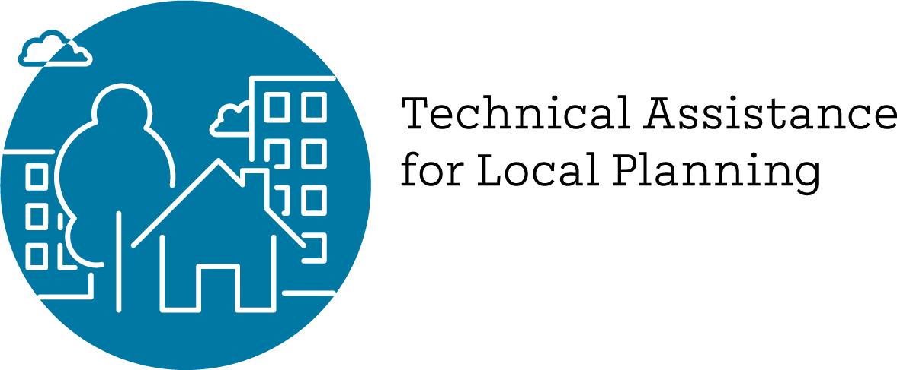
Regional Housing Technical Assistance Program

Slide 28
Program Goal
Regional Products, Cohorts, Workgroups, & Trainings
County Collaboratives
Local Grants & Consultant Bench
Assist Bay Area jurisdictions with adopting compliant Housing Elements and increasing housing opportunities in their communities through local, subregional, and regional resources
Notes:
Goal is to assist jurisdictions with their housing element updates and implementation
Resources at three scales:
Local: over the counter and competitive grants, as well as access to a bench of pre-qualified consultants
County Collaboratives: county-based groups staffed by a paid coordinator to provide TA and facilitate shared learning for the Housing Element update and related topics
Regional: data tools, community engagement products, trainings, topic-specific workgroups to generate shared deliverables (ex. ADU ordinance template), and peer cohorts of jurisdictions with similar planning challenges (ex. agricultural towns)

Slide 29











*
Collaboratives:
Mostly county-based groups staffed by paid coordinators that facilitate ongoing housing technical assistance
Workgroups:
Short-term, "deep dive" sessions focused on specific housing strategies
>
>
>
COUNTIES
STREAMLINING
RESILIENCE
Peer Cohorts:
Learning communities of jurisdictions with similar characteristics or challenges
PARKING
$$$
FEES
ADUs
DESIGN
*Collaboratives to be funded via local REAP grants

Slide 30
Housing Element Webinar Series
COVERED TOPICS:
FUTURE TOPICS:
Housing Element 101: Overview and New Laws
Annual Progress Report Q&A w/HCD
Sites Inventory Overview and Deep Dive
Using Data Effectively in Housing Element Updates
How to Talk About Housing: Data-Driven Lessons on Housing Messages that Work and Those that Backfire
Incorporating Environmental Justice and Safety into your Housing Element, co-hosted by OPR
May 25: Engage How To! Introduction to Best Remote Meeting Practices and Tools
June 8: Integrating Resilience into your Housing Element Update
Affirmatively Furthering Fair Housing
Meeting Strategies and Tactics
Tips for Certifiable Success
Recordings of all webinars will be available on ABAG’s website
Notes:
Ten-part training series for local planning and housing staff focused on key Housing Element topics that staff must start early in the process
Sessions held the second and fourth Tuesday of each month

Slide 31
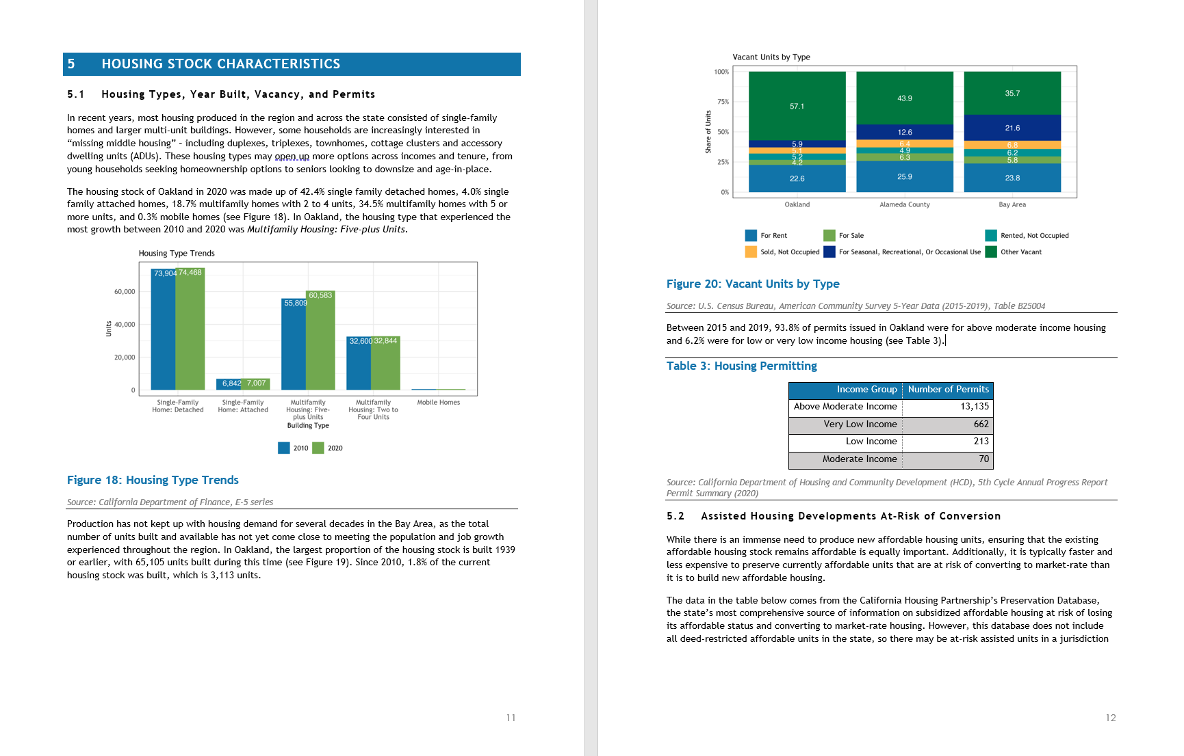
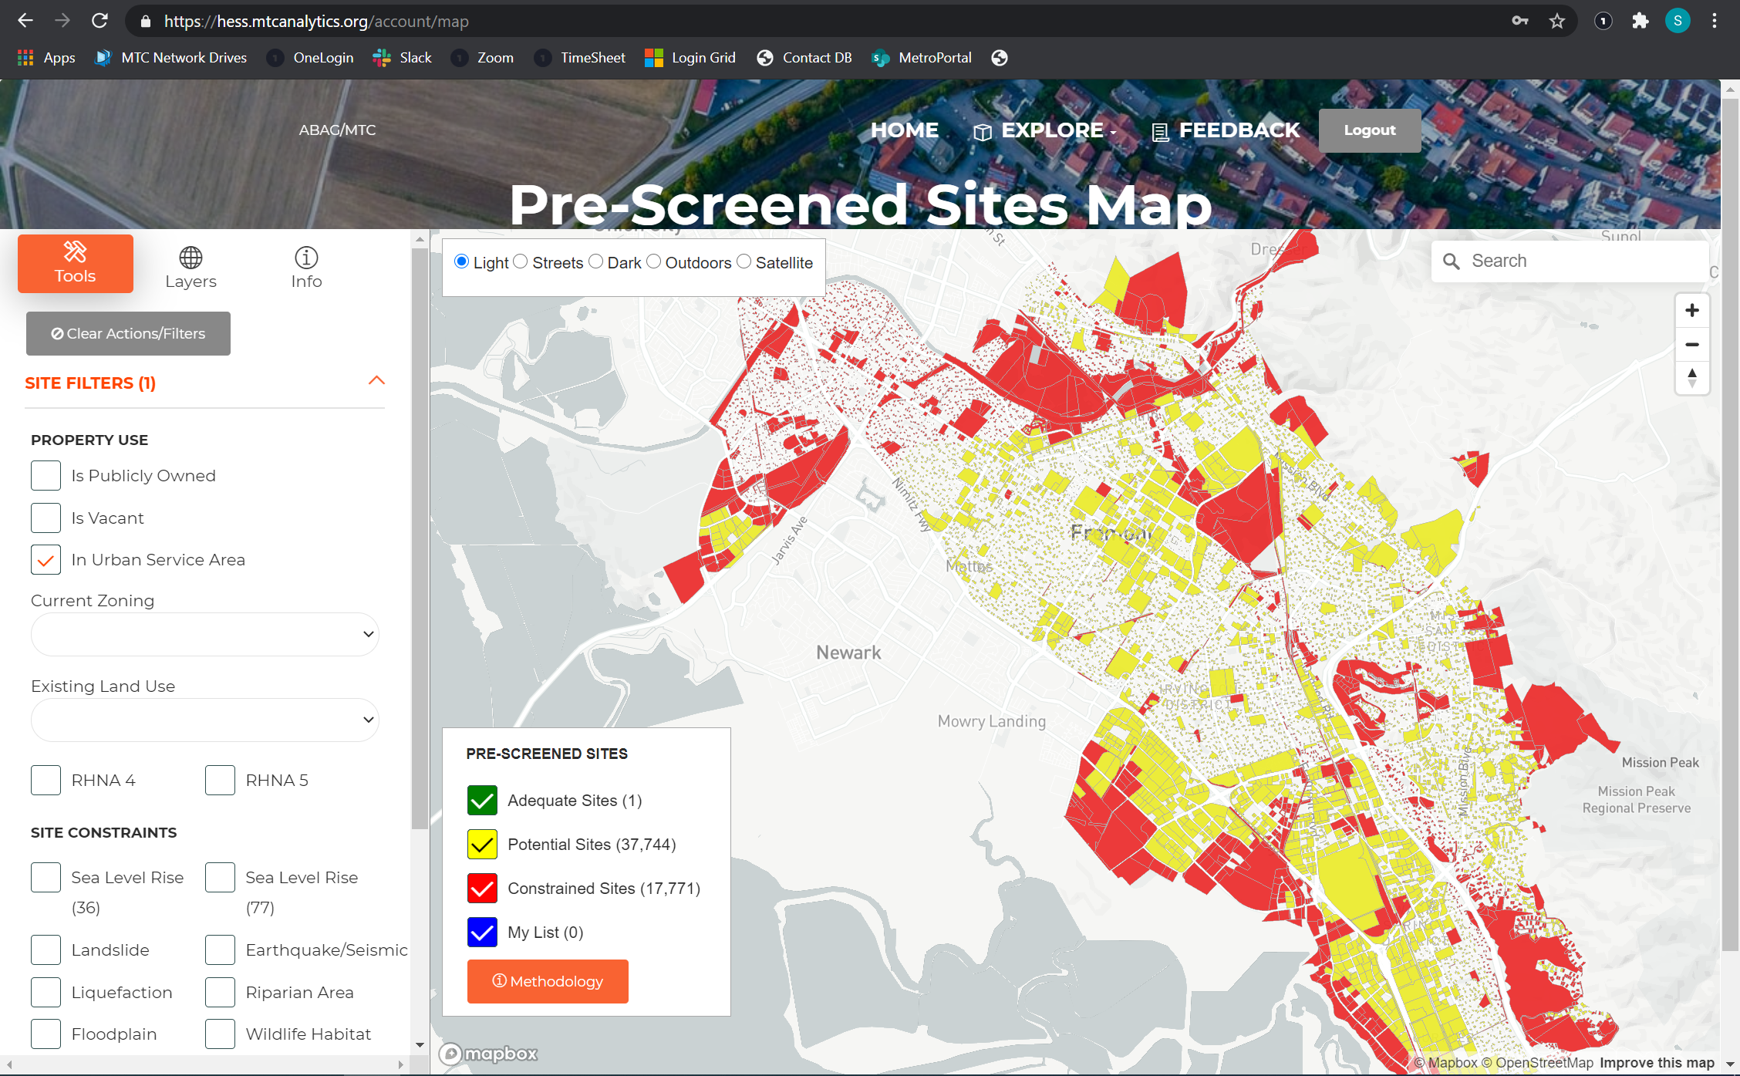
Regional Housing Data Tools
Housing Needs Data Packets
Housing Element
Site Selection Tool
Notes:
Housing Needs Data Packets:
Jurisdiction-level data packets contain tables, figures, and accompanying text that can be placed directly into the Housing Needs Section of the Housing Element
Available now on the ABAG website
Housing Element Site Selection Tool:
Web-based mapping tool to guide jurisdictions in identifying potential sites for the Housing Element Sites Inventory
Helps navigate new State requirements and support regional and local priorities
BETA version available now, with future iterations slated for release in the coming months

Slide 32
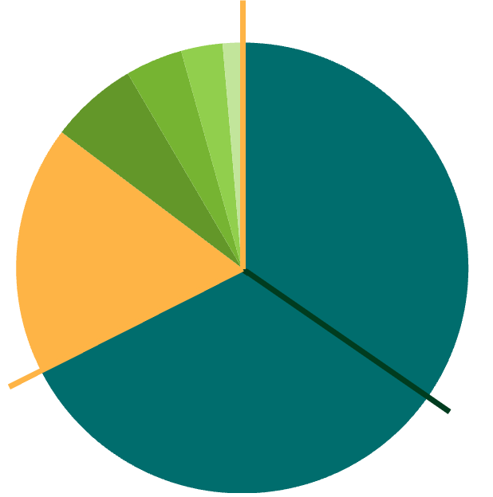

Local REAP Grants
Grants from state directly to local jurisdictions
$23.9M REAP GRANT FROM STATE TO ABAG
$13M Regional TA
LEAP
$25.5M
ABAG Allocations to Local Jurisdictions
Non-Competitive
$4.7M County Collaboratives
$3M RHNA-Based Allocations
$2.2M Minimum Allocations
SB 2
$24M
Competitive
$1M Scoring-based Allocations
Notes:
In addition to regional TA, providing direct grants to local jurisdictions from our Regional Early Action Planning funding
$10M in non-competitive grants to county collaboratives and all jurisdictions
Additional $1M in competitive grants to jurisdictions with exceptional proposals, slated for board approval in May

Slide 33

Regional Consulting Bench
Comprehensive Planning
Environment & Resilience
Transportation Policy & Implementation
Engagement & Outreach
Housing Policy & Planning
Legal Counsel
Transportation Program Development & Administration
Grant Writing
Process Improvements
Temporary Staffing for Local Governments
Economic & Real Estate Analysis
Notes:
To achieve costs savings and ease administrative burden for local jurisdictions, we are assembling a bench of pre-qualified consultants to provide on on-call consulting as needed for a wide range of planning activities
Local jurisdictions can use their REAP grants or other local funds to hire off the bench
Slated for board approval in May

Slide 34

Thank You.
For more information:
Visit the Regional Housing TA website or
contact HousingTA@bayareametro.gov

